Slide 1
HIR WORKSHOP
EG1004 | LAB 4C

Slide 2
OVERVIEW
Objective
IDBE Implementation
Background Information
Materials
Procedure
Assignment
Closing
Figure 1: Revit icon courtesy of Autodesk
1

Slide 3
OBJECTIVE
Use BIM software, Revit, to visualize an incomplete building design
Design a plumbing plan and electrical plan for one floor
Complete the incomplete building with a new floor, stairs, and a roof
Design the third floor of the incomplete building
2

Slide 4
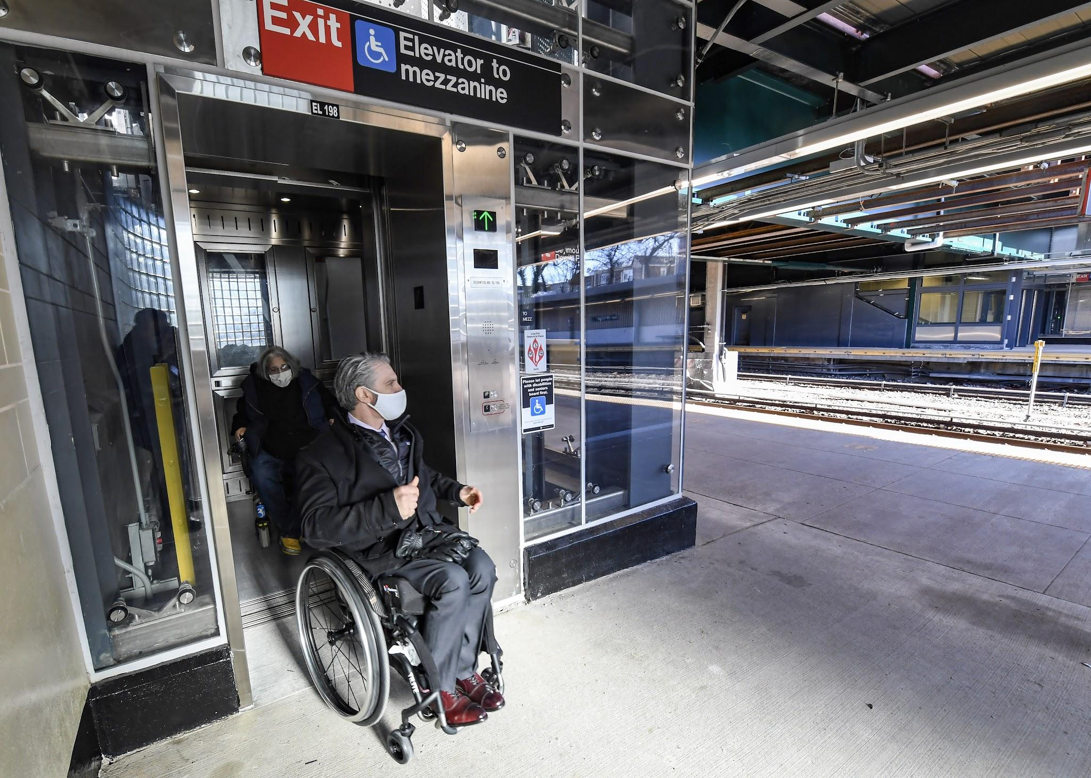
IDBE IMPLEMENTATION
Accessible Architectural Design
Can be used by people with a variety of disabilities independently
Includes ramps, elevators, braille signage, etc.
Consider– Who will be using the space you design? What changes could be made to improve accessibility and usability?
Figure 2: Person utilizing accessible design on NYC subway
3

Slide 5
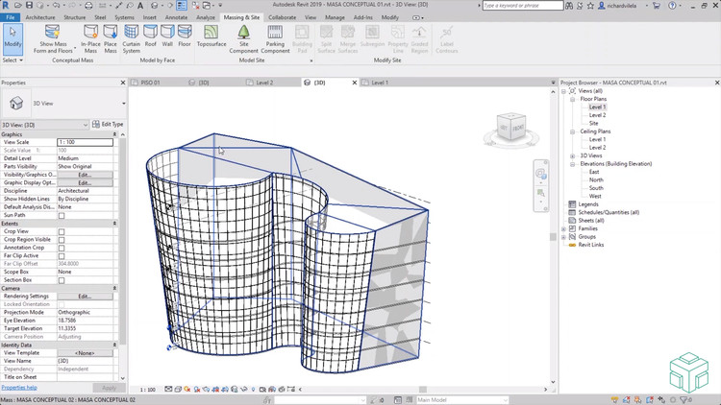
BACKGROUND INFORMATION
Autodesk Revit
Introduced in “Introduction to Revit”
Building Information Modeling (BIM) software
Used by architects, structural engineers, mechanical engineers, electrical engineers, plumbing engineers, and construction professionals
Figure 3: Revit in use courtesy of Autodesk
4

Slide 6
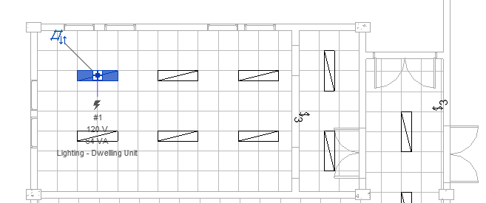
BACKGROUND INFORMATION
Plumbing Plan
Accounts for plumbing fixtures (sinks, toilets, showers, etc.)
Hot water, cold water, sanitary water systems
Electrical Plan
Electrical circuits connected to centralized panelboard
Circuit breakers, fuses, and electrical outlets
Allow for efficient wiring of outlets and appliances
Figure 4: Electrical Plan courtesy of CAD Notes
5

Slide 7
BACKGROUND INFORMATION
LEED Accreditation
Location and Transportation
Sustainable Sites
Water Efficiency
Energy and Atmosphere
Materials and Resources
Indoor Environmental Quality
Innovation
Regional Priority
Figure 5: LEED Accreditation courtesy of Everblue
6

Slide 8
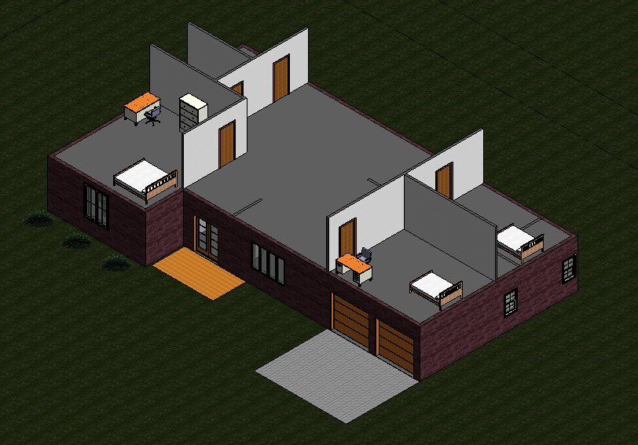
MATERIALS
A lab PC
Autodesk Revit 2020 or newer
Predesigned house template (download directly from the manual)
Figure 6: Incomplete House Template
7

Slide 9
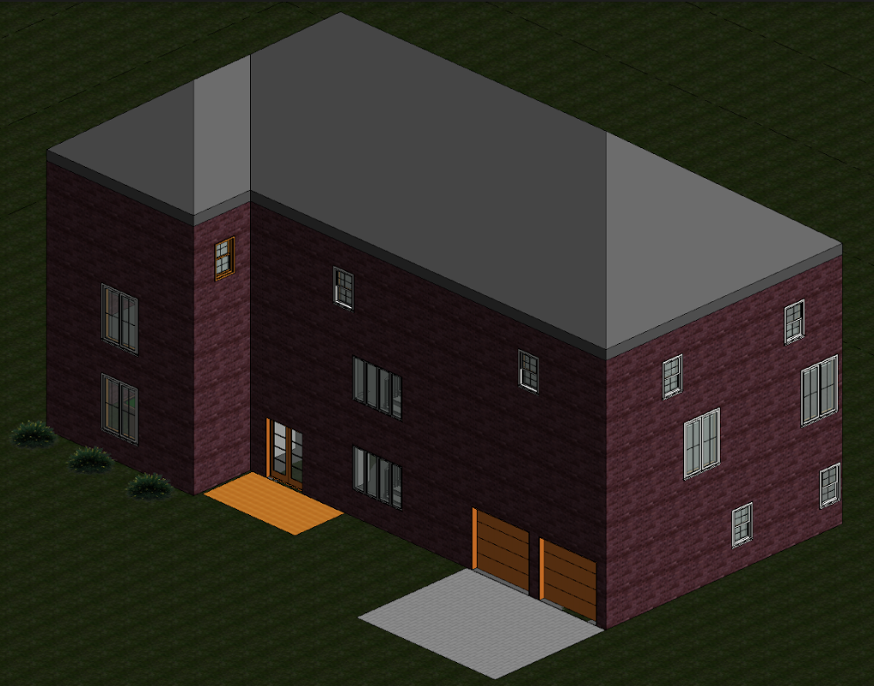
PROCEDURE
Part I: Plumbing Plan
Only complete cold-water system
Part II: Electrical Plan
Panelboard, switches, outlets, and circuits
Part III: Complete the Architectural Plan
Add a third floor, shafts, stairs, and a roof
Extra: Design the Third Floor
Import a component from a third-party website
Add rooms and furniture
Figure 7: Completed Architectural Plan
8

Slide 10
ASSIGNMENT
No lab report
No team presentation
9

Slide 11
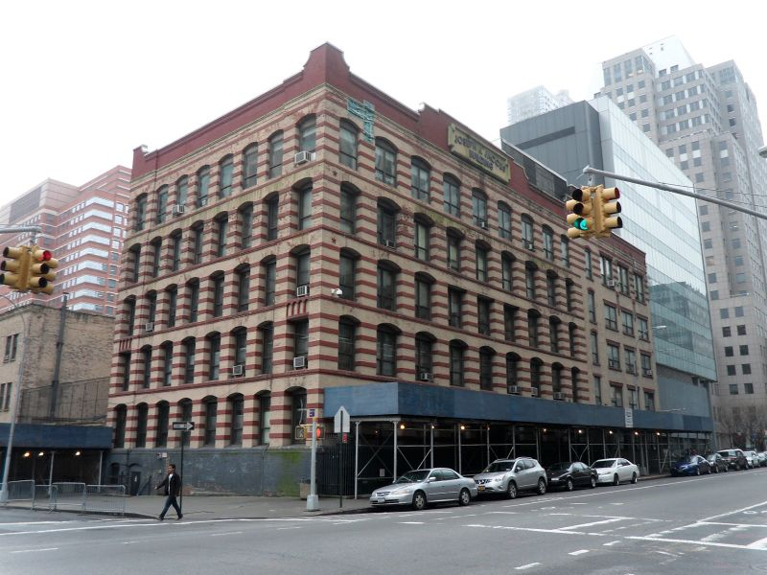
CLOSING
Ask TAs for help if needed
Only finish the architectural plan if time allows
Revit is not backward compatible, only use Revit 2020 or newer!
Begin working on HIR project after the workshop
Figure 8: Jacobs Administrative Building
10

Slide 12
NEXT STEPS
Draft the Preliminary Design Investigation (PDI) report
Begin working on the Milestone 1 Presentation
Begin working towards Benchmark A deliverables
One 40-student classroom
One 20-student classroom
One recreational space
Remember to create your designs in a single Revit Project (.rvt) file!
11

