Slide 1
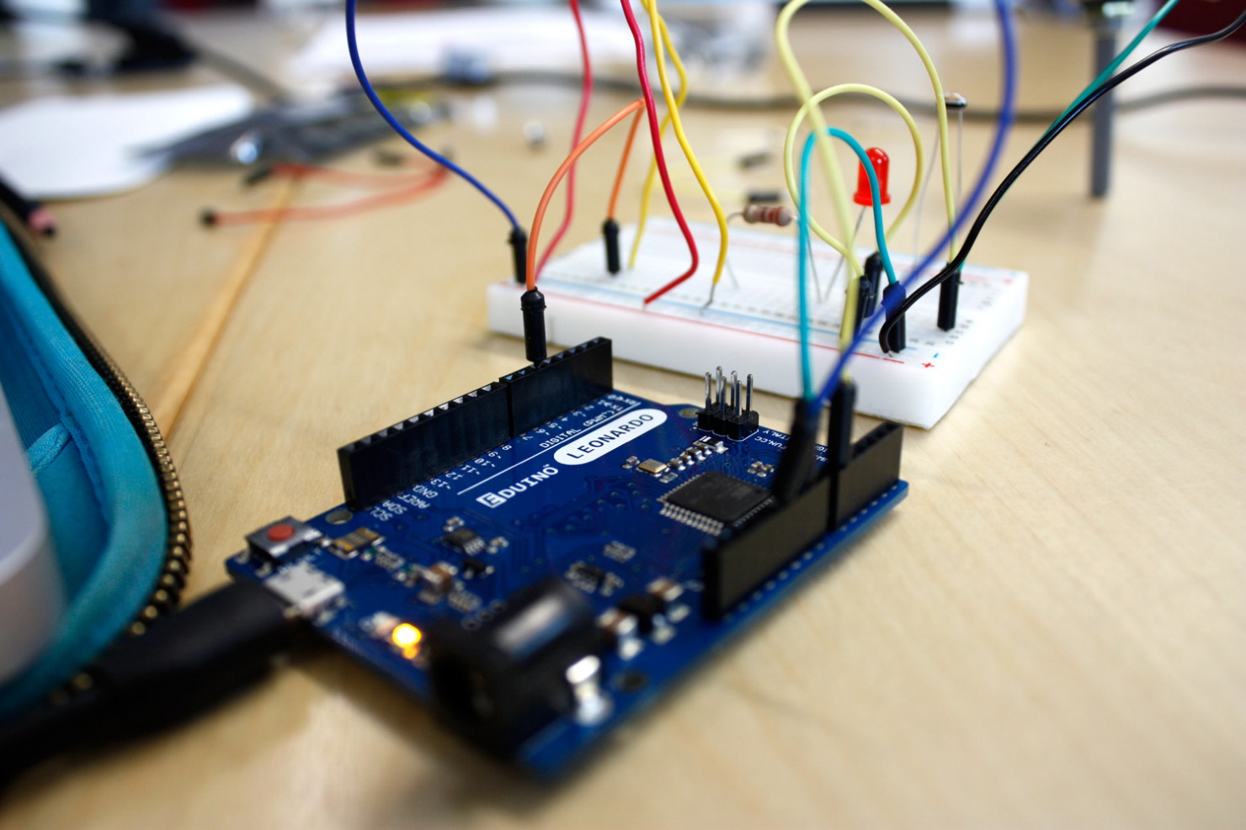
Prototyping with Micro-controllers,
Sensors, and Materials

Slide 2
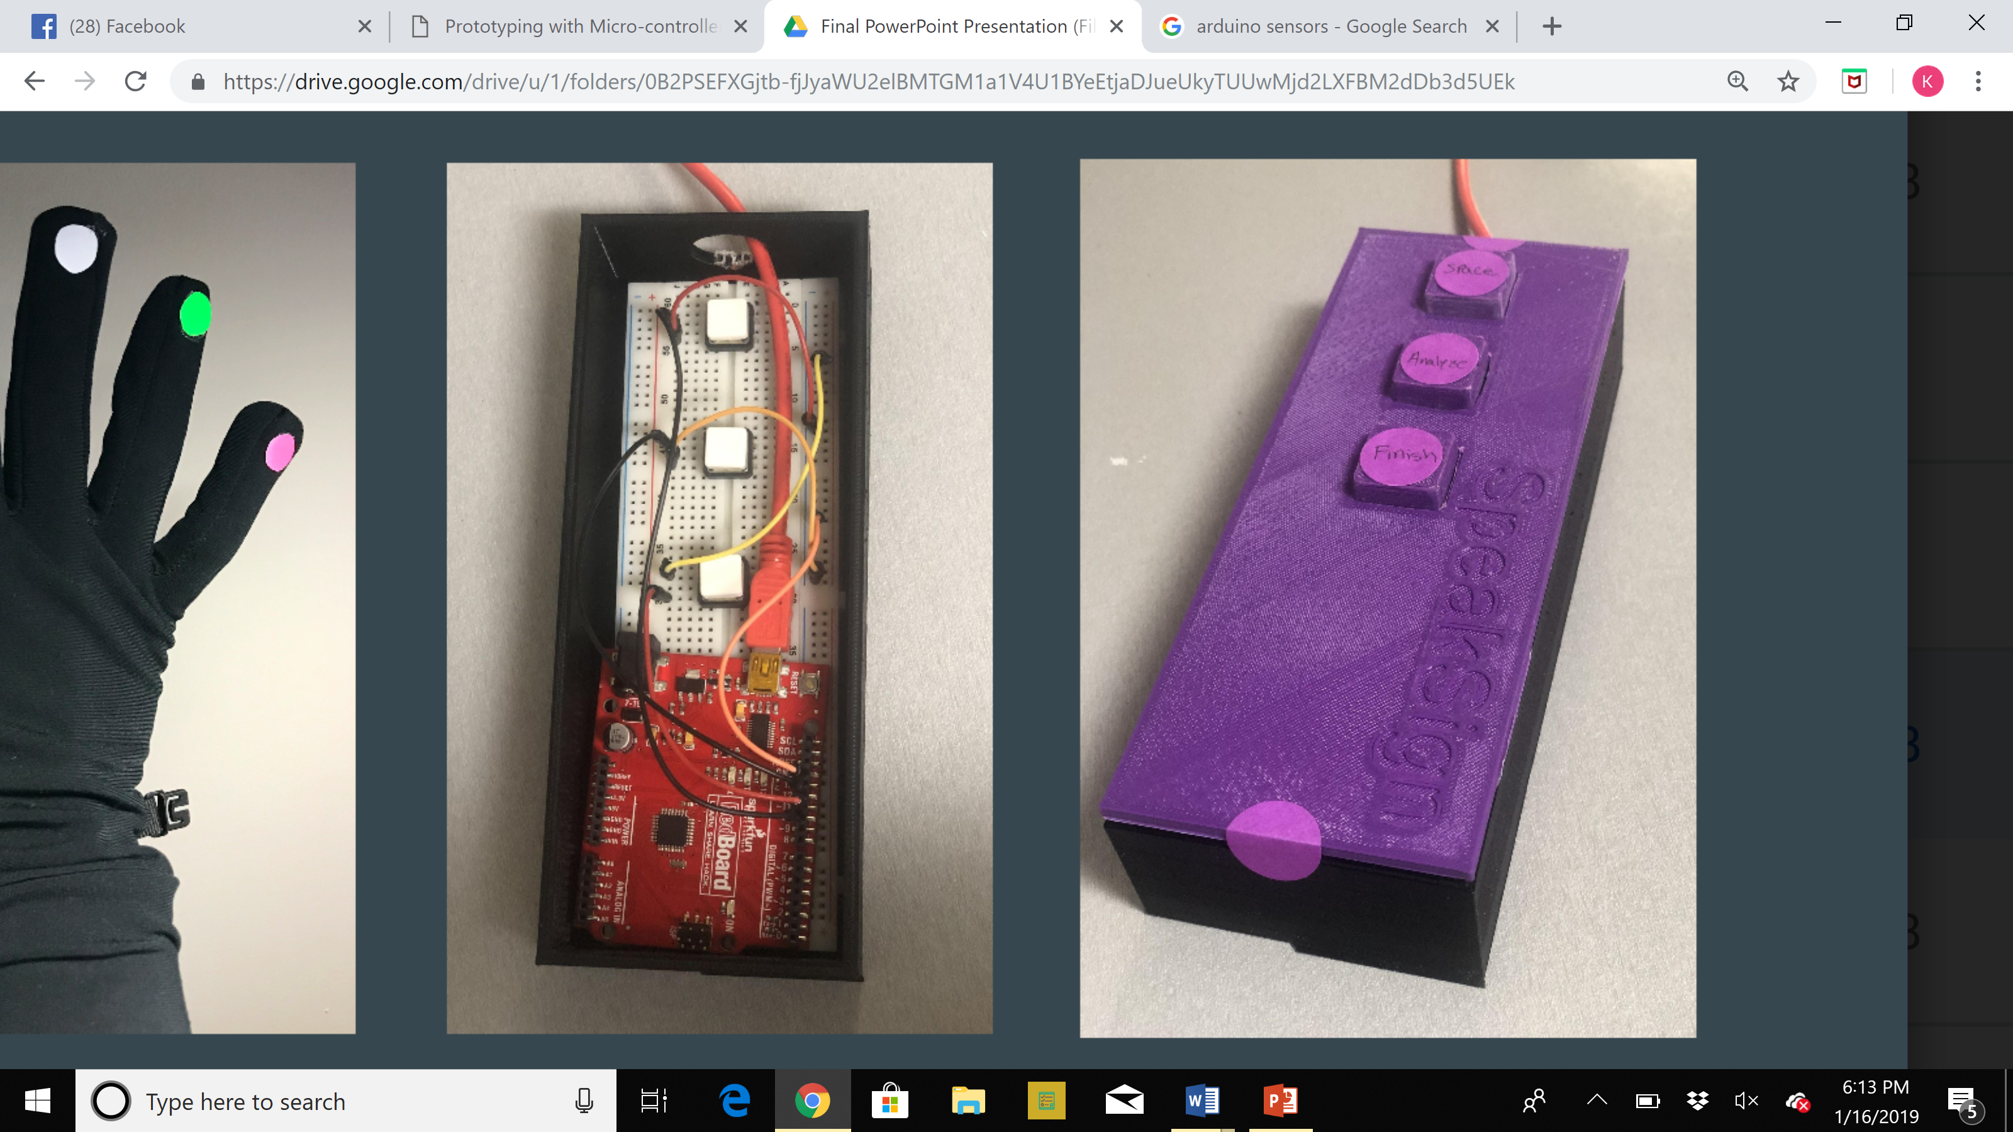
Overview
Objectives
Background
Materials
Procedure
Rules of the Competition
Report/Presentation
Closing

Slide 3
Objectives
What are sensors?
What is a microcontroller?
Testing code and building circuits
Building a thermometer to test with a thermal
insulation prototype

Slide 4
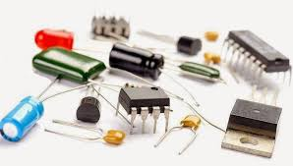
Electricity and Components
Electricity is the movement of electrons
Electrical current is the flow of electrons [Amperes]
  Voltage [Volts] is a difference in charge
  Electrical resistance is the ability to resist the flow of electrons [Ohms]

Slide 5
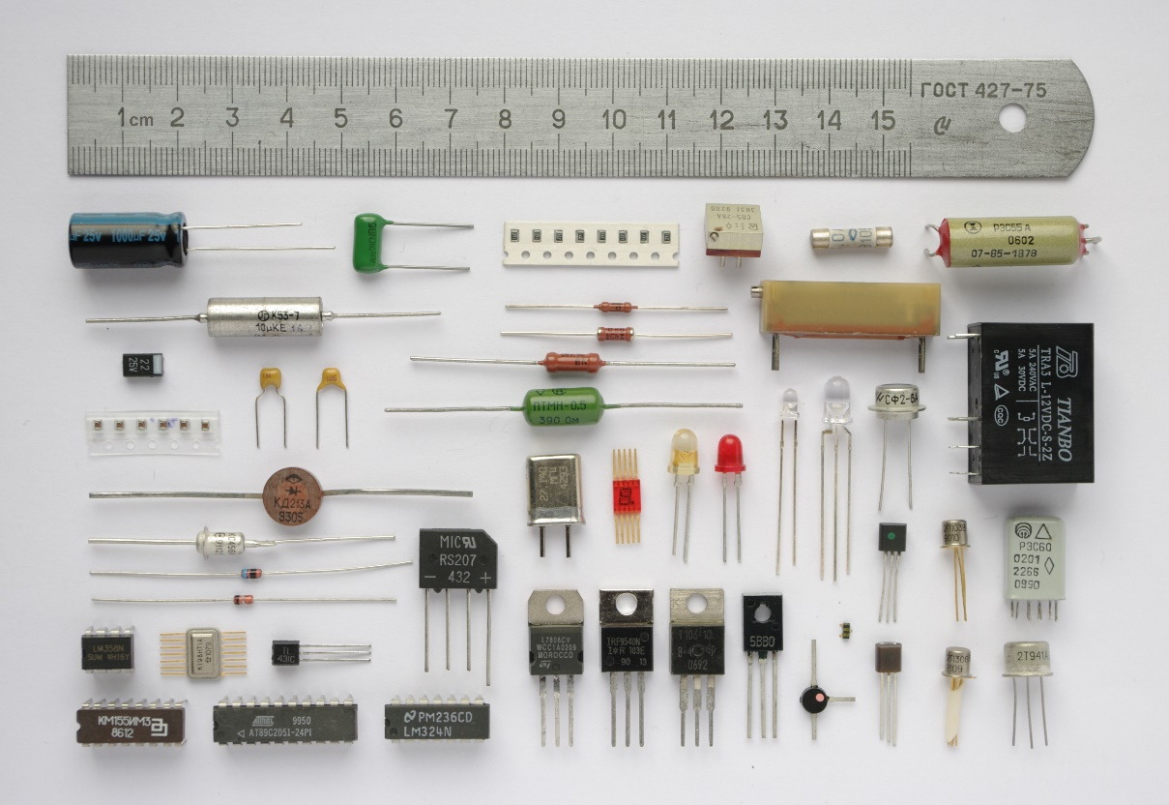
Common Electrical Components
DC Voltage sources
Resistors
Capacitors
Inductors
Push buttons and switches
Diodes and transistors

Slide 6
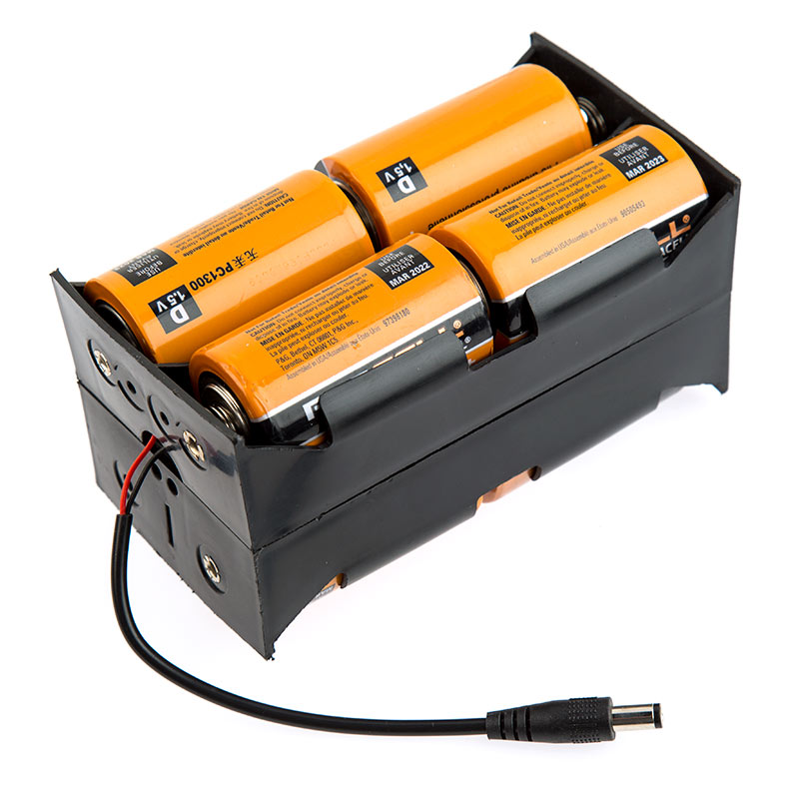
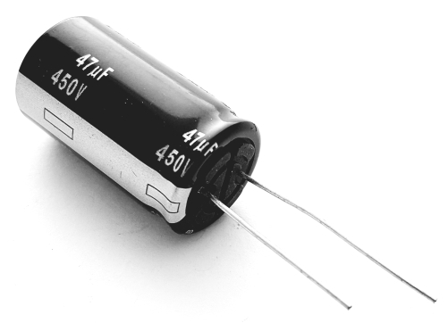
Common Electrical Components
DC Voltage Sources - power circuits because they have a voltage difference across their terminals
Capacitors - store energy in an electrical field and then dissipate it at a later time
  NOT a battery

Slide 7
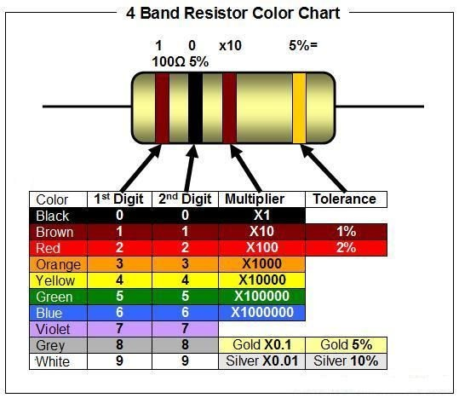

Common Electrical Components
Resistors can be used to control the voltages and currents of circuits
Color-coded bands based on magnitude of resistance

Slide 8
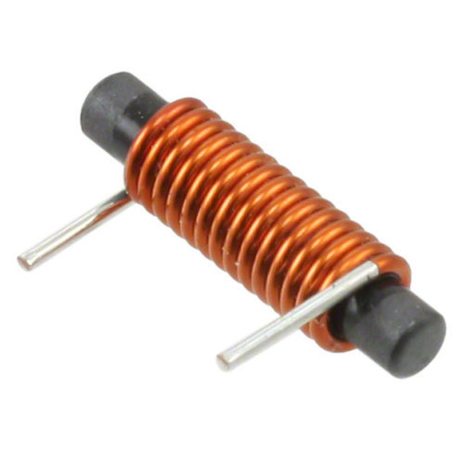
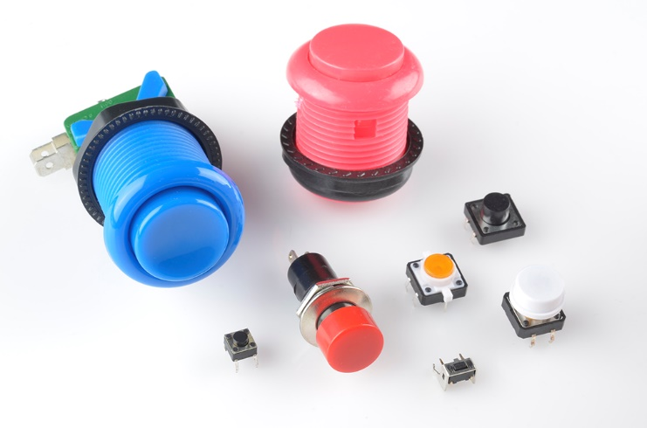
Common Electrical Components
Inductors store energy in a
magnetic field
Push buttons and switches stop or divert current
Diodes allow current to pass in one direction
  Light emitting diode (LED)

Slide 9
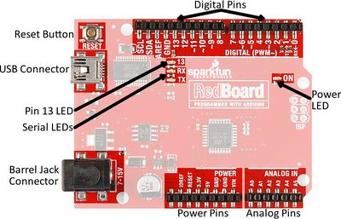
Microcontroller
A microcontroller is an inexpensive, programmable computer

Slide 10
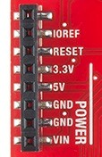
Microcontroller
3.3V: Typically used to power low-voltage sensors
5V: Most common power pin used to power circuits
GND: Ground pin (0 V)
VIN: Voltage-in can be used to power the board using a battery

Slide 11
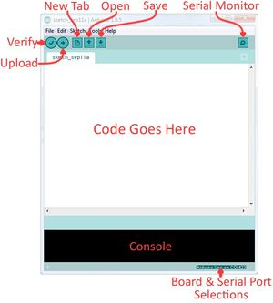
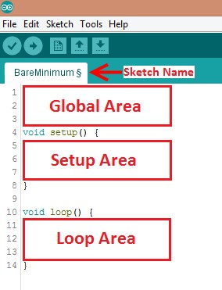
Programming the Arduino
Coding Outline
The Arduino IDE

Slide 12
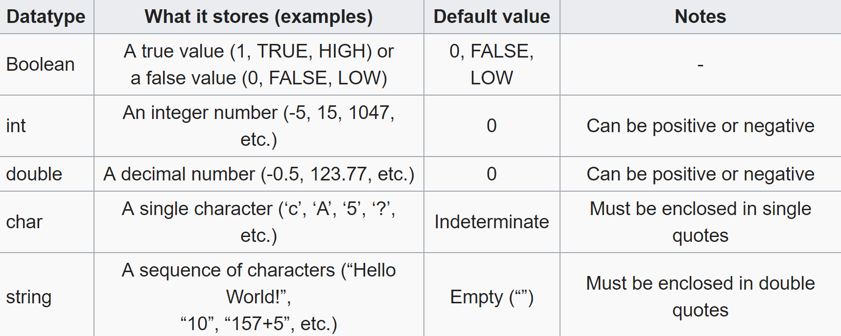
Arduino Programming
Data Types

Slide 13
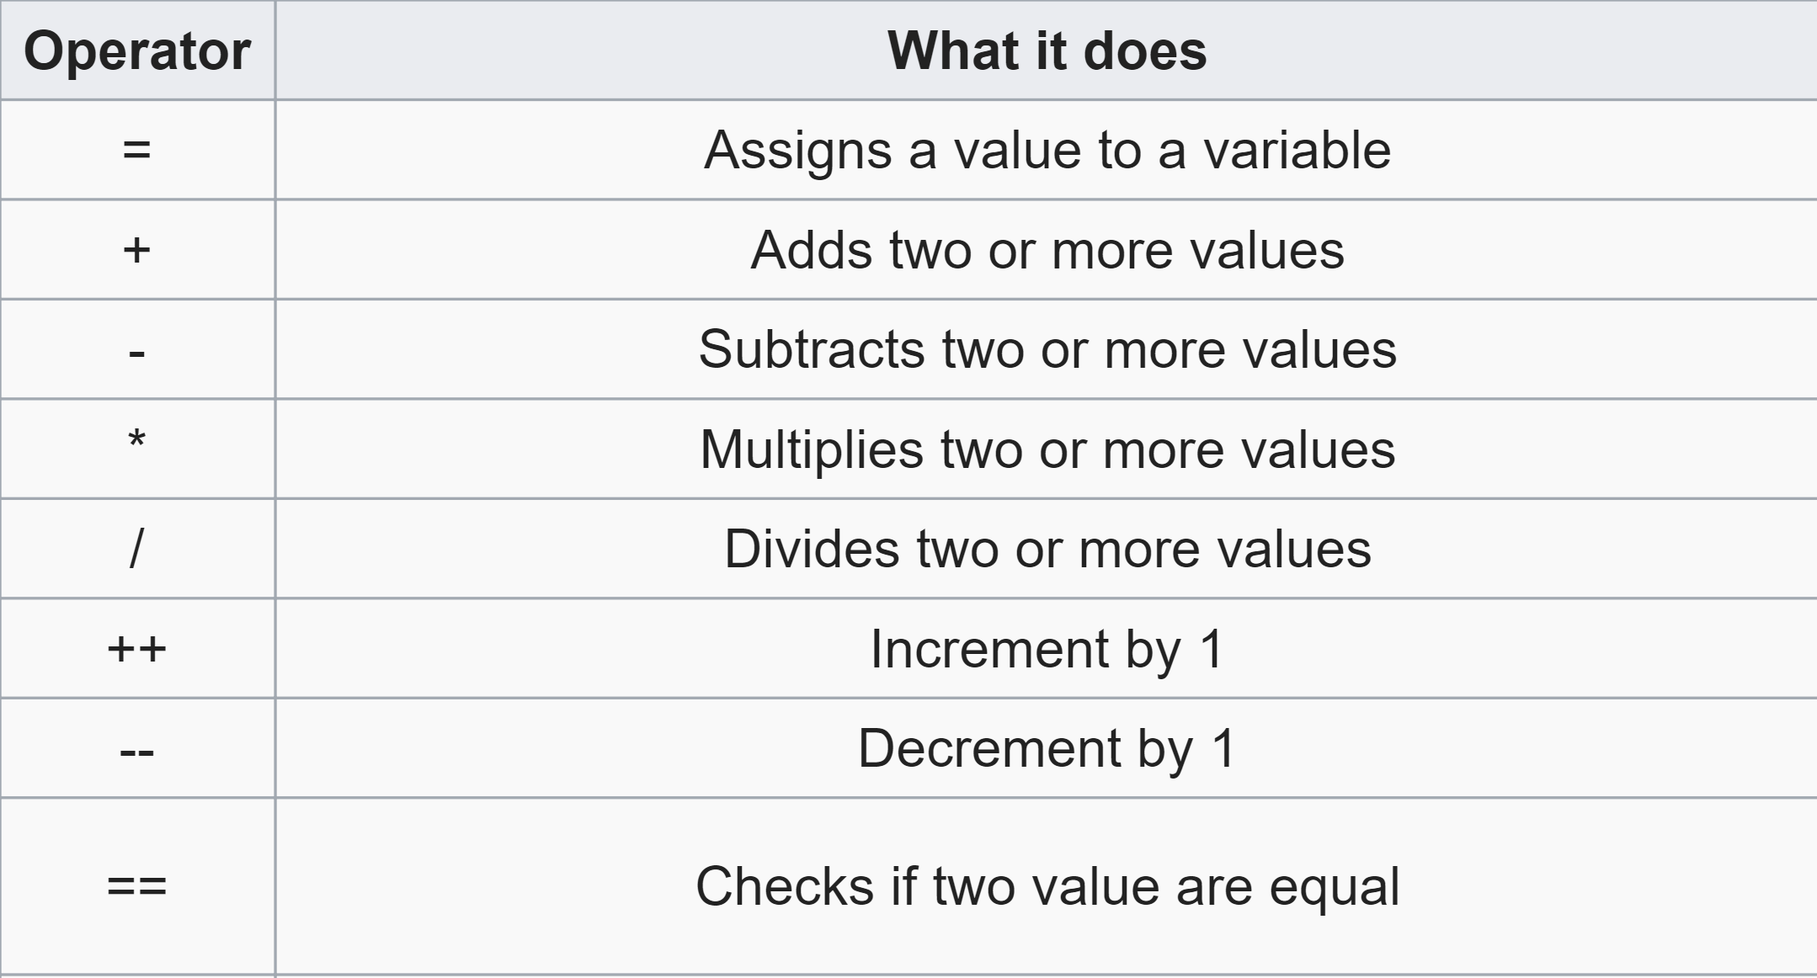
Arduino Programming
Common Operators

Slide 14
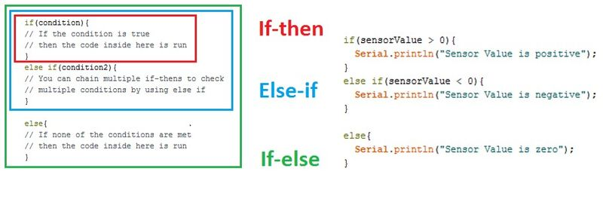
Arduino Programming
Conditional Statements

Slide 15
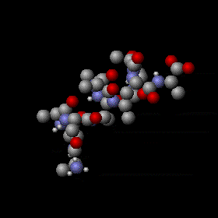
Heat and Heat Transfer
Heat: thermal energy (total kinetic energy of all atoms and/or molecules)
Heat transfer: passage of thermal energy from hot to cold body
Temperature: Average kinetic energy of
  atoms and/or molecules

Slide 16
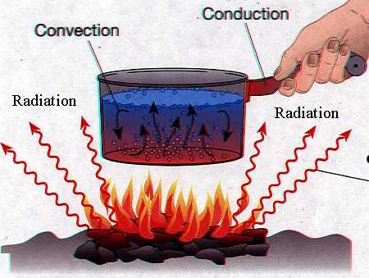
Means of Heat Transfer
Three types of heat transfer covered:
  Conduction: through matter (solids)
  Convection: through fluids
  Radiation: does not require medium

Slide 17
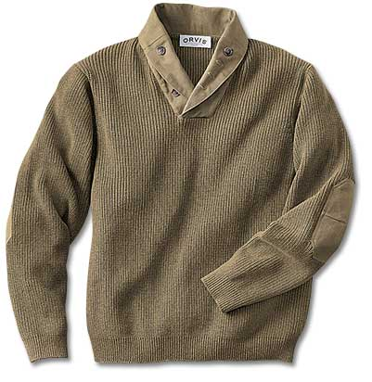
Thermal Insulation
Slows down heat transfer
Examples:
  Clothing
  Walls of houses
  Refrigerators
  Thermos bottles

Slide 18
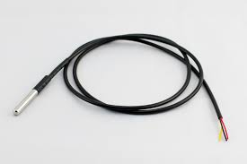
Materials for Lab
Arduino UNO microcontroller
and USB cable
Computer with Arduino IDE
Breadboard and jumper wire
Resistors
  220 Ω
  2.2 kΩ
LED
Pushbutton

Slide 19
Rules of the Competition
IC = insulating capability of container
IC is the downward slope of heat loss plot
TR is room temperature, TF is final thermocouple temperature
Team with lowest Minimal Design Ratio (MDR) wins

Slide 20
Competition Rules
No external heat sources may be used
Wax must be protected from sand falling into it
Container may not be held or covered during temperature readings
Wax can not be returned (no restarts)
At least one type of material must be used
Thermocouple may not be moved from its position in the lid
Container must remain on surface of testing area
Thermocouple/ lid must be placed on top of the lid so that the wax is fully covered
Do not touch hot wax or glass, they are HOT

Slide 21
Procedure
Build a simple LED circuit
Add a button to the previous LED circuit
Fix an Arduino code for a thermocouple
Build a thermocouple circuit using Arduino
Design and test a thermal device using the thermocouple built (competition)
    Goal of minimal design and maintaining temperature

Slide 22
Procedure (Cont.)
Receive melted wax inside jar from instructor
Place the jar inside the constructed container
Place lid on jar so that the thermocouple is fully submerged
Start the Arduino program
Run the program for 15 minutes
Analyze data

Slide 23
Assignment: Report
Title page
Discussion topics in the manual
Include original data with instructor’s initials
Scan in lab notes (ask TA for assistance)
TA must initial that table and graph were completed
Include table, graph, and photo of container

Slide 24
Assignment: Presentation
Team presentation
State rules of competition
Describe your design and its concepts
Include table of class results, sketches, and pictures
How could your current design be improved?

Slide 25
Closing
Think safety! Don’t play with hot wax or glass
Have all original data signed by TA
Submit all work electronically
Clean up workstations
Return all unused materials to TA

Slide 26

Micro-controllers, Sensors, and Materials
QUESTIONS?

