Slide 1
Product Evaluation (Sensors)

Slide 2

Overview
Objectives
Background Information
Materials
Procedure
Report
Closing

Slide 3
Objective
Create code for a pre-designed robot and test it against the EG standards for accuracy and precision
Emphasize the importance of product evaluation
Utilize sensors to demonstrate differences between hardcoding and sensors coding

Slide 4
Background Information
Design Analysis
Engineers perform prototype testing
  Look for improvement suggestions
  Continuously improves product quality
Tests are performed to a company standard
  If the standard is met, the product is acceptable
  If standard not met, product may be redesigned or withdrawn

Slide 5
Background Information
Accuracy
  Comparison of the average of the results to the standard
Precision
  Repeatability of the results
  How close are the results to each other?

Slide 6
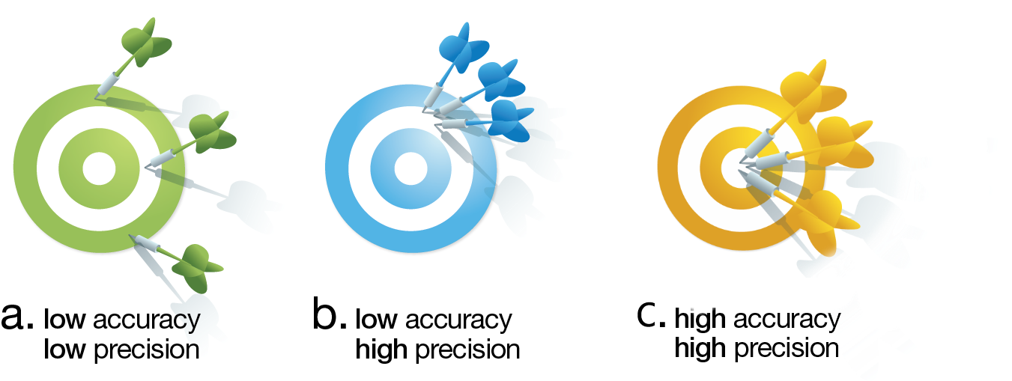
Background Information

Slide 7
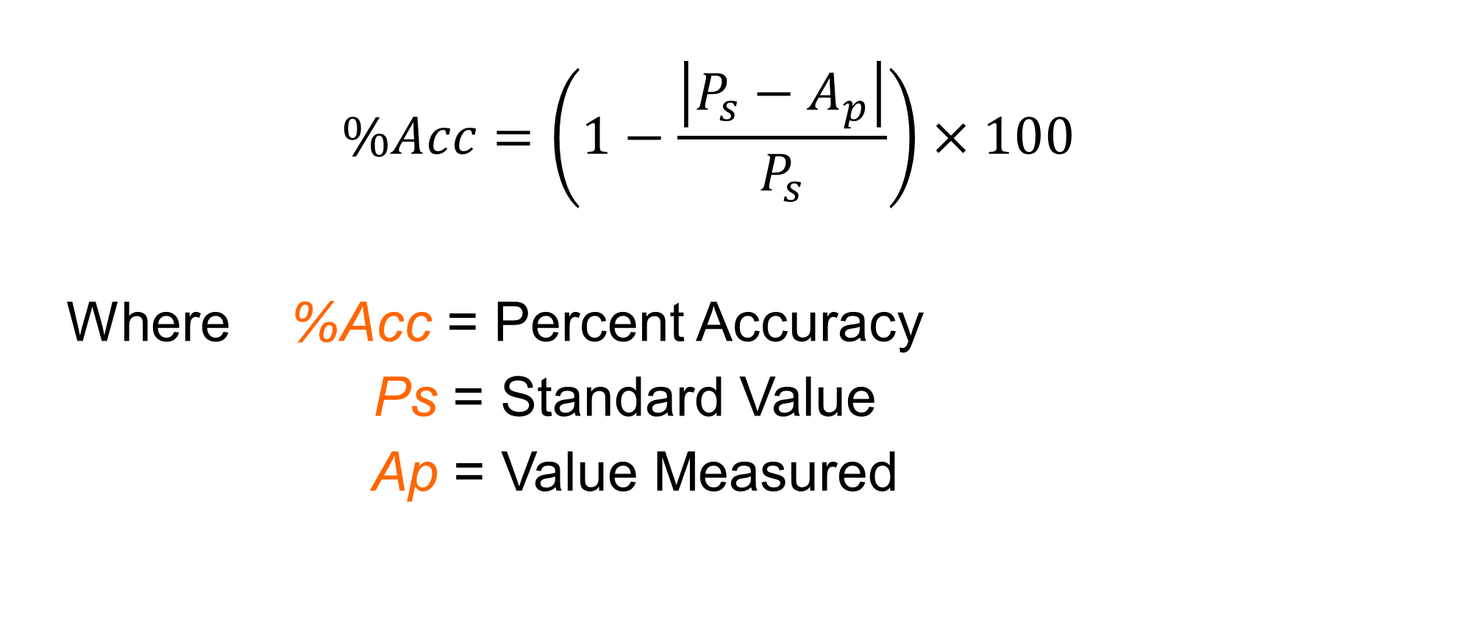
Background Information
$$\%Acc=\left(1−\frac{\left|P_{s}−A_{p}\right|}{P_{s}}\right)×100$$
Where %Acc = Percent Accuracy
Ps = Standard Value
Ap = Value Measured

Slide 8
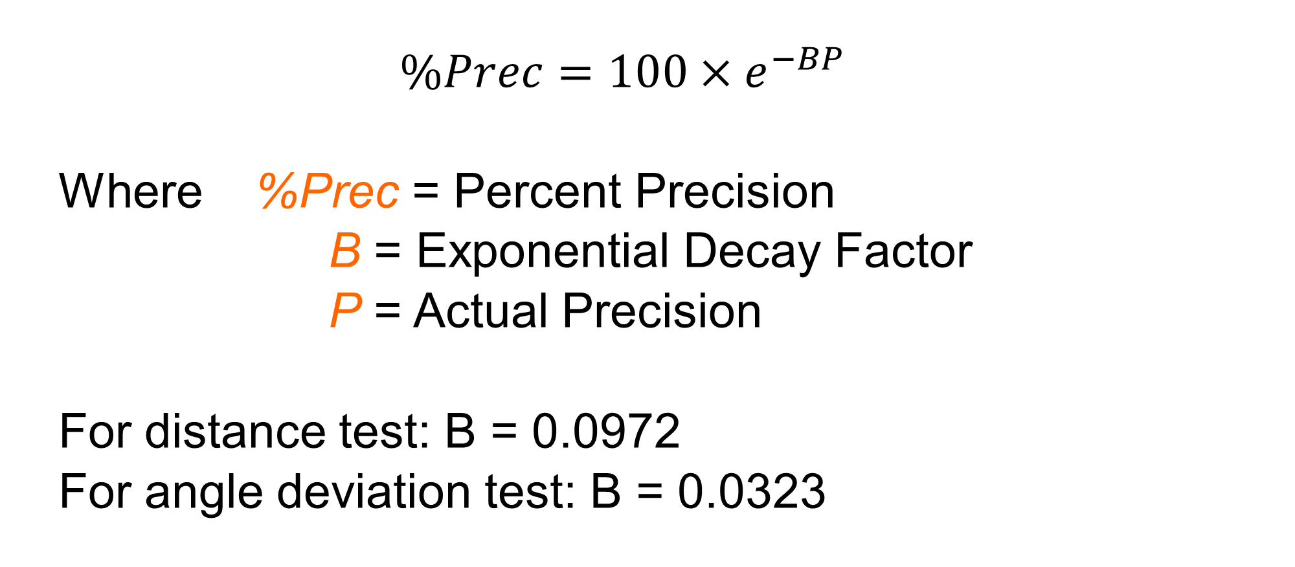
Background Information
$$\%Prec=100×e^{−BP}$$
Where %Prec = Percent Precision
B = Exponential Decay Factor
P = Actual Precision
For distance test: B = 0.0972
For angle deviation test: B = 0.0323

Slide 9

Background Information
Distance Test
  Section 1: 5cm
  Section 2: 10cm
Angle Deviation Test
  $P_{s}=360°$
wall
Measure distance from wall
θ in degrees
Target = 5cm

Slide 10
Background Information
Quality Improvement
Analyzing the design
Testing the design
  Through physical or mathematical modeling or computer modeling
Does the robot perform to standard?
  If no, what can be done to improve its functionality?
  If yes, what can be done to improve its performance beyond the standard?

Slide 11
Background Information
Reverse Engineering
Understanding how a product functions
  Disassembly of said product
  Noting the key components
Carried out in both software and hardware fields

Slide 12
Background Information
Sensors
Evaluates the robot’s surroundings
Creates inputs to control loops and switches
Three sensors used in this lab
  Light sensor (measures light properties)
  Gyro sensor (measures orientation)
  Ultrasonic sensor (measures distance)

Slide 13
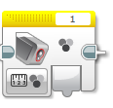
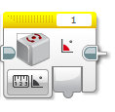
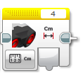
Background Information
Sensors

Slide 14
Background Information
Switches perform different actions depending on the input
  “If-else” statements
Loops continuously loop sections of code repeatedly until the end statement occurs
  Set amount of time, distance from wall, etc.

Slide 15
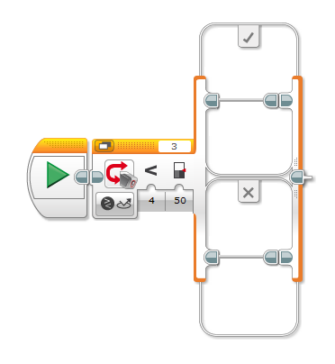
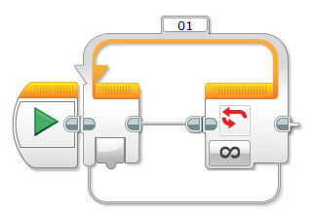
Background Information
Switches and Loops

Slide 16
Background Information
Ports 1, 2, 3, and 4 are for sensors and other inputs
Ports A, B, C, and D are for motors and other outputs
Port View displays sensor readings in real-time on the EV3 brick
  Ex. information for light intensity must be determined using port view to make the line-following code

Slide 17
Materials
Mindstorms Kit
Computer with Mindstorms Software
Protractor and Ruler
Mini-Course

Slide 18
Procedure - Overview
Fix faults in robot designs
Program robot to perform four tests
  Sections 1 & 2 without sensors
  Sections 1 & 2 with sensors
Determine if robot meets the 80% EG Standard
Reverse engineer the robot’s code and make quality improvements

Slide 19
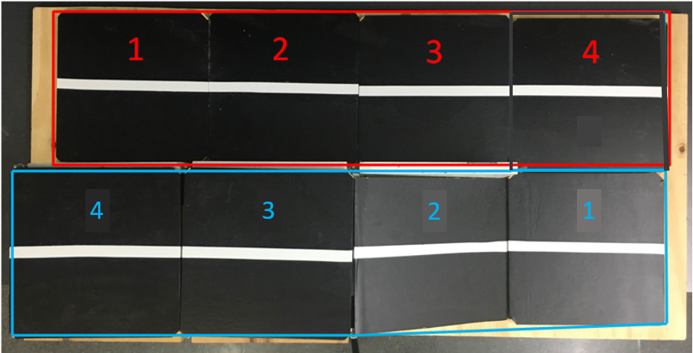
Procedure – Course Diagram
Red = Section 1
Blue = Section 2

Slide 20
Procedure - Hardcoding
Build assigned robot according to instructions
Spend 15 minutes practicing on mini-course with robot and modify any faults in the robot design
Create distance/angle test program without sensors following the manual instructions
Download program to EV3
Test different setting values to find optimal settings (10 min)
  Rotations, time, power, etc.
Conduct four trials once ideal settings are found
  Distance & Angle Deviation results are recorded simultaneously in the Datasheet template
Take screenshots of the first two lines of code
  Section 1 and Section 2

Slide 21
Procedure – Sensors Coding
Assess data collected and any observations
Consider how it works
  What can the sensors on the robot accomplish that hardcoding can’t?
Make necessary adjustments by adding sensors to the code following the manual’s instructions
  Find optimal values for sensors (10 min)
Retest using modified code and record data into Datasheet
Take screenshots of the final two lines of code
  Section 1 and Section 2

Slide 22
Procedure - Data
Tabulate raw data in the Datasheet
  Download the template by clicking the text in the manual

Slide 23
Procedure - Results
Tabulate results in a chart:
It must pass all the tests at a percentage of at least 80%
 | Accuracy | % Acc | Pass/Fail | Precision | % Prec | Pass/Fail
Distance Test
Angle of Deviation Test

Slide 24
Report
Individual lab report
Title page
Discussion topics in the manual
MUST include spreadsheet with test results, standard, average, accuracy, and precision

Slide 25
Presentation
Team presentation
Follow “Assignment” guidelines on EG Manual
Include photos of robot
Include screenshots of all code

Slide 26
Closing
Share tasks – each team member should take a turn building the code
Have all original data signed by a TA
Remember to submit all work electronically
Return all unused materials to TAs

Slide 27

Product Evaluation & Quality Improvement
QUESTIONS?

