Slide 1


The Timeshifter
Hour Glass, Inc.
Eve Fishinevich (Project Coordinator)
Rondell Sinanan (Head of Research)
Milestone 1
Date of Presentation: 08/99/9999
Section Z
Notes:
To replace this picture, just select and delete it. Then use the Insert Picture icon to replace it with one of your own!

Slide 2
Agenda
Project Objective
Background Information
Technical Design Description
Cost Estimate
Project Schedule
Summary

Slide 3
Projective Objective
Petitioning for the creation of the world’s first working time machine
Aiming to retrieve force field generator & saber tooth tiger
Aiming to have it run at 50 years per minute

Slide 4

Background Information
Requirements:
  Retrieve one item from the past
  Retrieve one item from the future
NASA is soliciting designs for a time
machine to find alternate energy
sources

Slide 5
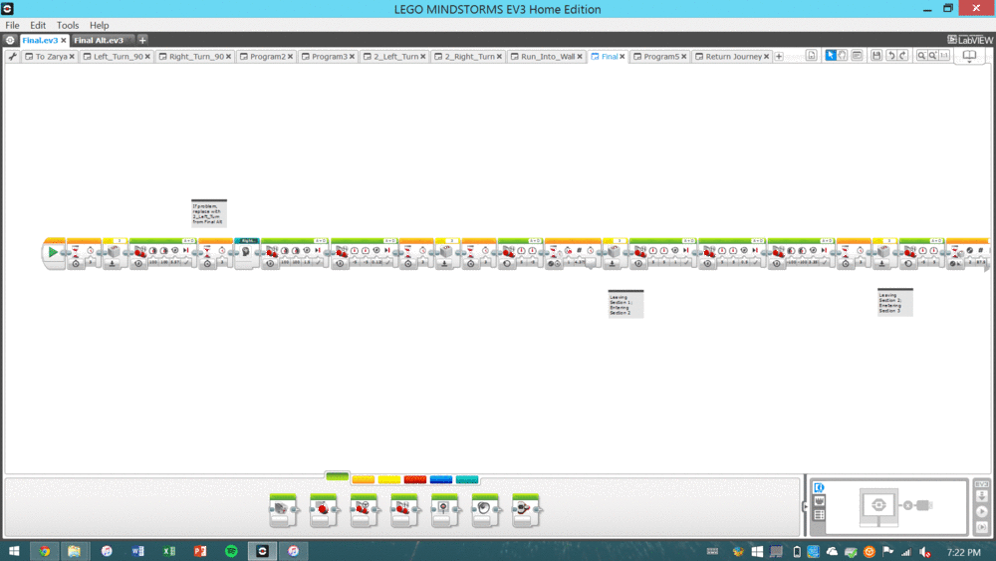
Technical Design Description
Our robot uses quantum technology to warp time
Travels 50 years in 5 minutes

Slide 6
Technical Design Description
Design Sketch
SKETCH
Notes:
https://upload.wikimedia.org/wikipedia/commons/thumb/8/80/T-FLEX-CAD-12-Rus.png/1280px-T-FLEX-CAD-12-Rus.png

Slide 7
Cost Estimate
Item/Employee | Quantity | Unit Cost | Cost
Item 1 | # | $$$ | $$$
Item 2 | # | $$$ | $$$
Item 3 | # | $$$ | $$$
Miscellaneous | # | $$$ | $$$
Labor | # | $$$ | $$$
Total | $$$

Slide 8
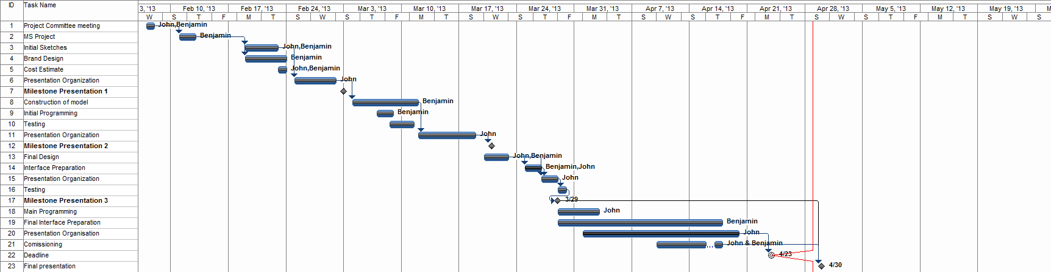
Project Schedule
Notes:
PROGRESS LINE SHOULD BE CLOSER TO THE BEGINNING SINCE IT’S ONLY MILESTONE 1!

Slide 9
Summary
We’re ahead of schedule
  Robot built on CAD
  Halfway built physically
We’re on budget
By Milestone 2:
  Physical robot fully built
  Retrieve item from the future or past
  (Benchmark A)

Slide 10
The Timeshifter
Hour Glass, Inc.
Eve Fishinevich (Project Coordinator)
Rondell Sinanan (Head of Research)
Milestone 1
Date of Presentation: 08/99/9999
Section Z
Notes:
To replace this picture, just select and delete it. Then use the Insert Picture icon to replace it with one of your own!

