Slide 1


Introduction into CAD

Slide 2
Overview
Objectives
Background
Materials
Procedure
Report/Presentation
Closing

Slide 3
Objectives
Understand the simulation capabilities of Fusion 360, a common computer-aided design (CAD) software
Use the basic of modeling techniques in Revit
Further develop product evaluation and minimal design skills

Slide 4
What is Fusion 360
Fusion 360 is a cloud based Computer Aided Design software
Allows engineers to make precisely scaled drawings that are turned into 3D models to visualize concepts or functionality
Run tests to imitate real world situations
Almost identical to Solidworks and a major upgrade from inventor in terms of accessibility and ease of use.

Slide 5
What is Autodesk Revit
A building modeling software for architects and engineers
Allows users to design buildings and other architectural structures in 3D while allowing for 2D drafting elements.
Can be used to track stages of a buildings lifecycle, from creation to demolition

Slide 6
Background Information
Simulation In Fusion 360
  Static Stress
      Simulates the linear responses to a force being applied to an object based on the material, constraints, and points of application
      analyzes the deformation, stress, and safety factor in a model from structural loads and constraints
      Can determine whether an object is ready to sustain real world loads or needs to be remodified
      The resultant safety factor is the measure of how much load a object can sustain before permanent deformation or fracture.

Slide 7
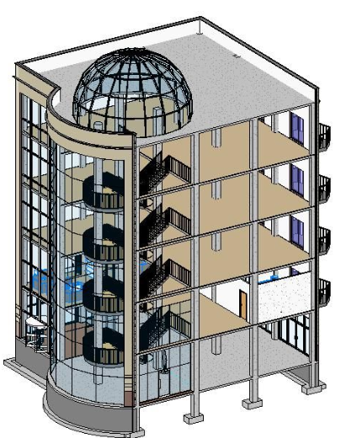
Background Information
3D Modeling in Revit
  Used for creating homes, buildings and structural support systems
  Used to create floor, plumbing, and electric plans, As well as heating, ventilation and air conditioning plans (HVAC)
  Capable of viewing models in three dimensions as well as being able to walkthrough structure floor by floor

Slide 8
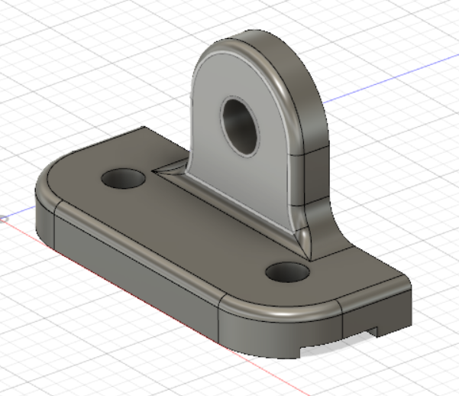
Materials
Computer
Fusion 360
Autodesk Revit
Predesigned parts

Slide 9
Revit Problem Statement Rundown
Create a 350-400 square foot apartment for residents/college students.
Should contain a bathroom, a bed, a kitchen, a table, and a desk.
Create an apartment with sufficient lighting (at least 1 window)
a floor plan layout of the entire apartment
an electric and a plumbing plan for the bathroom.

Slide 10
Procedure
Determine the location, magnitude and direction of the force, as well as material and location of constraints.
Run a stress test on the predesigned part given to you
Review factor of safety and location of fracture then use Fusion 360 to add the modifications onto the model without changing the main base
Rerun tests and remodify until part has safety factor of at least 3

Slide 11
Procedure
Sketch out the apartment based on the problem statement
Create the floor plan on Revit
Insert all required furniture and appliances
Create electrical plan on the same revit file
Create plumbing plan on separate mechanical template

Slide 12
Report/Presentation
Submit all files as a zip folder
  Before end of lab
Scan lab notes
Individual Lab report
No lab presentation, Instead milestone 1 presentation

Slide 13
Closing
Have all lab notes signed by TA
Each team member should have turn using software
Save all files
Submit all work electronically
Return all unused materials to TA

