Slide 1


Introduction into CAD

Slide 2
Overview
Objectives
Background
Materials
Procedure
Report/Presentation
Closing

Slide 3
Objectives
Understand Fusion 360, a common computer-aided design (CAD) software
Use basic modeling techniques in Revit
Develop product evaluation and minimal design skills

Slide 4
What is Fusion 360?
Cloud-based computer-aided design software
Allows engineers to make precisely scaled drawings that are turned into 3D models to visualize concepts or functionality
Runs tests to imitate real-world situations
Almost identical to SolidWorks and a major upgrade from Inventor

Slide 5
What is Autodesk Revit?
A building modeling software for architects
and engineers
Allows users to design buildings and other architectural structures in 3D while allowing for 2D drafting elements
Can be used to track stages of a building’s lifecycle, from creation to demolition

Slide 6
Background Information
Simulation in Fusion 360 – Static Stress
  Simulates the linear responses to a force being applied to an object based on the material, constraints, and points of application
  Analyzes the deformation, stress, and safety factor in a model from structural loads and constraints
  Can determine whether an object is ready to sustain real-world loads or needs to be remodified
  The resultant safety factor is the measure of how much load a object can sustain before permanent deformation or fracture

Slide 7
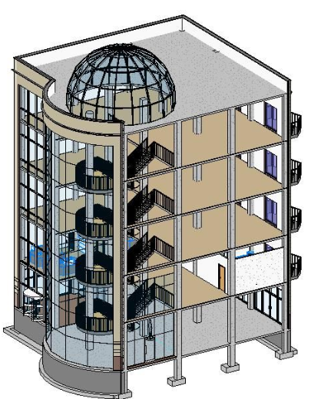
Background Information
3D Modeling in Revit
  Create homes, buildings, and structural support systems
  Create floor, plumbing, and electric plans, and heating, ventilation, and air conditioning plans (HVAC)
  View models in 3D and walk through structure floor by floor

Slide 8
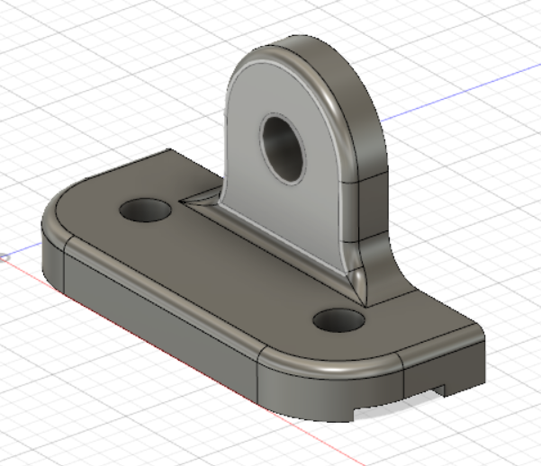
Materials
Computer
Fusion 360
Autodesk Revit
Predesigned parts

Slide 9
Revit Problem Statement
Create a 350 – 400 square foot apartment for residents/college students
Contains one: bathroom, bed, kitchen, table, and desk
Must have sufficient lighting (at least 1 window)
A floor plan layout of the entire apartment
An electrical and plumbing plan for the bathroom

Slide 10
Procedure – Fusion 360
Determine the location, magnitude, and direction of the force, as well as material and location of constraints
Run a stress test on the predesigned part assigned
Review factor of safety and location of fracture, then add the modifications onto the model without changing the main base
Rerun tests and remodify until part has safety factor of at least 3

Slide 11
Procedure – Revit
Sketch out the apartment based on the problem statement
Create the floor plan on Revit
Insert all required furniture and appliances
Create electrical plan on the same Revit file
Create plumbing plan on separate mechanical template

Slide 12
Report/Presentation
Submit all files as a zip file before end of lab
Scan lab notes
Individual lab report
No lab presentation, instead Milestone 1 presentation

Slide 13
Closing
Have all lab notes signed by TA
Each team member should have turn using software
Save all files
Submit all work electronically
Return all unused materials to TA

