Slide 1
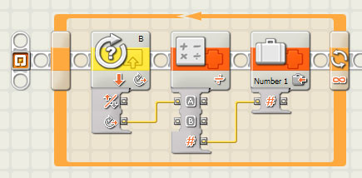

EG1003: Introduction to Engineering and Design
Laboratory 4: Sensors

Slide 2
Overview
Objective
Background
Materials
Procedure
Report / Presentation
Closing

Slide 3
Objectives
Design two sensor programs
  Mindstorms: use sensors to stop a motor when a red ball is detected
  LabVIEW: use a thermocouple to measure temperature in a heating and cooling program
Apply sensors to Semester-Long Design Projects

Slide 4
Concept : Control Systems
Control system
  System created to read and analyze data
  Use analyzed data for appropriate action
  Examples:
    Thermal controls
    Lighting systems
    Alarm systems
    Motion sensors

Slide 5
Concept: Sensors
Sensors
  Read data from test environment
  Data converted to digital format for computer
Some sensor types:
  Light
  Temperature
  Ultrasonic
  Touch
Sensors connect to different control devices:
  Lego sensors -> NXT
  Thermocouple -> DAC -> PC

Slide 6
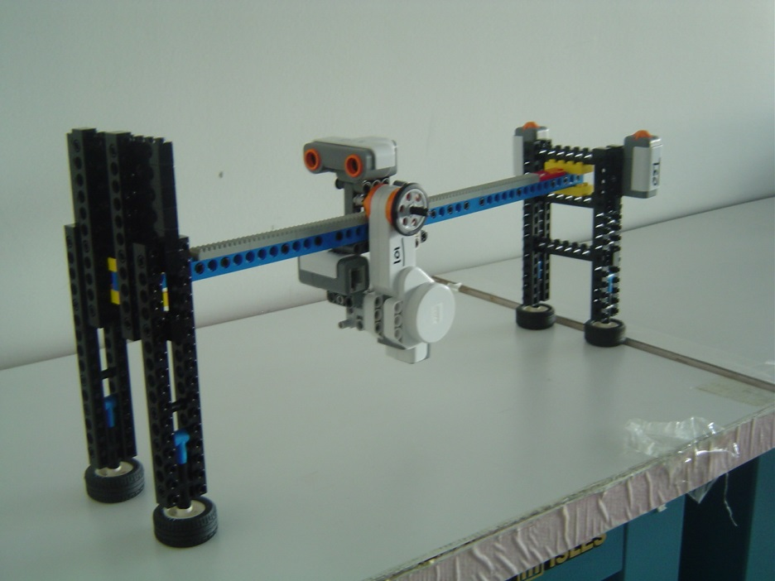
Materials
Mindstorms sensor program
  NXT
  Test assembly
  Computer with Mindstorms
LabVIEW sensor program
  Computer with LabVIEW + DAC
  Thermocouple

Slide 7
Procedure:
Mindstorms Sensor Program Part A
Port 1 touch sensor
  Starts program
  Starts motor on Port A
  Reverses direction of motor
Port 2 touch sensor
  Stops motor on Port A
  Ends program
Port B motor
  Varies speed of Port A motor

Slide 8
Procedure:
Mindstorms Sensor Program Part B
Port 3 ultrasonic sensor
  Reverse direction of motor when greater than 20cm from wall
  Reverse direction of motor when less than 8cm from wall

Slide 9
Procedure:
Mindstorms Sensor Program Part C
Port 4 light sensor
  Stops motor when red ball is detected (value greater than 45)
  Ends program

Slide 10
Assignment: Report/Presentation
No report for this lab
No Presentation for this lab
Milestone 2 due next recitation

Slide 11
Closing
Have all lab notes signed by TA
Each team member should have turn using software
Return all unused materials to TA

