Slide 1
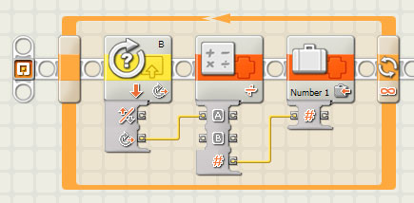

EG1003: Introduction to Engineering and Design
Laboratory 4: Sensors

Slide 2
Overview
Objective
Background
Materials
Procedure
Report / Presentation
Closing

Slide 3
Objectives
Design two sensor programs
  Mindstorms: use sensors to stop a motor when a red ball is detected
  LabVIEW: use a thermocouple to measure temperature in a heating and cooling program
Apply sensors to Semester-Long Design Projects

Slide 4
Concept : Control Systems
Control system
  System created to read and analyze data
  Use analyzed data for appropriate action
  Examples:
    Thermal controls
    Lighting systems
    Alarm systems
    Motion sensors

Slide 5
Concept: Sensors
Sensors
  Read data from test environment
  Data converted to digital format for computer
Some sensor types:
  Light
  Temperature
  Ultrasonic
  Touch
Sensors connect to different control devices:
  Lego sensors -> NXT/EV3
  Thermocouple -> DAC -> PC

Slide 6
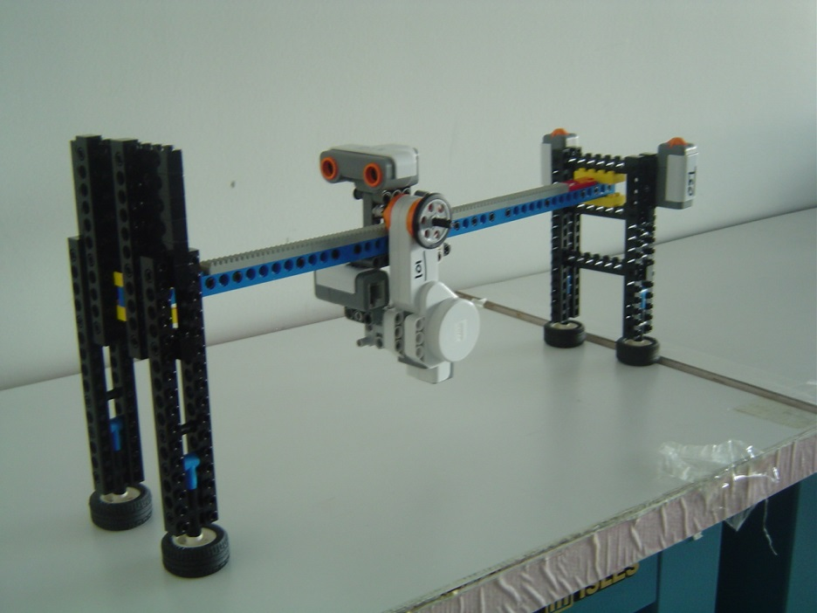
Materials
Mindstorms sensor program
  NXT/EV3
  Test assembly
  Computer with Mindstorms
LabVIEW sensor program
  Computer with LabVIEW + DAC
  Thermocouple

Slide 7
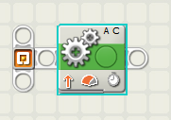
Procedure:
Rotation Sensor
Write a program that moves the robot forward for 3 seconds
  Add a code that reads the number of rotations during the 3 seconds
Write a program that displaying the number of rotations, but stops robot after 3 rotations

Slide 8
Procedure:
Ultrasonic Sensor
Write a program in which our NXT would show a happy face if the Ultrasonic Sensor detected a distance greater than 40 in, and show a sad face if the Ultrasonic Sensor detected a distance less than 40 in
Write a program where the NXT would display a caution sign when the Ultrasonic Sensor senses a distance less than 40 in but greater than 30 in, and display a sad face when the distance sensed is less than 30

Slide 9
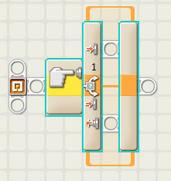
Procedure:
Touch Sensor
Write a program in which your robot would move when the touch sensor is pressed, and would stop when the touch sensor was released

Slide 10
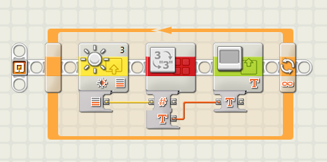
Procedure:
Light Sensor
Write a program for obtaining the light intensity and displaying it on the NXT's screen

Slide 11
Assignment: Report/Presentation
No report for this lab
No Presentation for this lab
Milestone 1 due next recitation

Slide 12
Closing
Have all lab notes signed by TA
Each team member should have turn using software
Return all unused materials to TA

