Slide 1
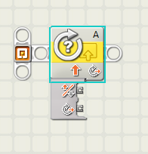
EG1003: Introduction to Engineering and Design
Sensors

Slide 2
Overview
Objective
Background
Materials
Procedure
Report / Presentation
Closing

Slide 3
Objective
Design sensor programs
Mindstorms: Use sensors to stop a motor when a red ball is detected
Apply sensors to Semester-Long Design Projects

Slide 4
Concept : Control Systems
Control system
System created to read and analyze data
Use analyzed data for appropriate action
Examples:
Thermal controls
Lighting systems
Alarm systems
Motion sensors

Slide 5
Concept: Sensors
Sensors
Read data from test environment
Data converted to digital format for computer
Some sensor types:
Light
Temperature
Ultrasonic
Touch
Sensors connect to different control devices:
Lego sensors -> NXT/EV3
Thermocouple -> DAC -> PC

Slide 6
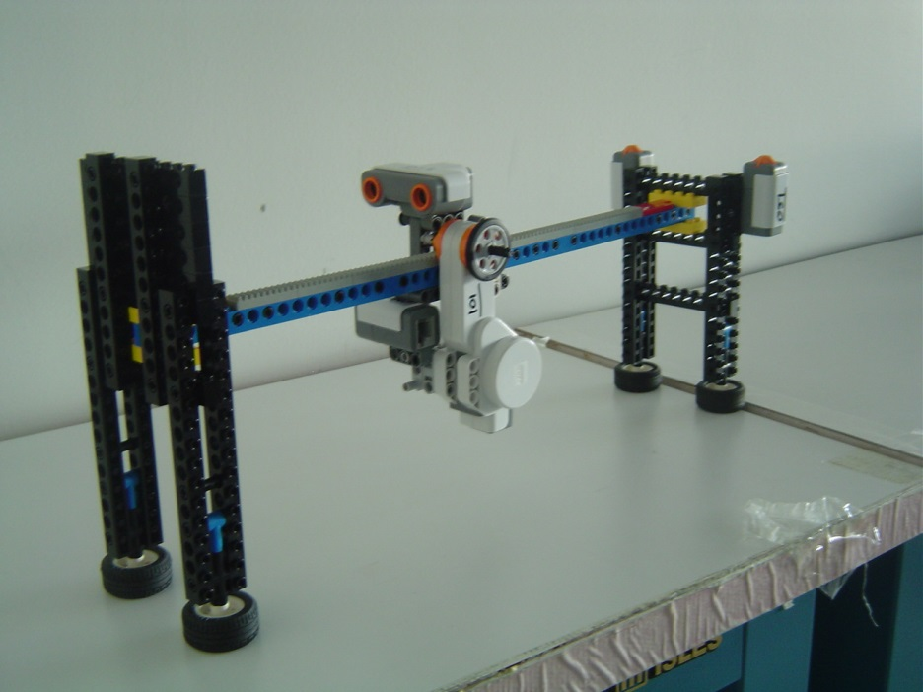
Materials
Mindstorms sensor program
NXT/EV3
Test assembly
Computer with Mindstorms
LabVIEW sensor program
Computer with LabVIEW + DAC
Thermocouple

Slide 7
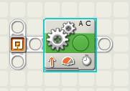
Procedure: Rotation Sensor
Write a program that moves the robot forward for 3 seconds
Add a code that reads the number of rotations during the 3 seconds
Write a program that displaying the number of rotations, but stops robot after 3 rotations

Slide 8
Procedure: Ultrasonic Sensor
If the sensor detects a distance greater than 40 in, a happy face should appear, and for a distance of less than 40 in, a sad face should appear
If the sensors detect a distance less than 40 in but greater than 30 in, a caution sign should appear. But for a distance less than 40 in but greater than 30 in, a sad face should appear

Slide 9
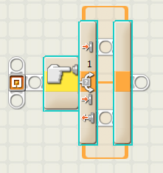
Procedure: Touch Sensor
Write a program in which your robot would move when the touch sensor is pressed, and would stop when the touch sensor was released

Slide 10
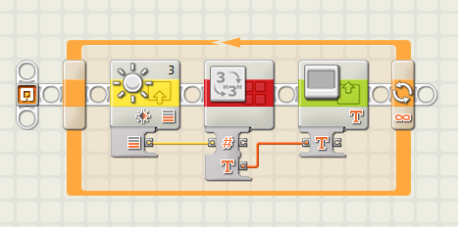
Procedure: Light Sensor
Write a program for obtaining the light intensity and displaying it on the NXT's screen

Slide 11
Assignment: Report/Presentation
No report for this lab
No Presentation for this lab
Milestone due next recitation

Slide 12
Closing
Have all lab notes signed by TA
Each team member should have turn using software
Return all unused materials to TA

