Slide 1

HOW TO GIVE A
RECITATION PRESENTATION
EG1003 | RECITATION 1

Slide 2
AGENDA
2
Lab Presentation Overview
Lab Presentation Format
Visual Delivery
Physical Delivery
Classroom Preparation & Etiquette
Questions

Slide 3
LAB PRESENTATION OVERVIEW
3
Timed five minute presentation on labs
Post-presentation feedback from Professor, WC, and TA
  Listen & learn: penalty for redundant feedback
Graded on visual and verbal presentation

Slide 4
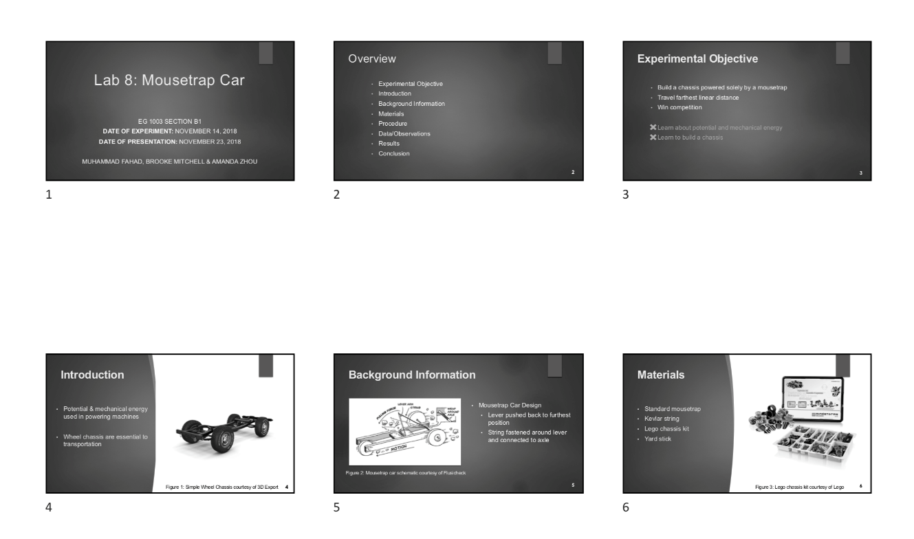
LAB PRESENTATION OVERVIEW
4
Submission:
EG Website at 11:59 pm night before recitation
Two printed copies brought to recitation
  Six slides per sheet horizontal
  Stapled
Figure 1: In class printout

Slide 5
PRESENTATION FORMAT
5
Consistent format and order for all lab presentations:
Title
Overview
Experimental Objective
Introduction
Background Information
Materials
Procedure
Data/Observations
Results
Conclusion
Title
ALWAYS use this order!

Slide 6
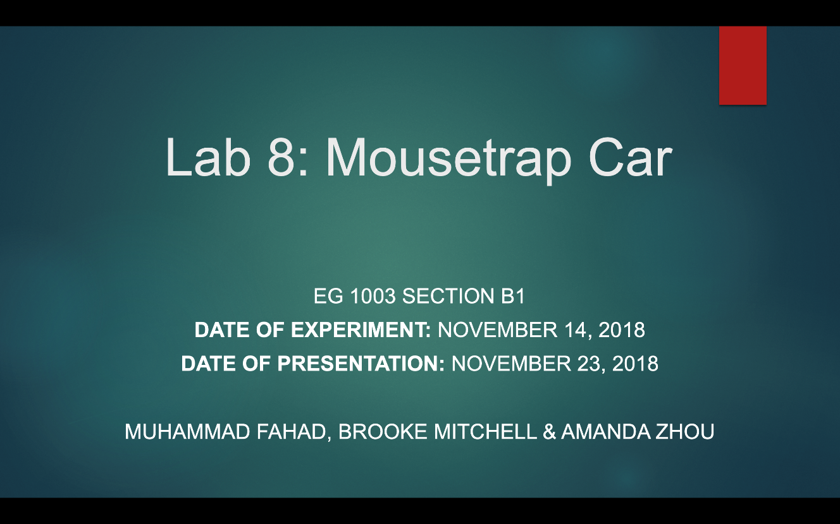
TITLE SLIDE
6
Lab number and title
Course number and section
Date of experiment
Date of presentation
Team members’ names
  Alphabetical by last name
Repeat title slide at end of presentation
Figure 2: Sample title slide

Slide 7
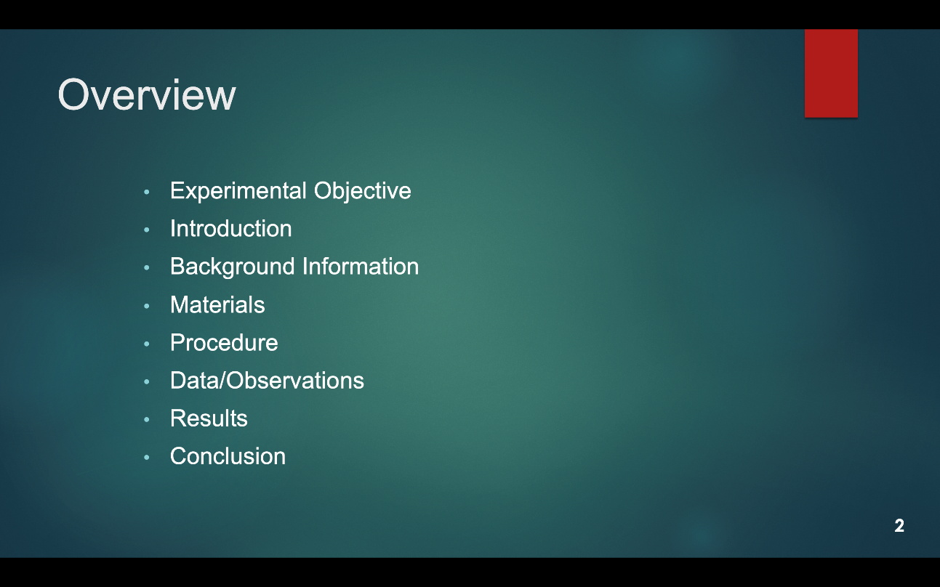
OVERVIEW SLIDE
7
Slide title “Overview”
No need to read slide aloud during presentation
Same overview slide/order for all presentations!
Figure 3: Overview slide sample

Slide 8
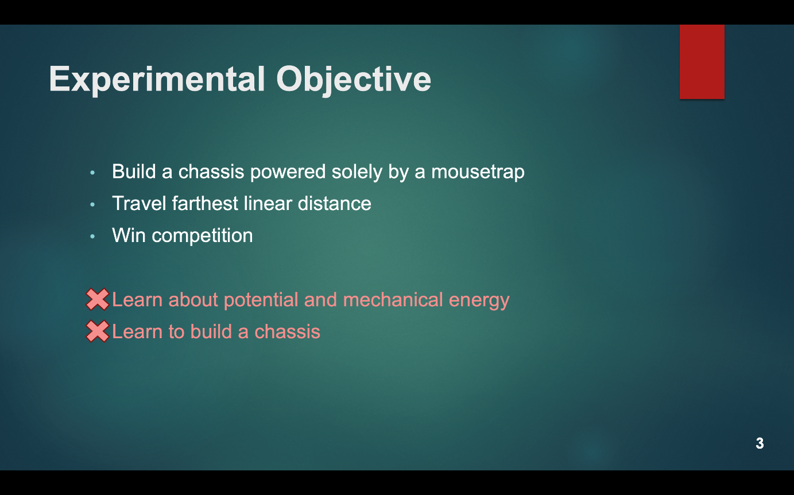
EXPERIMENTAL OBJECTIVE SLIDE
8
Slide title “Experimental Objective”
Scientific principles/objectives
  No learning objectives
Specify if experiment is a competition
Figure 4: Experimental objective sample

Slide 9
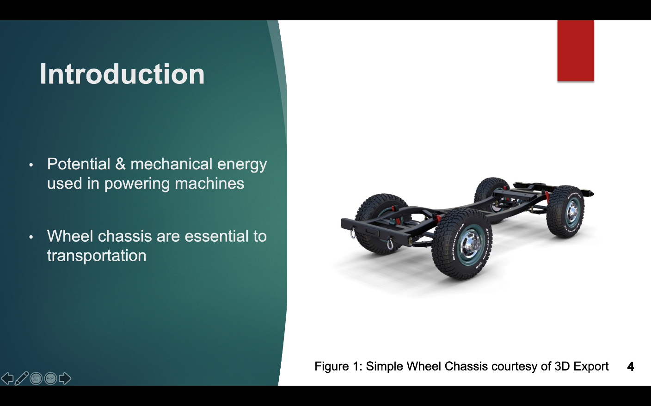
INTRODUCTION SLIDE
9
Slide title “Introduction”
Relevance & real-life applications of topics in lab
Importance of topics in engineering
Figure 5: Introduction sample

Slide 10
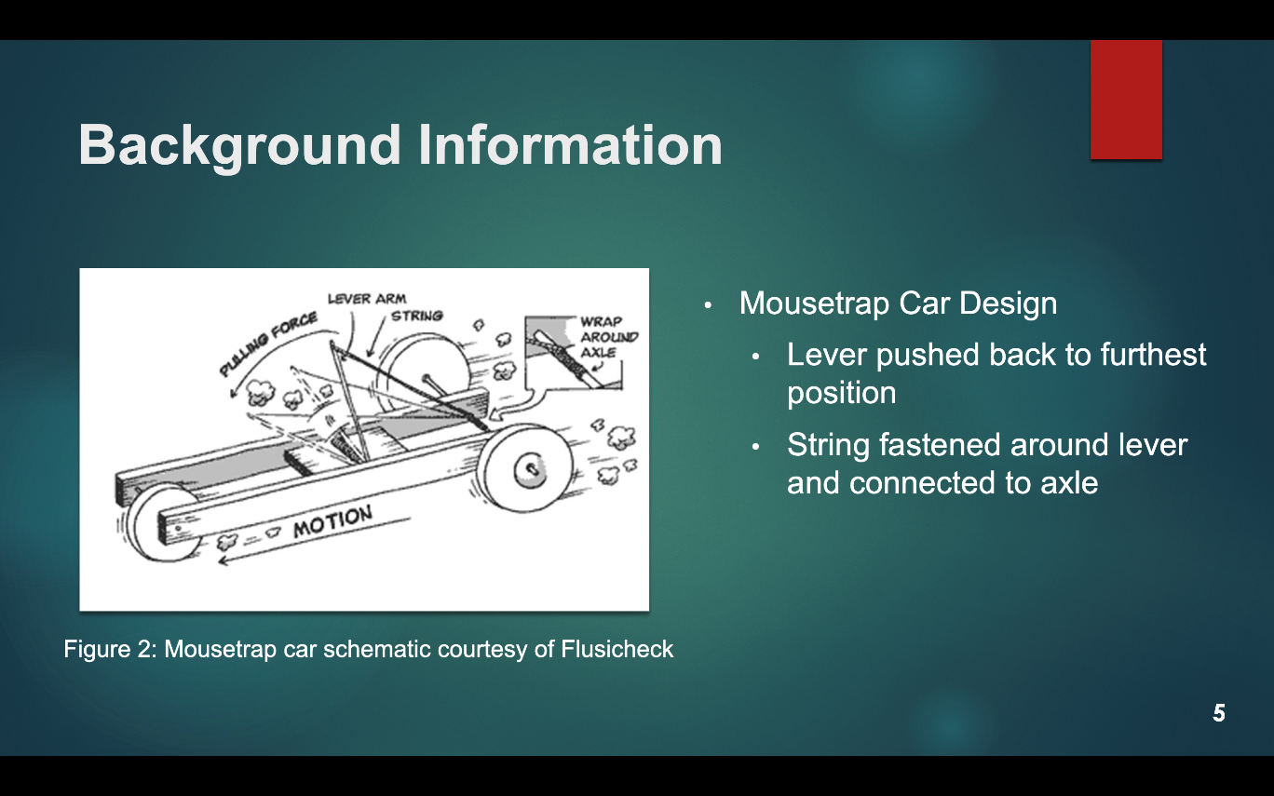
BACKGROUND INFO SLIDES
10
Slide title “Background Information”
Scientific background:
  Main concepts
  Theories
  Equations
  Competition rules & ratios
Figure 6: Background info sample

Slide 11
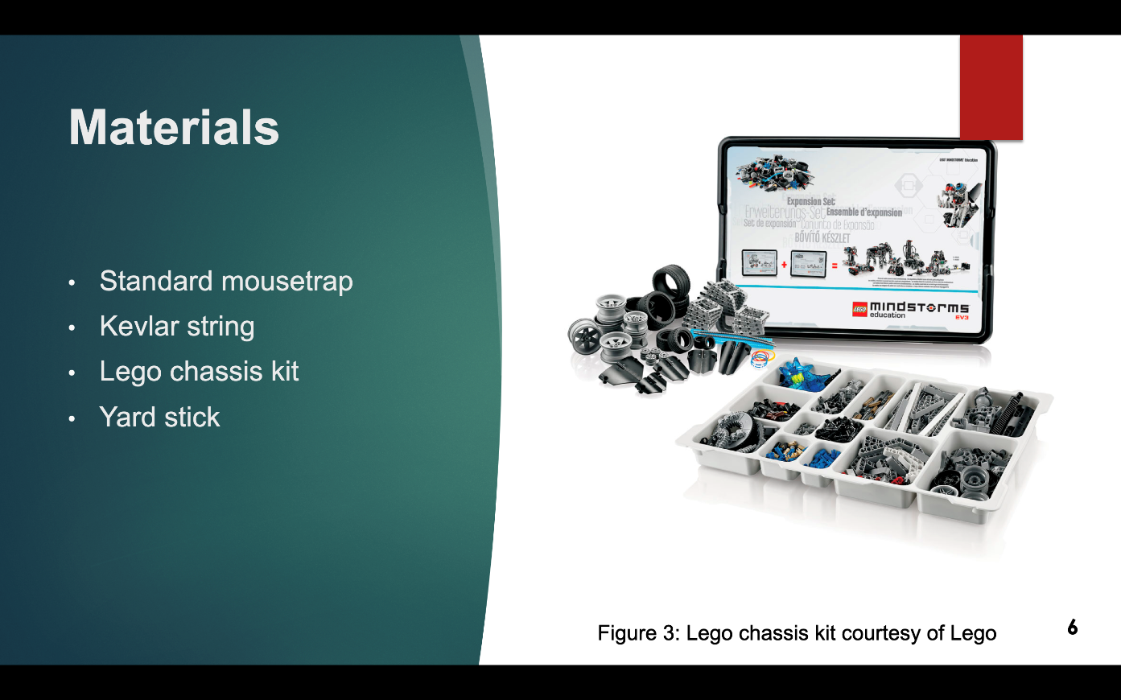
MATERIALS SLIDE
11
Slide title “Materials”
Only list materials used
No competition cost tables
No need to read aloud during presentation
Figure 7: Materials sample

Slide 12
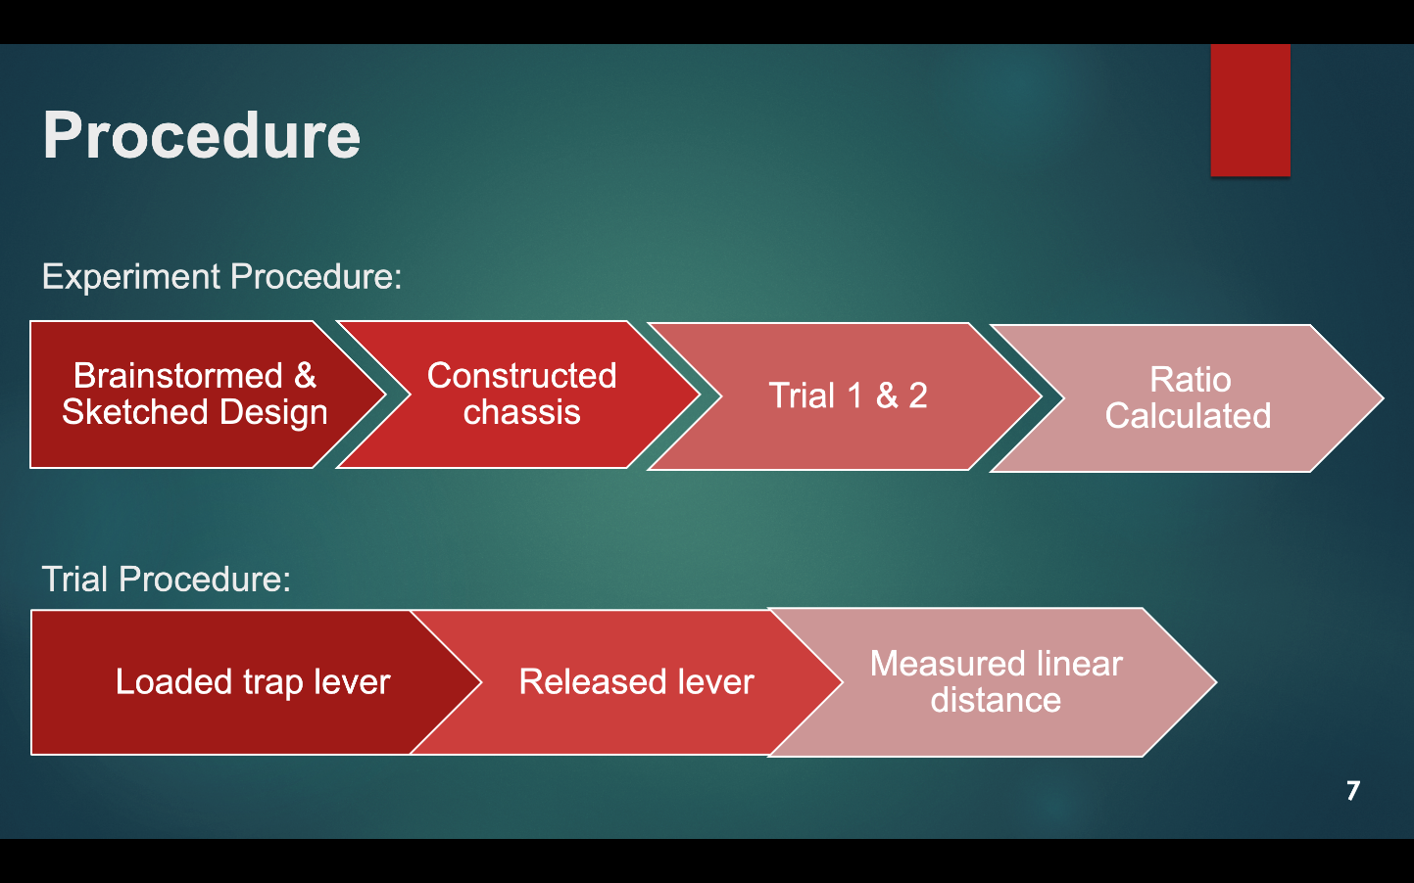
PROCEDURE SLIDES
12
Slide title “Procedure”
Steps followed in lab
  Flowcharts or bullets
Two slide maximum
Pictures of equipment (optional)
Figure 8: Procedure sample

Slide 13
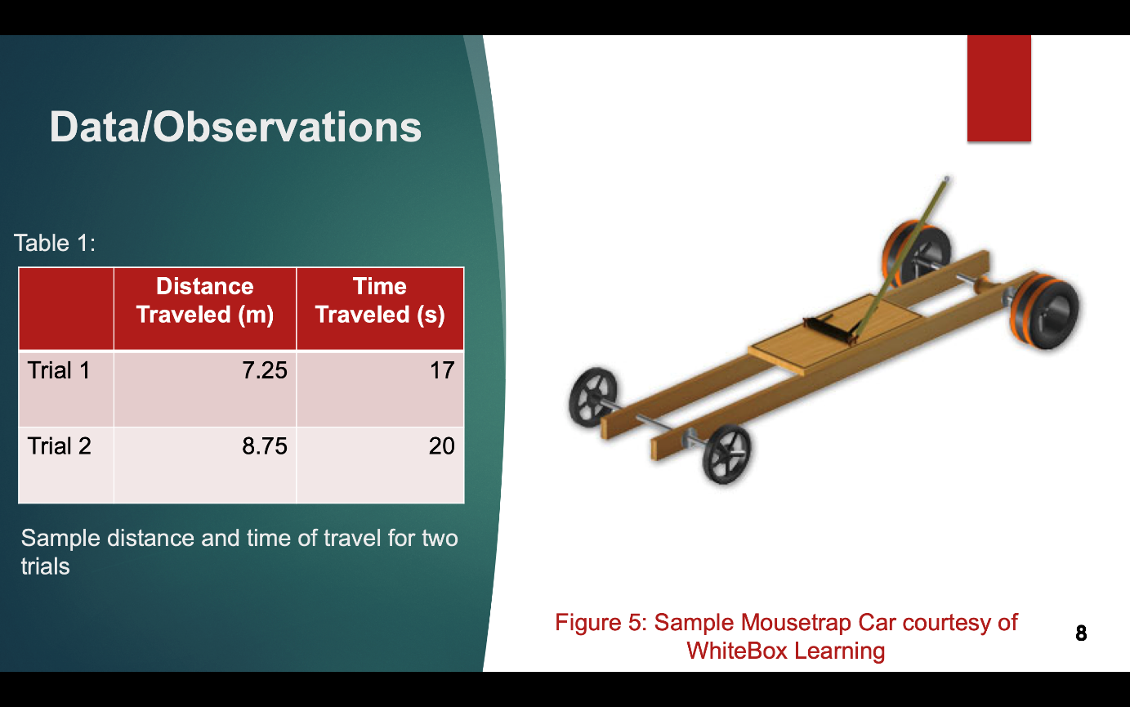
DATA/OBSERVATIONS SLIDE
13
Slide title “Data/Observations”
What you saw and recorded
  Pictures
  Tables (title)
  Graphs (title & labels)
All media must have captions!
Figure 9: Data/Observations sample

Slide 14
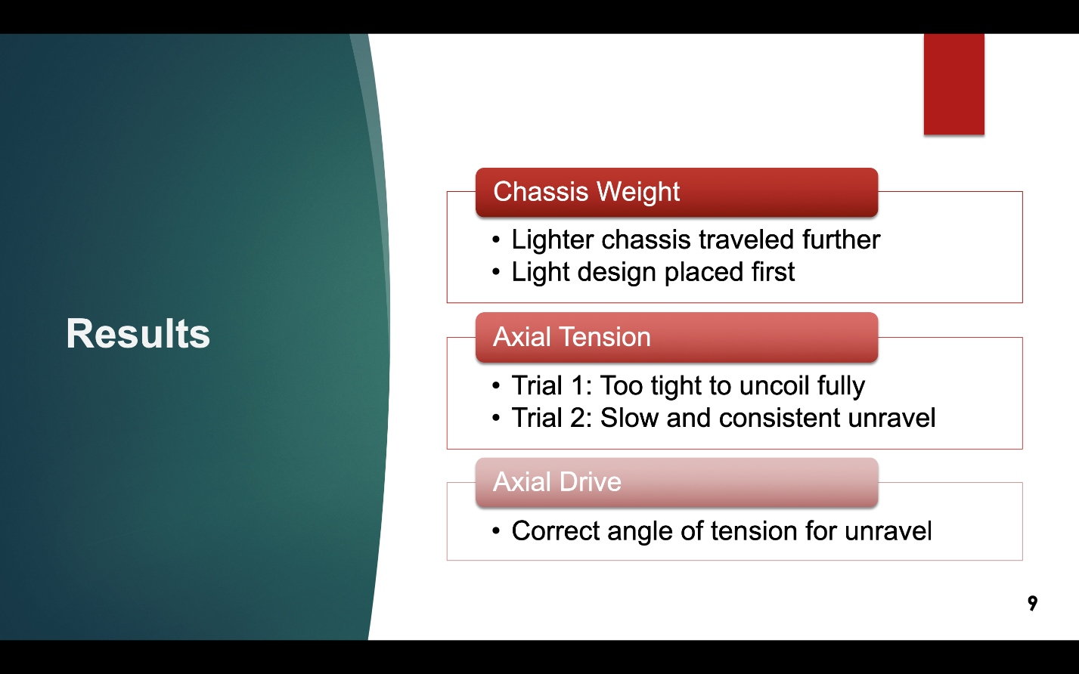
RESULTS SLIDE
14
Slide title “Results”
Show sample calculations
Compare results to expectations & other groups design’s
Refer to data to support results
Figure 10: Results sample

Slide 15
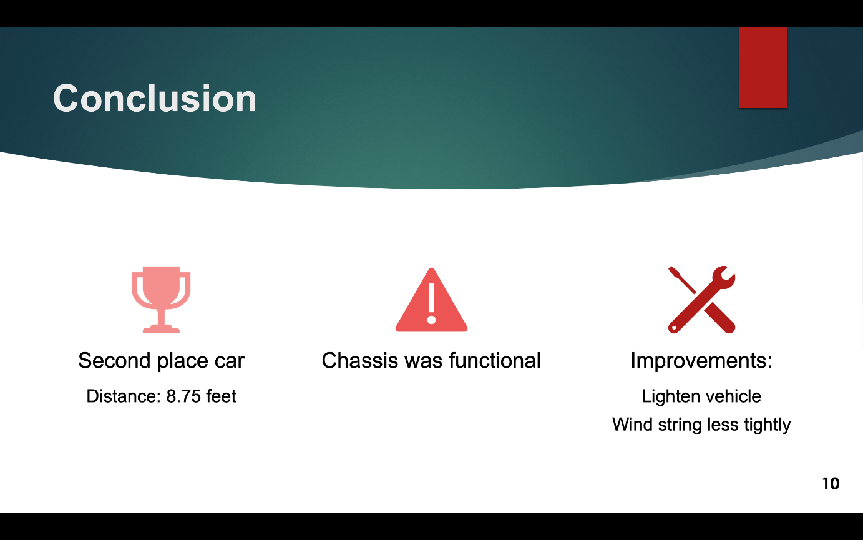
CONCLUSION SLIDE
15
Slide title “Conclusion”
Was experiment successful?
Objectives achieved
Place in competition
Improvements
Figure 11: Conclusion sample

Slide 16

VISUAL DELIVERY
16
No full sentences
Include images from labs
  No hand-drawn lab notes
Consistent fonts and text sizes
  No sans serif fonts
  18-point font minimum
Slide numbers
Don’t crowd slides
PROFESSIONAL & READABLE

Slide 17
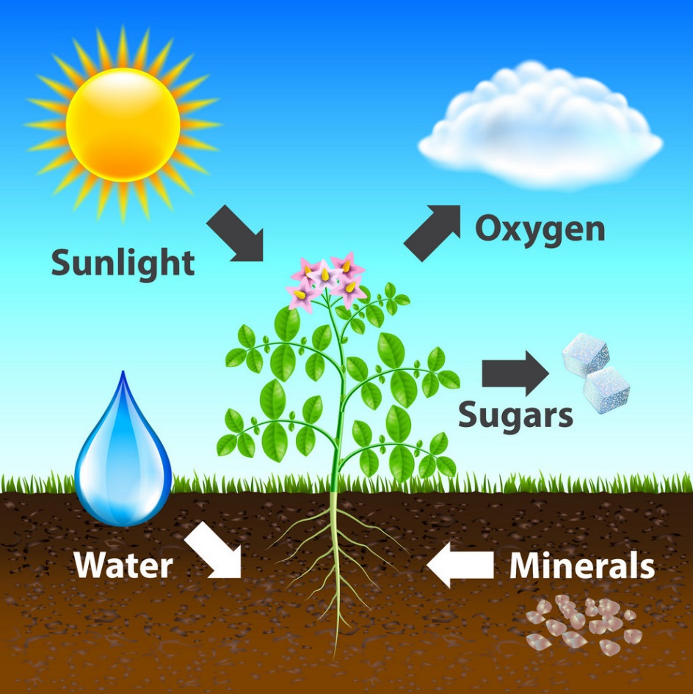
VISUAL DELIVERY
17
Use figures and images
  e.g. Figure 12 explains photosynthesis
Captions with every image
Main points on slides only
  Elaborate your points verbally
X by X Rule (X = 3, 4, 5, 6, or 7)
  e.g. 5 lines per slide, 5 words per line
Figure 12: Photosynthesis diagram courtesy of VectorStock

Slide 18

PHYSICAL DELIVERY
18
Speak loudly and slowly
Face the audience
Eye contact with audience
Utilize a laser pointer where appropriate
Mistakes happen!
  Stay calm and keep presenting
Figure 13: Presentation delivery courtesy of NBC

Slide 19
CLASSROOM PREPARATION
19
Preparation:
  Technical difficulties do happen!
  Bring extra copy of presentation on thumbdrive or laptop
  Be prepared to present without slideshow
Etiquette infractions result in loss of points
Classroom etiquette:
  No laptop/cellphone/technology use in class
  Give presenter your full attention
    No rehearsal during class time

Slide 20
QUESTIONS?
20

