Slide 1

LAZ &MRR WORKSHOP
LAB 4A
EG 1004 Introduction to Engineering & Design

Slide 2

OVERVIEW
Objective
Background Information
Materials
Procedure
IDBE Implementation
Assignment
Closing
Figure 1: VEX Robotics Logo Courtesy of VEX Robotics

Slide 3
OBJECTIVE
Program a small VEX robot to navigate a mini-course
Become familiar with the Arduino VEX library
Understand when and how to use a gyro sensor

Slide 4
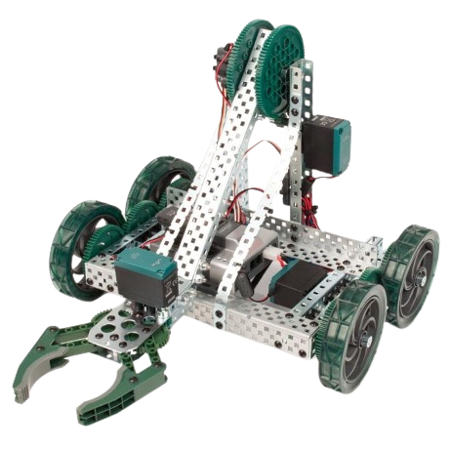
OBJECTIVE
VEX Robotics
  Used for LAZ and MRR projects
  Educational robotic system
  Microcontroller, motor shield, motors, battery, gyro sensor
Figure 3: VEX Clawbot Courtesy of Robot Mesh

Slide 5
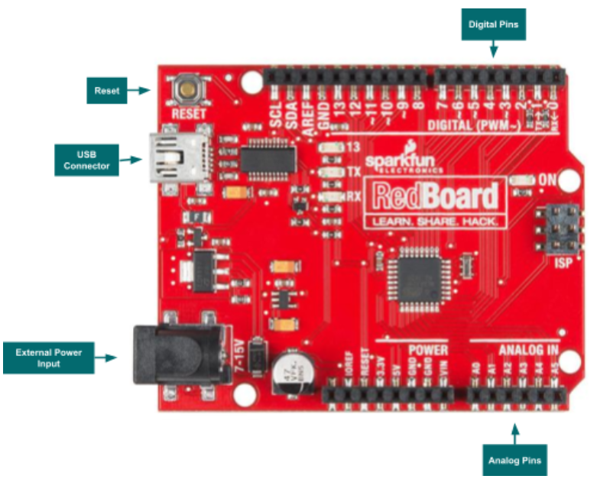
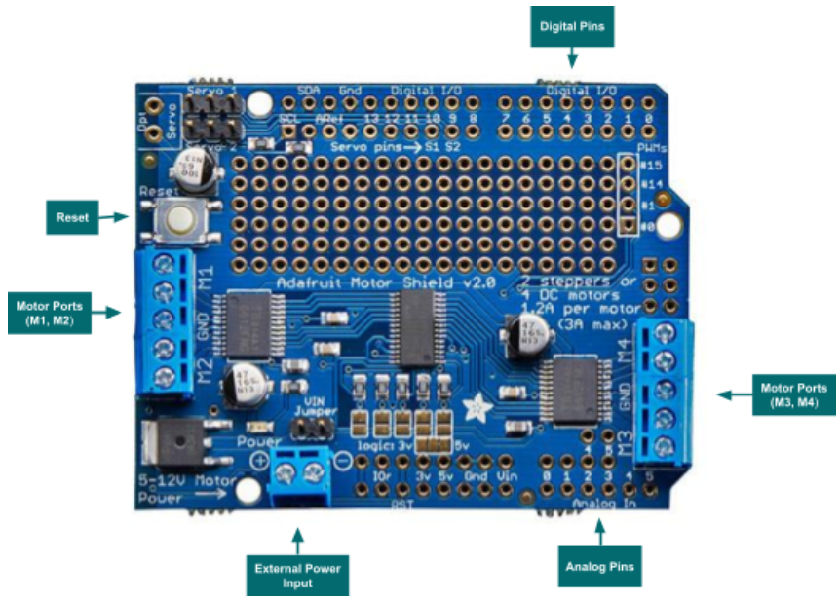
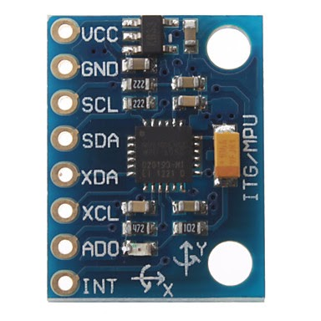

BACKGROUND INFORMATION
Figure 4: Arduino Microcontroller Layout
Figure 5: Arduino Motor Shield Layout
Figure 6: Gyro Sensor
5

Slide 6
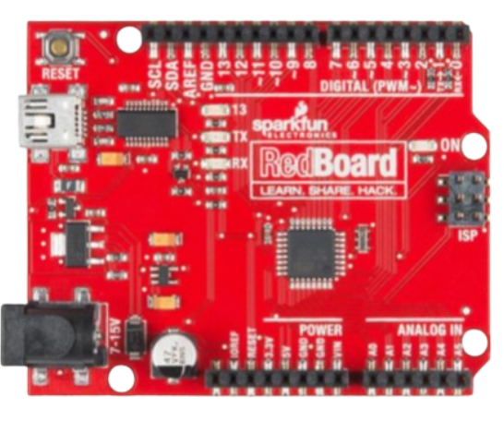
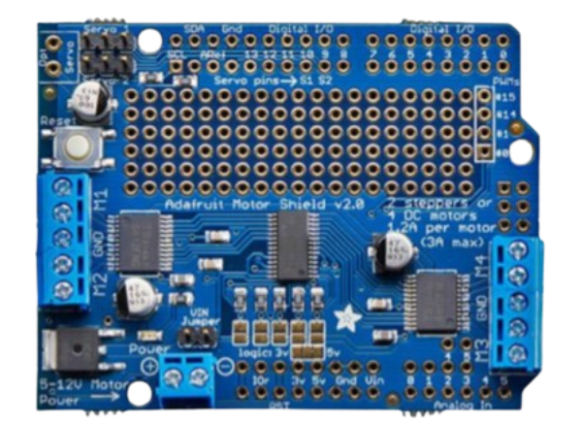
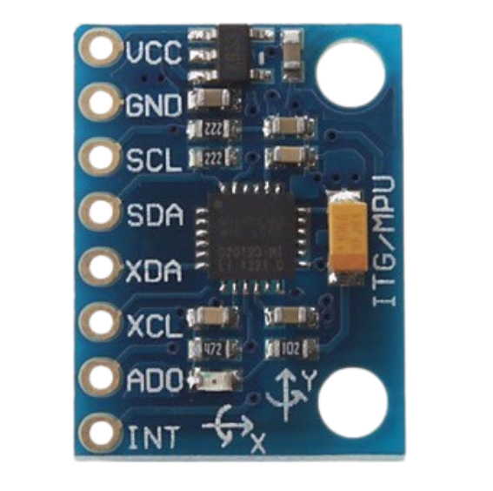
BACKGROUND INFORMATION
Arduino Microcontroller
Arduino Motor Shield
Gyro Sensor
Figure 4: Arduino Microcontroller Layout
Figure 5: Arduino Motor Shield Layout
Figure 6: Gyro Sensor

Slide 7
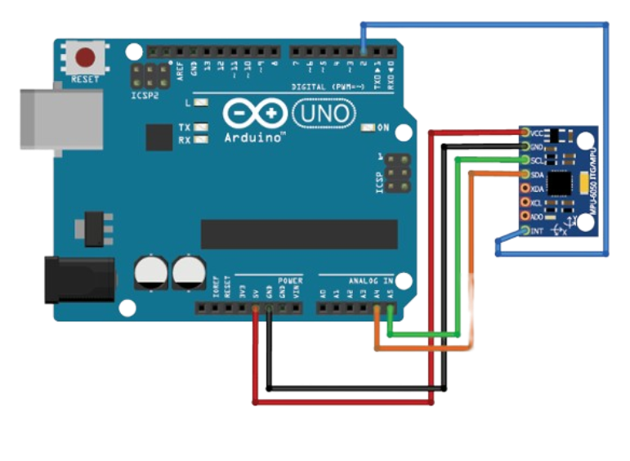
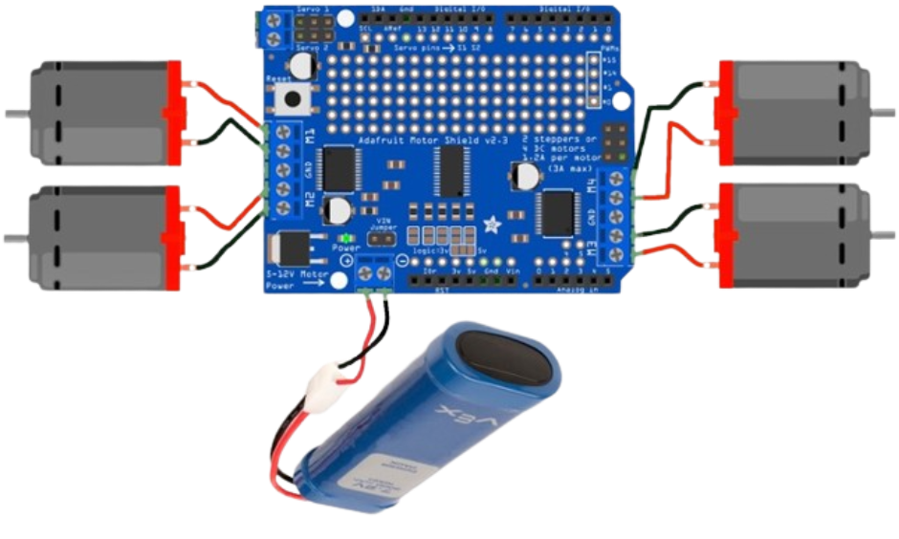
BACKGROUND INFORMATION
Motors and Battery Wiring
Gyro Wiring
Figure 7: Motors and Battery Wiring
Figure 8: Gyro Wiring

Slide 8
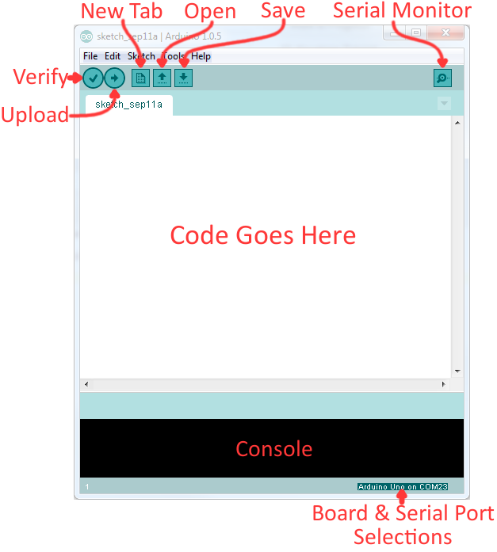
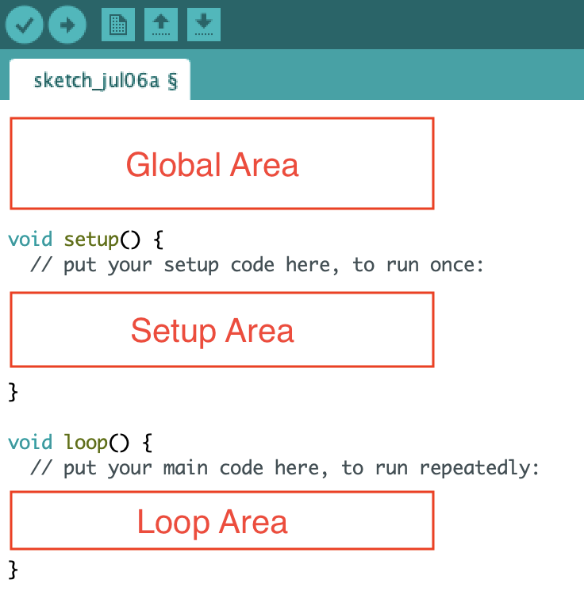
BACKGROUND INFORMATION
Arduino IDE – program to edit, compile, and upload code to the Arduino board
Code written in the Arduino programming language (based on C/C++)
VEX Library
Figure 9: Arduino IDE
7

Slide 9
BACKGROUND INFORMATION
Arduino IDE – program to edit, compile, and upload code to the Arduino board
Code written in the Arduino programming language (based on C/C++)
VEX Library

Slide 10
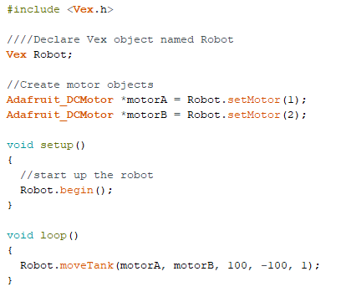
BACKGROUND INFORMATION
Order of Code:
  Import VEX Library
  Declare Object(s)
    Objects in the VEX Library include
      Vex Object
      Motor Objects
      Sensor Objects
  Call object functions to program the VEX Robot
    Each object type has different programmable functions that relate to their physical functions.
    Example: Robot.moveTank()
1
2
3
Figure 10: Example of Code in Arduino
8

Slide 11
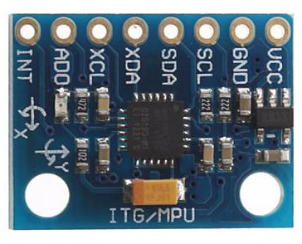
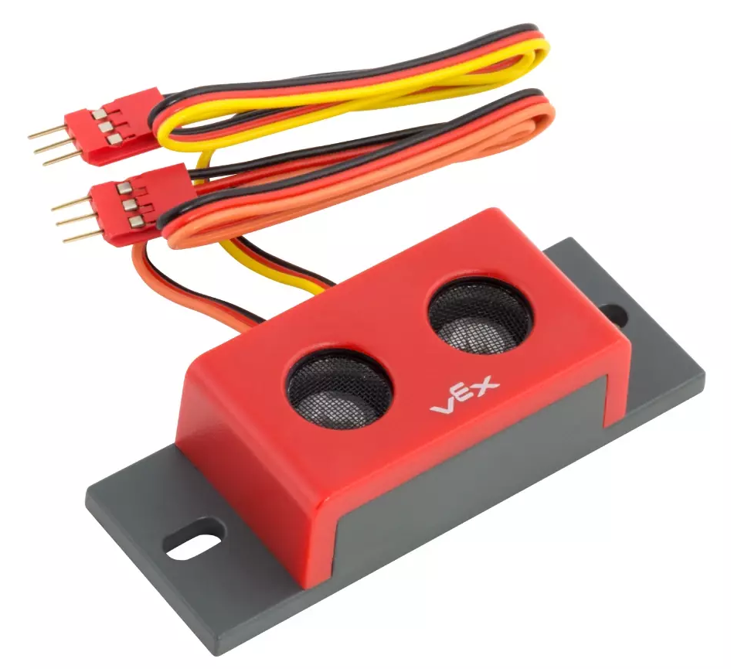
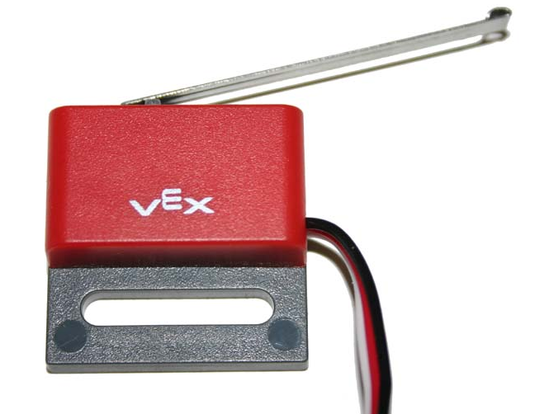
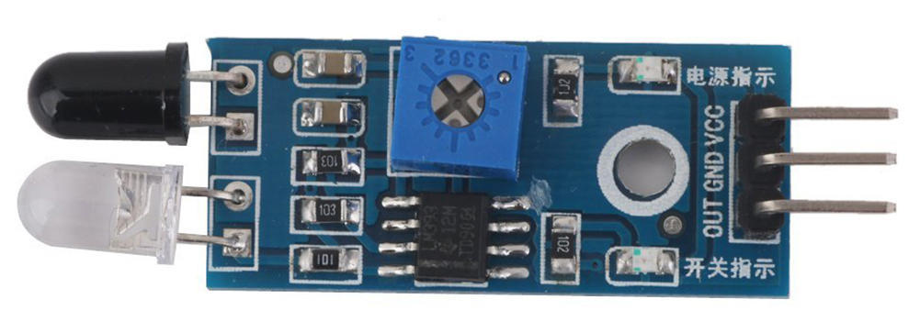
BACKGROUND INFORMATION
Sensor | Description | Picture
Gyro | Tracks the angle that the robot is turning or positioned at.
Ultrasonic | Determines how far the robot is from an obstacle. (returns the total distance)
Touch | Determines whether the robot is pressing against and obstacle or edge of the course.
IRObstacle | Detects if there are obstacles in the robot’s path. (returns HIGH if there’s an obstacle and LOW if there isn’t)
9

Slide 12
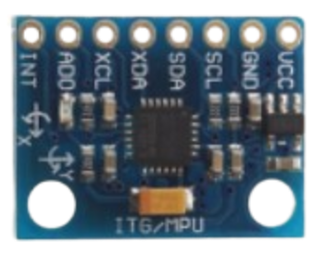
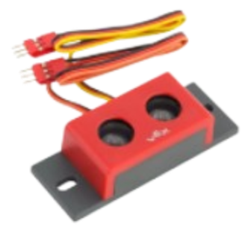
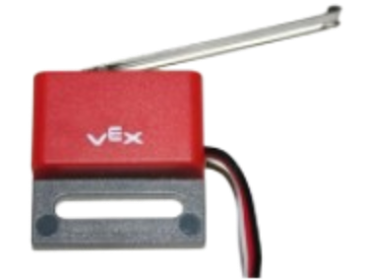
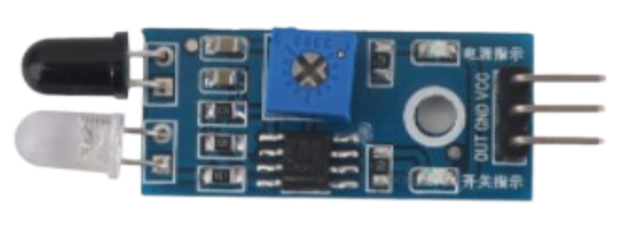
BACKGROUND INFORMATION
Gyro
Ultrasonic
Touch
IRObstacle
Determines how far the robot is from an obstacle. (returns the total distance)
Determines whether the robot is pressing against and obstacle or edge of the course.
Detects if there are obstacles in the robot’s path. (returns HIGH if there’s an obstacle and LOW if there isn’t)
Tracks the angle that the robot is turning or positioned at.

Slide 13
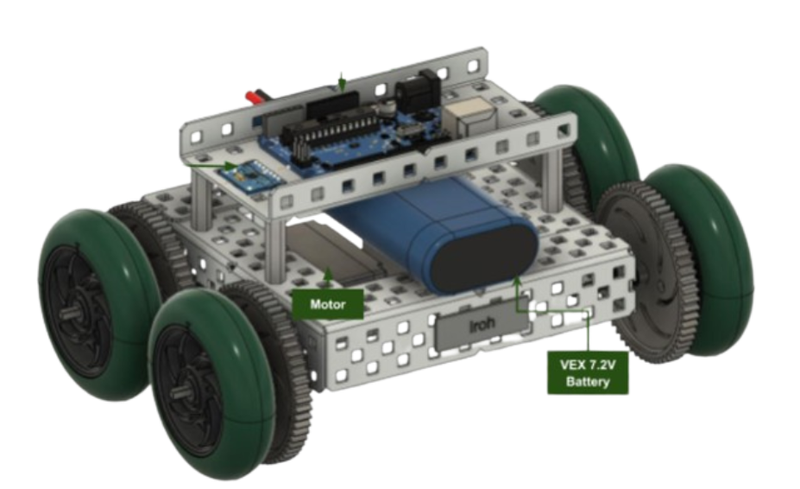
MATERIALS
A lab PC
Pre-built mini VEX robot
Mini VEX Course
Gyro Sensor
Arduino
Figure 11: Mini VEX robot

Slide 14
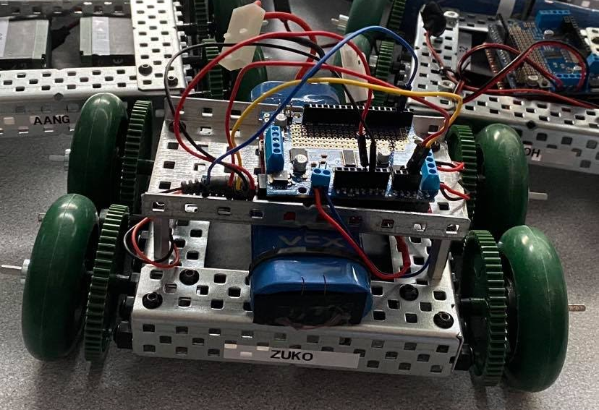
PROCEDURE
Part 1: Importing the Library
  Download and import the VEX Library into Arduino
Part 2: Setting up the VEX Robot Object
  Coding the robot to move forward
  Traverse tiles 1-4
Part 3: Setting up the Gyro Sensor Object
  Use gyro sensor to turn the robot
  Traverse tiles 4-5
Extra: Complete the Entire Course
  Traverse tiles 5-8
Figure 12: Mini VEX Robot

Slide 15
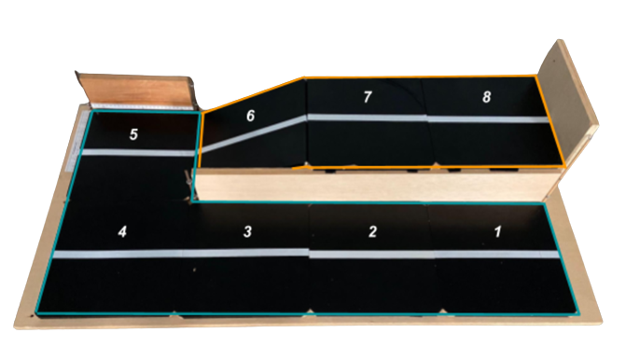
PROCEDURE
Figure 13: Mini VEX Course

Slide 16
PROCEDURE
Figure 13: Mini VEX Course

Slide 17
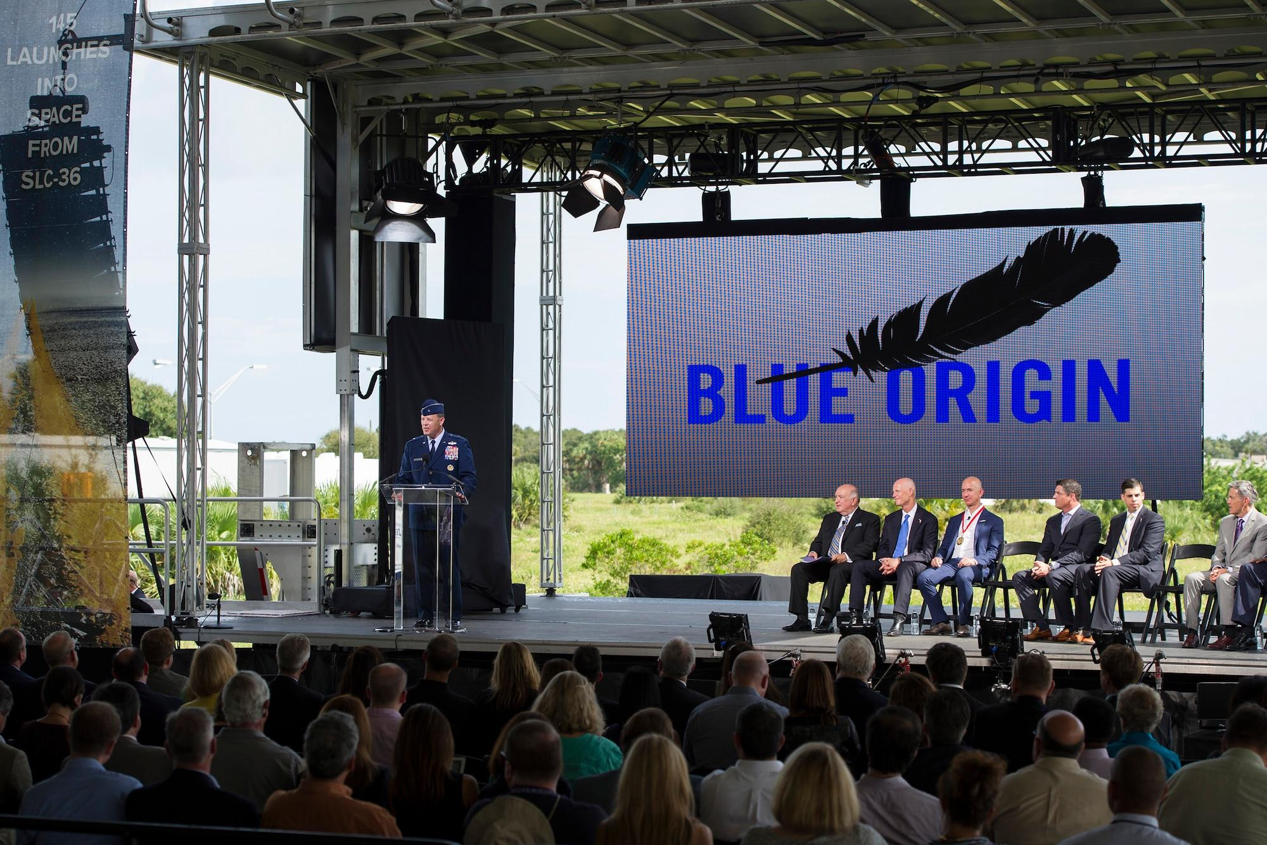
IDBE IMPLEMENTATION
Space Exploration and Colonization
  Exploration or exploitation?
  Right to alter landscape of other planets?
  High risk activity (causes body mass loss, sleeplessness, etc.)
  Causes pollution in space- what is our obligation to clean it up?
  Funded by governments and private businesses- should funds be used elsewhere?
Discuss other ethical dilemmas regarding space.
Figure 2: Jeff Bezos’ space exploration company Blue Origin

Slide 18
ASSIGNMENT
No lab report for lab 4
No presentation for lab 4

Slide 19
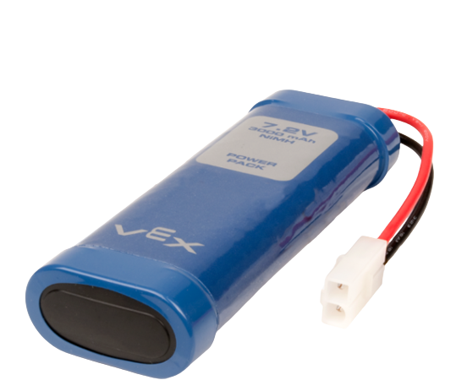
CLOSING
Ask TAs for help if needed
Only finish the entire course if time allows
Be careful not to go full power
Do not let any two exposed wires touch
Do not unplug the gyros or remove the motor shield
Disconnect the VEX battery when not in use
Figure 14: VEX Battery Courtesy of VEX Robotics

Slide 20
QUESTIONS?

Slide 21
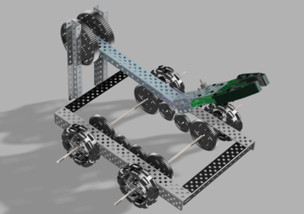
NEXT STOPS
Design and build the chassis of the robot
Design and build the claw (LAZ only)
Run test trials for sensor calibration
Draft the Preliminary Design Investigation (PDI) Report
Create a preliminary CAD drawing of the robot using Fusion 360
Begin working on the Milestone 1 Presentation
Figure 15: VEX LAZ Robot

