Slide 1

PROTOTYPING WITH MICROCONTROLLERS, SENSORS & MATERIALS (VIRTUAL)
EG1003 | LAB 5

Slide 2
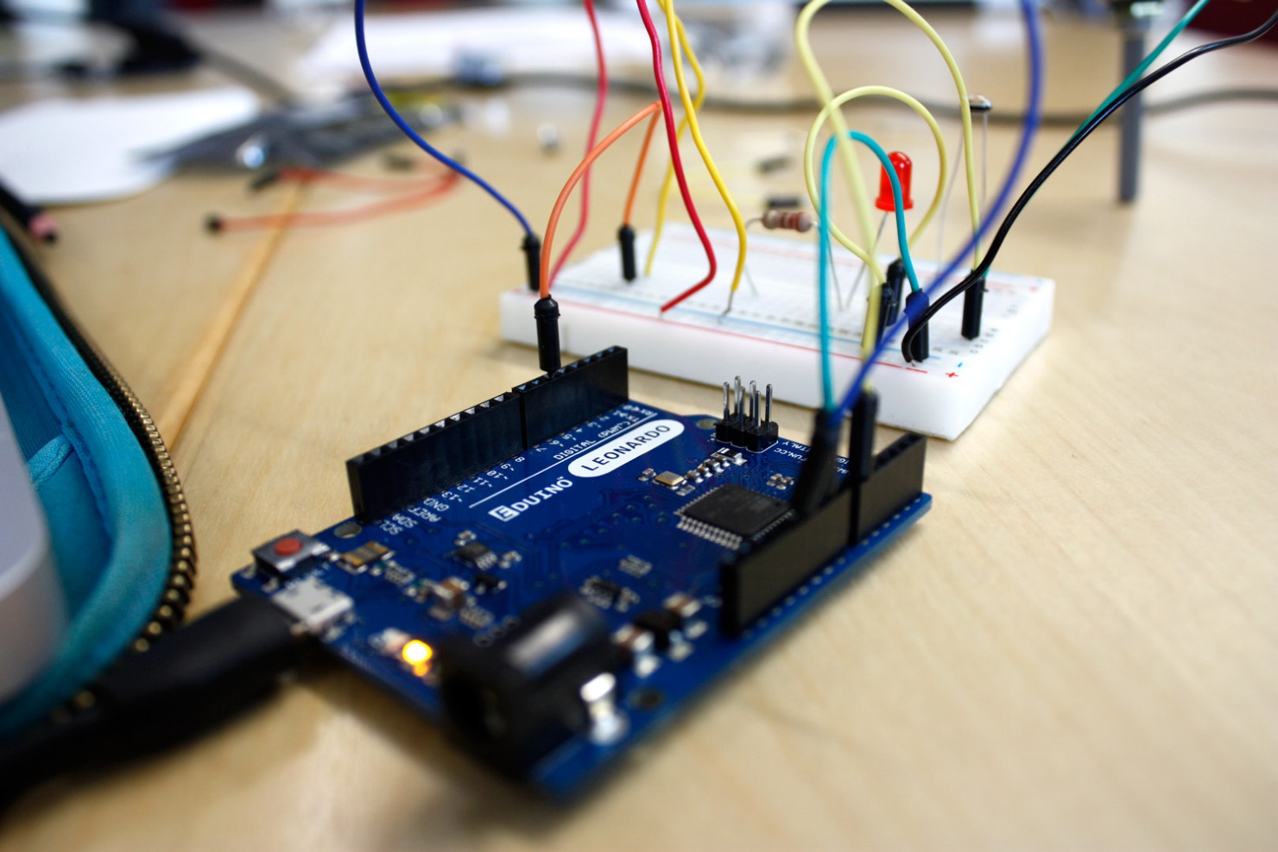
OVERVIEW
Objective
Background Information
Materials
Procedure
Assignment
Closing
Figure 1: Prototyping with Arduino Board
1

Slide 3
OBJECTIVE
Utilize electrical components, an Arduino board, and the Arduino IDE virtually in TinkerCAD to:
  Control an LED with and without a button
  Build a TMP 36 temperature sensing circuit
To analyze different designs for a device to slow the rate of heat loss
Use given data to evaluate the minimal design ratio of the designs
2

Slide 4
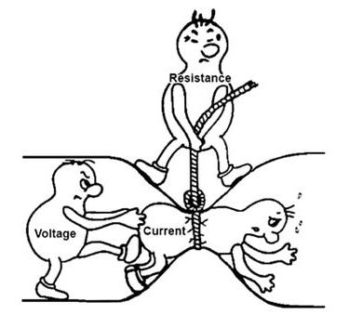
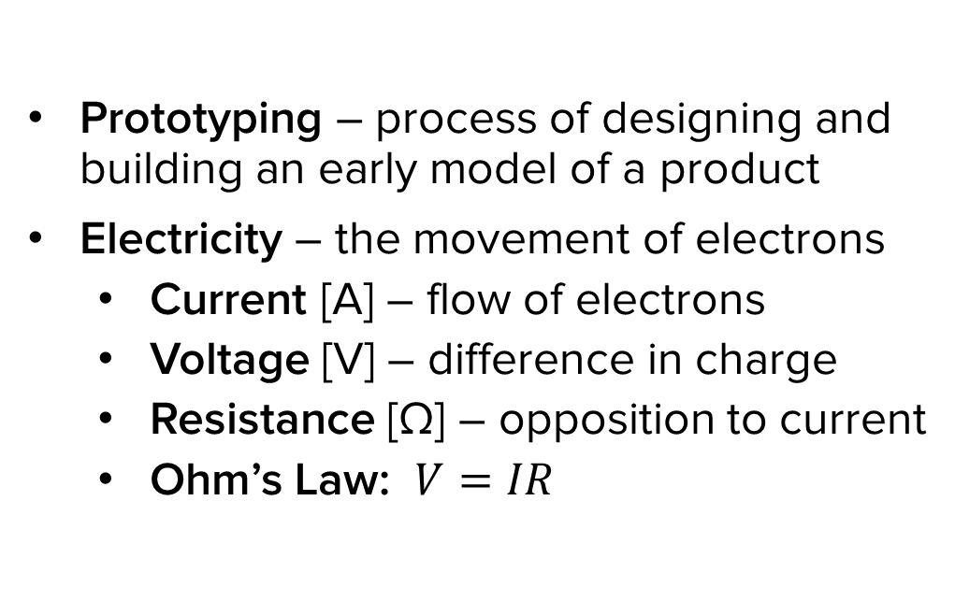
BACKGROUND INFORMATION
Prototyping – process of designing and building an early model of a product
Electricity – the movement of electrons
  Current [A] – flow of electrons
  Voltage [V] – difference in charge
  Resistance [Ω] – opposition to current
  Ohm’s Law: $V=IR$
Figure 2: Ohm’s Law Courtesy of Instructables
3

Slide 5
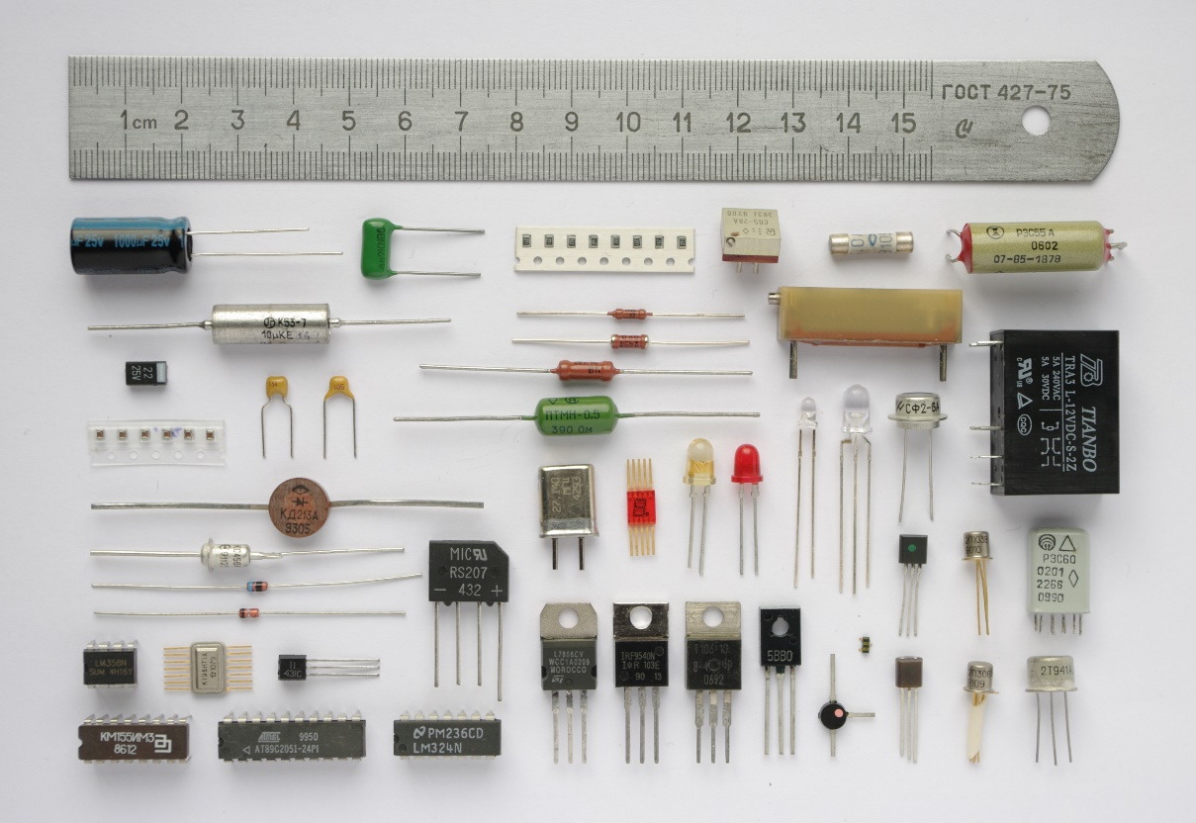
BACKGROUND INFORMATION
Common electrical components:
  Breadboards
  DC voltage sources
  Resistors
  Push-buttons and switches
  Diodes and transistors
  Light emitting diodes
Figure 3: Electrical Components Courtesy of Wikipedia
4

Slide 6
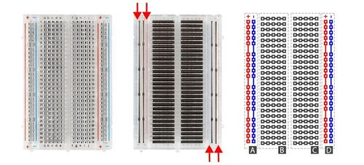
BACKGROUND INFORMATION
Breadboards
  Small boards used for circuit prototyping
  Allow temporary connection between circuit components
  Power rails connected vertically (Sections A & D)
  Non-colored rows connected horizontally (Sections B & C)
Figure 4: Breadboard Diagram
5

Slide 7
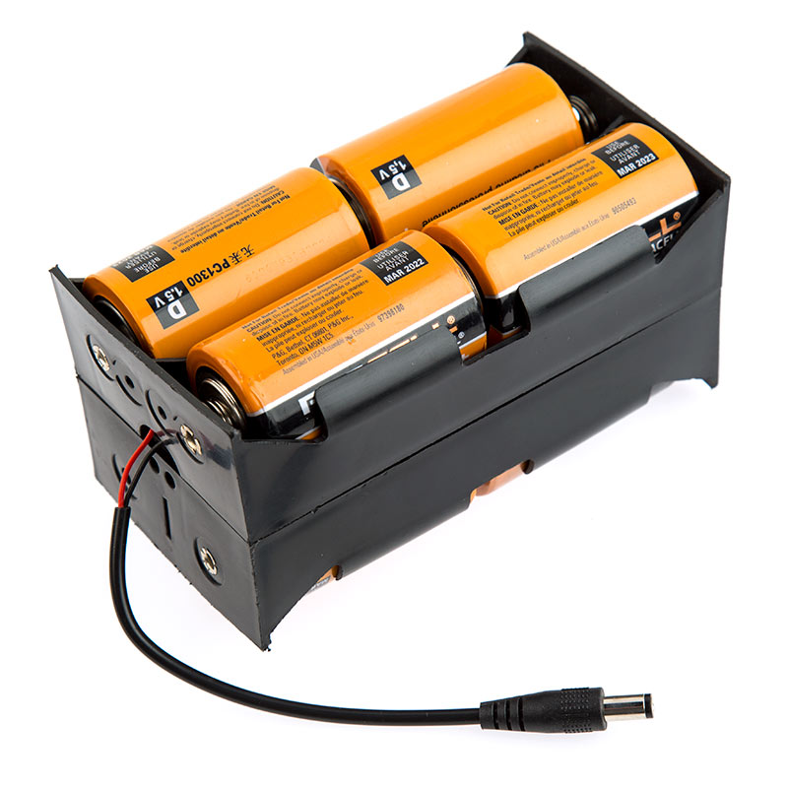
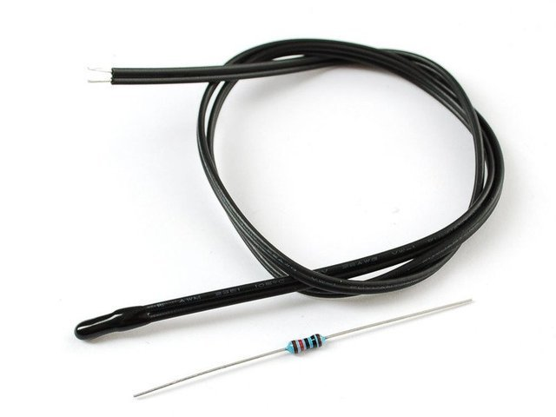
BACKGROUND INFORMATION
DC voltage sources – power circuits with voltage difference
Resistors – reduce the current flowing through a circuit
  Color-coded to indicate
  resistance value
  Thermistor – thermal resistor used to measure temperature
Figure 5: DC Voltage Source (Left),
Thermistor (Top Right), and Resistor (Bottom Right)
6

Slide 8
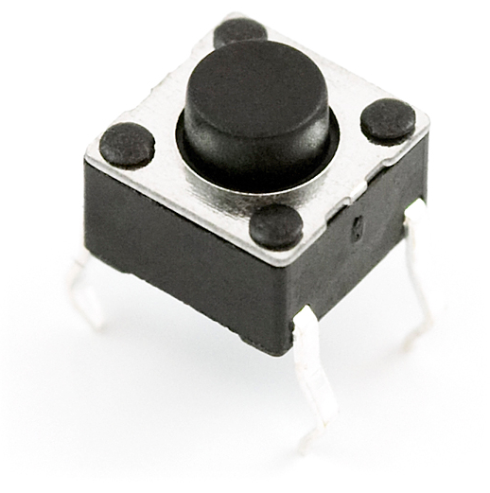
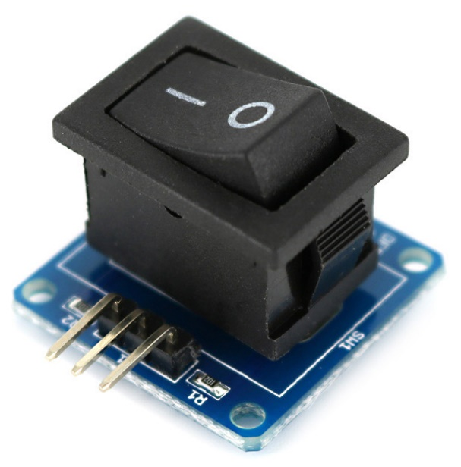
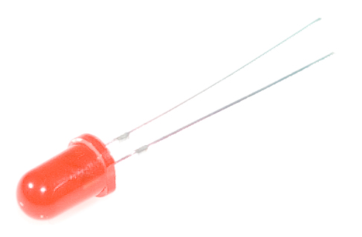
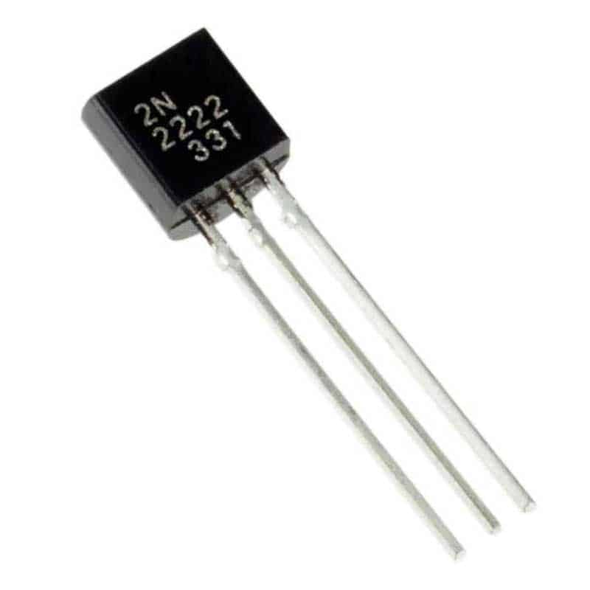
BACKGROUND INFORMATION
Push-buttons and switches – interrupt or divert current
Diodes and transistors – allow current to pass in only one direction
Light emitting diodes (LEDs) – diodes that use low voltage and current
Figure 6: Push-Button (Top Left), Switch (Top Right), LED (Bottom Left), and Transistor (Bottom Right)
7

Slide 9
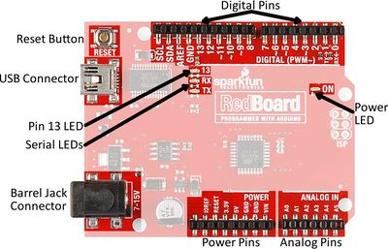
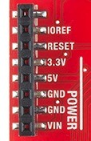
BACKGROUND INFORMATION
Microcontroller – inexpensive, programmable computer
  3.3V – typically used to power low-voltage sensors
  5V – most common power pin used to power circuits
  GND – ground pin (0 V)
  VIN – voltage-in can be used to power the board using a battery
Figure 7: Arduino RedBoard
8

Slide 10
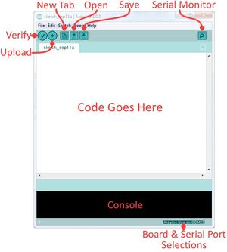
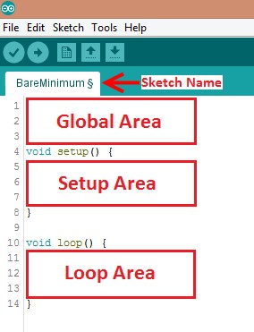
BACKGROUND INFORMATION
Arduino IDE – program to edit, compile, and upload code to the Arduino board
Code written in the Arduino programming language (based on C/C++)
In-program on TinkerCAD
Figure 8: Arduino IDE
9

Slide 11
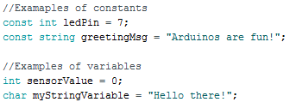
BACKGROUND INFORMATION
Datatypes – different kinds of data values
  e.g. int, double, char
Operators – perform operations on variables and constants
  e.g. +, =, ==, <=
Variables and constants – hold data according to datatype
Figure 9: Examples of Constants and Variables
10

Slide 12
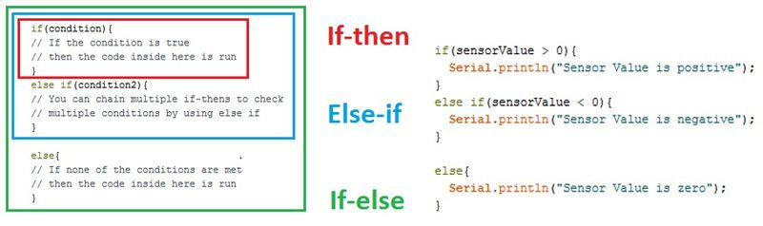
BACKGROUND INFORMATION
Conditional statements – run code enclosed by curly brackets when condition is met
Figure 10: Conditional Statements
11

Slide 13
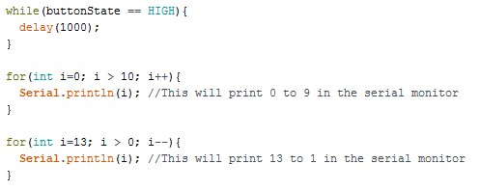
BACKGROUND INFORMATION
Loops – runs section of code repeatedly
  While loops – runs code until the end condition is met
  For loops – runs code for a specific number of times
Figure 11: While and For Loops
12

Slide 14

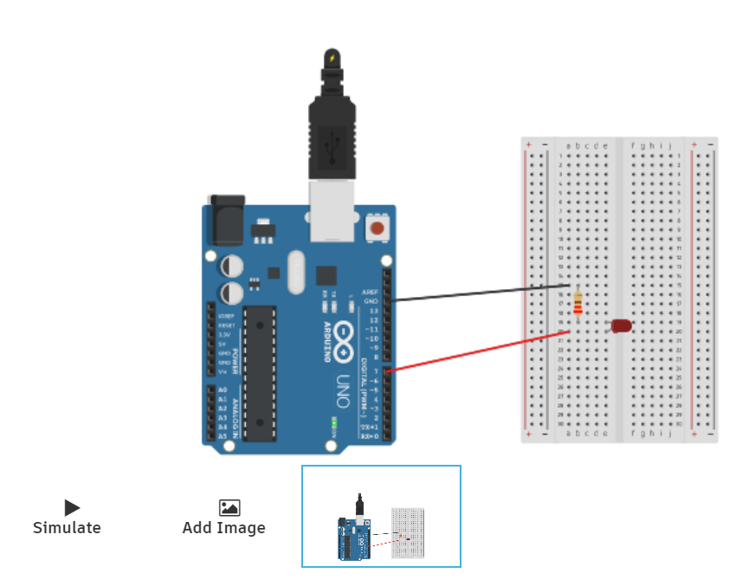
BACKGROUND INFORMATION
TinkerCAD
  www.tinkercad.com
    Log-in with Autodesk account
  Cloud-based 3D modeling software
  Used to create CAD models, simulate circuitry, and code virtually
Figure 12: Example TinkerCAD Template
13

Slide 15
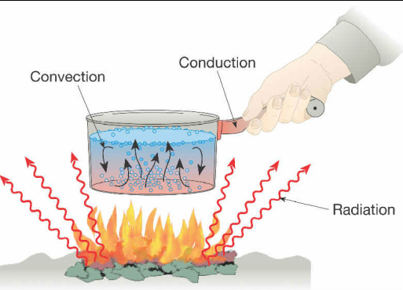
BACKGROUND INFORMATION
Heat – form of energy
Heat transfer – process of thermal energy moving from one body to another
  Conduction – through solids
  Convection – within a fluid medium (liquid or gas)
  Radiation – emitted energy in all directions with or without a medium
Figure 13: Modes of Heat Transfer Courtesy of
Mr. Oey’s Science Classes
14

Slide 16
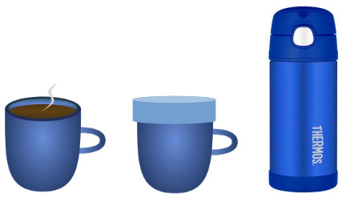
BACKGROUND INFORMATION
Thermodynamic system – defined area in the Universe separated by a boundary
  Open – transfers mass and heat
  Closed – only transfers heat
  Isolated – cannot transfer mass or heat
Figure 14: Open (Left), Closed (Center), and
Isolated (Right) Systems Courtesy of x-engineer.org
15

Slide 17
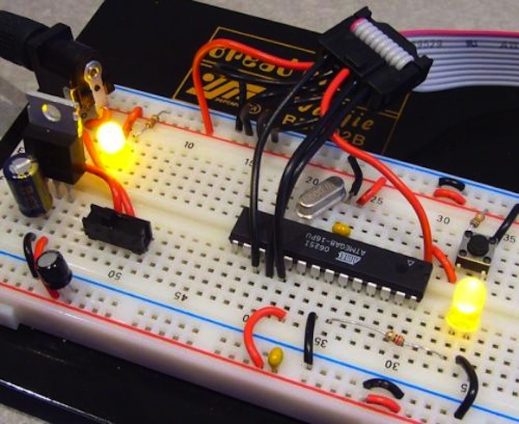
MATERIALS
Parts in TinkerCAD:
  Arduino UNO microcontroller
  TinkerCAD Code block with Arduino IDE
  Breadboard
  Wires
  220 Ω resistor
  10 kΩ resistor
  LED
  Push-button
  TMP 36 sensor
Figure 15: Prototyping with Breadboard
Courtesy of SparkFun
16

Slide 18
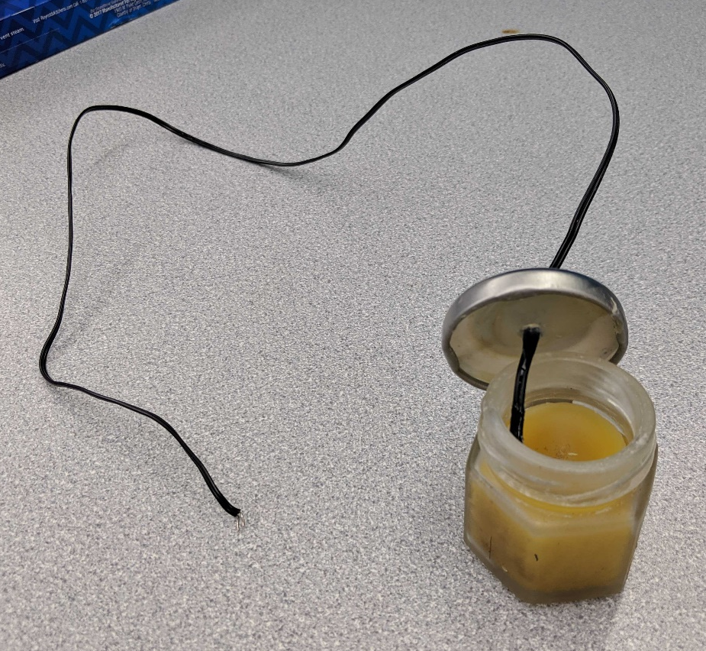
PROCEDURE
Part 1: Build an LED circuit in TinkerCAD
Part 2: Add a button to control the LED in TinkerCAD
Part 3: Thermal insulation device data analysis
  In-person, goal is to slow heat loss from a heated jar of beeswax
  Build circuit and add code for TMP 36 sensor in TinkerCAD to measure temperature of beeswax
  Perform data analysis for given data for various thermal insulating device designs
Figure 16: Jar of Beeswax
with Thermistor
17

Slide 19
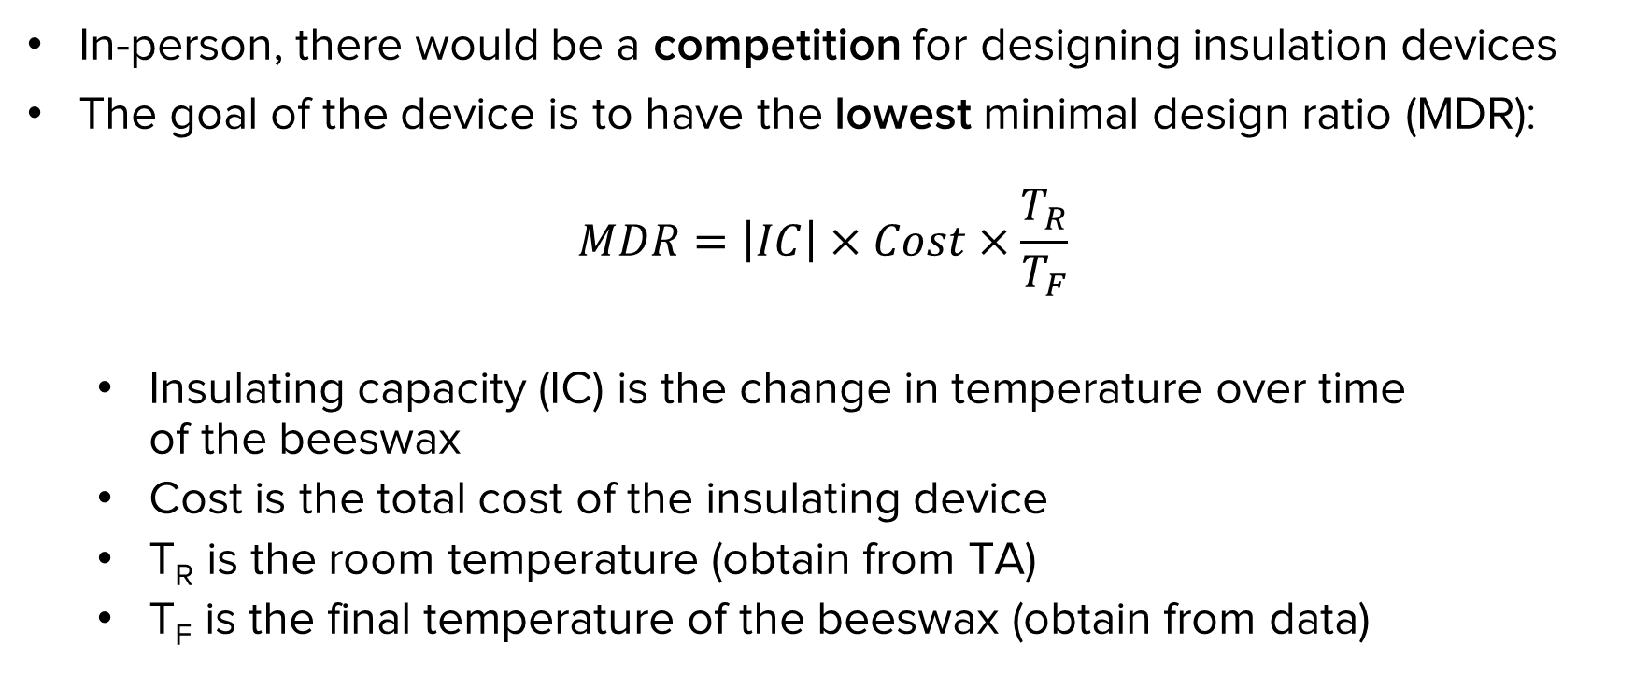
PROCEDURE
In-person, there would be a competition for designing insulation devices
The goal of the device is to have the lowest minimal design ratio (MDR):
$$MDR=\left|IC\right|×Cost×\frac{T_{R}}{T_{F}}$$
  Insulating capacity (IC) is the change in temperature over time
  of the beeswax
  Cost is the total cost of the insulating device
  T_{R} is the room temperature (obtain from TA)
  T_{F} is the final temperature of the beeswax (obtain from data)
18

Slide 20
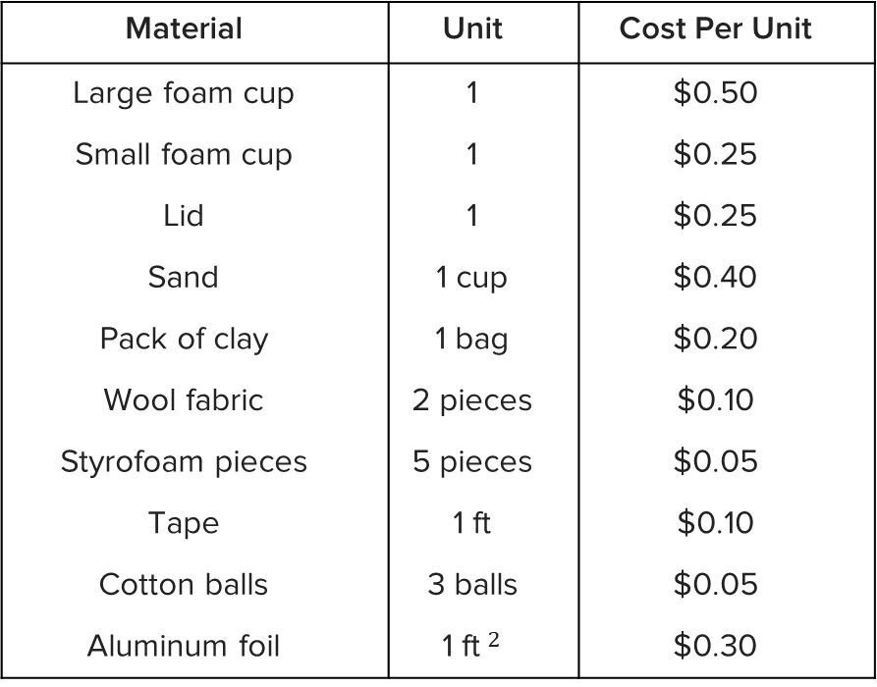
PROCEDURE
Material | Unit | Cost Per Unit
Large foam cup | 1 | $0.50
Small foam cup | 1 | $0.25
Lid | 1 | $0.25
Sand | 1 cup | $0.40
Pack of clay | 1 bag | $0.20
Wool fabric | 2 pieces | $0.10
Styrofoam pieces | 5 pieces | $0.05
Tape | 1 ft | $0.10
Cotton balls | 3 balls | $0.05
Aluminum foil | 1 ft$^{2}$ | $0.30
Table 1: Material Costs for Thermal Insulation Device Competition
19

Slide 21
PROCEDURE
Extra credit option:
  Design a thermal insulation device from materials at home
  If you don’t have the materials, try to make reasonable replacements
    Ex: Paper towels instead of wool fabric
  You can use materials not listed and approximate the price based on those in Table 1
    Don’t exaggerate the prices
  Explain why your design would be competitive
  Must include pictures of design sketch, cost table, and prototype in assignment
20

Slide 22
ASSIGNMENT
Individual lab report:
  Answer discussion questions in manual
  Include original graph (temperature vs. time) of insulating device
  Provide minimal design ratio calculation
  Provide price list and design improvements
  Due at 11:59 PM the night before Lab 6
Team presentation:
  Address discussion points in manual
  Describe the design of the insulating device
21

Slide 23

CLOSING
Be sure to compare results between different designs
Submit all work electronically
Take screenshots of the virtual circuitry and temperature vs. time graph
22

Slide 24
SOFTWARE FOR NEXT LAB
In preparation for the next virtual lab, download these software ahead of time:
  Autodesk Fusion 360 (BMD & RAD Groups)
  Autodesk Revit (HIR Groups)
  Fritzing (BMD & RAD Groups)
22

Slide 25
QUESTIONS?

