Slide 1
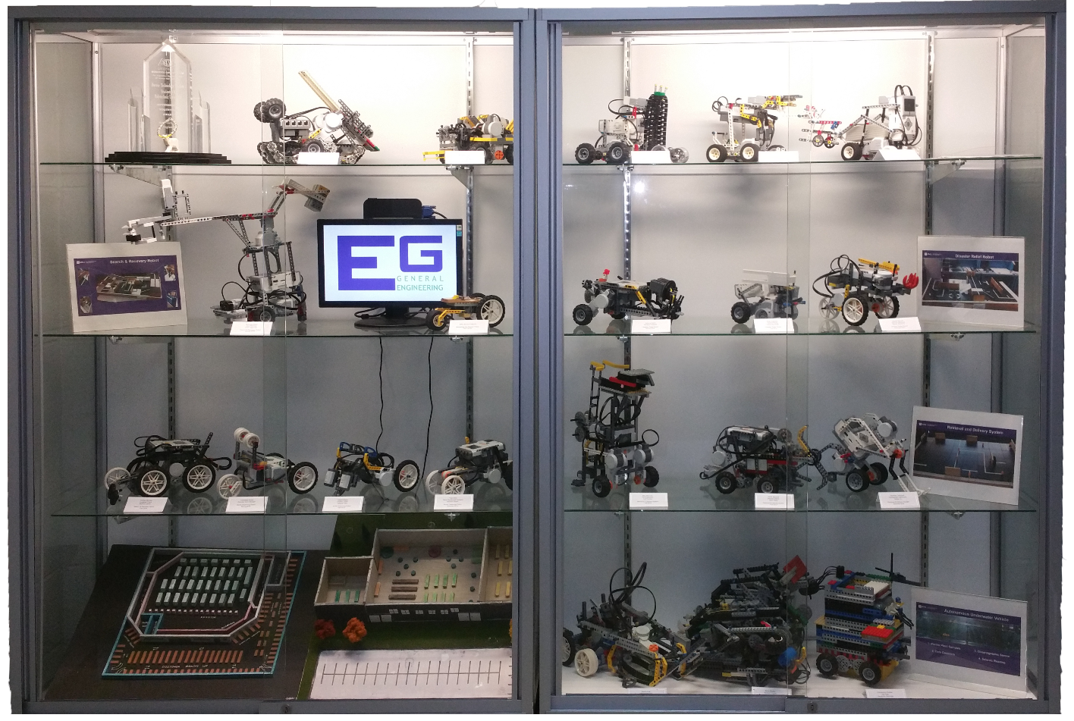


Nick Russo Awards
Nick Russo Awards presented for innovative design during Convocation

Slide 2
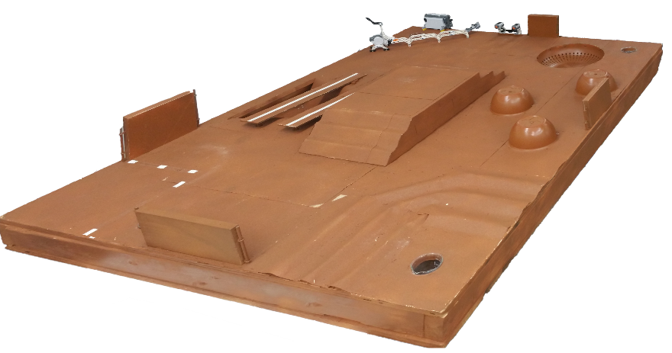
Semester-Long Design Project Options
Mars Rover Robot (MRR)
Retrieve and analyze water salinity readings to determine if life can exist on Mars
Notes:
Mention that it is our latest addition to the robot options

Slide 3
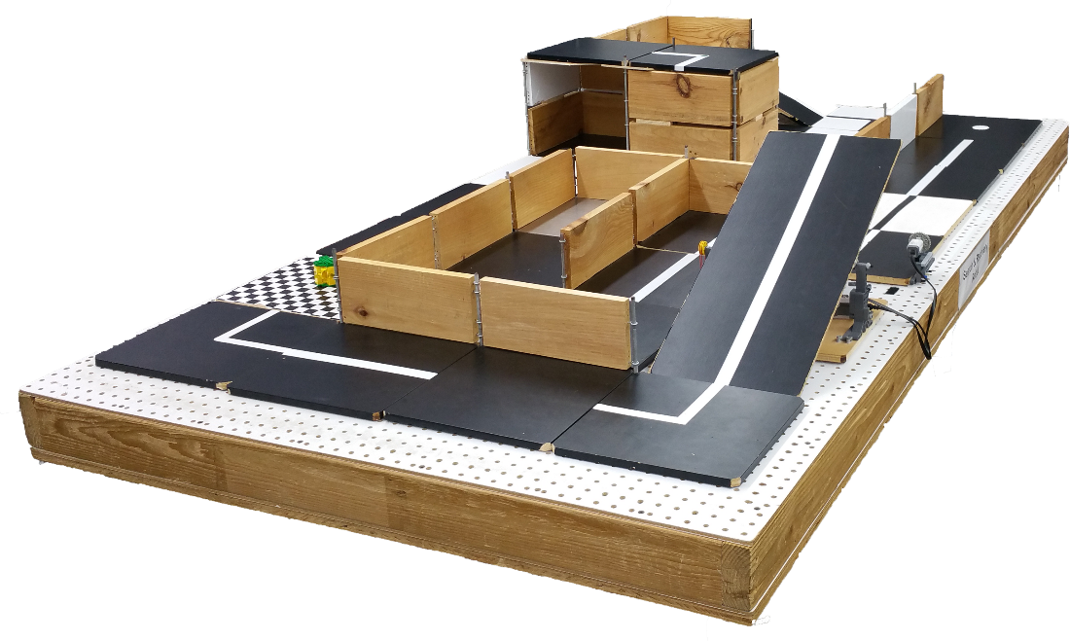
Semester-Long Design Project Options
Search & Recovery Robot (SRR)
Retrieve lost space module from moon and return safely

Slide 4
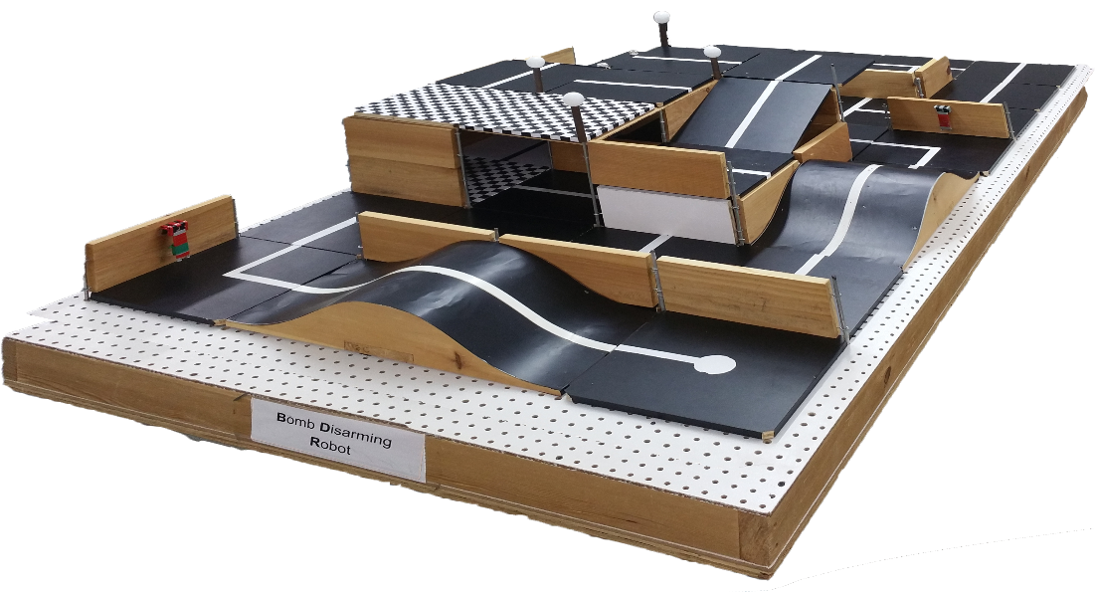
Semester-Long Design Project Options
Bomb Disarming Robot (BDR)
Safely navigate the course to deactivate a bomb, while avoiding decoys

Slide 5
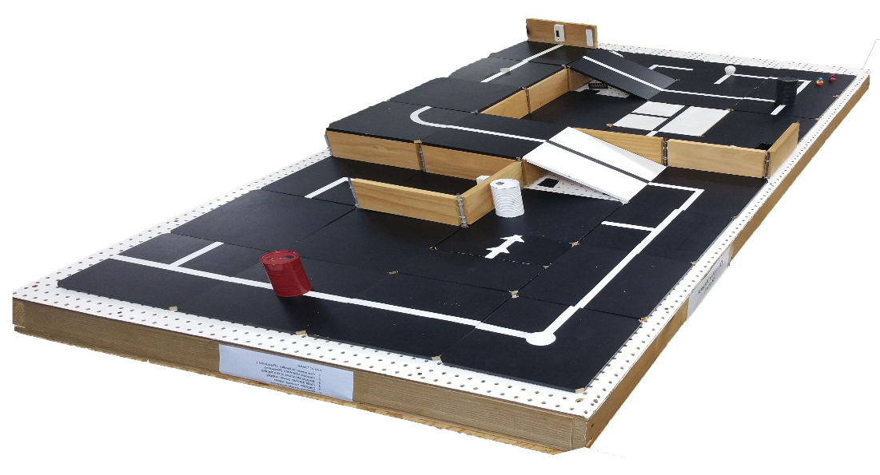
Semester-Long Design Project Options
Disaster Relief Robot (DRR)
After tragedy strikes, clean the affected area, rescue workers, and remove hazardous waste

Slide 6
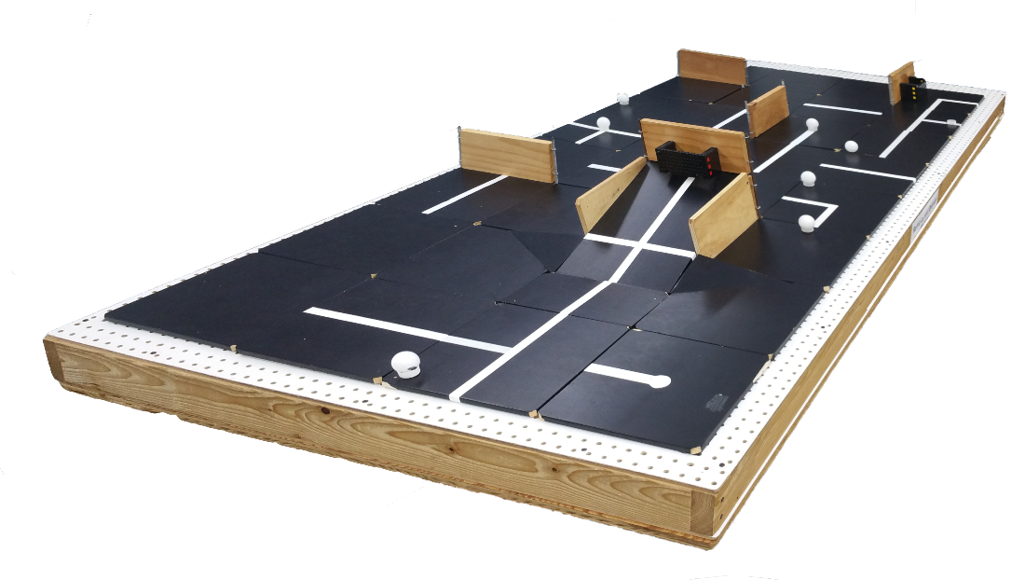
Semester-Long Design Project Options
Retrieval & Delivery System (RDS)
Collect and deliver “fuel cells” to power three different hospitals

Slide 7
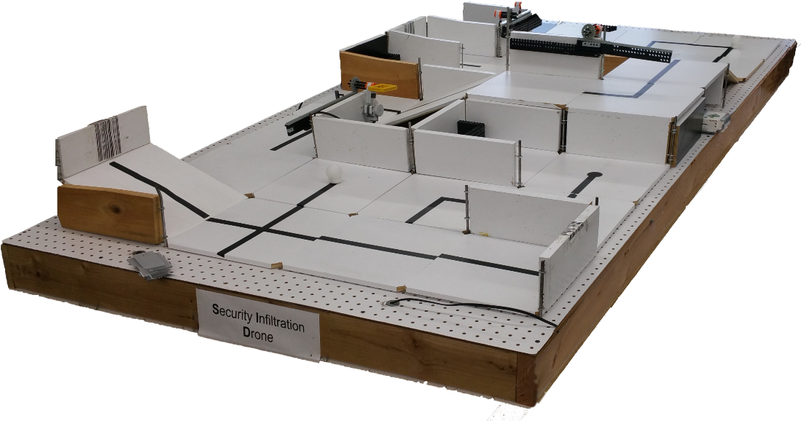
Semester-Long Design Project Options
Security Infiltration Drone (SID)
Open gates using barcodes to enter enemy headquarters, retrieve data canister and deliver canister to extraction point

Slide 8
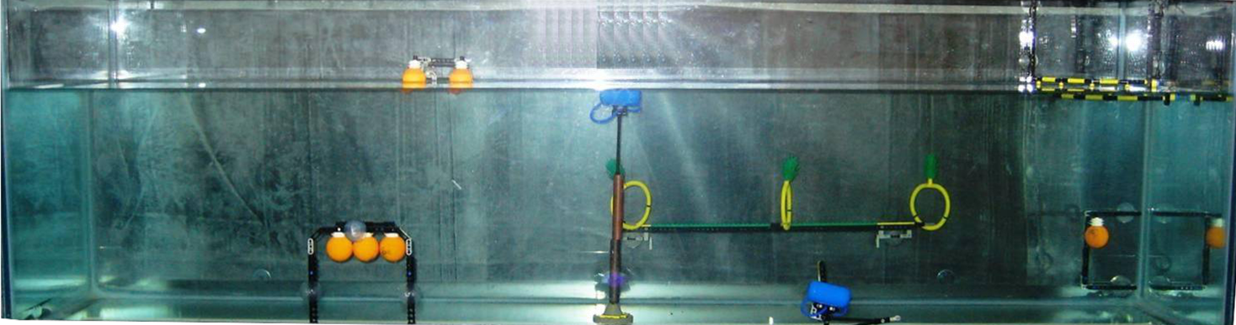
Semester-Long Design Project Options
Autonomous Underwater Vehicle (AUV)
Functions underwater to collect canisters,
release marine samples, and plug oil spill

Slide 9
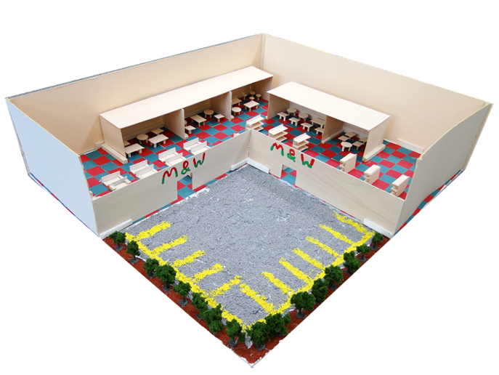
Semester-Long Design Project Options
Supermarket Logistics System (SLS)
Design a customer friendly supermarket through the use of AutoCAD

Slide 10
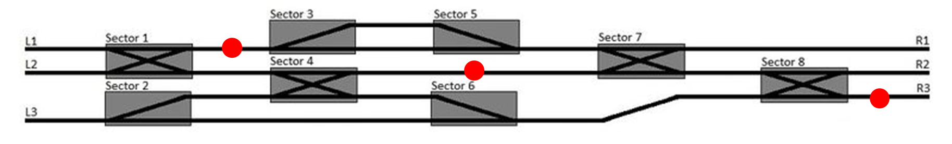
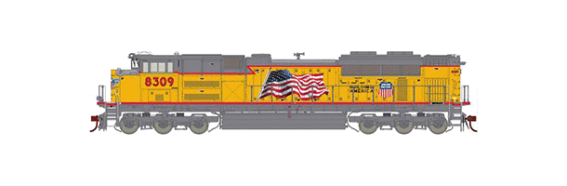
Semester-Long Design Project Options
Railroad Train Guidance System (RTGS)
Design a logic system to avoid obstacles by selecting an optimal path
Railroad Train Guidance System (RTGS)
Design a logic system to avoid obstacles by selecting an optimal path

