Slide 1

SUSTAINABLE ENERGY VEHICLE COMPETITION
EG1003 | LAB 7

Slide 2
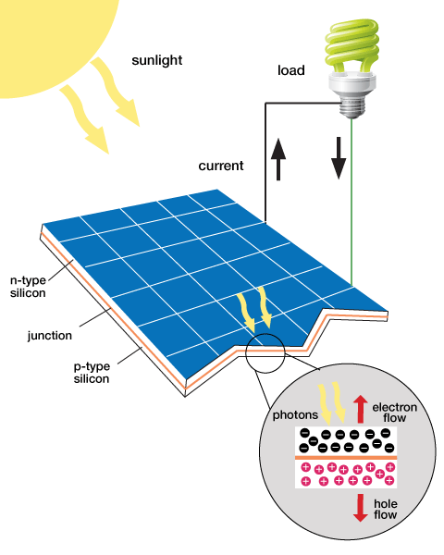
OVERVIEW
Objective
Background Information
Materials
Procedure
Assignment
Closing
1

Slide 3
OBJECTIVE
Learn about the capabilities of solar panels and wind turbines
Test the capabilities of capacitors
Design a sustainable energy car to compete against other groups
2

Slide 4
BACKGROUND INFORMATION
Renewable energy
Solar panels
Wind-turbine technology
Electronic components
3

Slide 5
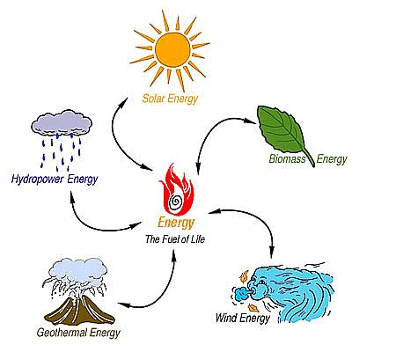
BACKGROUND INFORMATION
Renewable energy
  Harnessed from natural resources
  Clean energy sources
  Sources for energy are abundant
  in supply^{[1]}
Figure 1: Different types of renewable energy
4

Slide 6
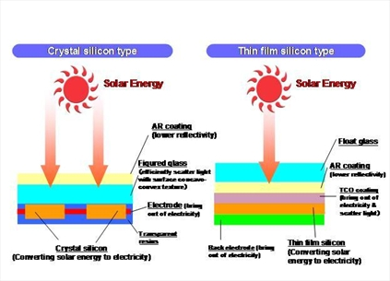
BACKGROUND INFORMATION
Solar panels
  Made from silicon or copper indium gallium (di)selenide (CIGS)
  Converts sunlight to electrical current
  Absorbed sunlight excites electrons to allow freedom of motion (generates an electric current)^{[2]}
Figure 2: Solar panel
5

Slide 7
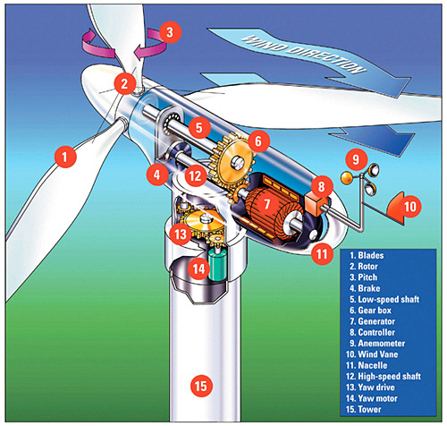
BACKGROUND INFORMATION
Wind turbine energy
  Use pressure difference generated by
  the wind to spin the turbine blades
  Converts mechanical energy into
  electrical energy
  The wind vane is used to determine the direction the wind-turbine will face^{[3]}
Figure 3: Wind turbine
6

Slide 8
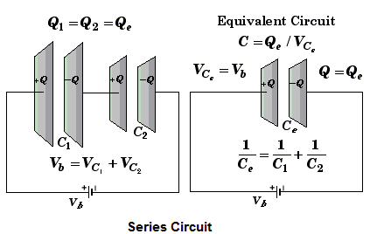
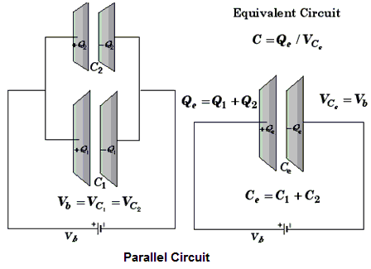
BACKGROUND INFORMATION
Capacitors
  A capacitor is an electrical device used to store charge
  Capacitors can be connected in parallel (increases charge stored) and in series (increases voltage stored)^{[5]}
  Store electrical energy
  1 F (Farad) polarized capacitor
Figure 5: Series circuit (above) & parallel circuit (below)
7

Slide 9
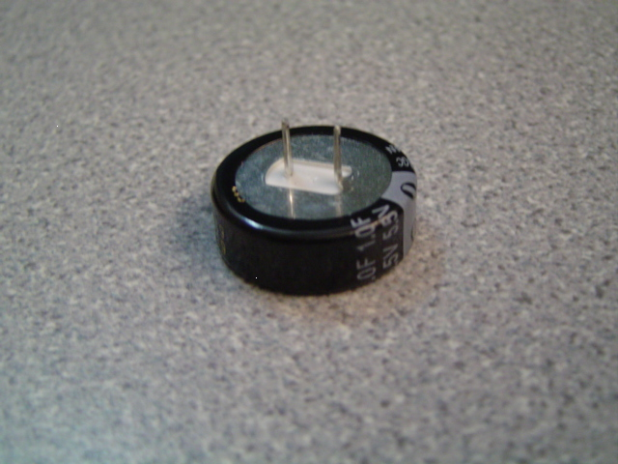
BACKGROUND INFORMATION
  Store electrical energy
  1 F (Farad) polarized capacitor
Positive
Negative
Figure 4: Capacitor
8

Slide 10
BACKGROUND INFORMATION
Capacitor charging
  Capacitor charge limit is restricted by charge voltage
  Maximizing applied voltage maximizes energy stored
  Capacitor is charged in time increments called the time constant (tau):
τ = RC
R = resistance, C = capacitance
9

Slide 11
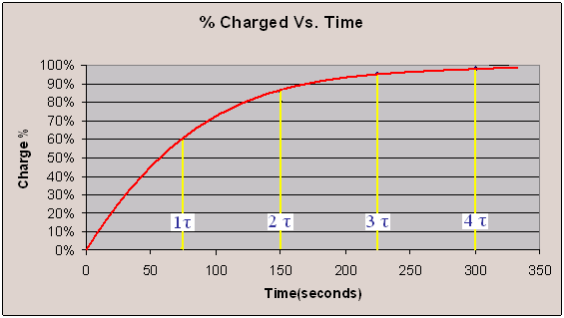
BACKGROUND INFORMATION
Percentage charged
  Charge is logarithmic
  It takes approximately 4τ to charge the capacitor
Figure 5: Percentage charge vs. Time graph
10

Slide 12
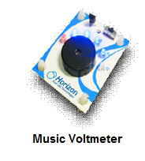
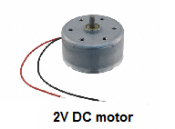
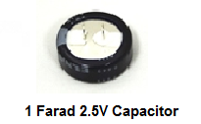
MATERIALS
Horizon Wind-Turbine
Solar Battery Panels
Adjustable Table fan
Heat Lamp
DMM (Digital Multi-meter)
Music Voltmeter
3V DC Motor
1 Farad 2.5V Capacitor
Alligator cable sets
Standard Lego Car Chassis plus Lego parts kit
Mini Electric propeller
LED (Light Emitting Diode)
Lego to Alligator Cable Clip Connector
Scissors
Tape
11

Slide 13
MATERIALS
Price List
  Horizon Wind-Turbine ($7.50/each)
  Solar Battery Panels ($10.00/each)
  1 Farad 5.5V Capacitor ($3.00/each)
  Alligator cable sets ($0.50/each pair)
  Lego to Alligator Cable Clip Connector ($0.10/each)
  Duct Tape ($0.10/feet)
12

Slide 14
PROCEDURE
Part 1: Test the power storage device
  Capacitor
Part 2: Test the assigned power source using music voltmeter
  Solar panel
  Wind turbine
Part 3: Design a sustainable energy car using the power source of your choice and capacitors
13

Slide 15
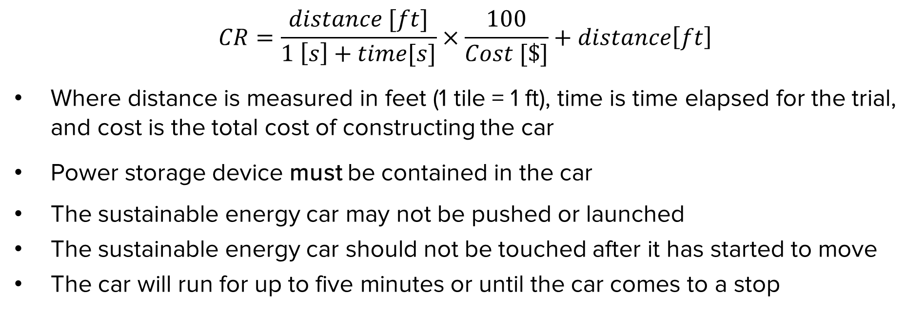
COMPETITION RULES
$$CR=\frac{distance [ft]}{1 \left[s\right]+time[s]}×\frac{100}{Cost [\$]}+distance\left[ft\right]$$
Where distance is measured in feet (1 tile = 1 ft), time is time elapsed for the trial, and cost is the total cost of constructing the car
Power storage device must be contained in the car
The sustainable energy car may not be pushed or launched
The sustainable energy car should not be touched after it has started to move
The car will run for up to five minutes or until the car comes to a stop
14

Slide 16
ASSIGNMENT
Team lab report:
  Title page
  Discussion of topics in the manual
  Include a picture of your vehicle
  Scan in lab notes (ask TA for assistance)
  TA must initial that table and graph were completed
15

Slide 17
ASSIGNMENT
Team presentation:
  State rules of competition
  Describe your design and its concept
  Include table of class results, cost and photo/video of design
  How could your current design be improved?
  Refer to “EG1003 Lab Presentation Format” found on
  EG website
16

Slide 18
CLOSING
Have all original data signed by TA
Submit all work electronically
Clean up workstations
Return all materials to TA
17

Slide 19

QUESTIONS?

