Slide 1

RECITATION 10
EG1004

Slide 2
AGENDA
Career Building
Activity: Elevator Pitches
Resumes Revisited
Milestone 3 Presentations
Design Pitch Activity
1

Slide 3
CAREER BUILDING

Slide 4
TOP PAYING MAJORS
1. Computer Science
Median Base Salary: $70,000
Popular Entry-Level Jobs:
Software Engineer, Systems Engineer, Web Developer
2. Electrical Engineering
Median Base Salary: $68,438
Popular Entry-Level Jobs:
Electrical Engineer, Systems Engineer, Software Developer
3. Mechanical Engineering
Median Base Salary: $68,000
Popular Entry-Level Jobs:
Mechanical Engineer, Design Engineer, Project Engineer
4. Chemical Engineering
Median Base Salary: $65,000
Popular Entry-Level Jobs:
Chemical Engineer, Process Engineer, Project Engineer
5. Industrial Engineering
Median Base Salary: $64,381
Popular Entry-Level Jobs:
Industrial Engineer, Quality Engineer, Production Planner
6. Information Technology
Median Base Salary: $64,008
Popular Entry-Level Jobs:
Programmer Analyst, Technical Support, Systems Engineer
7. Civil Engineering
Median Base Salary: $61,500
Popular Entry-Level Jobs:
Civil Engineer, Structural Engineer, Field Engineer
8. Statistics
Median Base Salary: $60,000
Popular Entry-Level Jobs:
Data Analyst, Statistician, Data Scientist
9. Nursing
Median Base Salary: $58,928
Popular Entry-Level Jobs:
Registered Nurse, Licensed Vocational Nurse, Case Manager
10. Management Information Systems
Median Base Salary: $58,000
Popular Entry-Level Jobs:
Network Administrator, Help Desk Analyst, Business Analyst
Learn More
3
Notes:
According to an article written by GlassDoor in 2018.

Slide 5

HOW TO GET A JOB
Tandon Career Services
  Tandon Career Fair
  Tandon Resources
The Wasserman Center | Brooklyn
  NYU Handshake
LinkedIn, Glassdoor
Figure 1: Wasserman Center location -- Wunsch Hall in MetroTech courtyard
4

Slide 6
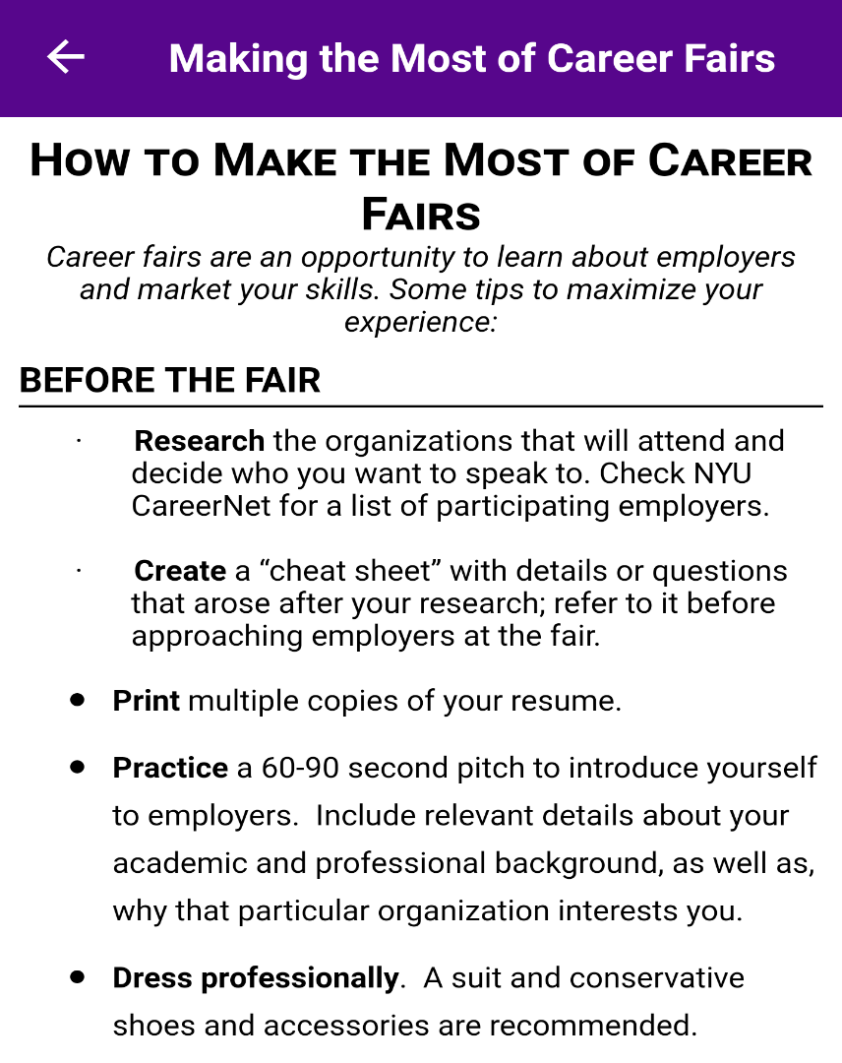


TANDON CAREER FAIR
Figures 2 & 3: Tandon Career Fair logo and tips
5

Slide 7
TYPES OF COMPANIES
Public
  Government – city, state, federal, and international
Private
  Consultant – design, analysis, modeling
  Contractor – construction & manufacturing
  Research & development: products, software
  Managerial, sales, non-profits
  Tech leaders & tech startup
Figure 4: Public vs private graphic courtesy of
EDUCBA
6

Slide 8
TYPES OF JOBS
Internships, Co-Ops
  Your number 1 priority!
Teaching Assistant
  EG 1004 Intro to Engineering
  MakerSpace
  Other Tandon courses
  K-12 summer STEM programs
Research Assistant
  Undergraduate Summer Research
  5 to 10 hours per week during semester
Future Labs Intern
  12 hours per week, 3 credits
7

Slide 9
RESUME BUILDING
Include examples that set you apart
Focus on your
  Work ethic and being detail oriented
  Networking and professional societies
Keep it concise (ONE PAGE )
Sections
  Education, Experience, Skills, Awards, Activities
8

Slide 10
PROFESSIONAL EMAILS
Opening Salutations – “Dear Ms. Williams,”
Put your name in the subject (and everywhere)
  Doe, Jane Application
Your email should be firstname.lastname@nyu.edu
Proofread
  Complete sentences & proper grammar
  Do not add email address until you proofread
Closing Salutations – “Thank you for your consideration,”
Attachment names
  Use your name: Doe, Jane Resume.pdf
Always Reply All on Emails!
Link to change NYU email alias
9

Slide 11
ACTIVITY

Slide 12
ACTIVITY
DEVELOP AN ELEVATOR PITCH
Imagine you are talking to a recruiter from your favorite company at a career fair & use your EG 1004 project to sell yourself.
11
Notes:
**Give the partners several minutes to complete the activity. Ask one or two members to share if desired.**

Slide 13
Design Pitch Exercise
CATME Peer Evaluations II
Cover Letter
MILESTONE 3 CHECK

Slide 14
CRAFT YOUR DESIGN PITCH

Slide 15
DESIGN PITCH
What are you trying to do?
NO JARGON
What are the limits of current practice?
What’s new in your approach?
Who cares?
What impact will success have?
What are the risks and payoffs?
How much will it cost?
How long will it take?
How will success be measured?
11
Notes:
**Give the partners several minutes to complete the activity. Ask one or two members to share if desired.**

Slide 16
QUESTIONS?

