Slide 1
Mousetrap Car Competition
Notes:
L.Mexhitaj 2009

Slide 2
Overview
What is a mousetrap car?
How it works
The competition
Design specifications
Rules
Scoring
Extra credit

Slide 3
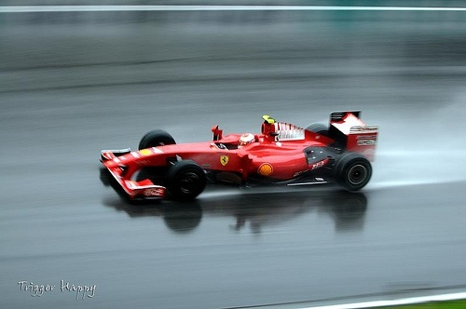
Objective
Design and construct a mousetrap car
Competition
Which design travels furthest?

Slide 4
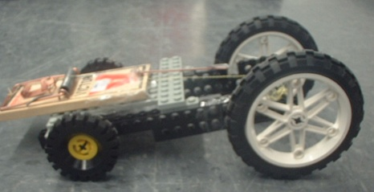
What is a mousetrap car?
A vehicle powered only by a standard mousetrap

Slide 5
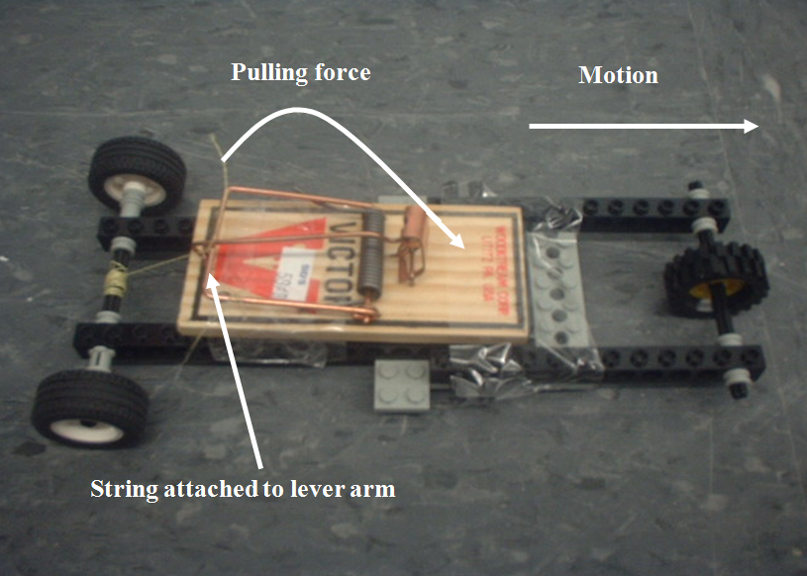
How does it work?
String wrapped
around axle
Lever arm pulls string; string rotates drive-axle;
drive-axle moves wheels to create forward motion

Slide 6
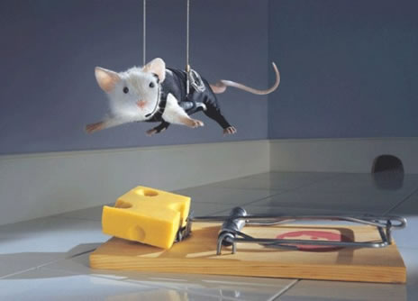
Materials
Robolab kit
Mousetrap
Kevlar string
Tape
Ebaumsworld

Slide 7
Procedure
Brainstorm designs using Lego parts
Sketch design
Construct

Slide 8
Design Specifications
Sketch must be drawn and initialed by TA before construction
Minimum of 1 wheel
Projectile designs not permitted
Mousetrap may be attached with tape
Mousetrap is only source of power
Mousetrap may not be physically altered

Slide 9
Competition
Load and position vehicle at starting line
Release mousetrap vehicle
Each team will have up to 3 trials (time permitting)
Modifications between trials permitted

Slide 10
Rules
Start
Pushing not allowed
Vehicle must not be touched once started
Linear distance traveled will be measured by TA
For collisions (wall, person) distance will be measured from start to point of impact

Slide 11
Credit
+10 points extra for greatest linear distance in section
Bonuses for other places as shown in the grading policy

Slide 12
Report
Individual lab report required
Discuss advantages and disadvantages of your design

Slide 13
Closing
Have photo taken of your design
Required for extra credit!
Disassemble vehicle
Return complete Lego kit & mousetrap
Remove all tape from parts

