Slide 1
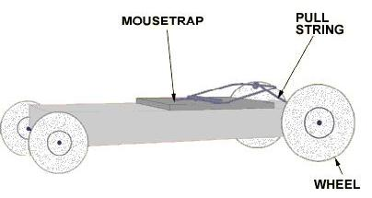
Mousetrap Car Competition

Slide 2
Overview
What is a mousetrap car?
How it works
The competition
Design specifications
Rules
Scoring
Extra credit

Slide 3
Objective
Design and construct a mousetrap car
Competition
Which design travels furthest?

Slide 4
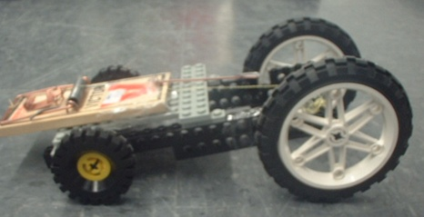
What is a Mousetrap Car?
A vehicle powered only by a standard mousetrap

Slide 5
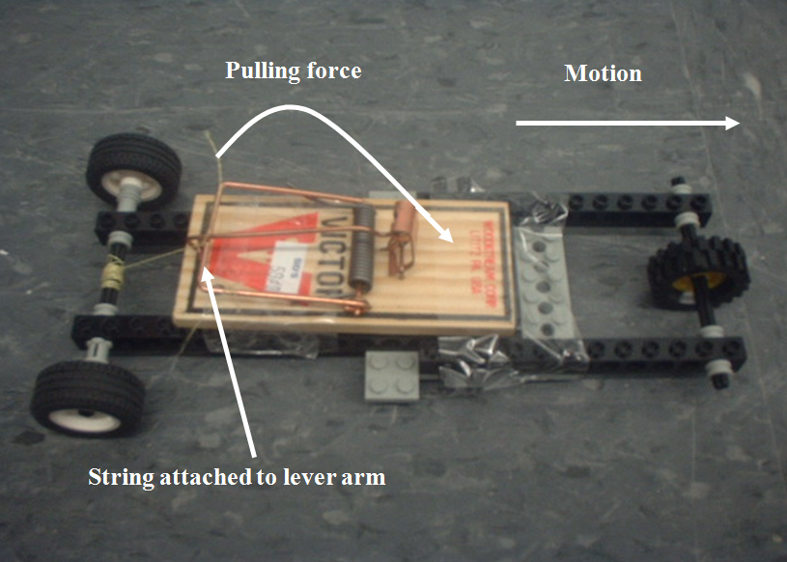
What is a Mousetrap Car?
Lever arm pulls string
String rotates drive-axle
Drive-axle moves wheels to create forward motion
String wrapped
around drive-axle

Slide 6
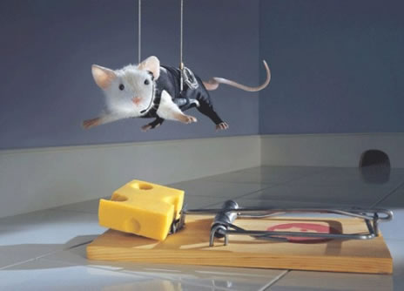
Materials
Robolab kit
Mousetrap
Kevlar string
Tape

Slide 7
Procedure
Brainstorm design using LEGO parts
Sketch design
Construct

Slide 8
Design Specifications
Sketch must be drawn and initialed by TA before construction
Minimum of 1 wheel
Projectile designs not permitted
Mousetrap may be attached with tape
Mousetrap is only source of power
Mousetrap may not be physically altered

Slide 9
Competition
Load and position vehicle at starting line
Release mousetrap vehicle
Each team will have up to 3 trials (time permitting)
Modifications between trials permitted

Slide 10
Rules
Start
Pushing not allowed
Vehicle must not be touched once started
Linear distance traveled will be measured by TA
For collisions (wall, person) distance will be measured from start to point of impact

Slide 11
Extra Credit
+10 points extra for greatest linear distance in section
Bonuses for other places as shown in the grading policy

Slide 12
Report
Individual lab report required
Discuss advantages and disadvantages of your design

Slide 13
Closing
Have photo taken of your design
Required for lab report
Disassemble vehicle
Return complete LEGO kit & mousetrap
Remove all tape from parts

Slide 14
Mousetrap Car Competition
QUESTIONS?

