Slide 1
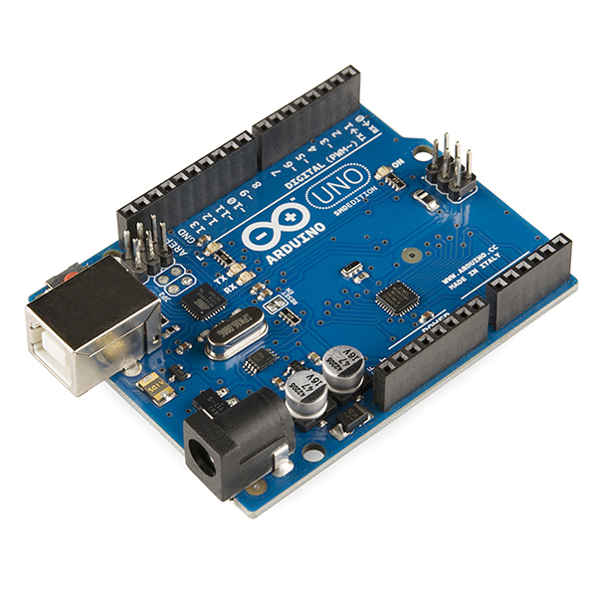
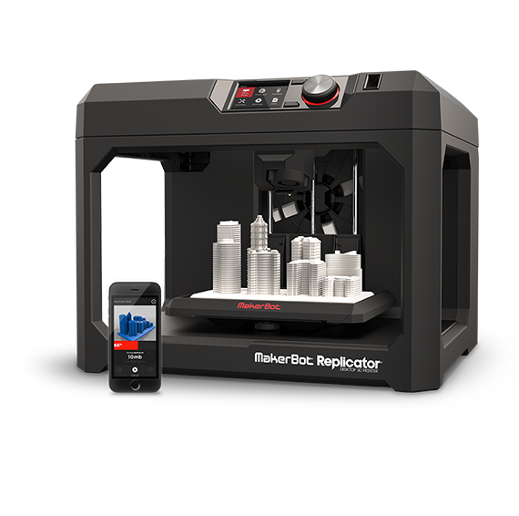
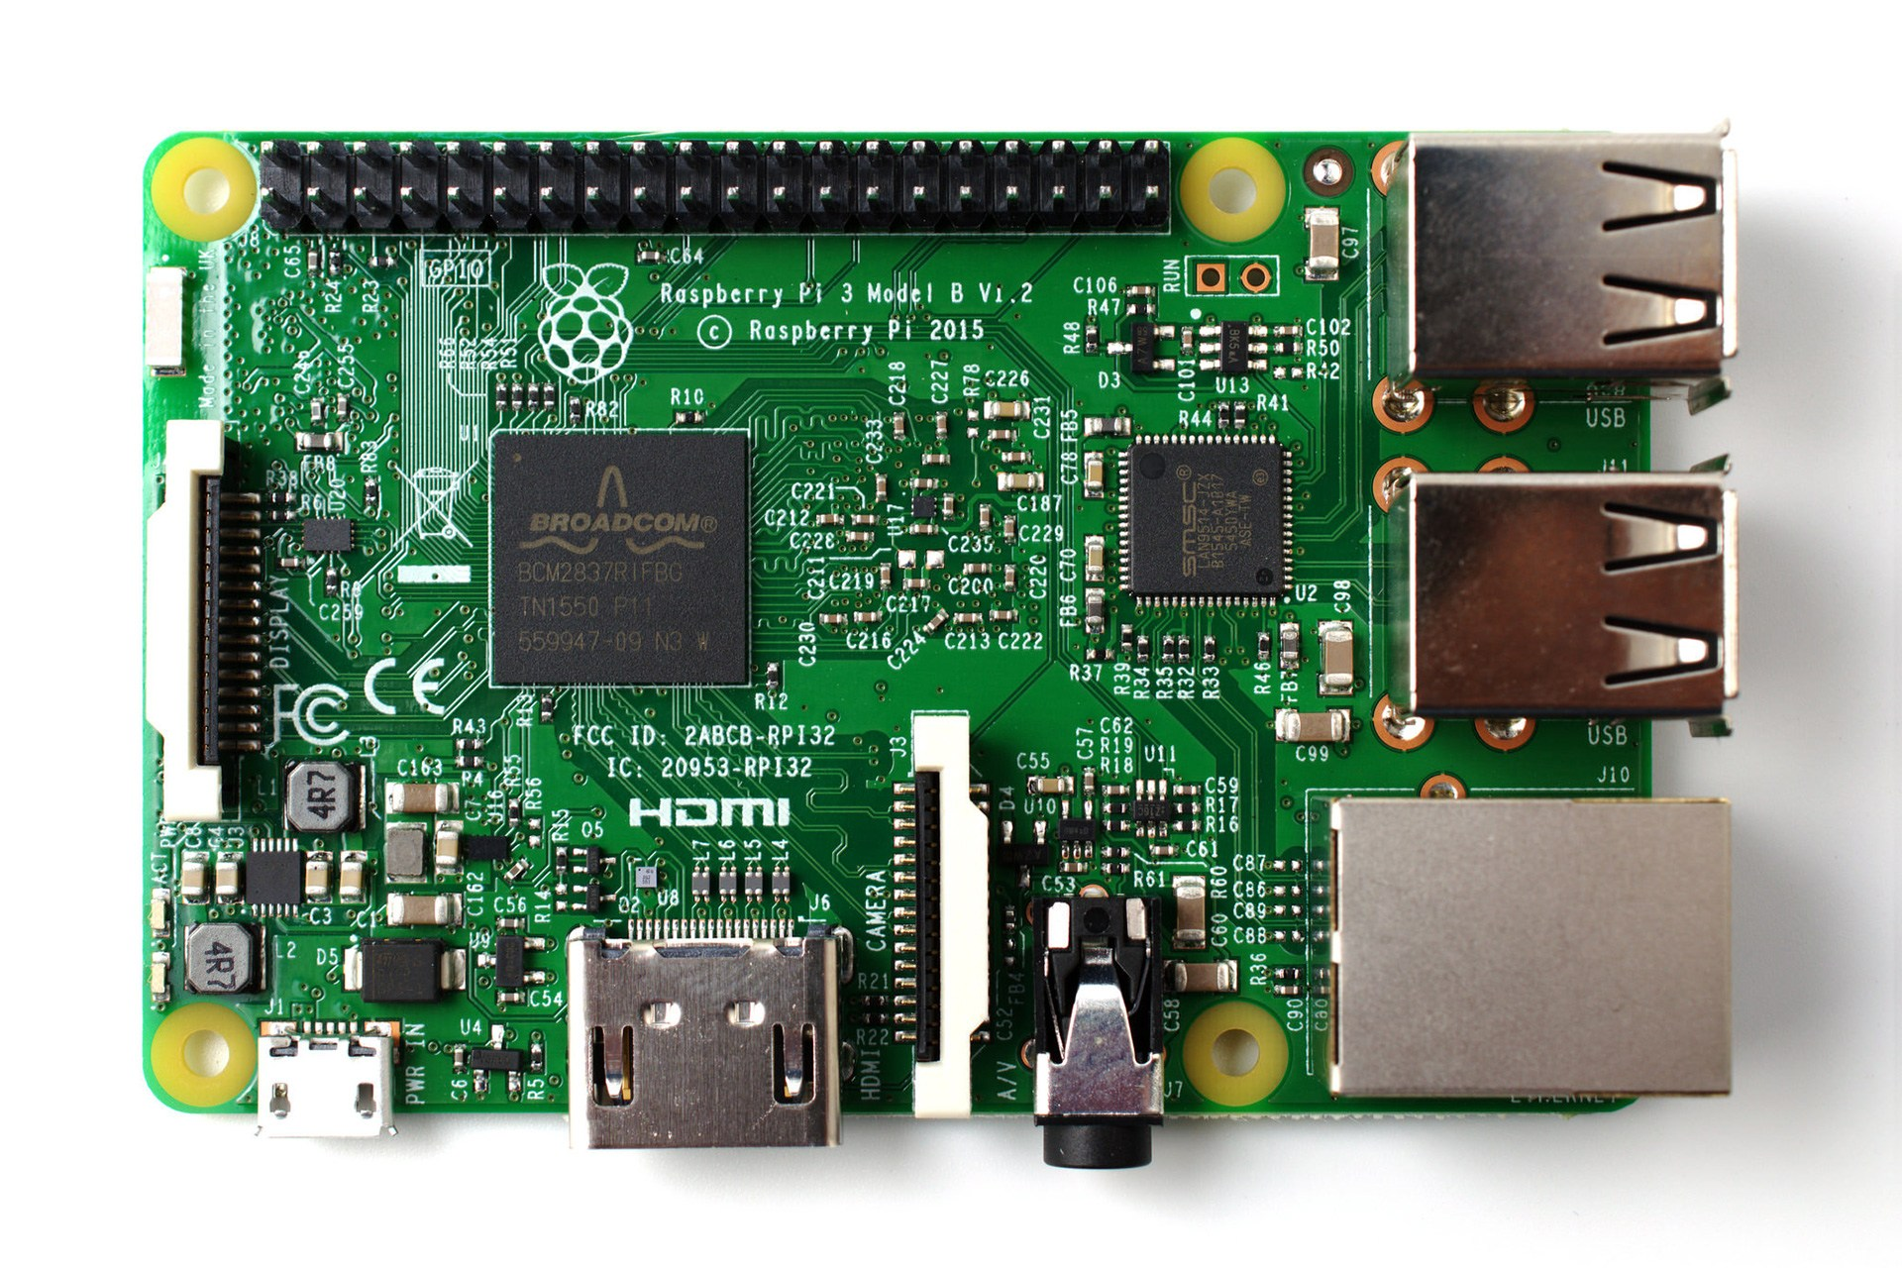
EG1003: Introduction to Engineering and Design
Semester-Long Design Project

Slide 2
Project Introduction
Project duration: 10 weeks
Teams of 3 people
Projects are open-ended
Any multidisciplinary topic
A physical prototype
A new invention
Technical innovation
Entrepreneurial

Slide 3
Project Grading
Item | % of Grade
Benchmarks and Commissioning | 50%
Final Presentation | 50%
NOTE: The SLDP counts toward 30% of your course final grade!

Slide 4

Project Grading
Benchmarks
  Completion of a specified portion of the project
  2 benchmarks throughout semester
  Refer to syllabus for due dates
  Penalties for not completing on time
Commissioning
  Completion of a final prototype
  Last phase of project
  Refer to syllabus for due dates
  Failure to commission will result in penalties

Slide 5

Project Grading
Project Submission
  Hand in technical and managerial related documents
  Must be received in order to obtain SLDP Grade (30%)
  Any missing items will result in penalties
  Refer to syllabus for deadline
  Refer to Submission Guidelines

Slide 6
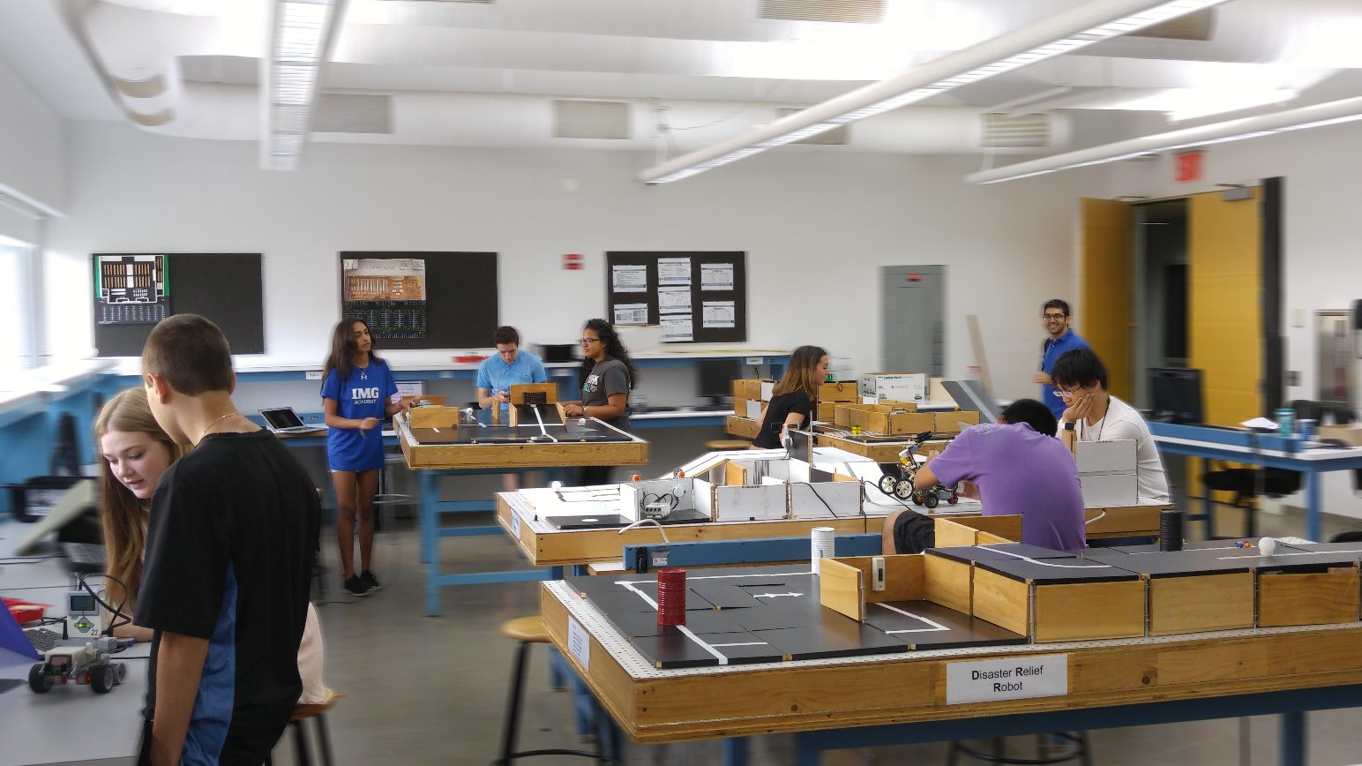
SLDP Options
Open-Ended Multidisciplinary Problem Spotting and Innovative Entrepreneurship
Must Develop a Physical Prototype

Slide 7
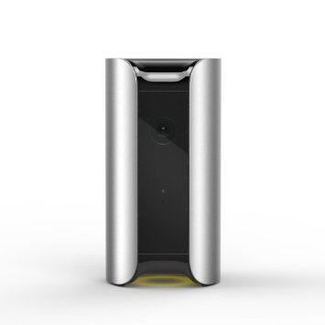
SLDP Options
Invention, Innovation, and Entrepreneurship (i²e)
Must be a physical prototype
Requires some programming
Requires an algorithm with at least two signal inputs (sensors) and one output, or a design of corresponding difficulty
Requires 3D printed elements

Slide 8
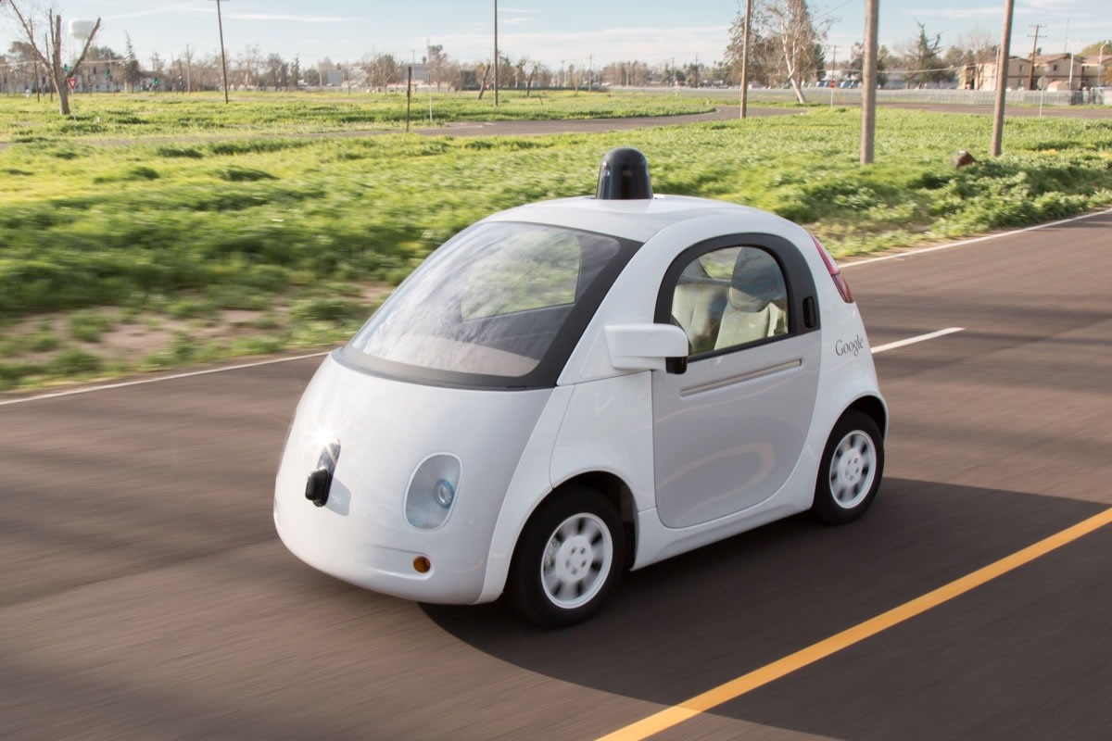
SLDP Requirements
Invention, Innovation, and Entrepreneurship (i²e)
Must be multidisciplinary (combines mechanical, civil, electrical, computer, computer science, and chemical)
Could be an app, smart device, sensor, robotic part, lab equipment, measurement tool
Or any innovative idea you have

Slide 9
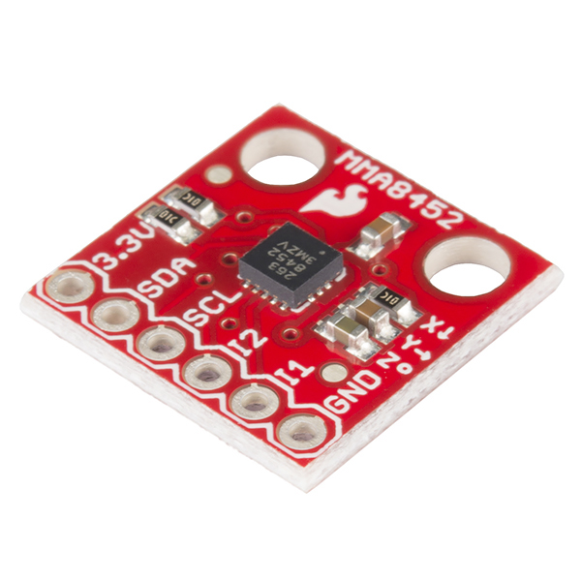
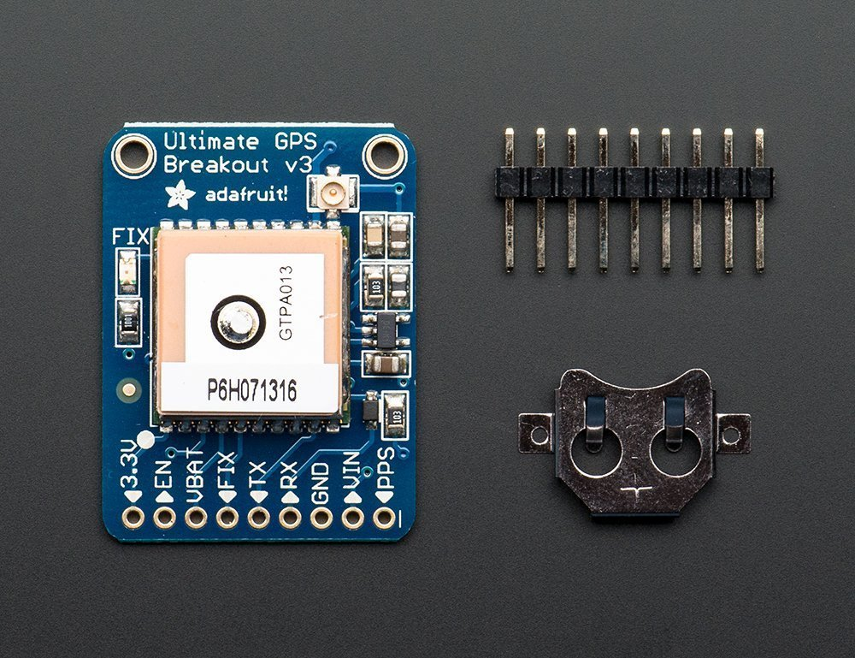
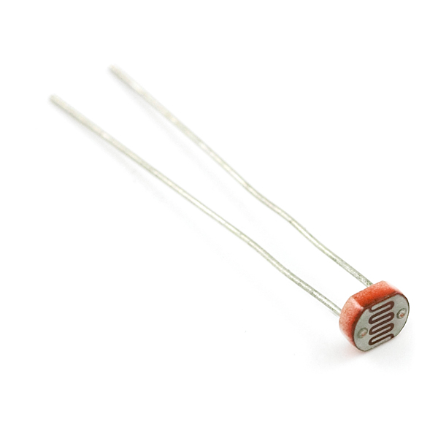
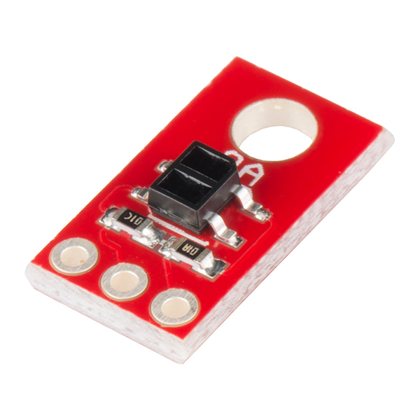
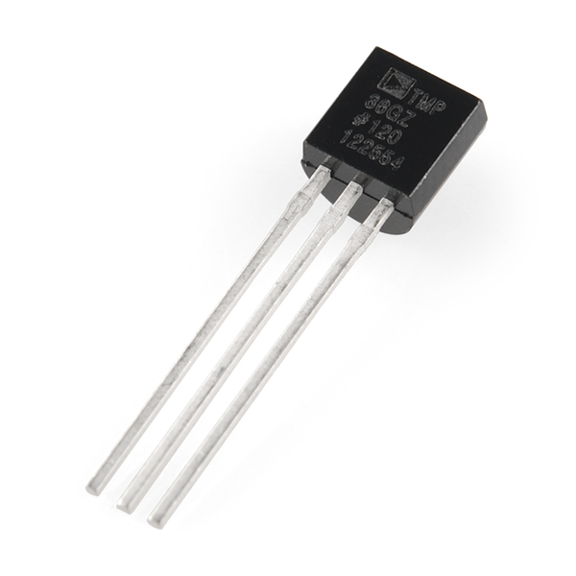
SLDP Materials
Invention, Innovation, and Entrepreneurship (i²e)
Arduinos, Raspberry Pi
3D printer filament
Input
  Light sensors, flex sensors, temperature sensors, IR sensors, GPS, accelerometers
Output
  LED, Display Panel, Computer, Phone
Breadboards, wires, and switches

Slide 10
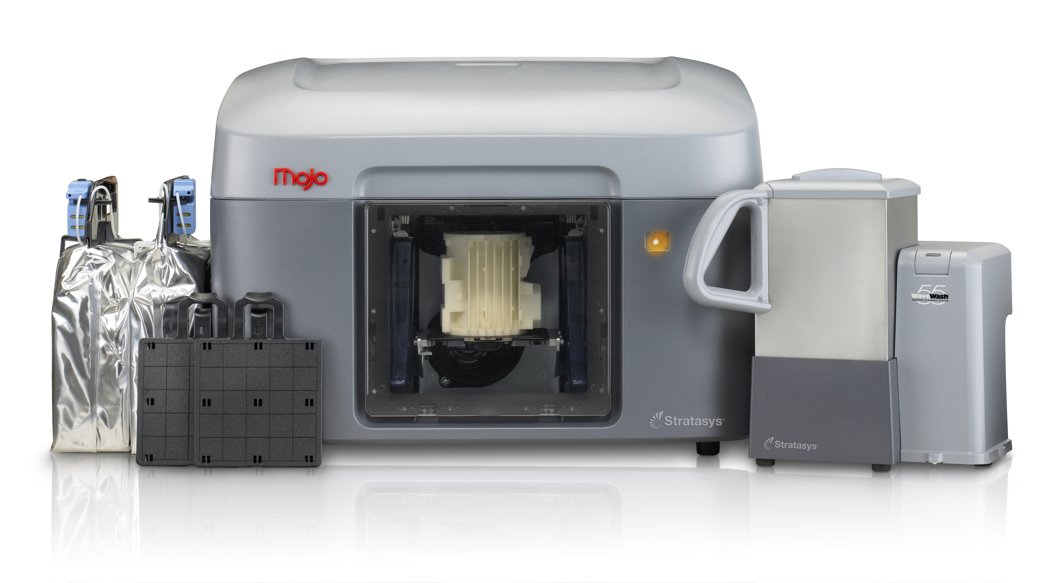
SLDP Support
Invention, Innovation, and Entrepreneurship (i²e)
NYU MakerSpace
EG Prototyping Lab (RH 223)
Senior mentors
In class training on brainstorming, the engineering design process, and entrepreneurial strategies

Slide 11

SLDP Inspiration
Invention, Innovation, and Entrepreneurship (i²e)
Internet of Things
Maker Movement
NYU Tandon School of Engineering Research Thrusts (Bio, Info, Urban)
Grand Challenges for Engineering

Slide 12
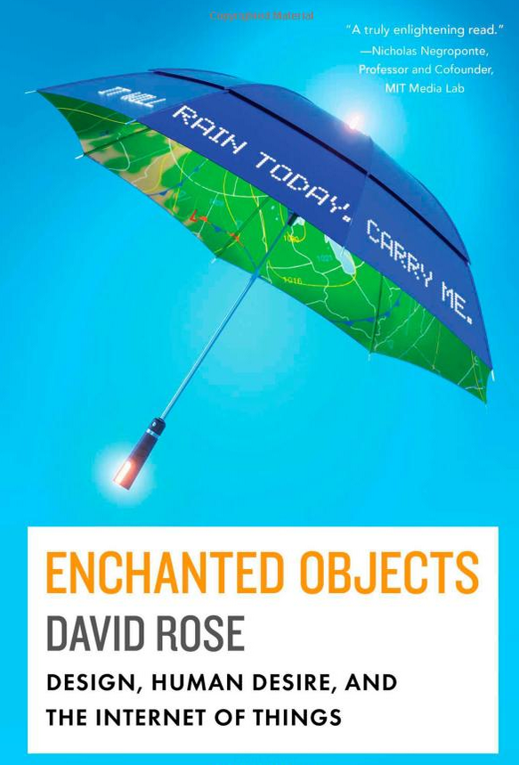
Internet of Things
Rose, D. (2014). Enchanted Objects: Design, Human Desire, and the Internet of Things. Simon and Schuster.

Slide 13
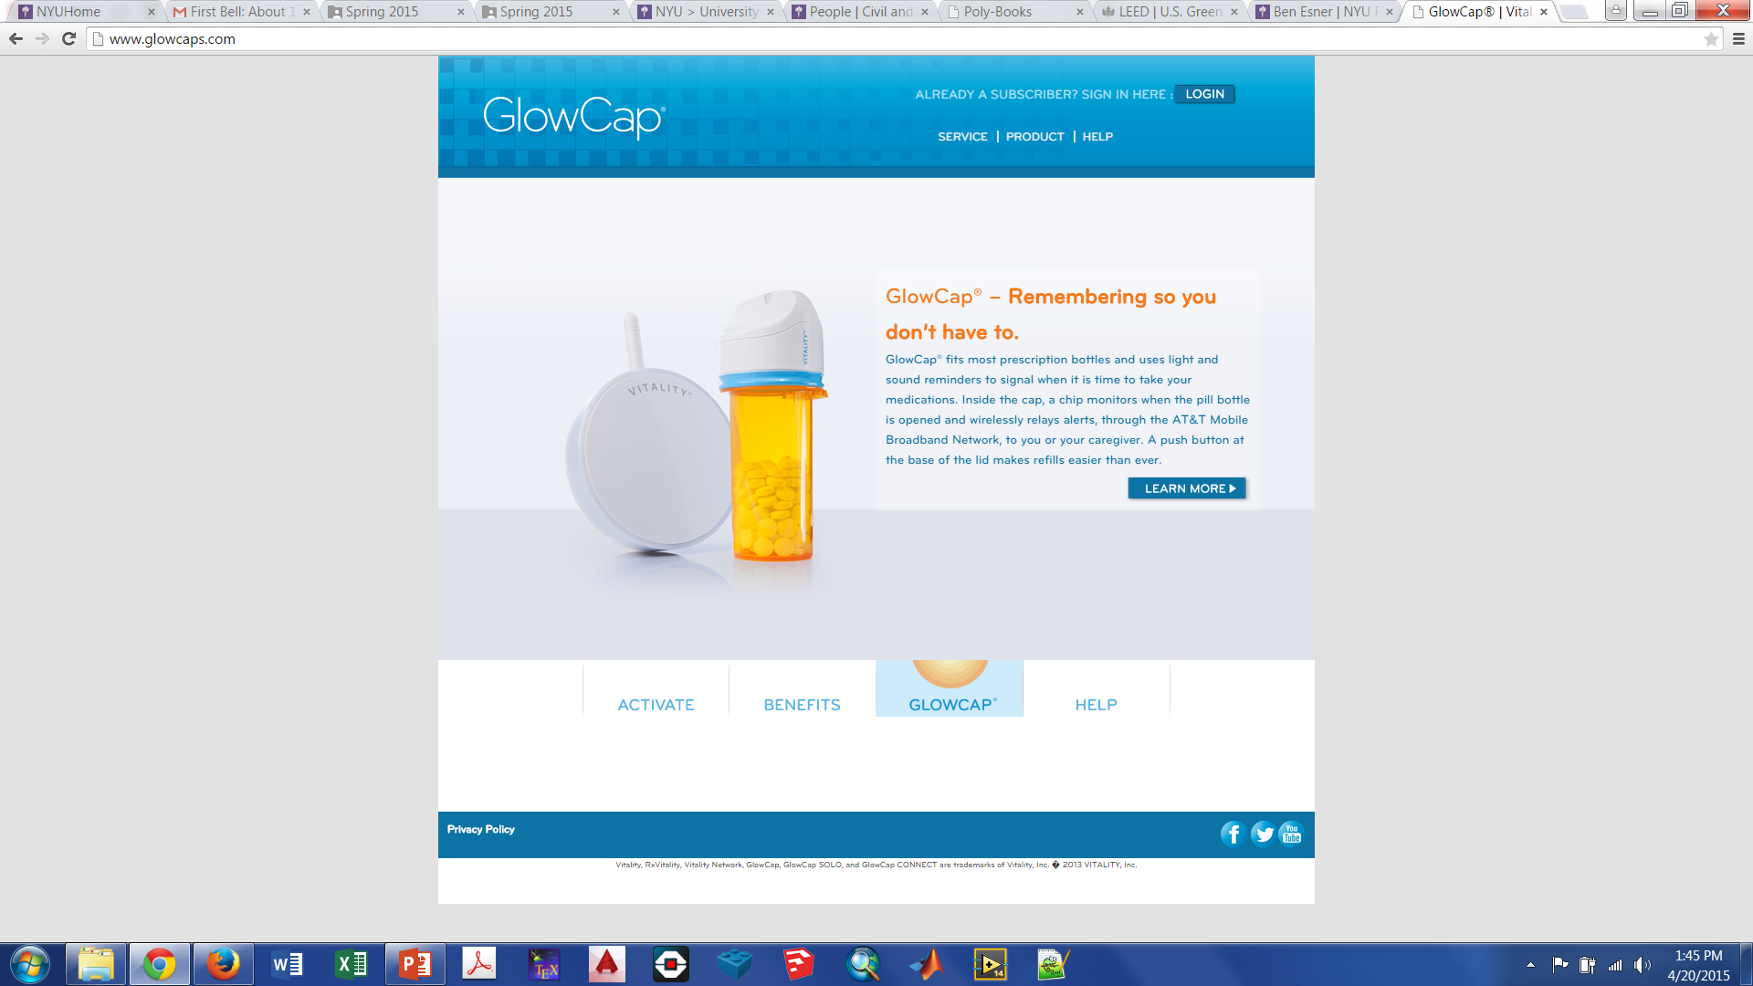
Internet of Things
Terminal World
Prosthetics
Animism
Enchanted Objects

Slide 14
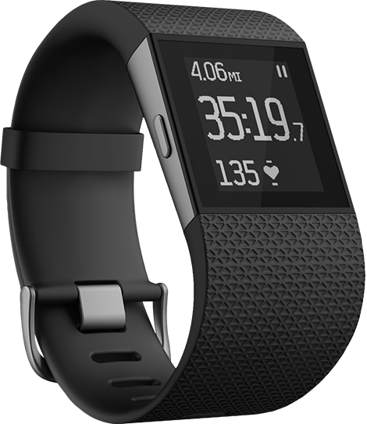
Maker Movement
To know all
To connect with others
Safety
Health
Travel
Creativity

Slide 15
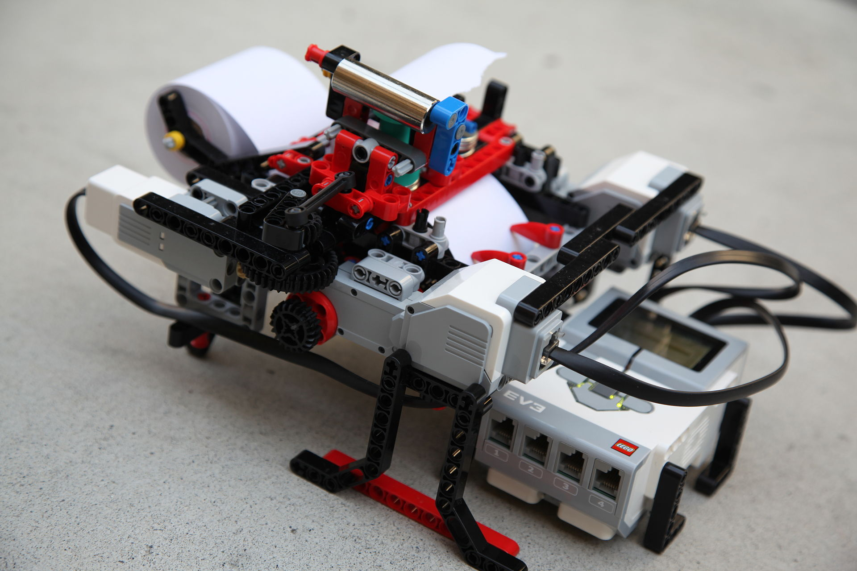
Maker Movement
Glanceabilty
Gestureability
Affordability
Wearability
Indestructability
Usability
Lovability
Braigo - Braille Printer with Lego Mindstorms EV3

Slide 16
NYU SOE Research Thrusts
Biomedical Bioinformatics Biotechnology Mechatronics Cybersecurity Integrated Digital Media Game Engineering Financial Engineering | Industrial Energy Transportation Construction Urban Systems Materials Aerospace Nuclear

Slide 17
NYU SOE Research Thrusts
Invention, Innovation, Entrepreneurship (Bio, Info, Urban)
Mechatronics
MAGNET (The Media and Games Network)
Game Innovation Lab
NYU Wireless
CUSP (Center For Urban Science And Progress)
Undergraduate Summer Research
Incubators (Varick, NYC ACRE, DUMBO)

Slide 18
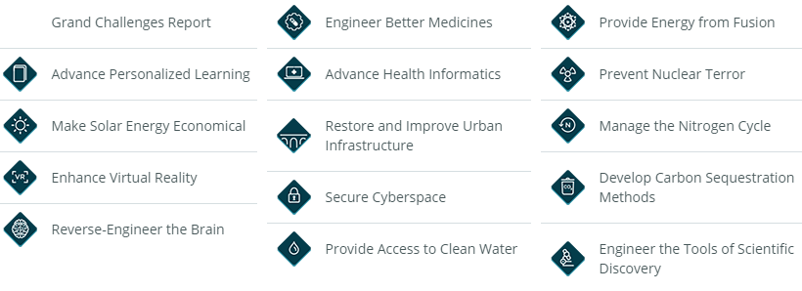
Engineering Grand Challenges

Slide 19
Emerging Engineering Topics
Batteries Green energy Connected buildings Prosthetics Virtual reality Augmented reality Electric autonomous vehicles | Wearable technology Ingestible technology Health monitoring Additive manufacturing Clean water Big data Cybersecurity SpaceX/Blue Origin

Slide 20
Emerging Engineering Topics
Maker Movement & Internet of Things | NYU Tandon SoE Research Focuses | Grand Challenges for Engineering
Making Technology oriented design and fabrication DIY and hacker culture IoT Connected devices Computer networks sharing sensor data | Bioengineering: biomedical and health technology IT + Media: cyber information and security Urban Systems: smart and sustainable cities | Health Informatics Cyber Security Urban Infrastructure Better Medicine Solar Energy Virtual Reality Clean Water Personalized Learning New Tools for Discovery

Slide 21
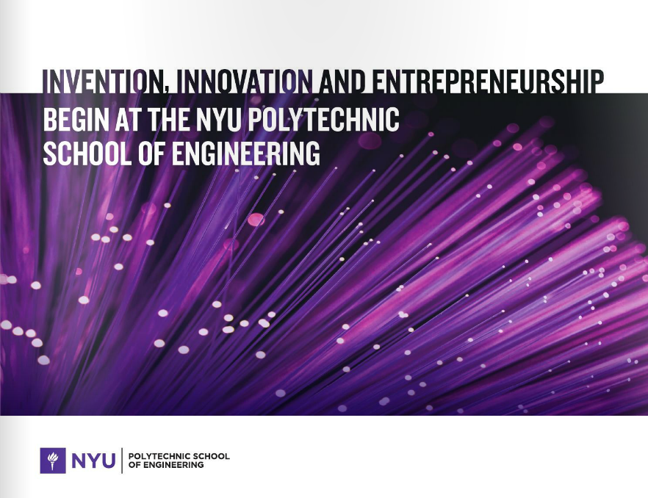
i²e

Slide 22
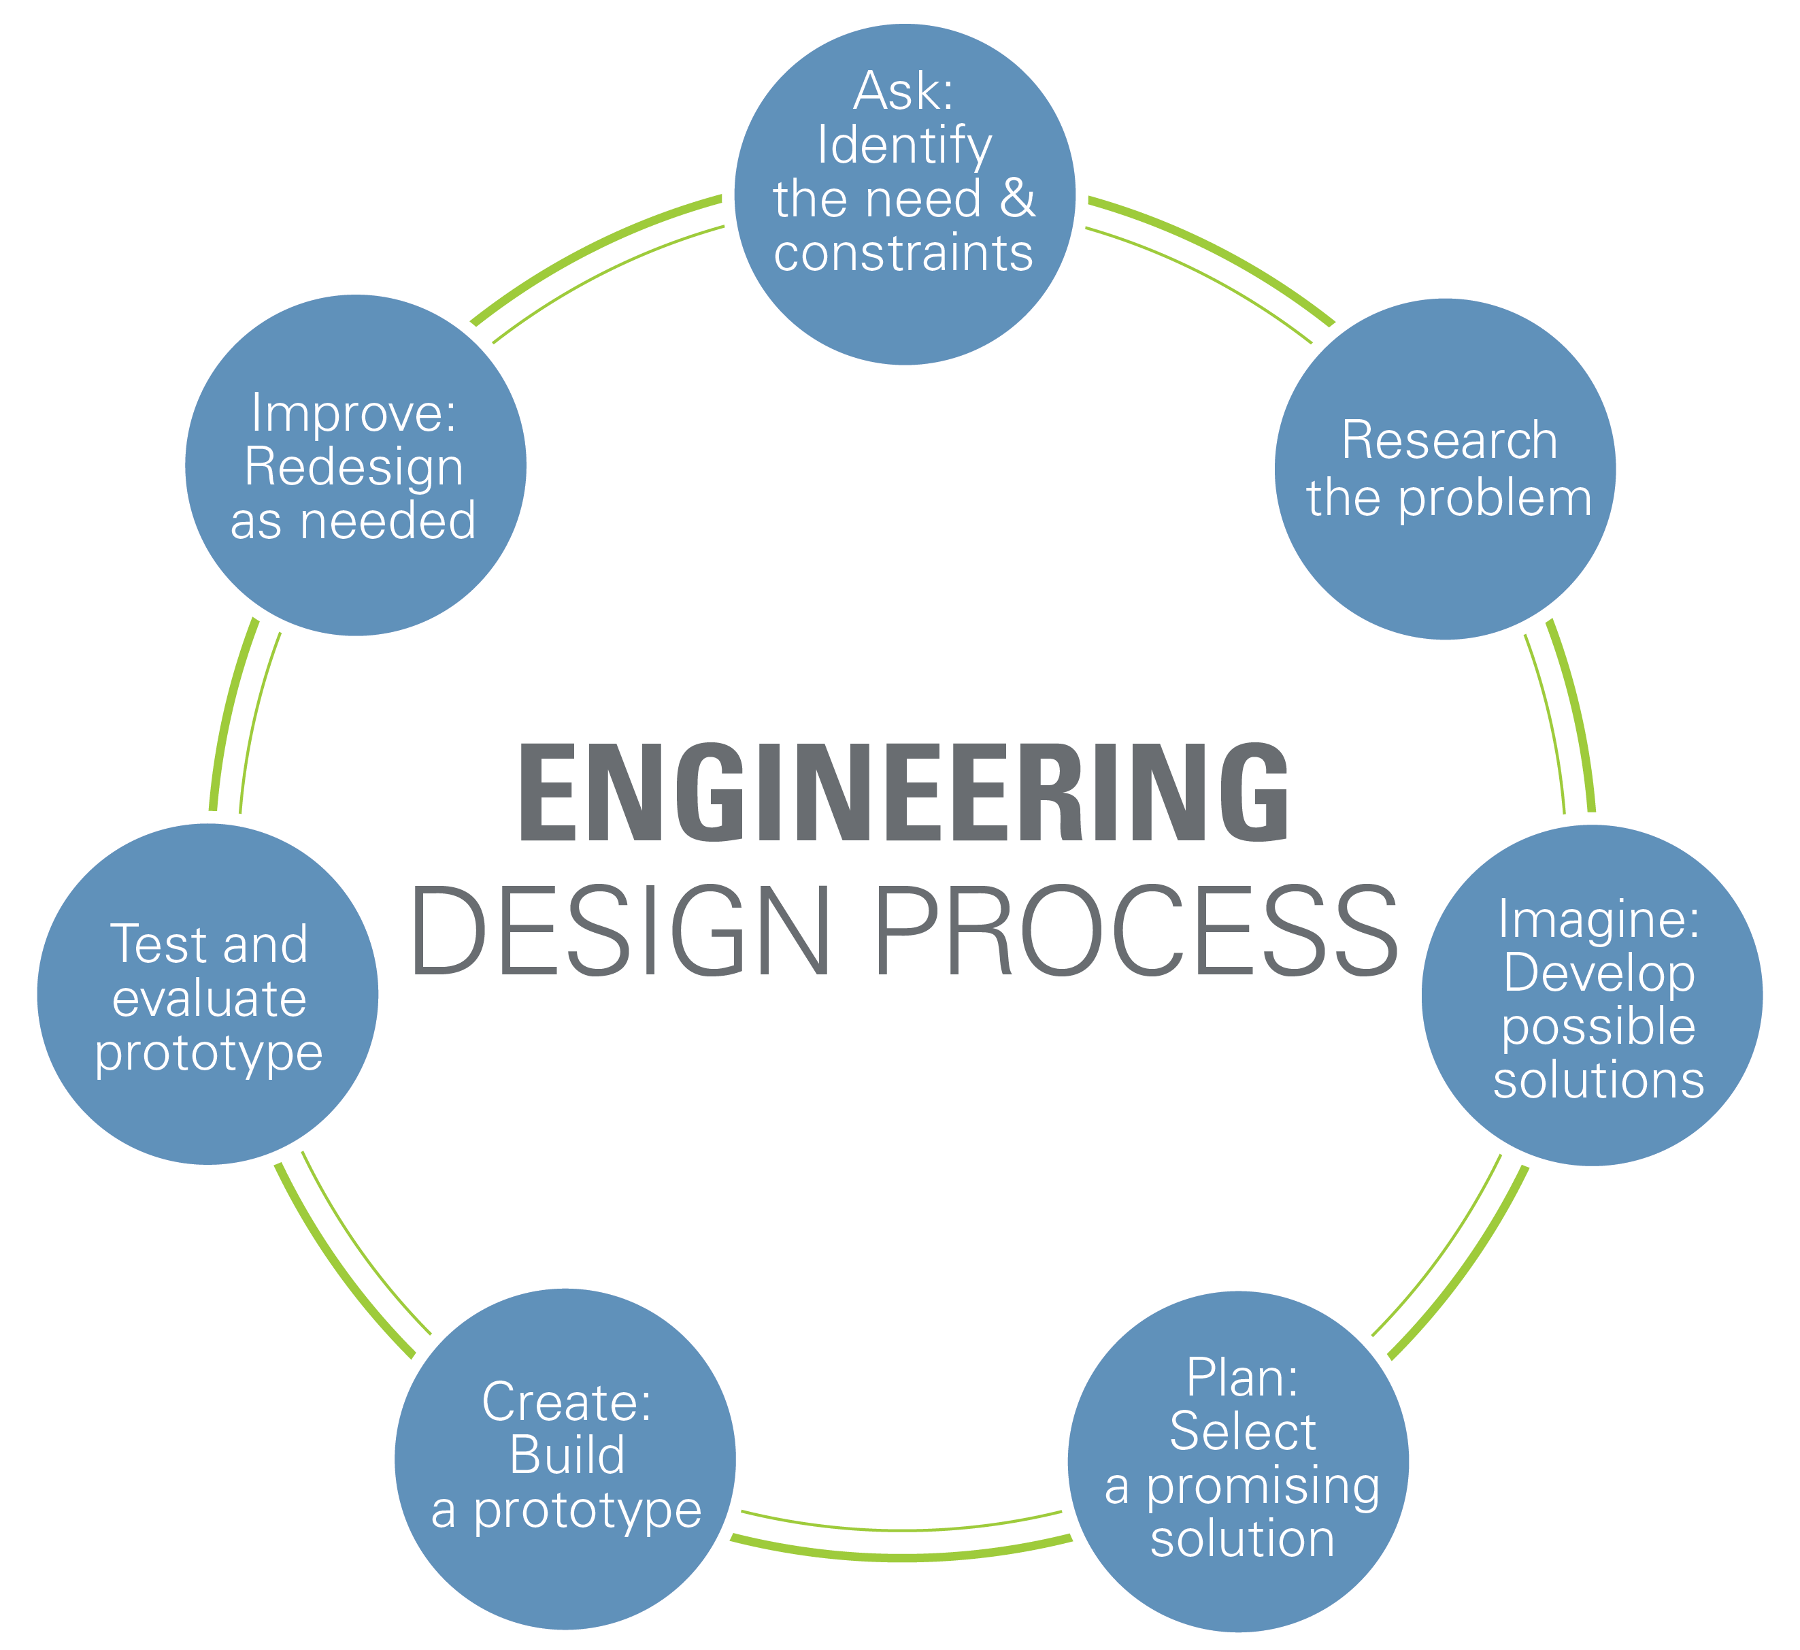
Engineering Design Process

Slide 23
Closing
Refer to manual.eg.poly.edu for details
Think about which topics interests you
Brainstorm ideas
Speak with professors and TAs regarding projects

