Slide 1

SUSTAINABLE ENERGY VEHICLE COMPETITION
EG1004 | LAB 10

Slide 2
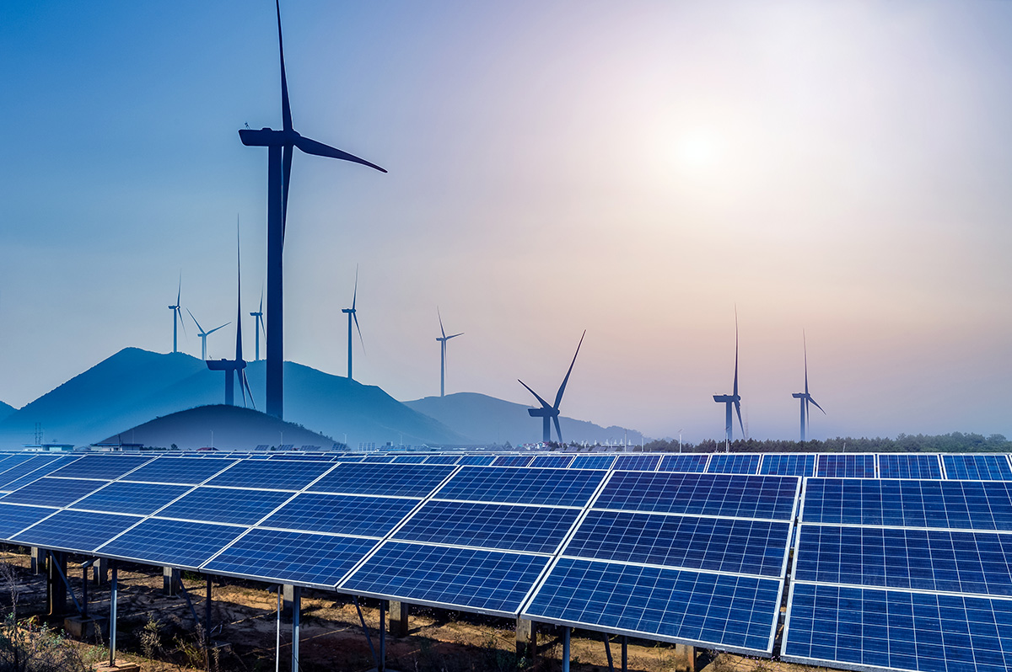
OVERVIEW
Objective
IDBE Implementation
Background Information
Materials
Procedure
Assignment
Closing
Figure 1: Renewable Energy Sources
Courtesy of Physics World
1

Slide 3
OBJECTIVE
Evaluate energy storage devices
Analyze different sources of renewable energy
Design a sustainable energy vehicle to enter in a competition
2

Slide 4



IDBE IMPLEMENTATION
High cost of sustainability
  Renewable energy sources can require new infrastructure- higher cost
  Companies are reluctant to invest in renewable energy because it is slower to produce
High price of remaining environmentally unethical
  Minority groups are disproportionately affected by climate change due to increased resource cost and the changing environments in their communities
Figure 2: Rising Sea Levels in the Maldives
3

Slide 5
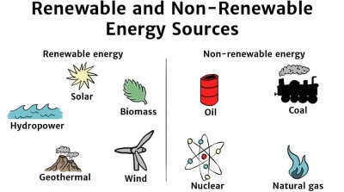
BACKGROUND INFORMATION
Renewable energy – energy harnessed from naturally replenished resources
Figure 3: Renewable vs. Non-Renewable Energy Sources Courtesy of Solar Schools
3

Slide 6
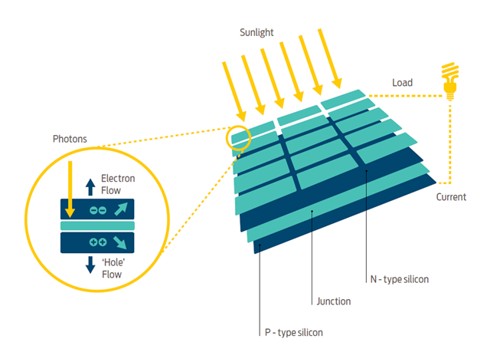
BACKGROUND INFORMATION
Solar panels – convert sunlight to electrical energy
  Incident sunlight excites electrons to
  next energy level, emitting energy
  Usually made of silicon
Figure 4: How Solar Panels Work
Courtesy of Good Energy
4

Slide 7
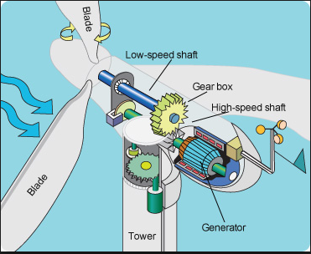
BACKGROUND INFORMATION
Wind turbine – converts wind energy to electrical energy
  Wind causes pressure difference on turbine blades
  Utilizes gear ratios to power generator
Figure 5: How Wind Turbines Work
Courtesy of Tech-Addict
5
Notes:
Rotating blades turn a low-speed shaft to a gearbox, which outputs power to an electrical generator through a high-speed shaft.

Slide 8
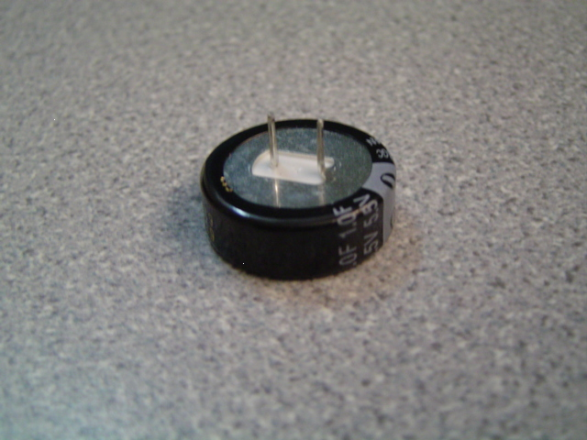
BACKGROUND INFORMATION
Capacitor – stores charge temporarily
  Are polarized
  Charged logarithmically (initially charges very fast but rate of charging slows down)
Positive
Negative
Figure 6: Polarized Leads of 1 Farad Capacitor
6

Slide 9


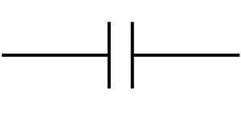

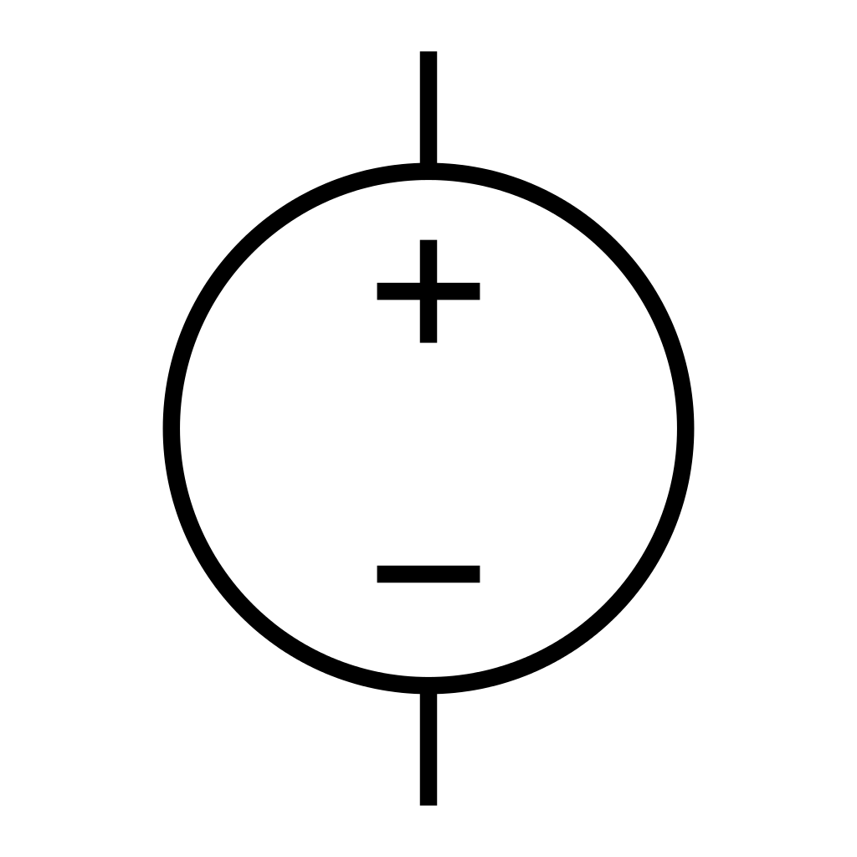
BACKGROUND INFORMATION
Symbols for common electrical components:
  Battery
  Capacitor
  DC source
  Voltmeter
  Ammeter
7

Slide 10
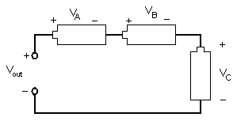
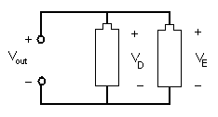


BACKGROUND INFORMATION
Series connections
  Current is equal across components
  Voltage across each component:
  $${V_{out}=V}_{A}+V_{B}+V_{C}$$
Parallel connections
  Current varies across components
  Voltage across each component:
  $${V_{out}=V}_{D}=V_{E}$$
Figure 7: Series Connection
Figure 8: Parallel Connection
8

Slide 11
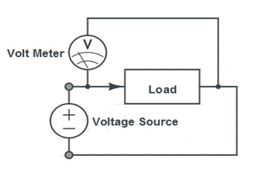
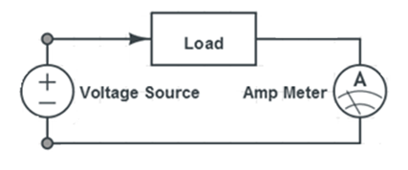
BACKGROUND INFORMATION
Digital multimeter – reads current and voltage across circuits
  Measure current in series, called ammeter
  Measure voltage in parallel, called voltmeter
Figure 9: Circuits for Using a Multimeter
9

Slide 12
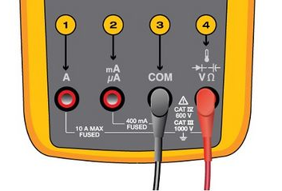
BACKGROUND INFORMATION
Multimeter Guidelines
  Ensure that the red lead is connected to the correct port
  Measuring current – Multimeter in series
  Measuring voltage – Multimeter in parallel
Figure 10: Ports on a Multimeter
10

Slide 13
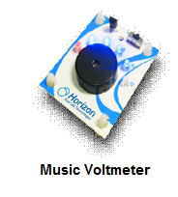
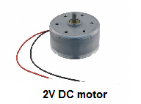
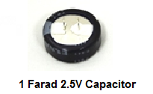
MATERIALS
Horizon wind-turbine
Sunforce 50013 1 W solar battery charger
Adjustable table fan
Heat lamp
3V power supply
Digital multimeter
Music voltmeter
9V DC motor
1 F 2.7 V capacitors
3 alligator clip sets
Standard LEGO kit
LEGO to alligator clip connector
Scissors
1 Farad 2.7V Capacitor
11

Slide 14
PROCEDURE
Part 1: Test the power storage device
  Charge a capacitor
  Test capacitors in series and parallel
Part 2: Test the assigned power source using music voltmeter
  Solar panel
  Wind turbine
Part 3: Design a sustainable energy vehicle using the power source of choice and enter in competition
12

Slide 15
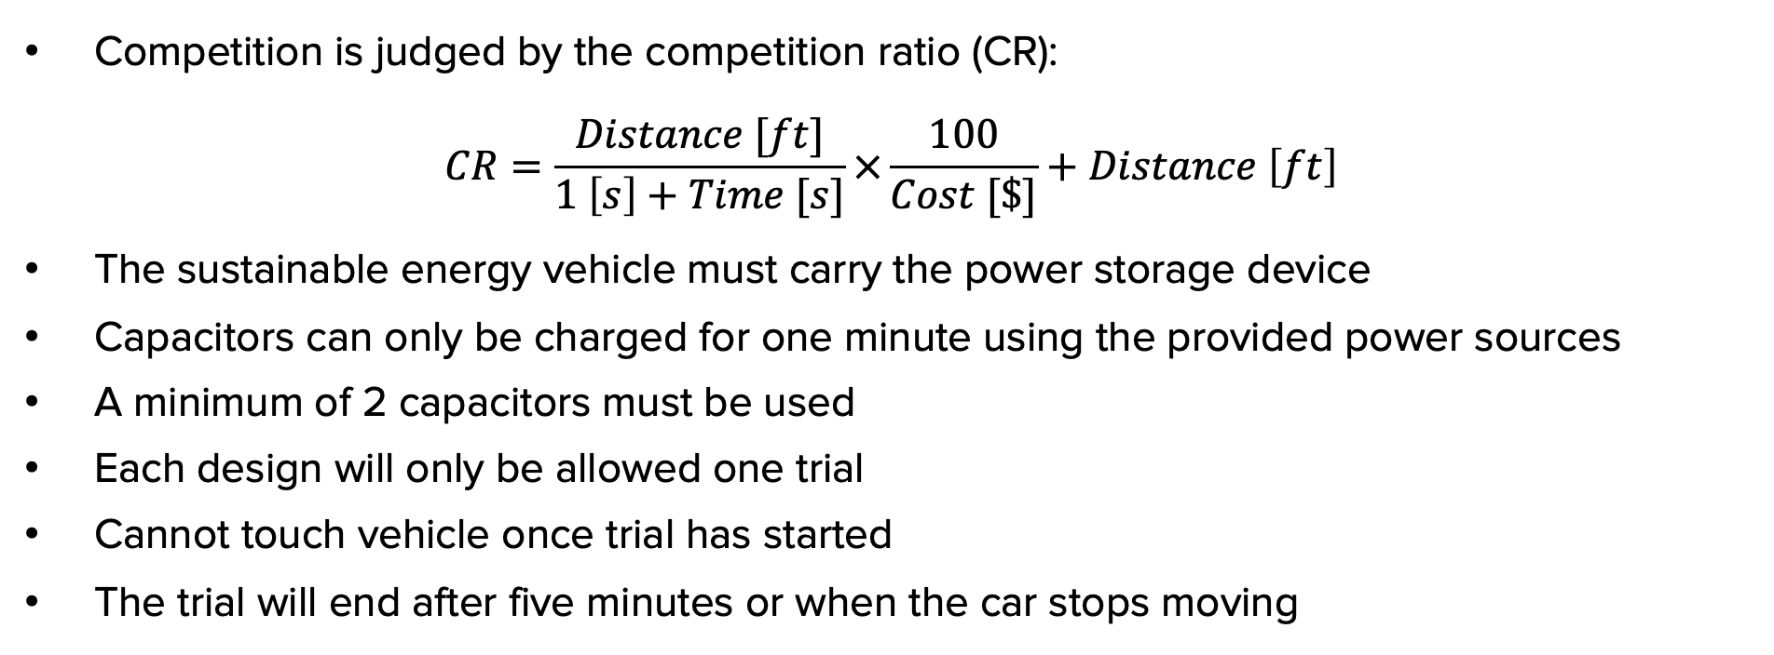
COMPETITION RULES
Competition is judged by the competition ratio (CR):
$$CR=\frac{Distance [ft]}{1 \left[s\right]+Time [s]}×\frac{100}{Cost [\$]}+Distance \left[ft\right]$$
The sustainable energy vehicle must carry the power storage device
Capacitors can only be charged for one minute using the provided power sources
A minimum of 2 capacitors must be used
Each design will only be allowed one trial
Cannot touch vehicle once trial has started
The trial will end after five minutes or when the car stops moving
13

Slide 16
COMPETITION RULES
Table 1: Cost List for Competition
Material | Unit | Cost Per Unit
Horizon Wind Turbine | 1 | $7.50
Solar Panel | 1 | $10.00
1 F 2.7 V Capacitor | 1 | $3.00
Alligator Clip Set | 1 pair | $0.50
LEGO Kit (Limit One Per Design) | 1 | $0.00
LEGO to Alligator Clip Connector | 1 | $0.10
Tape | 1 foot | $0.10
14

Slide 17
ASSIGNMENT
Team lab report:
  Answer discussion questions in manual
  Include picture and explanation of vehicle design
  Include spreadsheet with power source data and competition results
    Address how measurements from power sources impacted the design
  Due at 11:59 PM the night before Lab 11
Team presentation:
  Address discussion points in manual
  Include cost of vehicle design
15

Slide 18
CLOSING
Measure current in series and voltage in parallel
Submit all work electronically
Take pictures of the vehicle design
Clean up workstations
Return all unused materials to the TA
Handle the batteries with caution! Be careful not to touch the two leads together
16

Slide 19
QUESTIONS?

