Slide 1


INTRODUCTION TO EG1004 LAB
LAB 1
EG 1004 Introduction to Engineering & Design

Slide 2
OVERVIEW
Introductions
Lab Format
Absence & Tardy Policies
Student Expectations
Course Resources
IDBE Implementation
Registration

Slide 3

INTRODUCTIONS
Meet your TAs!
Introduce yourselves

Slide 4
LAB FORMAT
Lab groups of 2-4 students
Weekly quiz at the start of lab
  Lab and Lecture material
  First 10 minutes of lab
  Submit paper quiz to lab TA
  Make-up quizzes ONLY for excused absences
Lab survey at the end of each lab
Weekly lab report due at 11:59 pm on night before the next lab

Slide 5

ABSENCE & TARDY POLICIES
Students that arrive more than 15 minutes late will not be allowed to participate in lab
Inactivity for more than 30 minutes will result in an absence for the lab
Excused absences processed through NYU Tandon Student Advocacy
Makeup labs can be requested through the EG Website
Full absence & tardy policies on the EG1004 Manual

Slide 6
MAKEUP LAB POLICIES
STEP 1
STEP 2
STEP 3
Submit Make-up Lab Request Within Two Weeks of Lab Absence
Submit Presentation and Report Within a Week of Make-Up Lab Completion
Complete Make-up Lab Within a Week of Approval

Slide 7
STUDENT EXPECTATIONS
Be consistently engaged and communicating
Split tasks evenly among group members
Record lab notes
Follow all safety guidelines

Slide 8
COURSE RESOURCES
EG1004 Website
eg.poly.edu
Assignment submission
Course announcements
Syllabus & schedule
Grades
EG1004 Lab Manual
manual.eg.poly.edu
Lab & project information
Course material
Course policies
Help and how-tos

Slide 9
QUESTIONS?

Slide 10
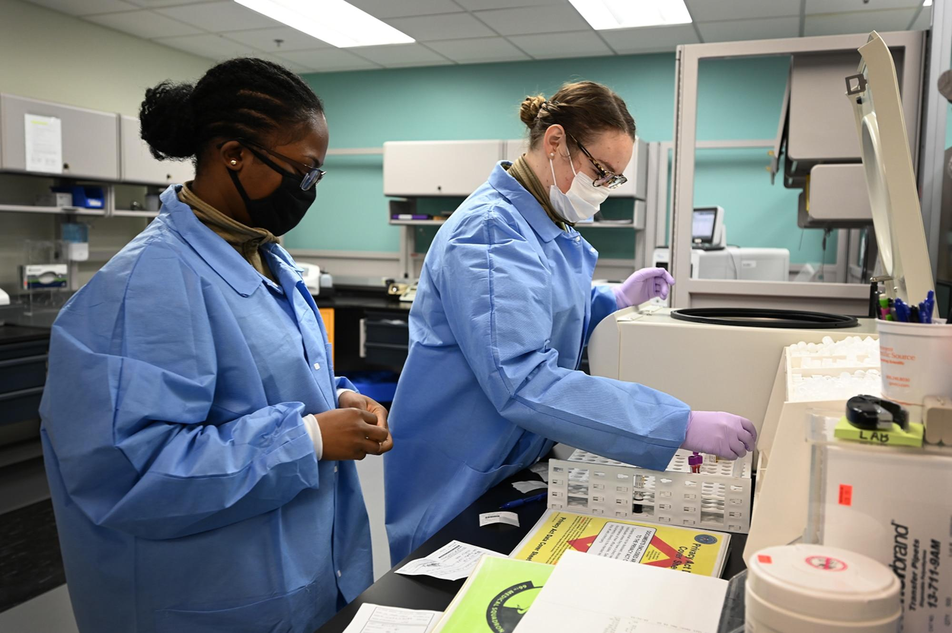
PREPARING TO WORK IN TEAMS
Strength and Areas of Improvement
  What skills can you bring to a team?
  What skills would you like to develop in EG?
Share an element of your identity that is important to you
Community Agreement
  What kind of learning environment would you like to be a part of?
Figure 1: Lab Team Working Together

Slide 11
WEBSITE REGISTRATION
Go to eg.poly.edu
Click on “Sign In” and login with your NYU email
Enter the appropriate information to register on the site
Once registered, the lab TA will approve your account

