Slide 1

RECITATION 2
EG1004

Slide 2
AGENDA
Engineering Beyond the Classroom
Technical Writing
CATME
Introduction to Semester Long Design Projects
Microsoft Project
1

Slide 3
ENGINEERING BEYOND THE CLASSROOM

Slide 4


ENGINEERING BEYOND THE CLASSROOM
Professional Societies
Majors & disciplines
Honors programs and career building
Blogs & News Sources
MIT Technology Review, TechCrunch, Wired
Professional Engineering License
Fundamentals of Engineering Exam
PE Exam/Graduate School/Continuing Education
3

Slide 5
ENGINEERING BEYOND THE CLASSROOM
ASME (Mechanical)
ASCE (Civil)
IEEE (Electrical)
AIChE (Chemical)
AIAA (Aerospace)
ASEE (Engineering Education)
NSPE (Professional Engineering)
Tau Beta Pi (Honors)
SWE (Society of Women Engineers)
SHPE (Society of Hispanic Professional Engineers)
NSBE (National Society of Black Engineers)
SASE (Society of Asian Scientists & Engineers)
4

Slide 6

HOW TO GET INVOLVED?
NYU Tandon Student Affairs Website
NYU Tandon Student Organizations
NYU Engage pages for each club
NYU Tandon Club Fest
Club Fest & Resource Fair Info
Club & Organization Directory
Talk to EG TAs!
Many TAs are club leaders (or know them)
Ask how to get connected!
5

Slide 7
TECHNICAL WRITING
Notes:
The following slides go through a sample published research paper. While in EG 1003 you are not writing a research paper, you will notice a lot of similarities between a research paper and the lab reports you’ll write for the course. It’s also important to understand the structure of these published papers as you will likely read many throughout your educational and professional career.

Slide 8
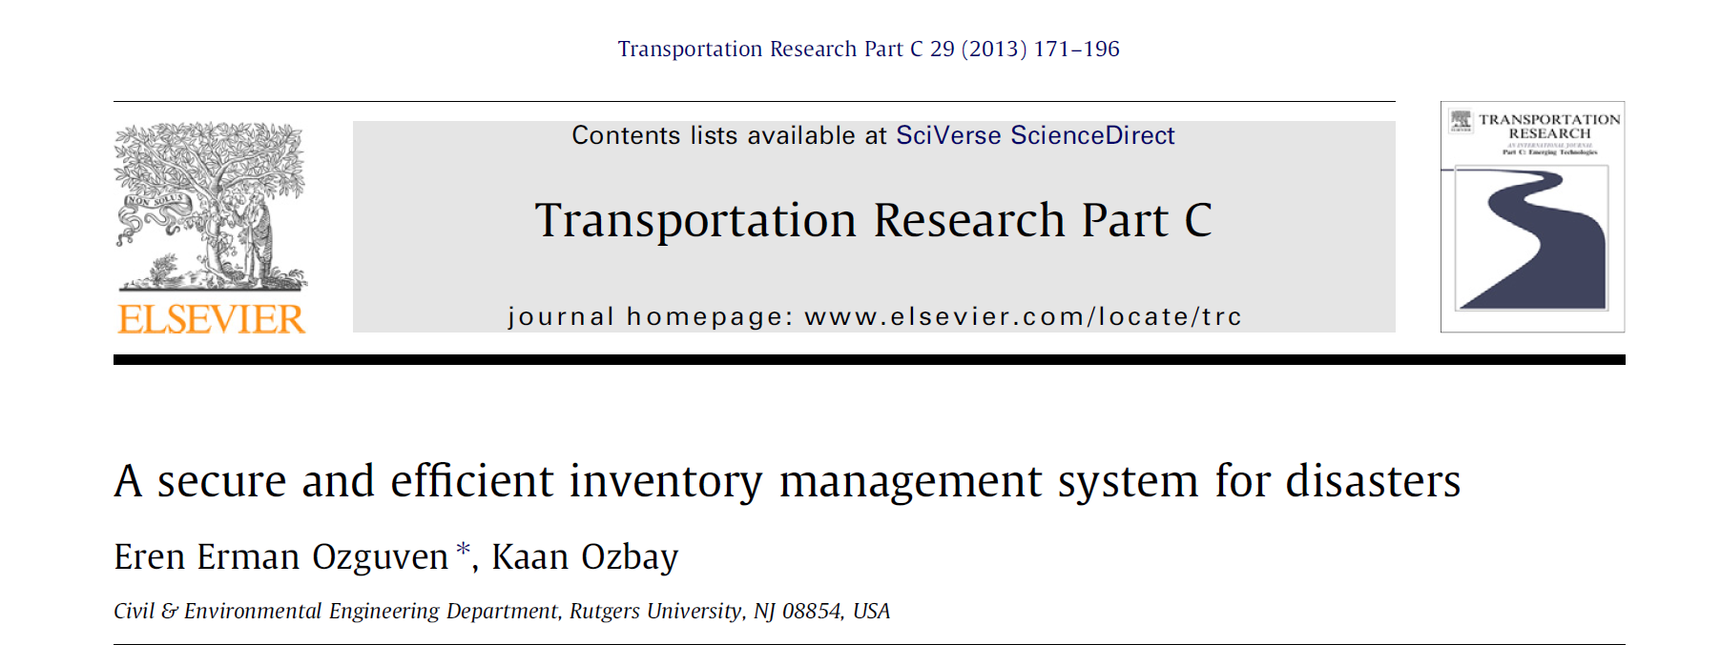
TECHNICAL WRITING
PUBLIC IDENTIFICATION
6
Notes:
This publication is one available through NYU Libraries’ online subscription to Elsevier (which has a large amount of publications in all fields). At the top middle next to the Elsevier symbol, is the journal in which this paper was originally published. Below you see the publication title which gives a brief insight to the research contained within. Under the title, the authors names are listed as well as the University that the authors are affiliated with, in this case, Rutgers.

Slide 9
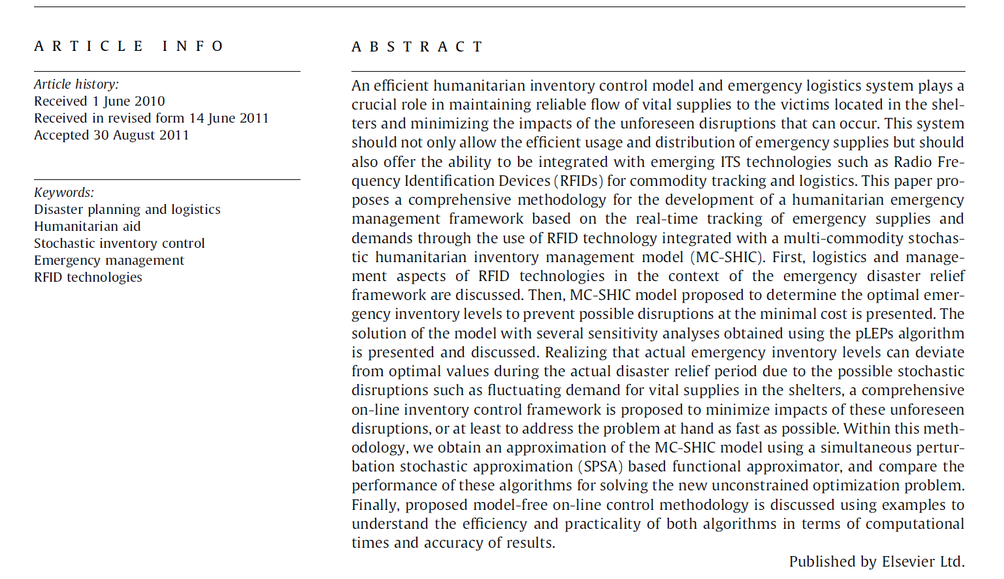
TECHNICAL WRITING
ABSTRACT
z
7
Notes:
This is an example of the abstract section of a publication. The abstract contains an overview of the objectives of the experiment and outcomes. Unlike this example abstract, you should aim for your abstract to be five to six sentences which is roughly equivalent to the highlighted portion above.

Slide 10
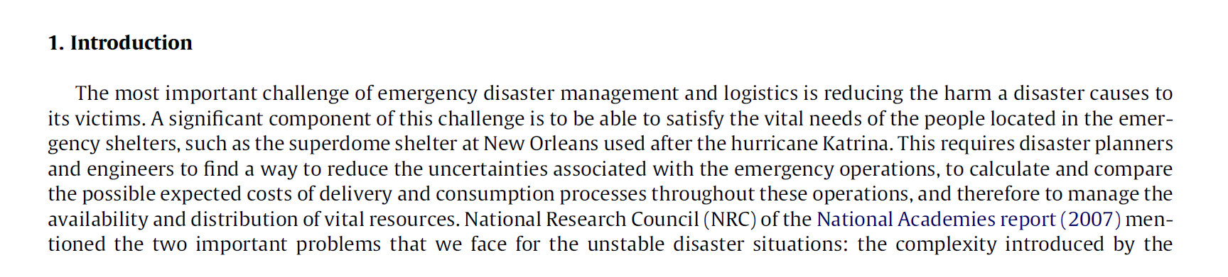
TECHNICAL WRITING
INTRODUCTION
8
Notes:
The introduction of your lab report should include the relevance of the lab and why the technology or engineering principles are relevant to us today as consumers and engineers. In your lab report introduction you also need to include the scientific principles present in the lab and relevant equations -- this is not shown in the research paper above.

Slide 11
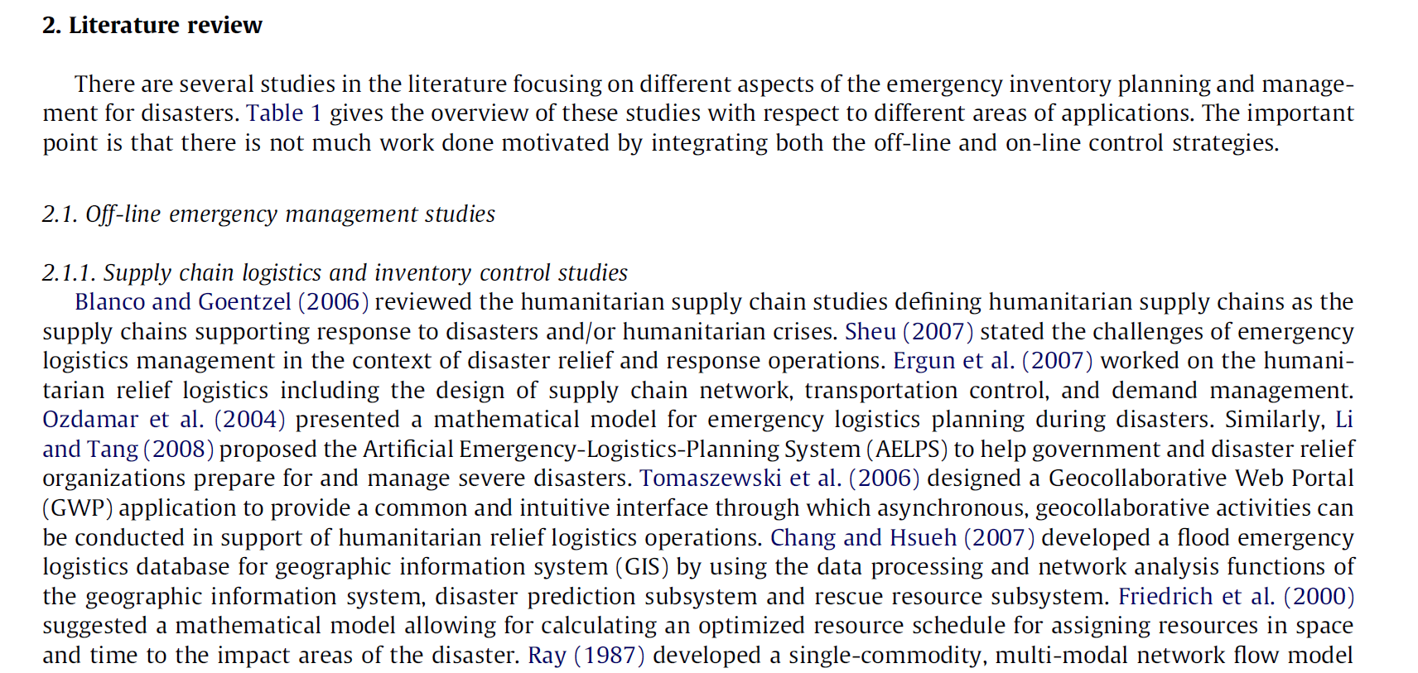
TECHNICAL WRITING
PROCEDURE
9
Notes:
The procedure of your lab report should outline the steps you took during the lab. The procedure in this example is a literature review which is more like the information you’ll include in your introduction section.

Slide 12

TECHNICAL WRITING
IN TEXT CITATION
10
Notes:
Throughout your lab report you will reference other sources and it is important to give proper credit. The highlights above show two different styles of in text citations.

Slide 13
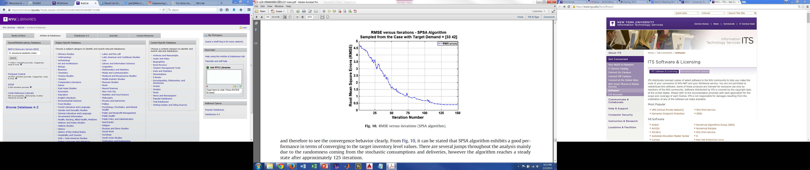
TECHNICAL WRITING
FIGURES
11
Notes:
In your lab report, images and charts will be shown as figures that are assigned numbers chronologically. Figures are labeled below the image and are referenced by name within the body of the text.

Slide 14
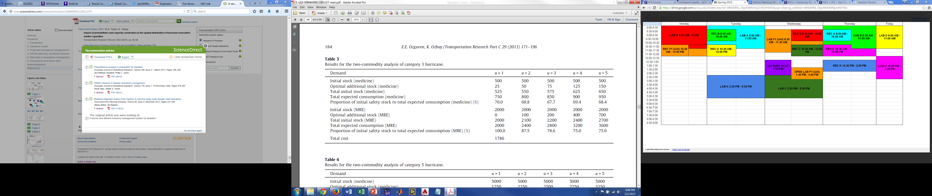
TECHNICAL WRITING
TABLES
12
Notes:
Tables help to present data collected in experiments. Tables are labeled above the data and are also referenced in the body of the text.

Slide 15

TECHNICAL WRITING
DATA & OBSERVATIONS
13
Notes:
The data and observations section includes the majority of the figures and tables in your report. In addition, sample calculations should be shown in the data and observation section.

Slide 16
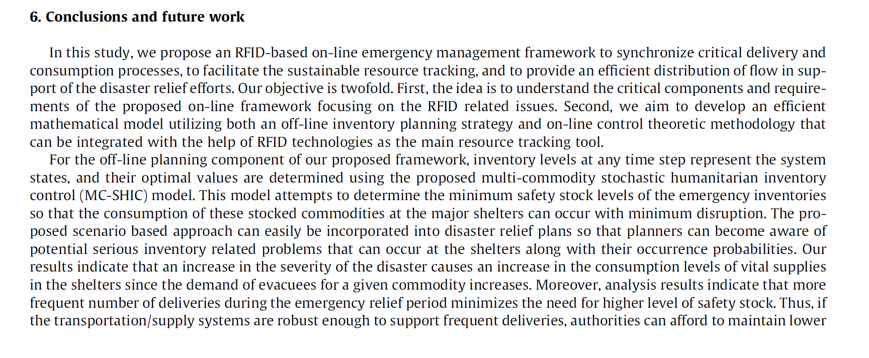
TECHNICAL WRITING
DISCUSSION & CONCLUSION
14
Notes:
The discussion and conclusion section should explain your findings and the outcome of the experiment. Future improvements and additional work that could be completed should also be mentioned.

Slide 17
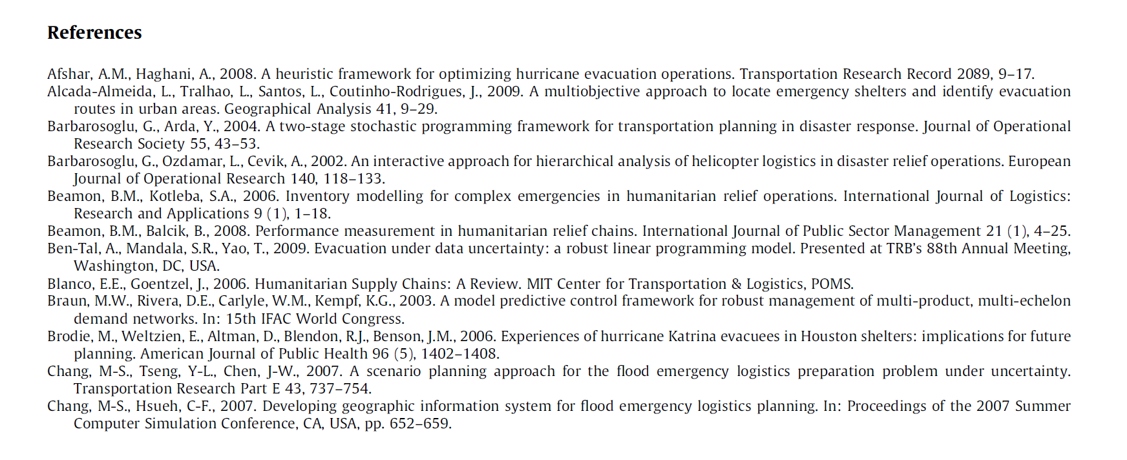
TECHNICAL WRITING
WORKS CITED
15
Notes:
Not only do you need to cite your sources in text, but all sources used in the report must be listed in the ‘works cited’ section. Some sources such as Google Scholar have citations for sources listed in different writing styles. You should also cite writing resources utilized such as a dictionary.

Slide 18
TECHNICAL WRITING
FINDING SOURCES
Google & Wikipedia
Google Scholar
NYU Libraries’ BobCat
Textbooks
  Electronic or physical copies
  FE Reference Manual
16
Notes:
When writing lab reports you should ensure that you are referencing academic sources. Google and Wikipedia are okay to address at first to refine your search criteria, but ultimately your sources need to be academic. Google scholar is a resource open to the general public to find academic articles, however, not all results will be academic and many will link to external resources that require subscriptions. NYU Libraries’ BobCat search tool allows full access to multiple research libraries.

Slide 19
CATME

Slide 20
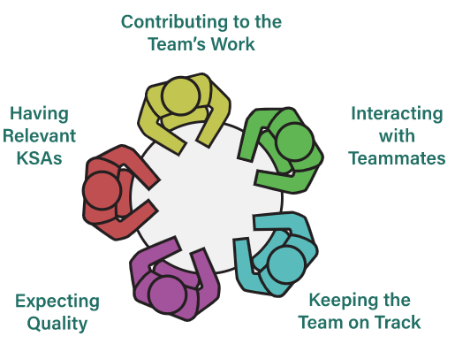
Why Do I Participate CATME?
Peer assessment on team dynamics
Monitor your performance on five dimensions
Identify any potential interpersonal conflicts
Professor’s intervention at early stage
Applicable individual team penalty based on evaluation
Figure 6: CATME Five Team Dimensions
17

Slide 21
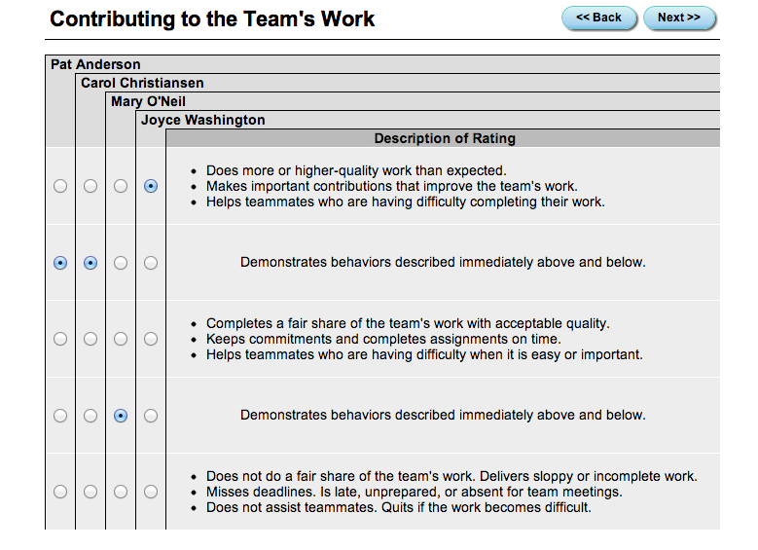
What Do I Need To Do?
Account will be automatically generated
Rater Practice due before Recitation 5 (Milestone 1)
Peer Evaluation I due before Recitation 7 (Milestone 2)
Peer Evaluation II due before Recitation 10 (Milestone 3)
Figure 7: CATME Interface
18

Slide 22
How To Write
Peer-to-Peer Comments*
Peer-to-Peer comments can be viewed by professor & team members
Practice reflecting on and incorporating feedback
Be respectful
Be real
There is no delete
Be trustworthy
Comment only on teammates’ behaviors
Your comments should be yours alone
* Courtesy of Purdue CATME team
19

Slide 23
Writing Effective
Peer-to-Peer Comments*
Balanced: Include both strengths and weaknesses
Respectful: Avoid negative language, set a positive tone
Implementable: Suggest ways which peers could immediately improve
Constructive: Not just identifying problems, offer solutions
Specific: Give detailed examples
* Courtesy of Purdue CATME team
20

Slide 24
Sample Peer-to-Peer Comments
Bad examples (Too generic): | Good examples:
A does not really understand what is going on | A could be more involved in the team activities. For example, A always miss the weekly team meeting. Also, A never give any feedback in the team discussion. I hope A could be more engaging and share with us A’s thoughts
B is very helpful and contributes a lot to the team | B is our evaluable team member. B is helping with organizing weekly team meetings and volunteering to take meeting notes. B is regarded by me as the team leader. B likes to keep everyone on track. B has very sound understanding on Arduino coding.
21

Slide 25
QUESTIONS?

