Slide 1


INTRODUCTION TO DIGITAL LOGIC
EG1004 | LAB 5

Slide 2

OVERVIEW
Objective
IDBE Implementation
Background Information
Materials
Procedure
Assignment
Closing
Figure 1: Semiconductor Courtesy of Scoop.it
1

Slide 3
OBJECTIVE
To design a combinational logic circuit for a given problem statement
To build and test the circuit on a breadboard
2

Slide 4

IDBE IMPLEMENTATION
Accessible Designs
  Designing an alarm with flashing lights is better for deaf users
  Reduces noise pollution
  But for visually impaired users, noise alarms are necessary
Be Aware– flashing lights and loud noises can have adverse effects on different people
As socially-aware engineers, what alarm solutions can you think of?
Figure 2: Flashing Fire Alarm
3

Slide 5
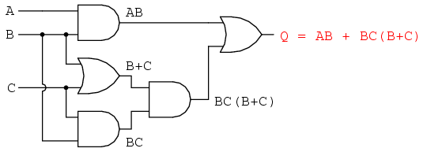
BACKGROUND INFORMATION
Digital logic:
  Conceptual language behind modern computer systems
  Two values of true and false (1 and 0) that lead to complicated decisions
Truth table – shows all the possible input combinations and their associated outputs (example on next slide)
Figure 3: Boolean Circuit Courtesy of
All About Circuits
4

Slide 6
BACKGROUND INFORMATION
Think of this example
An ATM has three options:
  Print statement
  Withdraw money
  Deposit money
The ATM will charge a fee when:
  Money is withdrawn
  A statement is printed without depositing money
Table 1: Truth Table for ATM Example
Inputs |  |  | Output
P (Print) | W (Withdraw) | D (Deposit) | C (Charge)
0 | 0 | 0
0 | 0 | 1
0 | 1 | 0
0 | 1 | 1
1 | 0 | 0
1 | 0 | 1
1 | 1 | 0
1 | 1 | 1
5

Slide 7
BACKGROUND INFORMATION
Think of this example
An ATM has three options:
  Print statement
  Withdraw money
  Deposit money
The ATM will charge a fee when:
  Money is withdrawn
  A statement is printed without depositing money
Table 1: Truth Table for ATM Example
Inputs |  |  | Output
P (Print) | W (Withdraw) | D (Deposit) | C (Charge)
0 | 0 | 0 | 0
0 | 0 | 1
0 | 1 | 0
0 | 1 | 1
1 | 0 | 0
1 | 0 | 1
1 | 1 | 0
1 | 1 | 1
6

Slide 8
BACKGROUND INFORMATION
Think of this example
An ATM has three options:
  Print statement
  Withdraw money
  Deposit money
The ATM will charge a fee when:
  Money is withdrawn
  A statement is printed without depositing money
Table 1: Truth Table for ATM Example
Inputs |  |  | Output
P (Print) | W (Withdraw) | D (Deposit) | C (Charge)
0 | 0 | 0 | 0
0 | 0 | 1 | 0
0 | 1 | 0
0 | 1 | 1
1 | 0 | 0
1 | 0 | 1
1 | 1 | 0
1 | 1 | 1
7

Slide 9
BACKGROUND INFORMATION
Think of this example
An ATM has three options:
  Print statement
  Withdraw money
  Deposit money
The ATM will charge a fee when:
  Money is withdrawn
  A statement is printed without depositing money
Table 1: Truth Table for ATM Example
Inputs |  |  | Output
P (Print) | W (Withdraw) | D (Deposit) | C (Charge)
0 | 0 | 0 | 0
0 | 0 | 1 | 0
0 | 1 | 0 | 1
0 | 1 | 1
1 | 0 | 0
1 | 0 | 1
1 | 1 | 0
1 | 1 | 1
8

Slide 10
BACKGROUND INFORMATION
Think of this example
An ATM has three options:
  Print statement
  Withdraw money
  Deposit money
The ATM will charge a fee when:
  Money is withdrawn
  A statement is printed without depositing money
Table 1: Truth Table for ATM Example
Inputs |  |  | Output
P (Print) | W (Withdraw) | D (Deposit) | C (Charge)
0 | 0 | 0 | 0
0 | 0 | 1 | 0
0 | 1 | 0 | 1
0 | 1 | 1 | 1
1 | 0 | 0
1 | 0 | 1
1 | 1 | 0
1 | 1 | 1
9

Slide 11
BACKGROUND INFORMATION
Think of this example
An ATM has three options:
  Print statement
  Withdraw money
  Deposit money
The ATM will charge a fee when:
  Money is withdrawn
  A statement is printed without depositing money
Table 1: Truth Table for ATM Example
Inputs |  |  | Output
P (Print) | W (Withdraw) | D (Deposit) | C (Charge)
0 | 0 | 0 | 0
0 | 0 | 1 | 0
0 | 1 | 0 | 1
0 | 1 | 1 | 1
1 | 0 | 0 | 1
1 | 0 | 1
1 | 1 | 0
1 | 1 | 1
10

Slide 12
BACKGROUND INFORMATION
Think of this example
An ATM has three options:
  Print statement
  Withdraw money
  Deposit money
The ATM will charge a fee when:
  Money is withdrawn
  A statement is printed without depositing money
Table 1: Truth Table for ATM Example
Inputs |  |  | Output
P (Print) | W (Withdraw) | D (Deposit) | C (Charge)
0 | 0 | 0 | 0
0 | 0 | 1 | 0
0 | 1 | 0 | 1
0 | 1 | 1 | 1
1 | 0 | 0 | 1
1 | 0 | 1 | 0
1 | 1 | 0
1 | 1 | 1
11

Slide 13
BACKGROUND INFORMATION
Think of this example
An ATM has three options:
  Print statement
  Withdraw money
  Deposit money
The ATM will charge a fee when:
  Money is withdrawn
  A statement is printed without depositing money
Table 1: Truth Table for ATM Example
Inputs |  |  | Output
P (Print) | W (Withdraw) | D (Deposit) | C (Charge)
0 | 0 | 0 | 0
0 | 0 | 1 | 0
0 | 1 | 0 | 1
0 | 1 | 1 | 1
1 | 0 | 0 | 1
1 | 0 | 1 | 0
1 | 1 | 0 | 1
1 | 1 | 1
12

Slide 14
BACKGROUND INFORMATION
Think of this example
An ATM has three options:
  Print statement
  Withdraw money
  Deposit money
The ATM will charge a fee when:
  Money is withdrawn
  A statement is printed without depositing money
Table 1: Truth Table for ATM Example
Inputs |  |  | Output
P (Print) | W (Withdraw) | D (Deposit) | C (Charge)
0 | 0 | 0 | 0
0 | 0 | 1 | 0
0 | 1 | 0 | 1
0 | 1 | 1 | 1
1 | 0 | 0 | 1
1 | 0 | 1 | 0
1 | 1 | 0 | 1
1 | 1 | 1 | 1
13

Slide 15
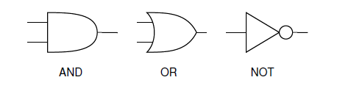
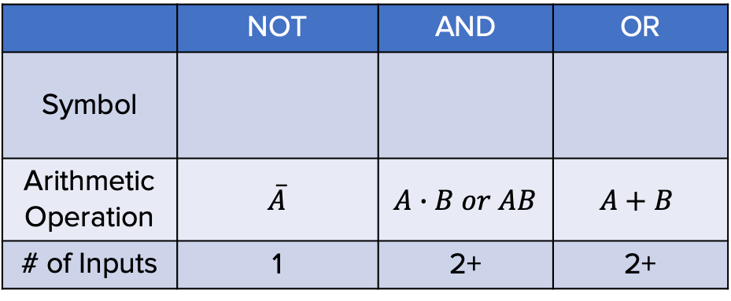
BACKGROUND INFORMATION
Logic gates:
  NOT gate – inverts the input
  AND gate – both inputs must be true for the output to be true
  OR gate – if either input is true the output will be true
Table 2: Logic Gates
 | NOT | AND | OR
Symbol
Arithmetic Operation | $$\overline{A}$$ | $$A∙B or AB$$ | $$A+B$$
# of Inputs | 1 | 2+ | 2+
14

Slide 16
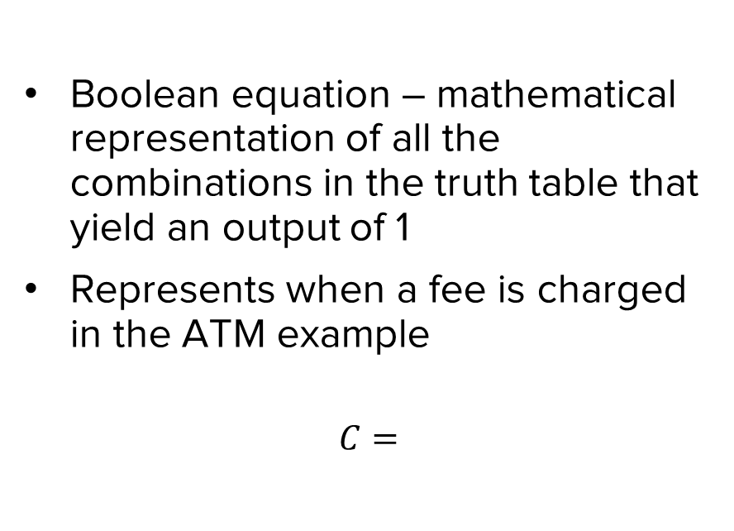
BACKGROUND INFORMATION
Table 3: Truth Table for ATM Example with True Combinations
Inputs |  |  | Output
P (Print) | W (Withdraw) | D (Deposit) | C (Charge)
0 | 0 | 0 | 0
0 | 0 | 1 | 0
0 | 1 | 0 | 1
0 | 1 | 1 | 1
1 | 0 | 0 | 1
1 | 0 | 1 | 0
1 | 1 | 0 | 1
1 | 1 | 1 | 1
15

Slide 17
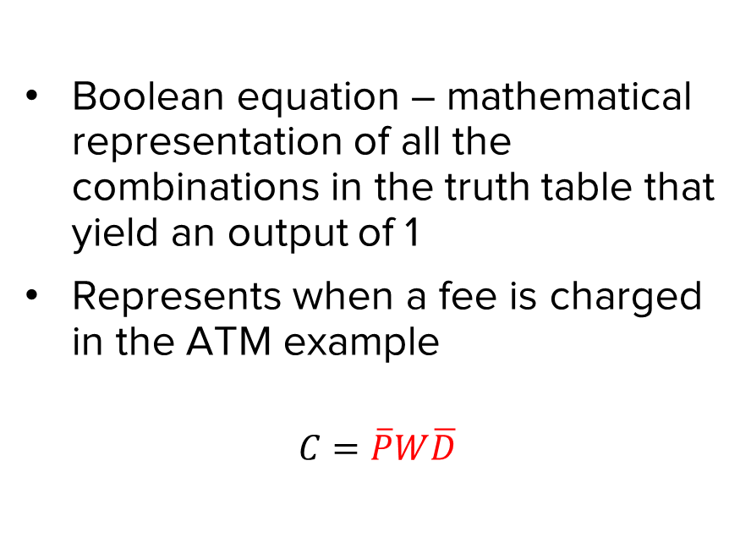
BACKGROUND INFORMATION
Table 3: Truth Table for ATM Example with True Combinations
Inputs |  |  | Output
P (Print) | W (Withdraw) | D (Deposit) | C (Charge)
0 | 0 | 0 | 0
0 | 0 | 1 | 0
0 | 1 | 0 | 1
0 | 1 | 1 | 1
1 | 0 | 0 | 1
1 | 0 | 1 | 0
1 | 1 | 0 | 1
1 | 1 | 1 | 1
16

Slide 18
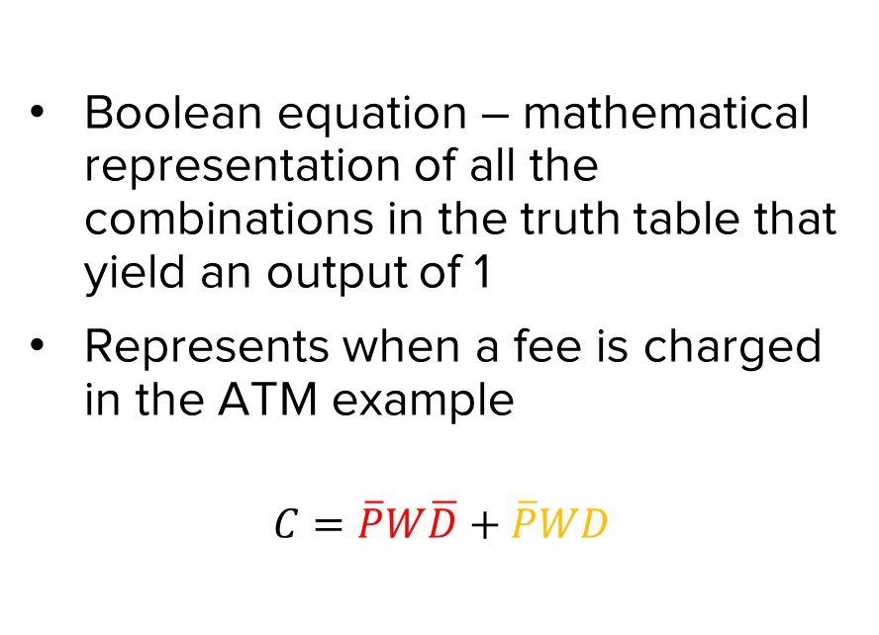
BACKGROUND INFORMATION
Table 3: Truth Table for ATM Example with True Combinations
Inputs |  |  | Output
P (Print) | W (Withdraw) | D (Deposit) | C (Charge)
0 | 0 | 0 | 0
0 | 0 | 1 | 0
0 | 1 | 0 | 1
0 | 1 | 1 | 1
1 | 0 | 0 | 1
1 | 0 | 1 | 0
1 | 1 | 0 | 1
1 | 1 | 1 | 1
17

Slide 19
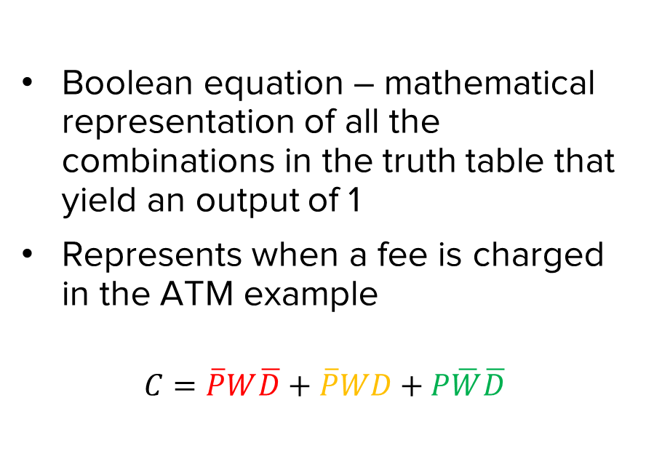
BACKGROUND INFORMATION
Table 3: Truth Table for ATM Example with True Combinations
Inputs |  |  | Output
P (Print) | W (Withdraw) | D (Deposit) | C (Charge)
0 | 0 | 0 | 0
0 | 0 | 1 | 0
0 | 1 | 0 | 1
0 | 1 | 1 | 1
1 | 0 | 0 | 1
1 | 0 | 1 | 0
1 | 1 | 0 | 1
1 | 1 | 1 | 1
18

Slide 20
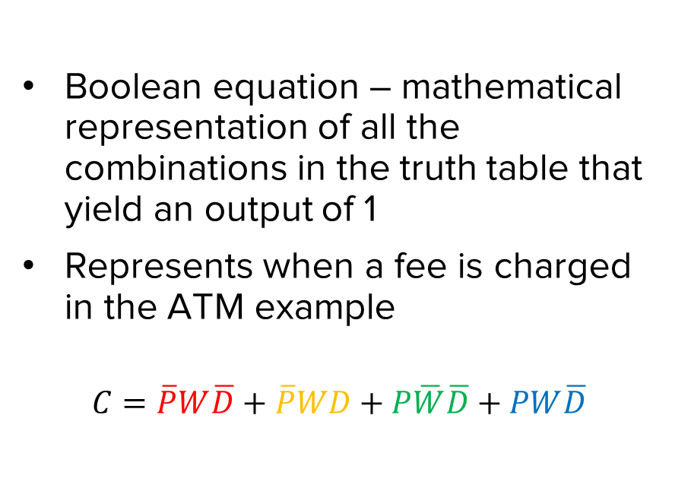
BACKGROUND INFORMATION
Table 3: Truth Table for ATM Example with True Combinations
Inputs |  |  | Output
P (Print) | W (Withdraw) | D (Deposit) | C (Charge)
0 | 0 | 0 | 0
0 | 0 | 1 | 0
0 | 1 | 0 | 1
0 | 1 | 1 | 1
1 | 0 | 0 | 1
1 | 0 | 1 | 0
1 | 1 | 0 | 1
1 | 1 | 1 | 1
19

Slide 21
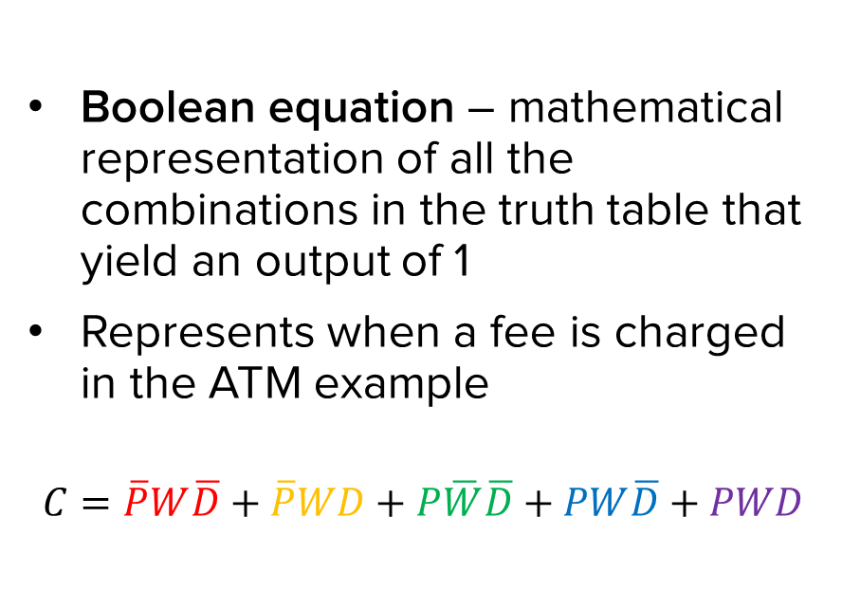
BACKGROUND INFORMATION
Table 3: Truth Table for ATM Example with True Combinations
Inputs |  |  | Output
P (Print) | W (Withdraw) | D (Deposit) | C (Charge)
0 | 0 | 0 | 0
0 | 0 | 1 | 0
0 | 1 | 0 | 1
0 | 1 | 1 | 1
1 | 0 | 0 | 1
1 | 0 | 1 | 0
1 | 1 | 0 | 1
1 | 1 | 1 | 1
20

Slide 22
BACKGROUND INFORMATION
Karnaugh map (K-map) – two-dimensional representation that shows the common characteristics of the inputs
Only one value can change at a time between adjacent rows and columns
Table 4: K-map for ATM Example
21

Slide 23
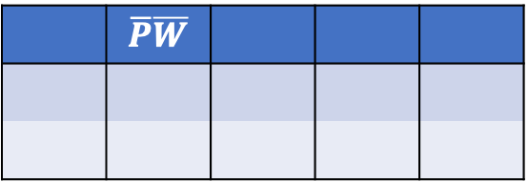
BACKGROUND INFORMATION
Karnaugh map (K-map) – two-dimensional representation that shows the common characteristics of the inputs
Only one value can change at a time between adjacent rows and columns
Table 4: K-map for ATM Example
 | $$\overline{P}\overline{W}$$
22

Slide 24
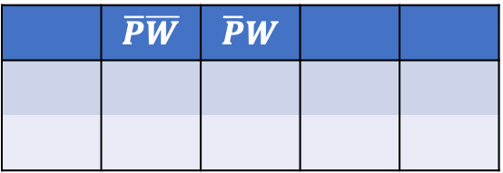
BACKGROUND INFORMATION
Karnaugh map (K-map) – two-dimensional representation that shows the common characteristics of the inputs
Only one value can change at a time between adjacent rows and columns
Table 4: K-map for ATM Example
 | $$\overline{P}\overline{W}$$ | $$\overline{P}W$$
23

Slide 25
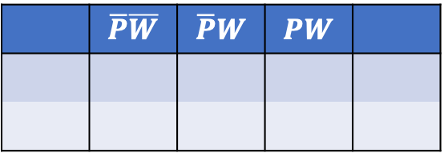
BACKGROUND INFORMATION
Karnaugh map (K-map) – two-dimensional representation that shows the common characteristics of the inputs
Only one value can change at a time between adjacent rows and columns
Table 4: K-map for ATM Example
 | $$\overline{P}\overline{W}$$ | $$\overline{P}W$$ | $$PW$$
24

Slide 26
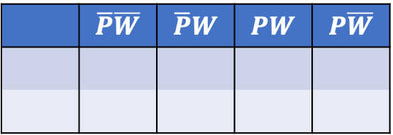
BACKGROUND INFORMATION
Karnaugh map (K-map) – two-dimensional representation that shows the common characteristics of the inputs
Only one value can change at a time between adjacent rows and columns
Table 4: K-map for ATM Example
 | $$\overline{P}\overline{W}$$ | $$\overline{P}W$$ | $$PW$$ | $$P\overline{W}$$
25

Slide 27
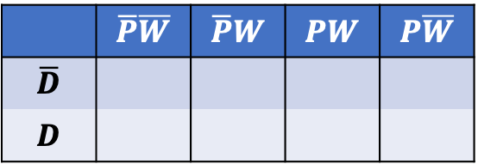
BACKGROUND INFORMATION
Karnaugh map (K-map) – two-dimensional representation that shows the common characteristics of the inputs
Only one value can change at a time between adjacent rows and columns
Table 4: K-map for ATM Example
 | $$\overline{P}\overline{W}$$ | $$\overline{P}W$$ | $$PW$$ | $$P\overline{W}$$
$$\overline{D}$$
$$D$$
26

Slide 28
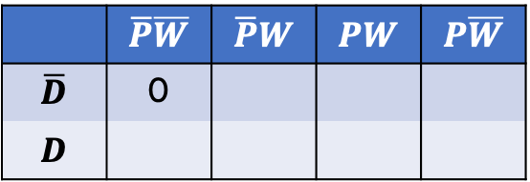
BACKGROUND INFORMATION
Karnaugh map (K-map) – two-dimensional representation that shows the common characteristics of the inputs
Only one value can change at a time between adjacent rows and columns
Table 4: K-map for ATM Example
 | $$\overline{P}\overline{W}$$ | $$\overline{P}W$$ | $$PW$$ | $$P\overline{W}$$
$$\overline{D}$$ | 0
$$D$$
27

Slide 29
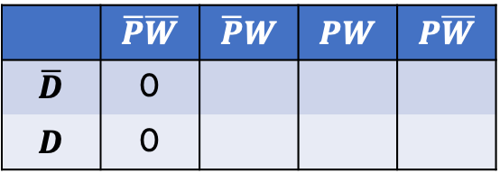
BACKGROUND INFORMATION
Karnaugh map (K-map) – two-dimensional representation that shows the common characteristics of the inputs
Only one value can change at a time between adjacent rows and columns
Table 4: K-map for ATM Example
 | $$\overline{P}\overline{W}$$ | $$\overline{P}W$$ | $$PW$$ | $$P\overline{W}$$
$$\overline{D}$$ | 0
$$D$$ | 0
28

Slide 30
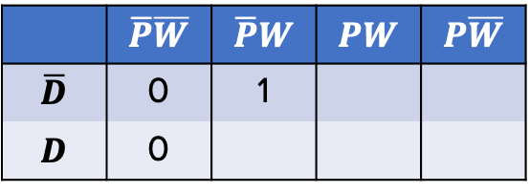
BACKGROUND INFORMATION
Karnaugh map (K-map) – two-dimensional representation that shows the common characteristics of the inputs
Only one value can change at a time between adjacent rows and columns
Table 4: K-map for ATM Example
 | $$\overline{P}\overline{W}$$ | $$\overline{P}W$$ | $$PW$$ | $$P\overline{W}$$
$$\overline{D}$$ | 0 | 1
$$D$$ | 0
29

Slide 31
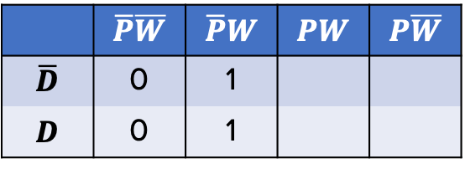
BACKGROUND INFORMATION
Karnaugh map (K-map) – two-dimensional representation that shows the common characteristics of the inputs
Only one value can change at a time between adjacent rows and columns
Table 4: K-map for ATM Example
 | $$\overline{P}\overline{W}$$ | $$\overline{P}W$$ | $$PW$$ | $$P\overline{W}$$
$$\overline{D}$$ | 0 | 1
$$D$$ | 0 | 1
30

Slide 32
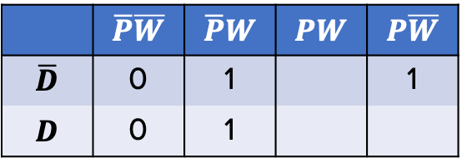
BACKGROUND INFORMATION
Karnaugh map (K-map) – two-dimensional representation that shows the common characteristics of the inputs
Only one value can change at a time between adjacent rows and columns
Table 4: K-map for ATM Example
 | $$\overline{P}\overline{W}$$ | $$\overline{P}W$$ | $$PW$$ | $$P\overline{W}$$
$$\overline{D}$$ | 0 | 1 |  | 1
$$D$$ | 0 | 1
31

Slide 33
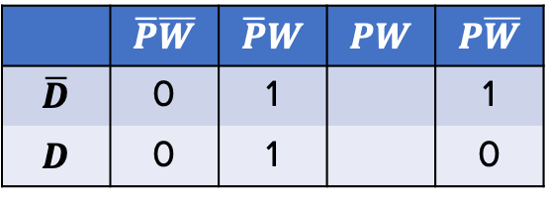
BACKGROUND INFORMATION
Karnaugh map (K-map) – two-dimensional representation that shows the common characteristics of the inputs
Only one value can change at a time between adjacent rows and columns
Table 4: K-map for ATM Example
 | $$\overline{P}\overline{W}$$ | $$\overline{P}W$$ | $$PW$$ | $$P\overline{W}$$
$$\overline{D}$$ | 0 | 1 |  | 1
$$D$$ | 0 | 1 |  | 0
32

Slide 34
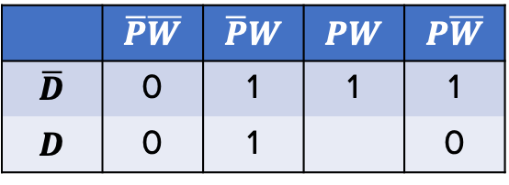
BACKGROUND INFORMATION
Karnaugh map (K-map) – two-dimensional representation that shows the common characteristics of the inputs
Only one value can change at a time between adjacent rows and columns
Table 4: K-map for ATM Example
 | $$\overline{P}\overline{W}$$ | $$\overline{P}W$$ | $$PW$$ | $$P\overline{W}$$
$$\overline{D}$$ | 0 | 1 | 1 | 1
$$D$$ | 0 | 1 |  | 0
33

Slide 35
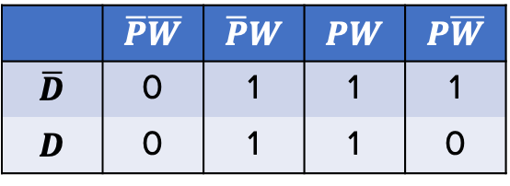
BACKGROUND INFORMATION
Karnaugh map (K-map) – two-dimensional representation that shows the common characteristics of the inputs
Only one value can change at a time between adjacent rows and columns
Table 4: K-map for ATM Example
 | $$\overline{P}\overline{W}$$ | $$\overline{P}W$$ | $$PW$$ | $$P\overline{W}$$
$$\overline{D}$$ | 0 | 1 | 1 | 1
$$D$$ | 0 | 1 | 1 | 0
34

Slide 36

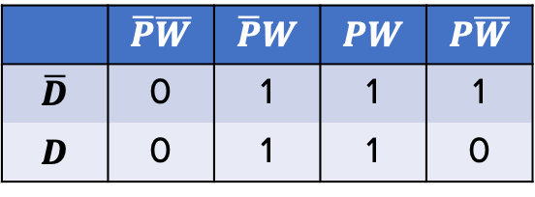
BACKGROUND INFORMATION
Simplified Boolean equation – mathematical representation of true values in the K-map
  Box together 1s in the K-map
  Number of cells in a box must be a
  power of 2 (1, 2, 4, 8, etc.)
  Look for the biggest boxes first
  Boxes can overlap
Simplified equation is determined by constant variable(s) in each box
Table 5: Simplified Boolean Equation
for ATM example
 | $$\overline{P}\overline{W}$$ | $$\overline{P}W$$ | $$PW$$ | $$P\overline{W}$$
$$\overline{D}$$ | 0 | 1 | 1 | 1
$$D$$ | 0 | 1 | 1 | 0
35

Slide 37

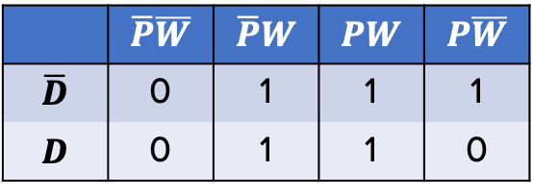
BACKGROUND INFORMATION
Simplified Boolean equation – mathematical representation of true values in the K-map
  Box together 1s in the K-map
  Number of cells in a box must be a
  power of 2 (1, 2, 4, 8, etc.)
  Look for the biggest boxes first
  Boxes can overlap
Simplified equation is determined by constant variable(s) in each box
Table 5: Simplified Boolean Equation
for ATM example
 | $$\overline{P}\overline{W}$$ | $$\overline{P}W$$ | $$PW$$ | $$P\overline{W}$$
$$\overline{D}$$ | 0 | 1 | 1 | 1
$$D$$ | 0 | 1 | 1 | 0
36

Slide 38

BACKGROUND INFORMATION
Simplified Boolean equation – mathematical representation of true values in the K-map
  Box together 1s in the K-map
  Number of cells in a box must be a
  power of 2 (1, 2, 4, 8, etc.)
  Look for the biggest boxes first
  Boxes can overlap
Simplified equation is determined by constant variable(s) in each box
Table 5: Simplified Boolean Equation
for ATM example
 | $$\overline{P}\overline{W}$$ | $$\overline{P}W$$ | $$PW$$ | $$P\overline{W}$$
$$\overline{D}$$ | 0 | 1 | 1 | 1
$$D$$ | 0 | 1 | 1 | 0
37

Slide 39


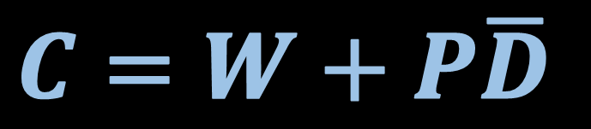



BACKGROUND INFORMATION
Combinational logic circuit – graphical representation of the simplified Boolean equation
OR
AND
NOT
Figure 4: Combinational Logic Circuit for ATM Example
38

Slide 40
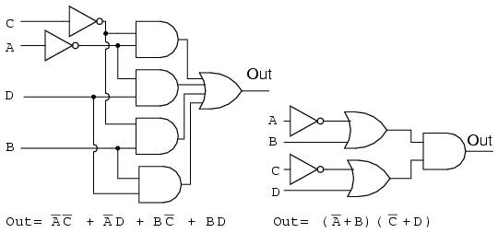
BACKGROUND INFORMATION
Minimization of Boolean functions
  K-map used to simplify complex Boolean equations
  Reduces complexity of logic circuit
  Would increase efficiency and decrease cost in implementation
Figure 5: Complex Logic Circuit (Left) vs.
Simplified Logic Circuit (Right)
39

Slide 41
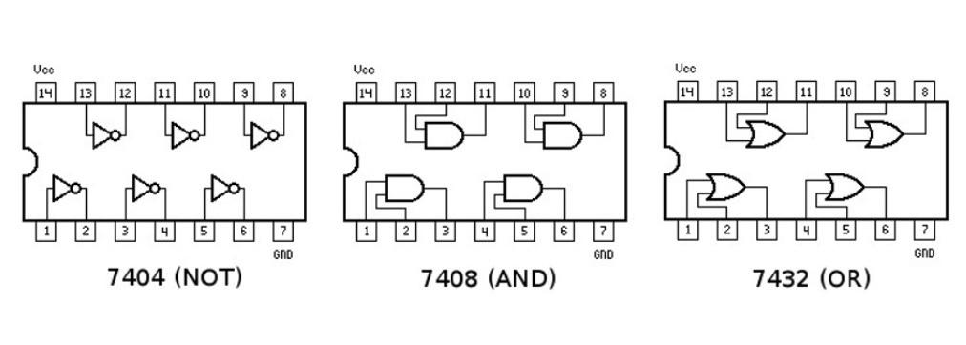
BACKGROUND INFORMATION
Integrated Circuits (ICs) – chips that consist of small assemblies of electronic components
Logic Gate ICs consist of logic gates that can be used to prototype combinational logic circuits on a breadboard
Figure 6: Diagram of NOT/AND/OR IC Chips
40

Slide 42
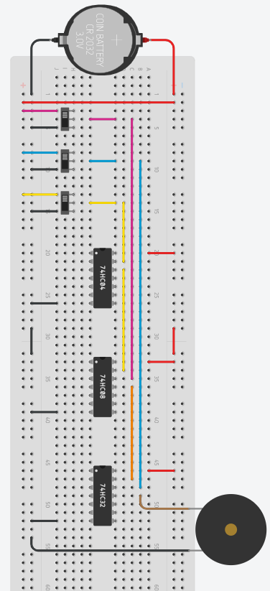



BACKGROUND INFORMATION
Print (P)
Withdraw (W)
Deposit (D)
Figure 7: Diagram of the example ATM circuit
41

Slide 43
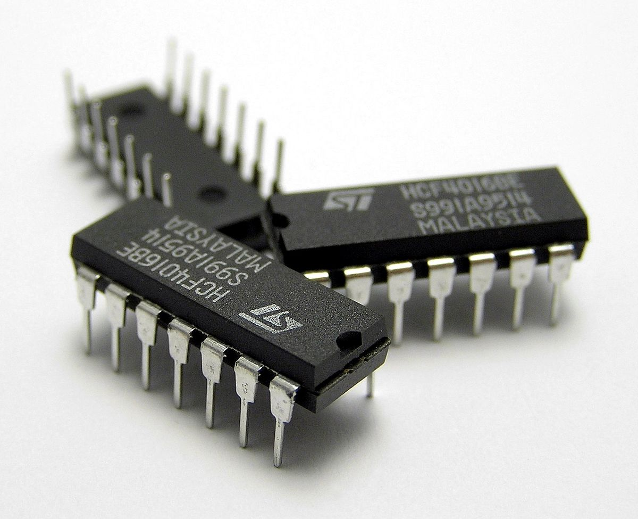
MATERIALS
A 7432 IC (4 dual-input OR gates)
A 7408 IC (4 dual-input AND gates)
A 7404 IC (6 single-input NOT gates)
Breadboard
5V Battery Case
LED
220 Ω Resistor
Slide Switches
Wires
Figure 8: Integrated circuit (IC) chips
courtesy of Wikipedia
42

Slide 44
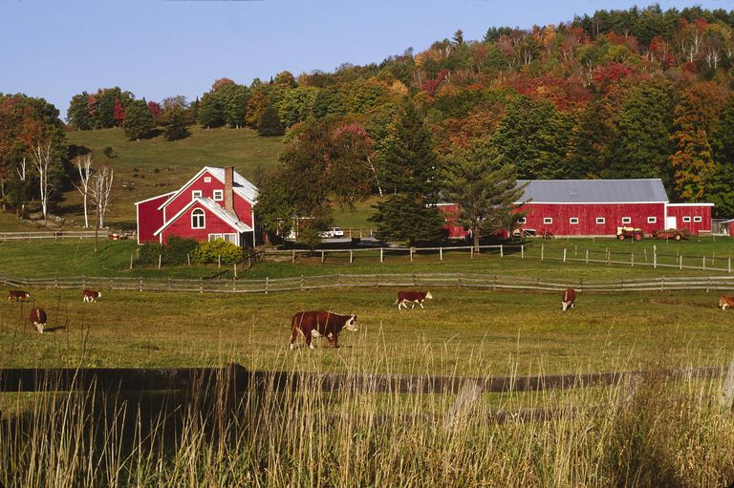
PROBLEM STATEMENT
Farmer Georgi has a hen on his 350-acre farm that produces high-quality eggs
To protect the hen from a fox who has been wandering around the farm and his grain, he needs an alarm system
Figure 9: Farmer Georgi’s Farm
Courtesy of ThoughtCo
43

Slide 45
PROBLEM STATEMENT
Farmer Georgi has two barns
  Think of Barn A as “0” and Barn B as “1” in the truth table
A fox, hen, and grain can be in either barn at anytime
Design an alarm system that will sound when:
  The fox and hen are in the same barn
  The hen and grain are in the same barn
44

Slide 46
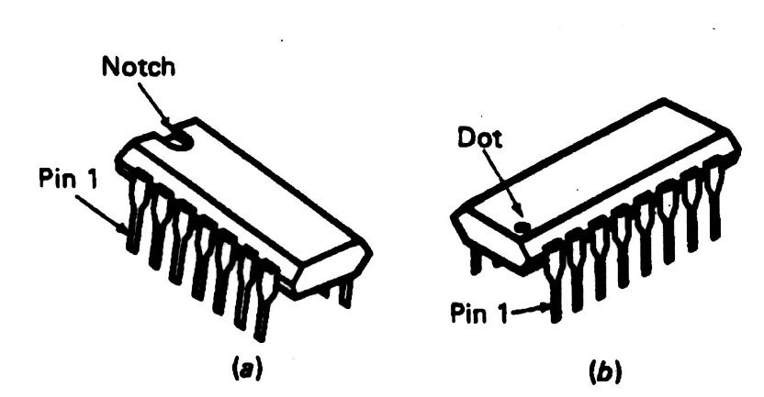
PROCEDURE
Part I: Formulate the Simplified Boolean Equation
Build a truth table for the alarm system
Create a Boolean equation
Build a K-map
Create a simplified Boolean equation
Draw a combinational logic circuit
  Add a light bulb to represent the alarm
Figure 10: IC Chip
45

Slide 47
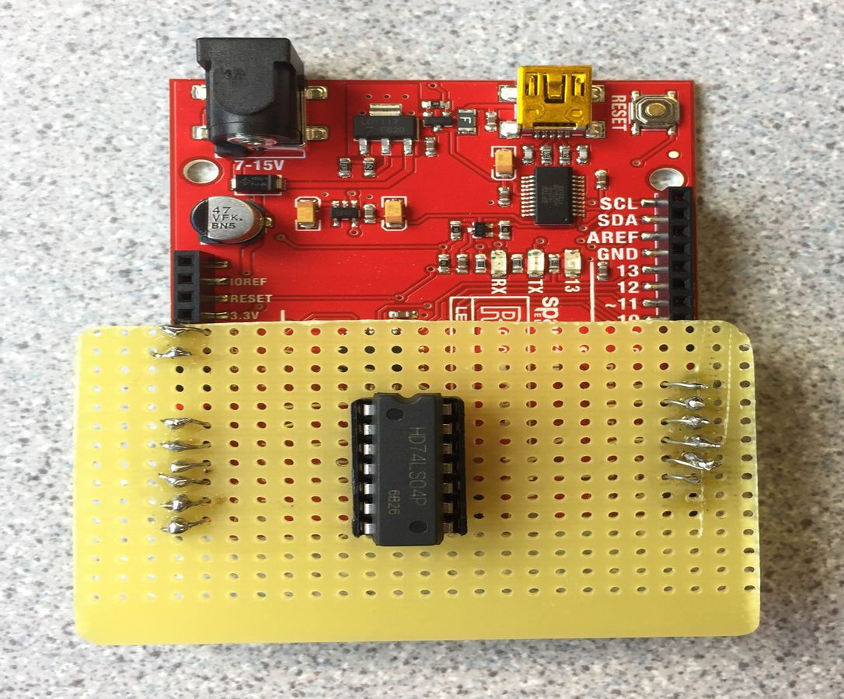
PROCEDURE
Part II: Test the IC Chips
Use the Arduino board setup by the TAs to test the NOT/OR/AND IC chips
The Arduino program will determine if the IC chips are functional or not
Orient the IC chips properly
Figure 11: IC chip tester
46

Slide 48
PROCEDURE
Part III: Build the Combinational Logic Circuit
Build and test the logic circuit on a breadboard
  Wire the combinational logic circuit using the IC chips
  Power (+5V) and ground the IC chips
  Orient the IC chips properly
Figure 12: Diagram of NOT/AND/OR IC Chips
47

Slide 49
ASSIGNMENT
Individual lab report:
  Answer discussion questions in manual
  Explain how k-maps help simplify the circuitry
  Include the truth table, both Boolean equations, and k-map
  Include pictures of the completed logic circuit
  Due at 11:59 PM the night before Lab 6
Team presentation:
  Address discussion points in manual
  Include pictures of the completed logic circuit
48

Slide 50
CLOSING
Take pictures of the completed logic circuit
Clean up workstations
Return all unused materials to the TA
49

Slide 51
QUESTIONS?

