Slide 1

RECITATION 7
EG1004

Slide 2
AGENDA
Literature Review
Engineering Design Canvas
Creating a LinkedIn Profile
Milestone 2 Presentations
2

Slide 3
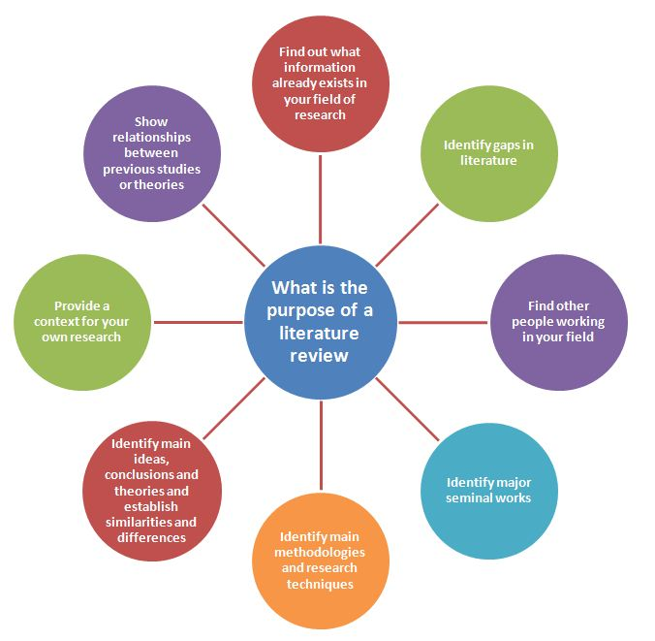

LITERATURE REVIEW
Figure 1: Literature review purpose
courtesy of Michigan State University
3

Slide 4
Design Canvas Exercise
CATME Peer Evaluations I
LinkedIn Profile
MILESTONE 2 CHECK

Slide 5
ENGINEERING DESIGN CANVAS

Slide 6
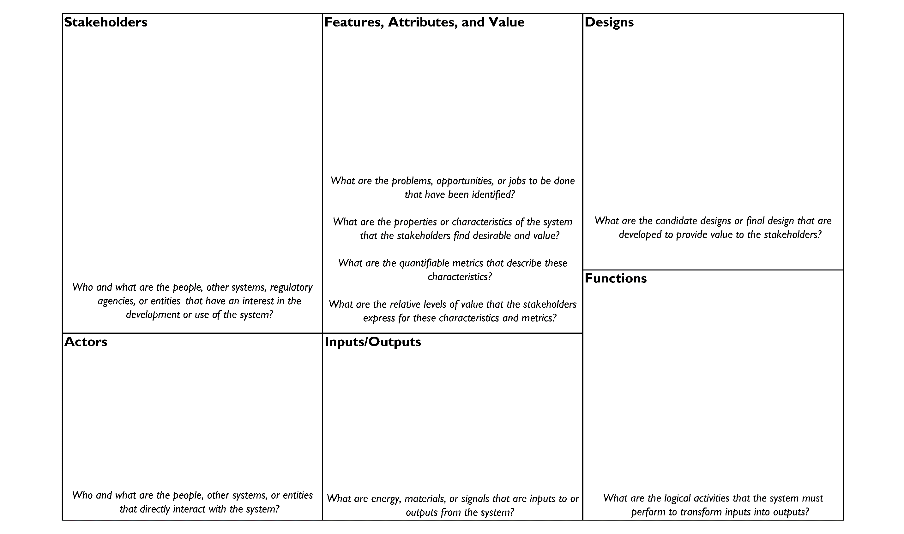
ENGINEERING DESIGN CANVAS
4
Notes:
**Have students complete this design canvas with their SLDP groups regarding their SLDP project**

Slide 7
QUESTIONS?

