Slide 1

Boom Construction

Slide 2
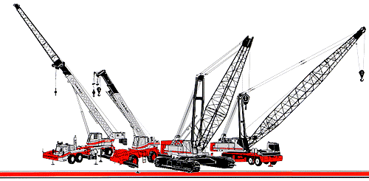
Overview
Objectives
Background
Materials
Procedure
Rules of the Competition
Report/Presentation
Closing

Slide 3
Objectives
What is a boom?
How and why do materials fail?
  Stress and strain
Design light-weight boom to hold significant load
Understand factors engineers consider when designing a boom
Construct and test boom

Slide 4
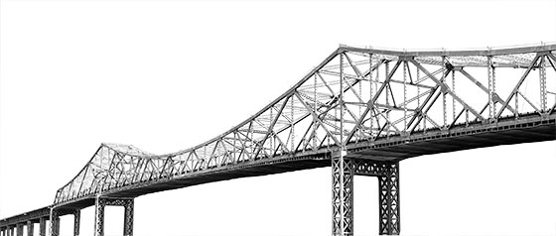
Boom
Lifts and moves heavy objects
  Objects usually much heavier than the boom
Examples:
  Construction cranes
  Computer monitor arms
  Cantilever bridges
  Rotating bridges

Slide 5
Common Structural Modes of Failure
Corrosion
Thermal cycling
Thermal shock
Breakage under load
Instant fracture
Delayed response (fatigue)

Slide 6
Corrosion
Exposure to caustic chemical for extended periods
  Acids
  Water (rust)
Substances and material react
  Material weakened by being “eaten away”
Examples:
  Iron rusting (exposing iron to water)
  Wind blowing sand on rocks, bridges, etc.
Salt
Air (oxidation)

Slide 7
Thermal Cycling
Material’s temperature changes continuously over time
Material cracks or shatters due to stresses created by expansion/contraction
Example:
  Elastic in clothes cracks once removed from clothes dryer

Slide 8
Thermal Shock
Material undergoes extreme temperature changes in a short time period
Mixed temperatures throughout material cause compression and expansion, resulting in cracks
Example:
  Hot glass bottle placed into ice cold water, bottle would explode and shatter

Slide 9
Breakage Under Load
Maximum load supported by material is exceeded
Material cracks/crumbles (i.e. thermal shock)
Over usage
  Too many load cycles

Slide 10
Stress and Strain
Stress: measure of internal force that keeps material together
  Resists from change of body
Strain: measure of deformation (elongation/compression) of material
  Change from original dimension
Examples:
  Stretching of rope while pulling
  Car tire under load

Slide 11
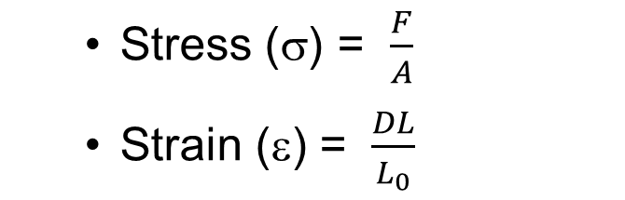
Stress-Strain Figure
Fixed Support
Stress (σ) = $\frac{F}{A}$
Strain (ε) = $\frac{DL}{L_{0}}$
Cross-sectional
area of bar
L_{o}
DL
Load F
F = applied force
A = cross-sectional area
DL = change in length
L_{o} = original length

Slide 12
Stress-Strain Graph
UTS
Key points/regions
  UTS (Ultimate Tensile Strength)
  Fracture Stress
  Elastic Region {E}
  Plastic Region {P}
{P}
Stress (σ) [Pa]
{E}
Fracture Stress
Strain (ε) [mm/mm]

Slide 13
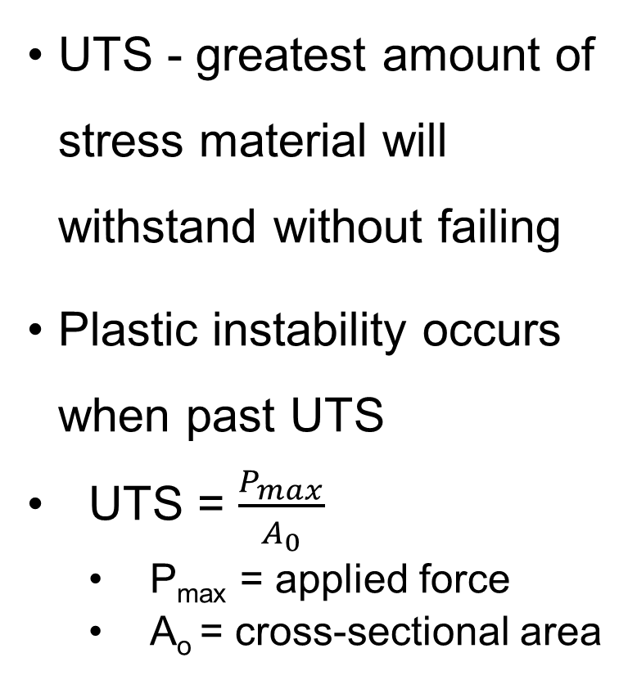
Stress-Strain Graph
UTS
UTS - greatest amount of stress material will withstand without failing
Plastic instability occurs when past UTS
UTS = $\frac{P_{max}}{A_{0}}$
  P_{max} = applied force
  A_{o} = cross-sectional area
{P}
Stress (σ) [Pa]
{E}
Fracture Stress
Strain (ε) [mm/mm]

Slide 14
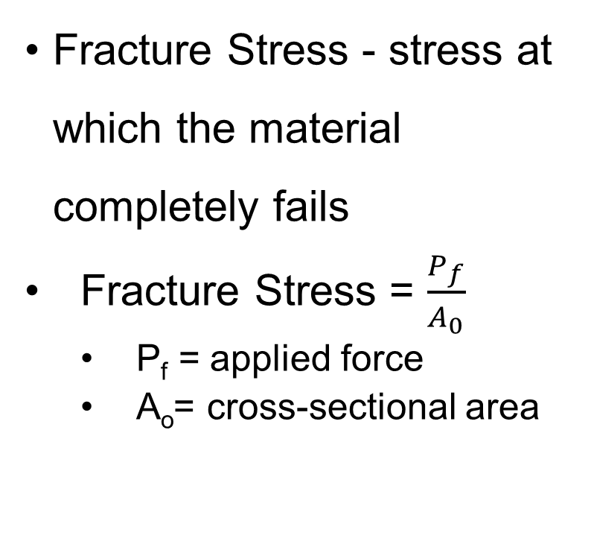
Stress-Strain Graph
UTS
Fracture Stress - stress at which the material completely fails
Fracture Stress = $\frac{P_{f}}{A_{0}}$
  P_{f} = applied force
  A_{o}= cross-sectional area
{P}
Stress (σ) [Pa]
{E}
Fracture Stress
Strain (ε) [mm/mm]

Slide 15
Stress-Strain Graph
Strain will disappear when stress is removed
Stress and strain vary linearly, obeying Hooke’s Law (σ ∝ ε)
Stiffness of material found by Young’s Modulus of Elasticity:
E = σ/ε
(slope of elastic region)
UTS
{P}
Stress (σ) [Pa]
{E}
Fracture Stress
Strain (ε) [mm/mm]

Slide 16
Stress-Strain Graph
Strain will NOT disappear when stress is removed
Permanent deformation
Range of plasticity:
Ductile materials deform considerably before fracture
Brittle materials do not deform much and failure occurs suddenly
UTS
{P}
Stress (σ) [Pa]
{E}
Fracture Stress
Strain (ε) [mm/mm]

Slide 17
Stress-Strain Example
The Plastic Pen Cap and Nervous Student
1. Elastic Region - Student applies force, bending tip of pen cap back. When force is removed, tip of cap returns to original position.
2. Plastic Region - Student twists and bends tip of cap. When force is removed, the tip of cap stays mangled.
3. UTS - Student bends cap some more. Cap still in one piece, but certain areas are very weak and on the verge of breaking.
4. Fracture Stress - Student bends cap one more time. The cap finally breaks into two pieces.
1
2
3
4

Slide 18


Materials for Lab
2 thin dowels (0.8 cm dia. x 122 cm)
2 thick dowels (1.1 cm dia. x 122 cm)
6 x 30.5 cm bamboo skewers
3D-printed dowel connectors
Cellophane tape
Kevlar string

Slide 19
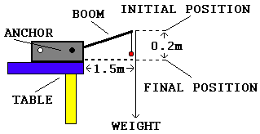
Setup for Testing

Slide 20

Competition Ratio
Unadjusted Ratio:
Adjusted Ratio:

Slide 21
Competition Rules
Design Specifications
  TA initials and dates sketches of design before materials are distributed
  Materials may be cut and arranged in any way
  Boom must extend a horizontal distance of at least
  1.5 m after mounting
  Construction must be completed in time allotted
  No more than 2 minutes to anchor boom
  Weight will be added until boom deflects 0.2 m
Design Specifications
Disqualifications
Declaration of winners

Slide 22
Competition Rules
Disqualifications
  Design is less than 1.5 m horizontally when mounted
  Exceeds 2 minute max time for anchoring boom
  Boom must only touch anchor
    (10.2 cm dia. pipe)
Design Specifications
Disqualifications
Declaration of winners

Slide 23
Competition Rules
Declaration of Winners
  Design with highest adjusted ratio wins competition
  Decision of TAs are FINAL
Design Specifications
Disqualifications
Declaration of winners

Slide 24
Competition
Boom Design
  Observe provided materials
  Brainstorm design strategy with team members
  Note design decisions and necessary design changes
  Sketch proposed design
  Have TA initial sketch and notes
  Build boom according to sketch
Boom Design
Test
Post-Test

Slide 25
Competition
Test
  TA will create a spreadsheet to record competition results
  Weigh boom and announce value to TA
  When instructed, fasten boom to anchor
    Announce when “DONE!”, to record time
  TA measures length from tip of anchor to weight mounting point on boom
    Must meet 1.5 m requirement
  Add weights until boom deflects 0.2 m vertically, or fails
Boom Design
Test
Post-Test

Slide 26
Competition
Post-Test
  TA announces winner of competition
    Team with largest adjusted ratio wins
  Copies of spreadsheet available to all teams on eg.poly.edu
  TA initials and scans original data
Boom Design
Test
Post-Test

Slide 27
Assignment: Report
Individual lab report
Title page
Discussion topics in the manual
Include class results and photo of boom

Slide 28
Assignment: Presentation
Team presentation
State rules of competition
Describe your design and its concepts
Include table of class results, sketches, photo of boom
How could your current design be improved?

Slide 29
Closing
Think safety! Be careful not to poke classmates with the dowels
Have all original data signed by TA
Submit all work electronically
Clean up workstations
Return all unused materials to TA

Slide 30

Boom Construction Competition
QUESTIONS?

