Slide 1

INTRODUCTION TO EG1004
EG1004 | RECITATION 1

Slide 2





COURSE OBJECTIVES
Explore concentrations of engineering
Develop professional skills
  Teamwork
  Oral communication
  Written communication
Explore technical tools & skills
Utilize the engineering design process
2

Slide 3




COURSE FORMAT
Lecture
1 hr. / week
Lab
3 hr. / week
Recitation
1.5 hr. / week
Semester-Long Design Project
3

Slide 4
ATTENDANCE POLICIES
Lecture
ID SWIPE
Lab
ID SWIPE
Recitation
PRESENTATION
Semester-Long Design Project
OWN TIME
4

Slide 5
ATTENDANCE POLICIES
Full absence & tardy policies on the EG1004 Manual
Lecture
NO MAKE UP
E-mail Recitation Professor
Lab
Makeup by Request
Visit Website
Recitation
E-mail Recitation Professor
Semester-Long Design Project
OWN TIME
5

Slide 6



LECTURE
Professors and industry experts lecture on engineering disciplines
Mandatory attendance
  Taken during first five minutes
  Don’t be late!
6

Slide 7
LABORATORY
Lab groups of 2-3 students
Weekly lab report due at 11:59 pm on night before the next lab
Weekly quiz
  Lab material
  Lecture material
Makeup labs requested on EG website
7

Slide 8

RECITATION
Student presentations on labs & projects
Due at 11:59 pm the night before recitation
Professor and TA material on becoming a well-rounded engineer:
  Engineering career pathways
  Professional skills
  Engineering mindset
  Technical writing
8

Slide 9

SEMESTER-LONG DESIGN PROJECT (SLDP)
12-week project
Teams of 2-3 students
More info to come
Figure 1: Sample SLDP RAD project courtesy of EG1003
9

Slide 10
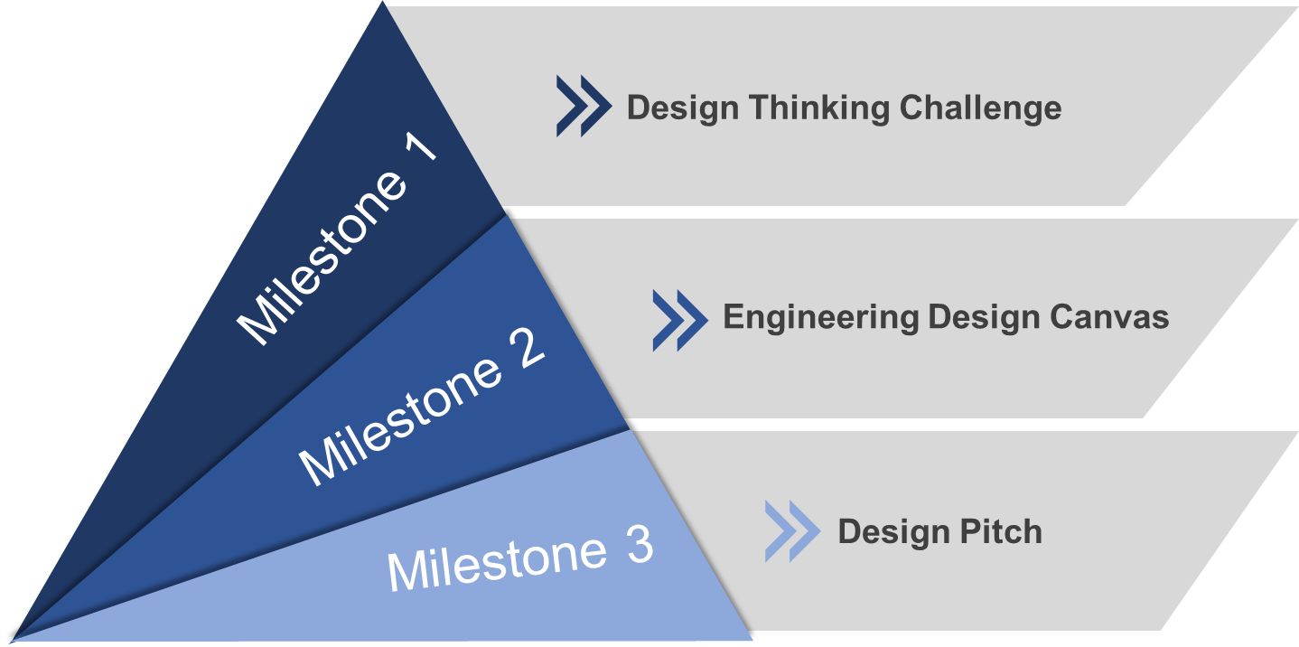

PROFESSIONAL SKILLS
Contributing to the Team’s Work
Interacting with Teammates
Having Relevant KSAs
Keeping the Team on Track
Expecting Quality
10

Slide 11


JOB APPLICATION PRACTICE
Tandon Career Services Lecture
Writing Consultant Presentations
Compile a Mock Job Application
Resume
Cover Letter
LinkedIn Profile
ePortfolio
11

Slide 12
GRADING BREAKDOWN
Item | Percentage of Grade
TA Lab Reports | 15%
WC Lab Reports | 15%
Lab Quizzes | 5%
Recitation Presentations | 15%
Semester-Long Design Project | 30%
Professional Development | 10%
Lecture Attendance | 10%
12

Slide 13
COURSE RESOURCES
EG1004 Website
eg.poly.edu
Assignment submission
Course announcements
Syllabus & schedule
Grades
EG1004 Lab Manual manual.eg.poly.edu
Lab & project information
Course material & presentations
Course policies
Help and how-tos
13

Slide 14
QUESTIONS?

