Slide 1


COMPUTER-AIDED DESIGN (CAD) COMPETITION
EG1004 | LAB 2

Slide 2


OVERVIEW
Objective
IDBE Implementation
Background Information
Materials
Procedure
Competition Rules
Assignment
Closing
Figure 1: Fusion 360 (Left) and Cura (Right) Courtesy of AppRecs and Wikipedia
1

Slide 3
OBJECTIVE
Use CAD software, Fusion 360, to modify a design
Analyze and modify a poorly-designed part in Fusion 360
Enter the modified part in a competition against other redesigns
2

Slide 4

IDBE IMPLEMENTATION
Inclusive Leadership
  Effective and inclusive leaders work to identify their peers’ strengths and support their weaknesses
  Our social identities play an important role in how we lead and the ways we can relate to others
Conflict Resolution
  How do you approach an interpersonal conflict?
  What expectations do you have for your team members? Are these realistic expectations?
  How can we make our emotions and the emotions of others heard?
Figure 2: Inclusive Leadership from Deloitte
3

Slide 5
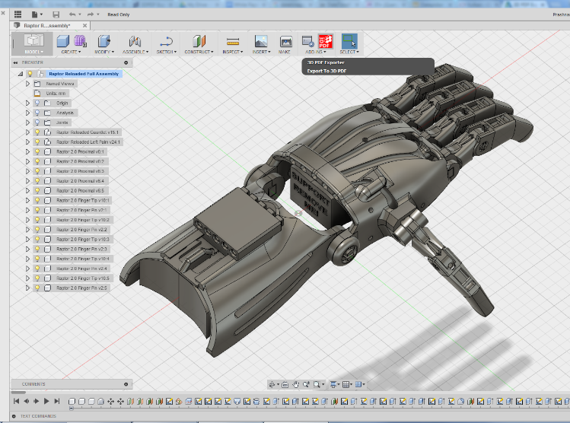
BACKGROUND
Fusion 360
  Computer-Aided Design (CAD) software
  Creates 3D drawings of engineering designs
  Also used for CAM, rendering, simulation, etc.
3D printing – allows for rapid prototyping and onsite manufacturing
Cura
  3D printing preparation application
Figure 3: Fusion 360 in use courtesy of Autodesk
4

Slide 6
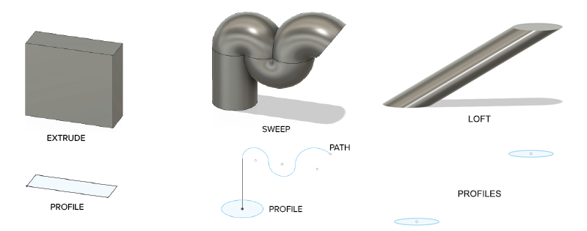
BACKGROUND INFORMATION
Design workspace
  Used to make precisely-scaled drawings of engineering designs
  Sketch a 2D profile
  Generate 3D body using Extrude, Sweep, or Loft
Figure 4: Extrude and Sweep tools
5

Slide 7
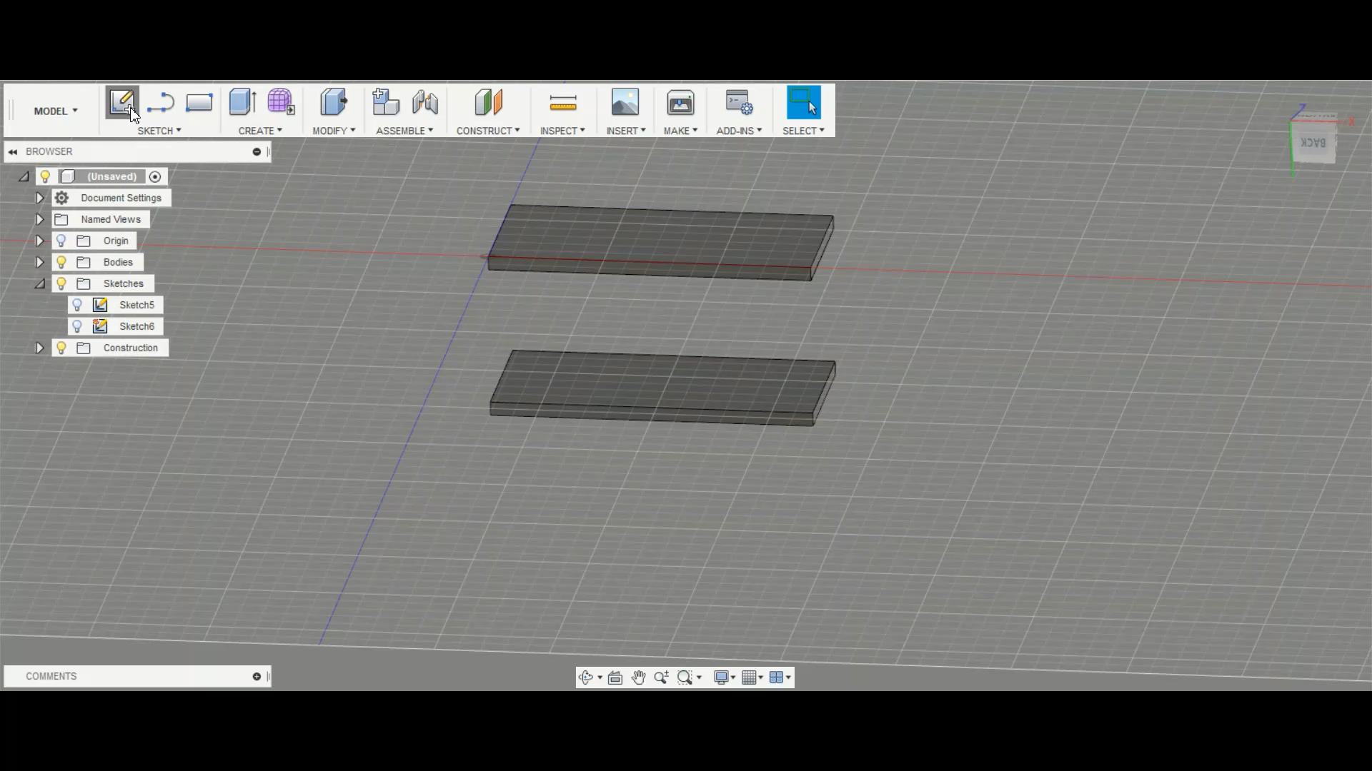
BACKGROUND INFORMATION
Loft
  Creates a 3D extrusion to connect two profiles
Sweep
  Creates a 3D model of a surface (profile) along a specific path
Figure 3: Extrude and Sweep tools
6
Notes:
The video has NO AUDIO, so make sure to walk through and narrate what is happening. The first thing they do here is a loft, and then a sweep.

Slide 8
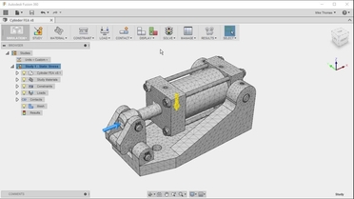
BACKGROUND INFORMATION
Simulation workspace
  Used to run structural analysis on model under real-world conditions
  Define the constraints (boundary conditions) on the model
  Apply a load to simulate real-world force
  Generate a mesh, an array of polygons making up the body of the model
Figure 5: Fusion 360 mesh courtesy of O’Reilly
7

Slide 9
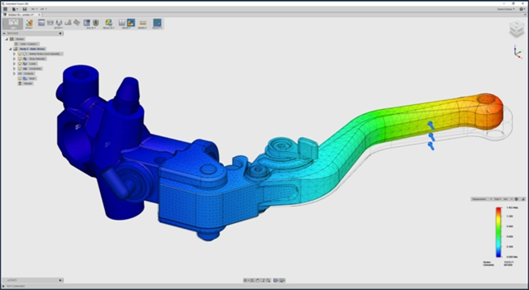
BACKGROUND INFORMATION
Simulation workspace
  Run simulation to obtain safety factor, a value used to describe how much stronger a system is than the expected load
  Can determine if an object is ready to sustain real-world loads or needs to be remodified
Figure 6: Fusion 360 simulation courtesy of Engineering.com
8

Slide 10
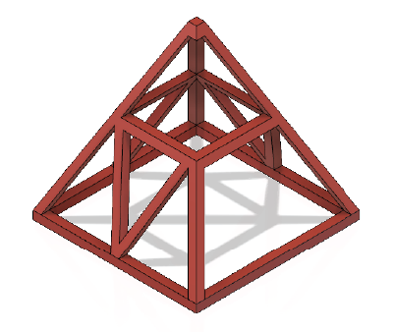
MATERIALS
A lab PC
Fusion 360
Predesigned part files (download
directly from the manual)
Figure 7: Truss Pyramid
9

Slide 11
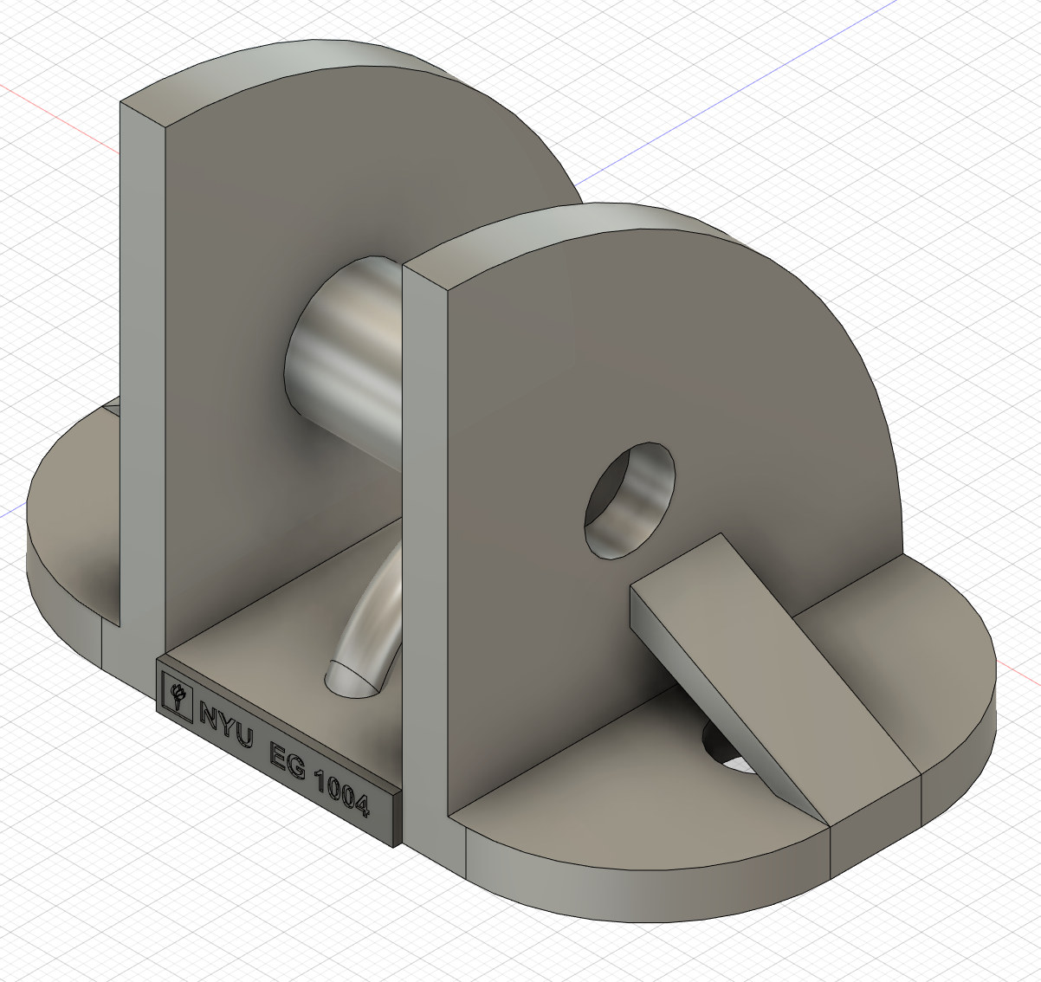
PROCEDURE
Part 1: Set up the File
Part 2: Learning Exercise
  Simultaneous activity with TAs
Figure 8: Redesigned Part
10

Slide 12
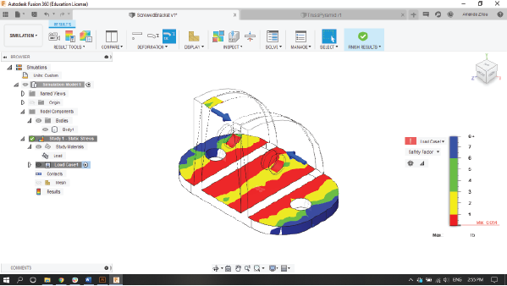
PROCEDURE
Part 3: CAD Competition
  Find the load, material, and
  constraints on the model
  Run a static stress simulation
  Review the initial factor of safety
  Modify the model in the Design workspace within the limits of the competition rules
  Rerun simulations and remodify until
  the part has safety factor of at least 3
  Save and store the F3D file for later use
Figure 9: Screwed bracket static stress simulation
11

Slide 13
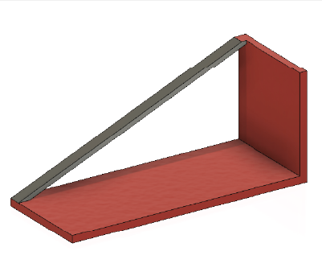
COMPETITION RULES
Redesigned part must be less than double the initial volume
Redesigned part must have a safety factor of at least 3
Cannot alter the applied loads or constraints
Cannot remove the areas highlighted in red on the model
Can only use aluminum, steel, copper, or lead
Figure 10: Wire
Supported Shelf
12

Slide 14
ASSIGNMENT
Individual lab report:
  Answer discussion questions in manual
  Learning Exercise section need not be discussed
  Include screenshots of at least two simulations
  Due at 11:59 PM the night before Lab 3
Team presentation:
  Address discussion points in manual
  Learning Exercise section need not be discussed
  Include drawings (top, front, most detailed side, isometric) of
  unmodified and modified part
  Due at 11:59 PM the night before Recitation 3
13

Slide 15
LAB REPORT REMINDER
CONTRIBUTION STATEMENTS
Paragraph at the end of Conclusion
Discuss the parts of the lab that you completed
State the importance of these parts to the overall experiment
Refer to the Sample Lab Report manual page under Writing Resources
14
Notes:
The paragraph needs to be added to the end of every conclusion. This does NOT apply to lab 3 lab reports. This applies to Lab 4 lab report and all the other lab reports after that. Ask them to refer to the Sample Lab Report page available on the manual under Writing Resources if they are confused. The paragraph is a part of the conclusion so it does not need a separate title.

Slide 16
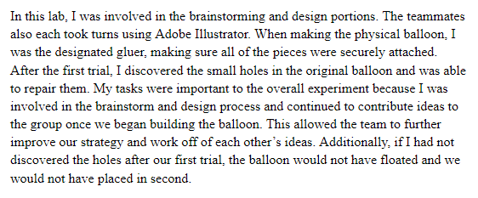
LAB REPORT REMINDER
EXAMPLE
15
Notes:
This example is also in the sample lab report manual page.

Slide 17
CLOSING
Have all original data signed by a TA
Submit all work electronically
Take screenshots of mechanical part before and after modification
16

Slide 18
QUESTIONS?

