Slide 1

RECITATION 1
EG1003

Slide 2
AGENDA
Engineering Curriculum
Course Overview
Academic Honesty & Plagiarism
How to Give a Recitation Presentation
2

Slide 3
ENGINEERING CURRICULUM

Slide 4
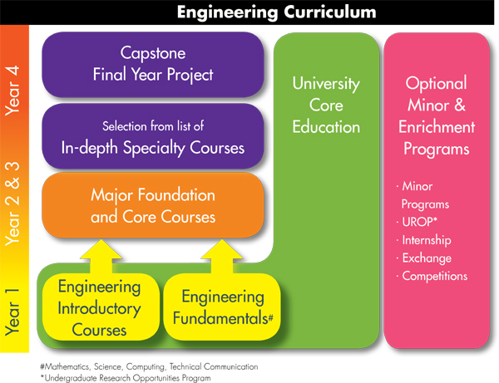

ENGINEERING CURRICULUM
4
Notes:
Many engineering schools across the world use this framework to provide engineering students with the skills and knowledge they’ll need post-university

Slide 5
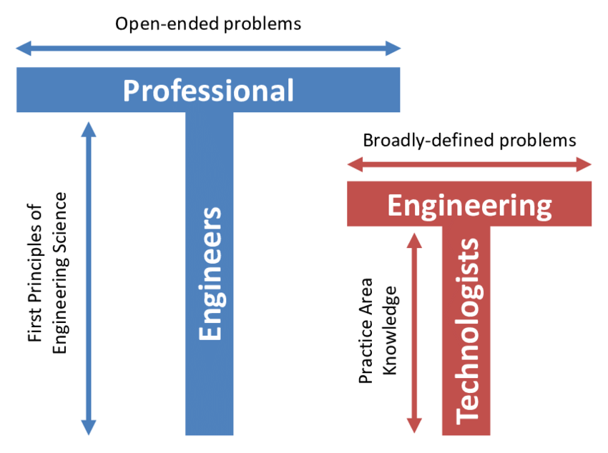
ENGINEERING CURRICULUM
The ‘T’ Shaped Engineer:
Height represents expertise
Width represents breadth of general knowledge
‘T’ shape enables engineers to solve a wide range of problems
5
Notes:
The engineering curriculum chart on the previous slide helps to create ’T’ shaped professional engineers. A professional engineer is someone who has a strong foundational science and mathematics background which greatly increases the scope of projects one can work on. An Engineering Technologist is someone who does not have a strong foundation in sciences and math (may not have a college degree) and focus instead on implementation and technical skills.

Slide 6
ENGINEERING CURRICULUM
ABET Outcomes:
Identify, formulate, and solve engineering problems by applying principles of engineering, science, and mathematics.
Apply analysis and synthesis in the engineering design process, resulting in designs that meet desired needs.
Develop and conduct appropriate experimentation, analyze and interpret data, and use engineering judgment to draw conclusions.
Communicate effectively with a range of audiences.
Recognize ethical and professional responsibilities in engineering situations
Recognize the ongoing need for additional knowledge and locate, evaluate, integrate, and apply this knowledge appropriately.
An ability to function effectively on teams that establish goals, plan tasks, meet deadlines, and analyze risk and uncertainty
6
Notes:
Professional Engineers are those who come out of an ABET accredited engineering program. The ABET accreditation of each major in an engineering school helps provide engineers with the best education by implementing high programmatic standards created by the ABET board. Major programs are reassessed and audited often to ensure that the program adequately prepares engineers for the workforce. The outcomes above highlight some of the ABET accreditations and goals for engineers to develop through their studies. These outcomes are largely used to create curriculum, including in EG 1003.

Slide 7
COURSE OVERVIEW

Slide 8



COURSE OBJECTIVES
Explore concentrations of engineering
Develop professional skills
  Teamwork
  Oral communication
  Written communication
Develop technical skills
Utilize the engineering design process
8

Slide 9




COURSE FORMAT
Lecture
1 hr / week
Lab
3 hr / week
Recitation
1.5 hr / week
Semester-Long Design Project
9

Slide 10
LECTURE
Department and guest lecturers cover engineering aspects
Mandatory attendance
  Taken during first five minutes
  Don’t be late!
10

Slide 11
LABORATORY
Lab groups of 2-3 students
Weekly lab report due at 11:59 pm on night before the next lab
Weekly quiz
  Lab material
  Lecture material
Makeup labs requested on EG website
11

Slide 12

RECITATION
Student presentations on labs & projects
Due at 11:59 pm the night before recitation
Professor and TA material on becoming a well-rounded engineer:
  Engineering career pathways
  Professional skills
  Engineering mindset
  Technical writing
12

Slide 13
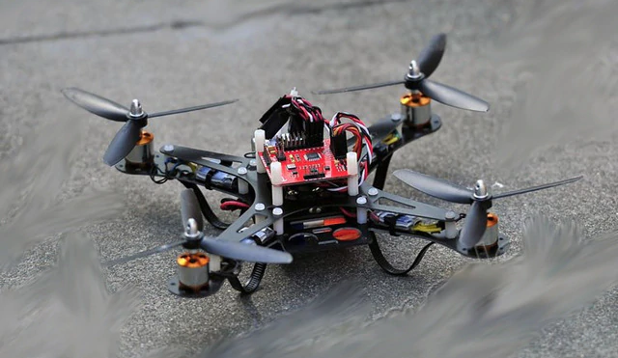
SEMESTER-LONG DESIGN PROJECT (SLDP)
Ten-week project
Teams of 2-3 students
More info to come
Figure 1: Sample SLDP RAD project courtesy of EG1003
13

Slide 14
ABSENCE & TARDY POLICIES
Lecture
  Attendance in first five minutes
Laboratory
  No extensions on quiz time for tardiness
Recitation
  Unexcused absences result in 0 on presentation
  Your group will present without you
14

Slide 15

ABSENCE & TARDY POLICIES
Notify Professor and Recitation TA in advance of absence
Excused absences processed through NYU Tandon Student Affairs
Full absence & tardy policies on the EG1003 Manual
15

Slide 16
GRADING BREAKDOWN
Item | Percentage of Grade
TA Lab Reports | 20%
WC Lab Reports | 20%
Lab Quizzes | 5%
Recitation Presentations | 15%
Semester-Long Design Project | 30%
Lecture Attendance | 10%
16

Slide 17
COURSE RESOURCES
EG1003 Website
eg.poly.edu
Assignment submission
Course announcements
Syllabus & schedule
Grades
EG1003 Lab Manual manual.eg.poly.edu
Lab & project information
Course material
Course policies
Help and how-tos
17

Slide 18
QUESTIONS?

Slide 19
ACADEMIC HONESTY & PLAGIARISM

Slide 20

WHAT IS ACADEMIC DISHONESTY?
NYU Code of Conduct: Misrepresentation, deception, dishonesty, or any act of falsification to influence academic evaluation
Cheating
Fabrication
Falsifying data or sources
Group work on individual tasks
Using unauthorized resources
Unauthorized Collaboration
Using work for multiple courses
Duplicating Work
Forgery
Altering an academic document
Plagiarism
Failure to credit borrowed content
20

Slide 21
IMPORTANCE OF PROPER CITATION
Severe consequences for failing to give proper credit
Professionally
Civil penalties (lawsuits)
Criminal penalties
End of career
Academically
Zeros on assignments
Reported to Student Affairs
Expulsion from the university
Course failure
Loss of reputation
21

Slide 22

PROFESSIONAL ETHICS
National Society of Professional Engineers Code of Ethics
  Responsibility for welfare, safety and health of the public
  Uphold respectability of profession
  Avoid deceptive acts
Full code of ethics at NSPE.org
Figure 2: NSPE Logo courtesy of NSPE
22

Slide 23
EG1003 PLAGIARISM POLICY
1st Offense
Zero on assignment, notify Student Affairs
2nd Offense
Fail EG1003
  Software used to
  compare lab reports:
  Peer submissions
  Previous students
  Other sources
23

Slide 24
STRATEGIES TO AVOID PLAGIARISM
Start Early
Don’t Share Work
Last minute pressure can cause students to plagiarize
Deductions for late work are better than a zero
You are also penalized if your work is copied!
Cite Frequently
Cite lab manual and all other sources used
Don’t Search Online Databases
Your work is checked using a software
Citation presentation in student manual to help
24

Slide 25
CITING IN LAB REPORTS
  Full citation in works cited section:
    NYU Tandon School of Engineering. (2020). “Lab 11: Biomedical Forensics.” EG1003 Online Lab Manual. Accessed 6 August 2020 from manual.eg.poly.edu.
  In text citation near info quoted or paraphrased:
    (NYU Tandon, 2020)
25

Slide 26
QUESTIONS?

Slide 27
HOW TO GIVE A
RECITATION PRESENTATION

Slide 28
LAB PRESENTATION OVERVIEW
Timed five-minute presentation on labs
Post-presentation feedback from Professor, WC, and TA
  Listen & learn: penalty for redundant feedback
Graded on visual and verbal presentation
28

Slide 29
PRESENTATION FORMAT
Consistent format and order for all lab presentations:
Title
Agenda
Experimental Objective
Introduction
Background Information
Materials
Procedure
Data/Observations
Results
Conclusion
Title
ALWAYS use this order!
29

Slide 30
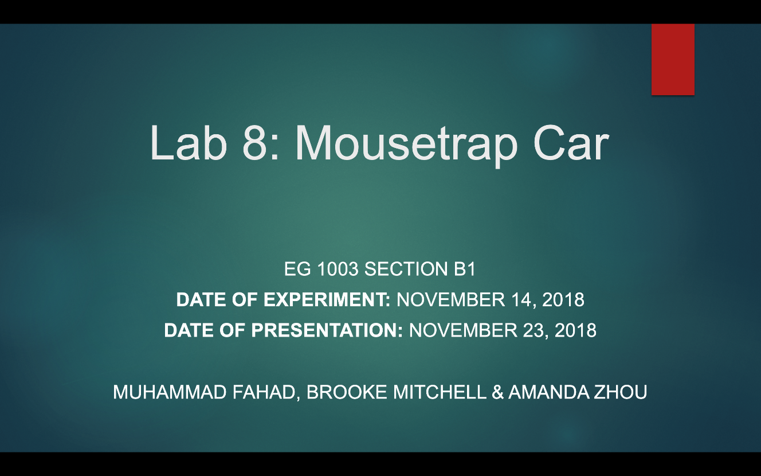
TITLE SLIDE
Lab number and title
Course number and section
Date of experiment
Date of presentation
Team members’ names
  Alphabetical by last name
Repeat title slide at end of presentation
Figure 3: Sample title slide
30

Slide 31
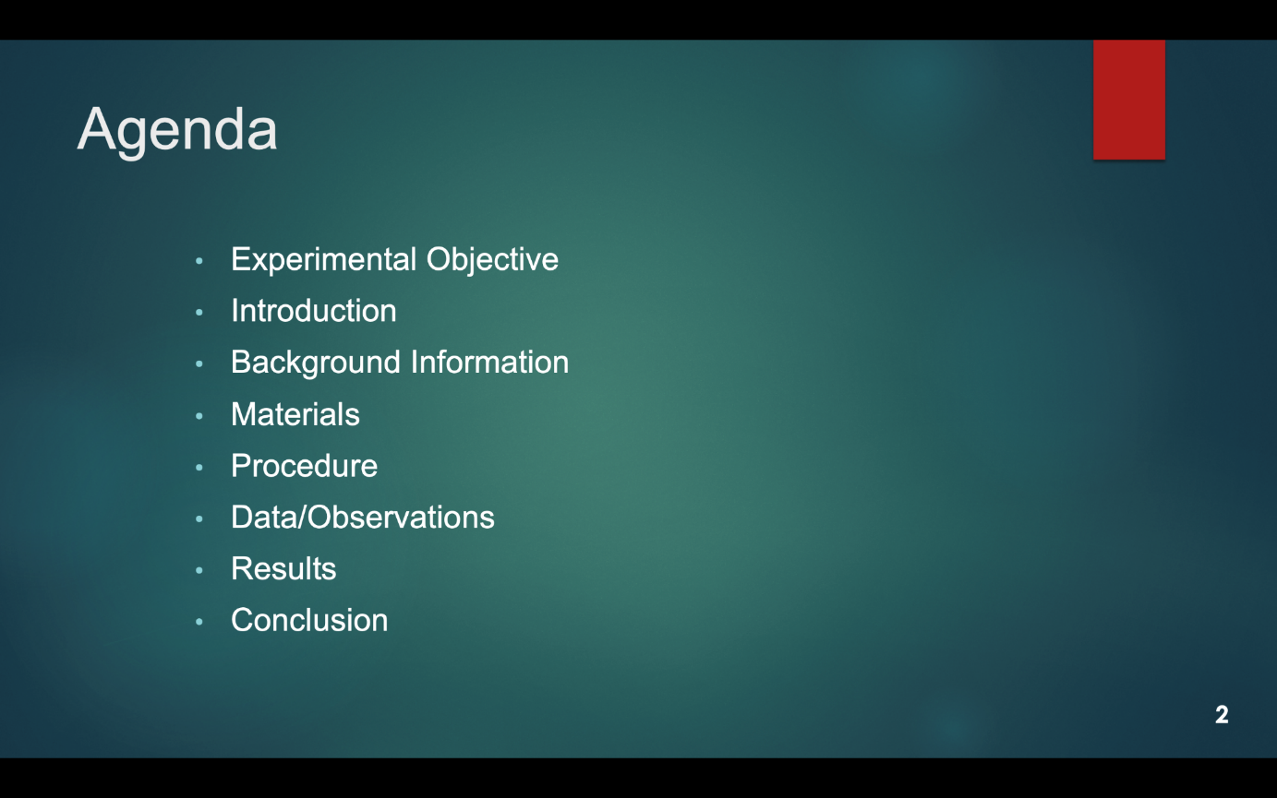
AGENDA SLIDE
Slide title “Agenda”
No need to read slide aloud during presentation
Same agenda slide/order for all presentations!
Figure 4: Agenda slide sample
31

Slide 32
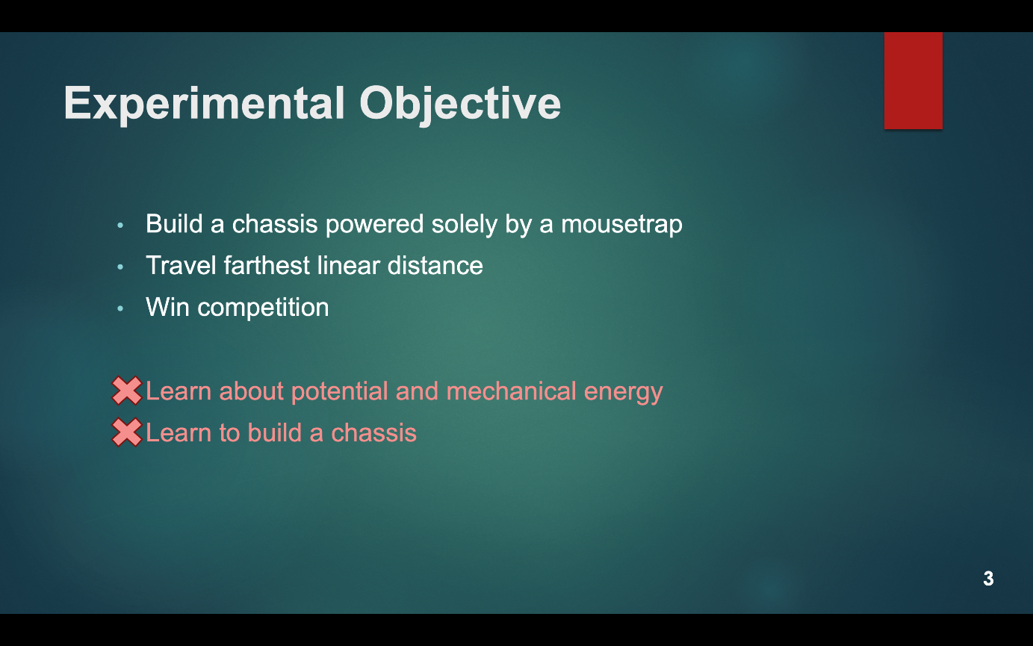
EXPERIMENTAL OBJECTIVE SLIDE
Slide title “Experimental Objective”
Scientific principles/objectives
  No learning objectives
Specify if experiment is a competition
Figure 5: Experimental objective sample
32

Slide 33
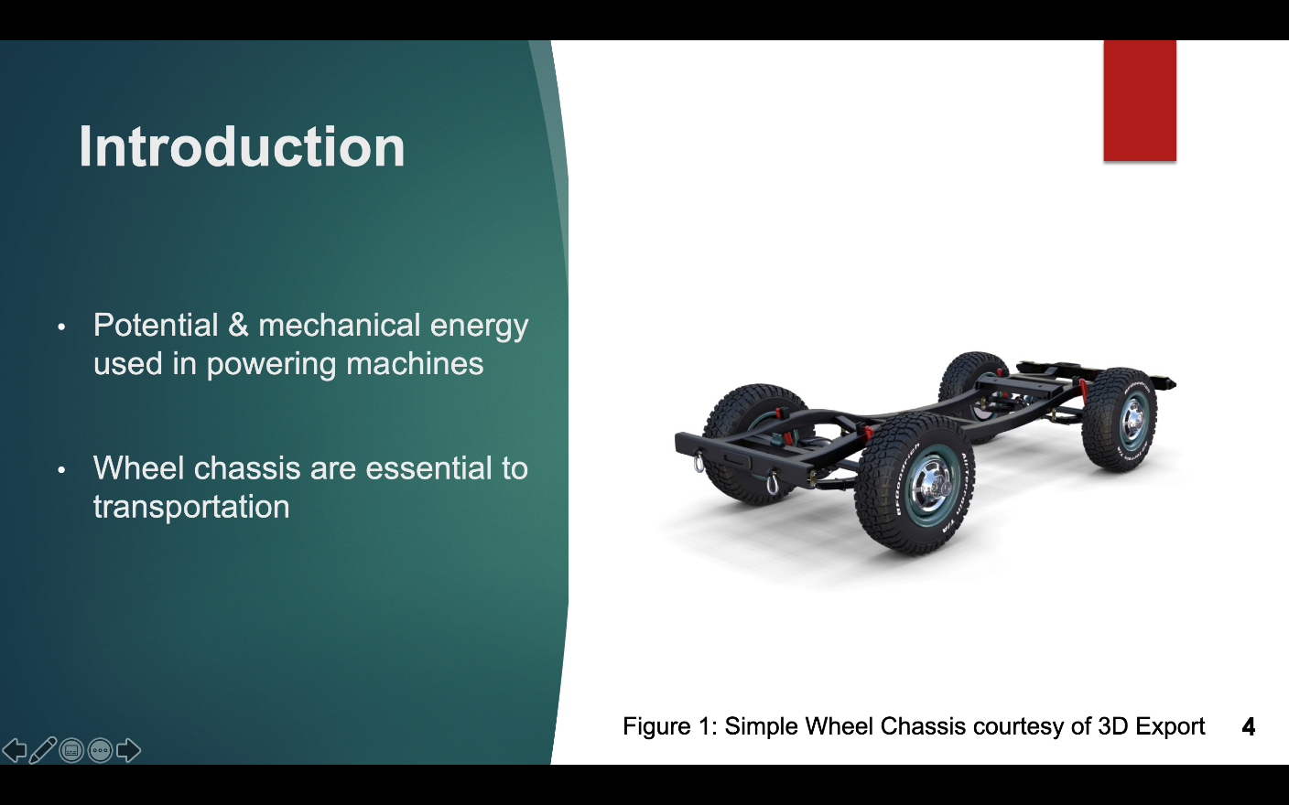
INTRODUCTION SLIDE
Slide title “Introduction”
Relevance & real-life applications of topics in lab
Importance of topics in engineering
Figure 6: Introduction sample
33

Slide 34
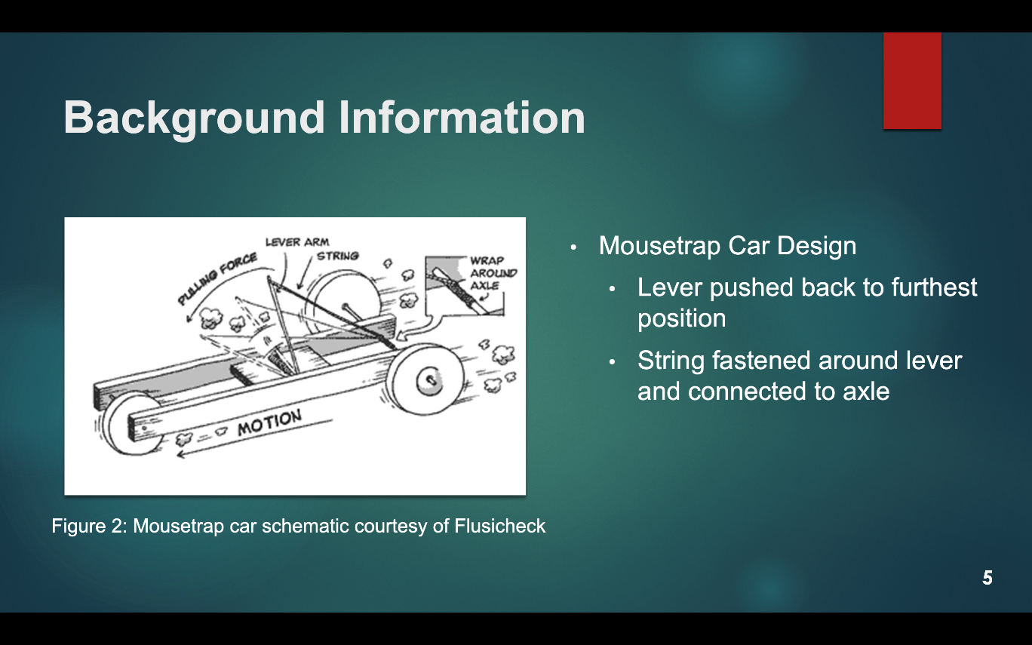
BACKGROUND INFORMATION SLIDES
Slide title “Background Information”
Scientific background:
  Main concepts
  Theories
  Equations
  Competition rules & ratios
Figure 7: Background info sample
34

Slide 35
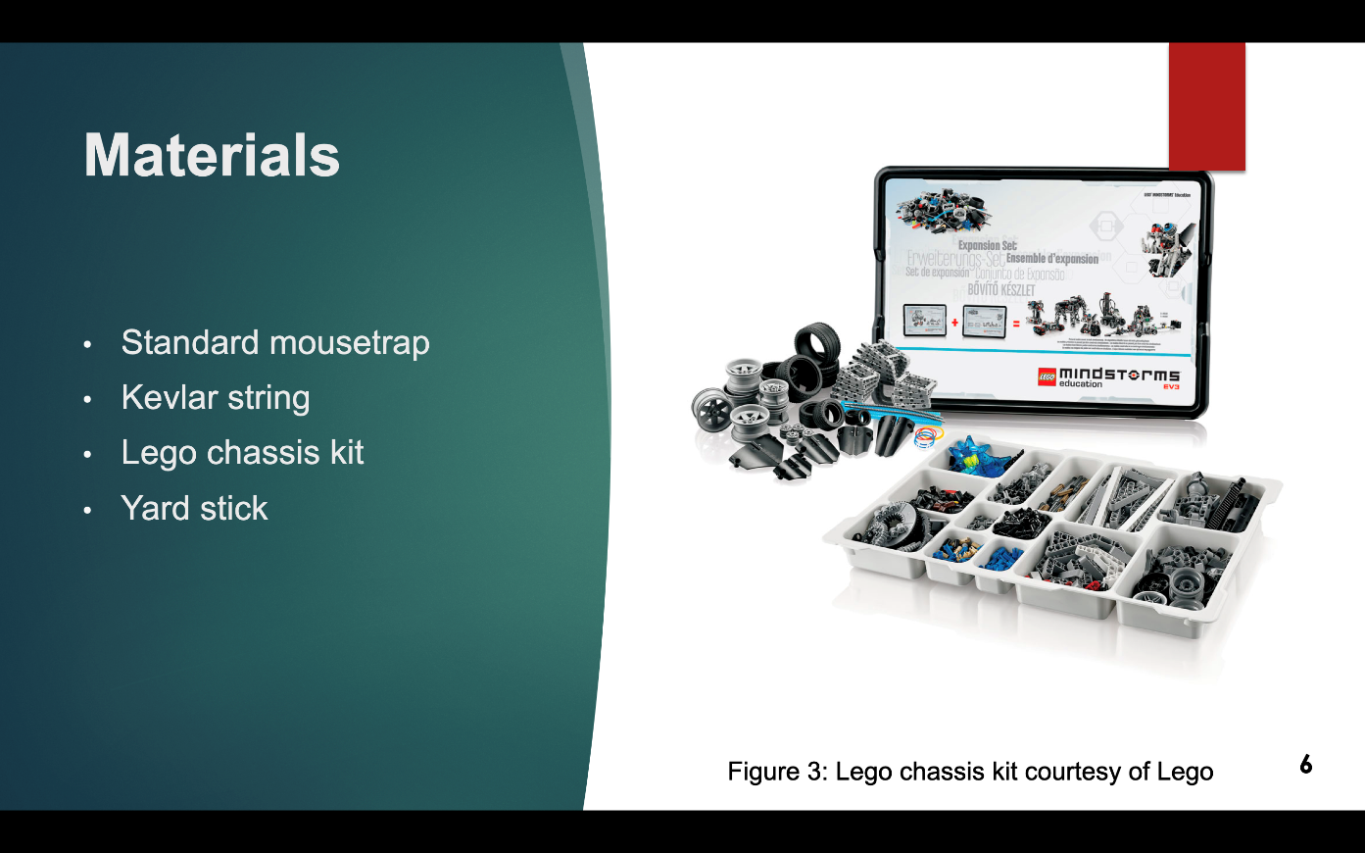
MATERIALS SLIDE
Slide title “Materials”
Only list materials used
No competition cost tables
No need to read aloud during presentation
Figure 8: Materials sample
35

Slide 36
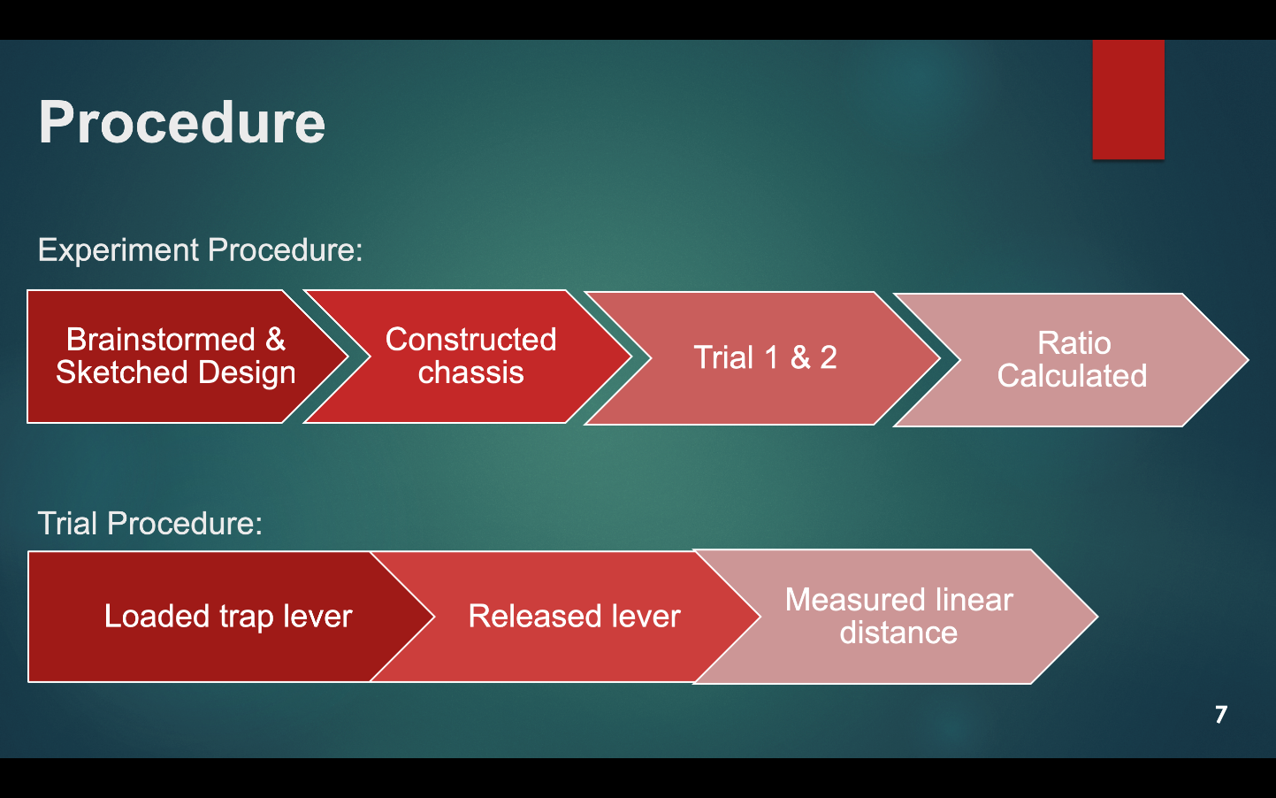
PROCEDURE SLIDES
Slide title “Procedure”
Steps followed in lab
  Flowcharts or bullets
Two slide maximum
Pictures of equipment (optional)
Figure 9: Procedure sample
36

Slide 37
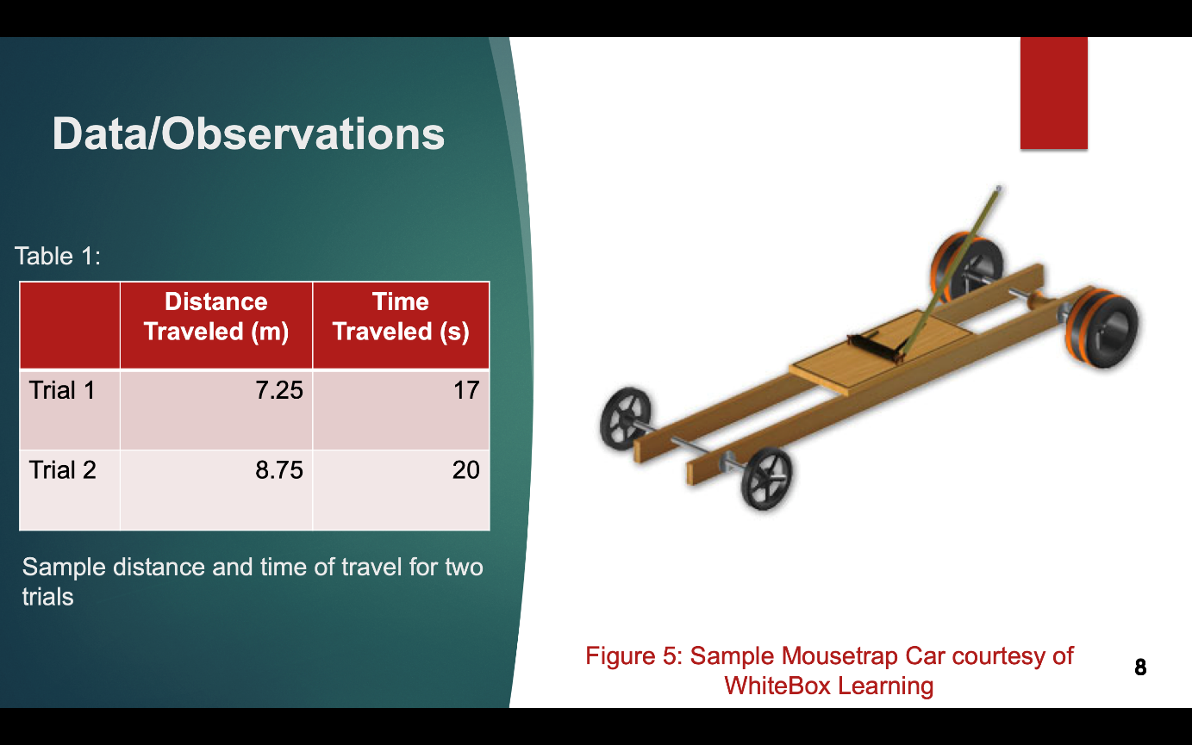
DATA/OBSERVATIONS SLIDES
Slide title “Data/Observations”
What you saw and recorded
  Pictures
  Tables (title)
  Graphs (title & labels)
All media must have captions!
Figure 10: Data/Observations sample
37

Slide 38
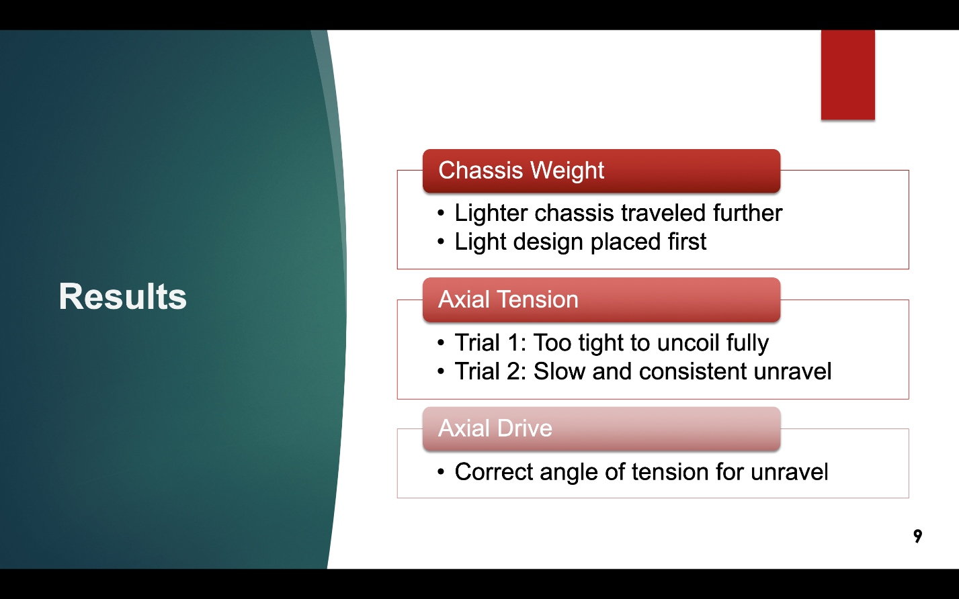
RESULTS SLIDE
Slide title “Results”
Show sample calculations
Compare results to expectations & other groups design’s
Refer to data to support results
Figure 11: Results sample
38

Slide 39
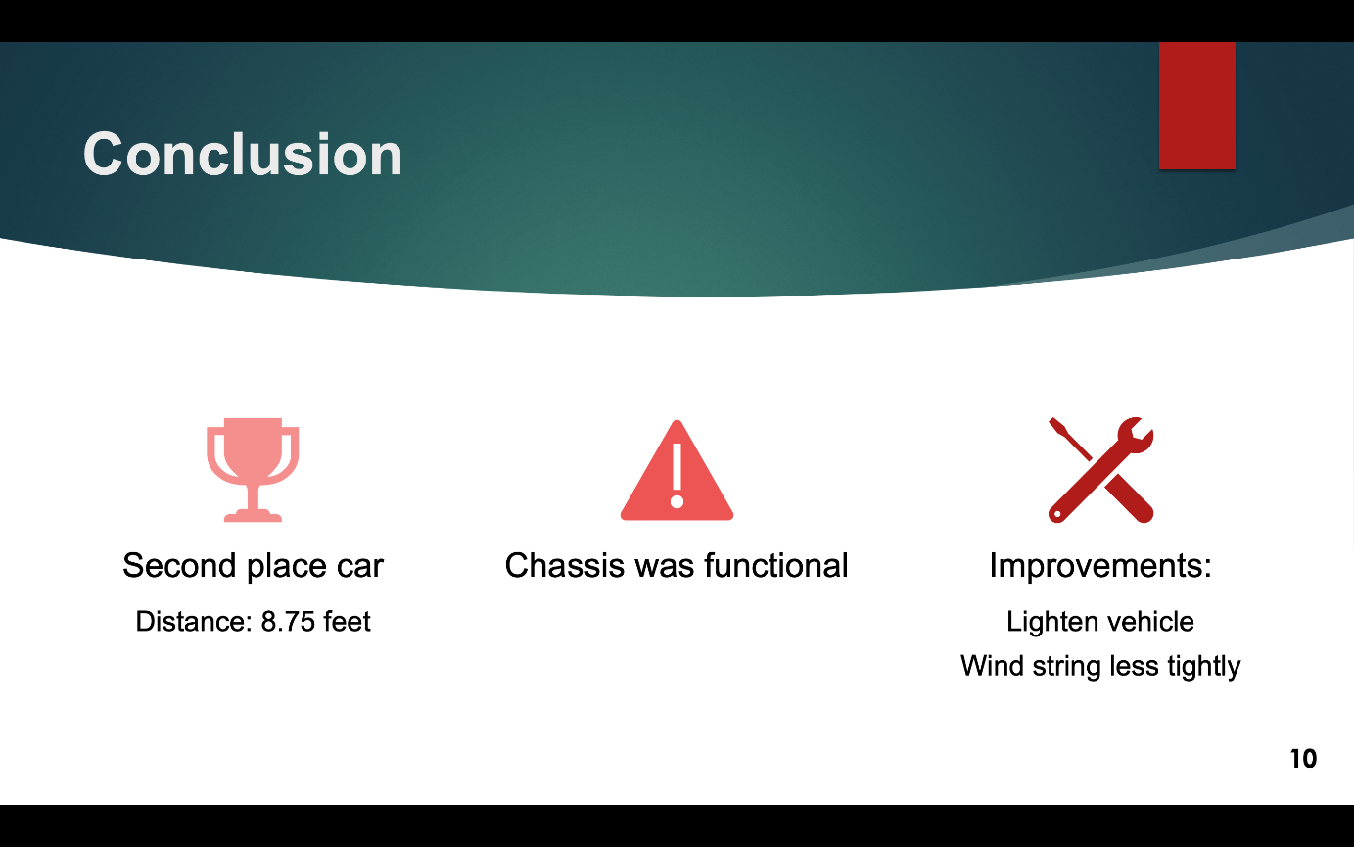
CONCLUSION SLIDE
Slide title “Conclusion”
Was experiment successful?
Objectives achieved
Place in competition
Improvements
Figure 12: Conclusion sample
39

Slide 40

VISUAL DELIVERY
No full sentences
Include images from labs
  No hand-drawn lab notes
Consistent fonts and text sizes
  No serif fonts
  18-point font minimum
Slide numbers
Don’t crowd slides
PROFESSIONAL & READABLE
40
Notes:
For reference, the slide number at the top of the slide is size 18

Slide 41
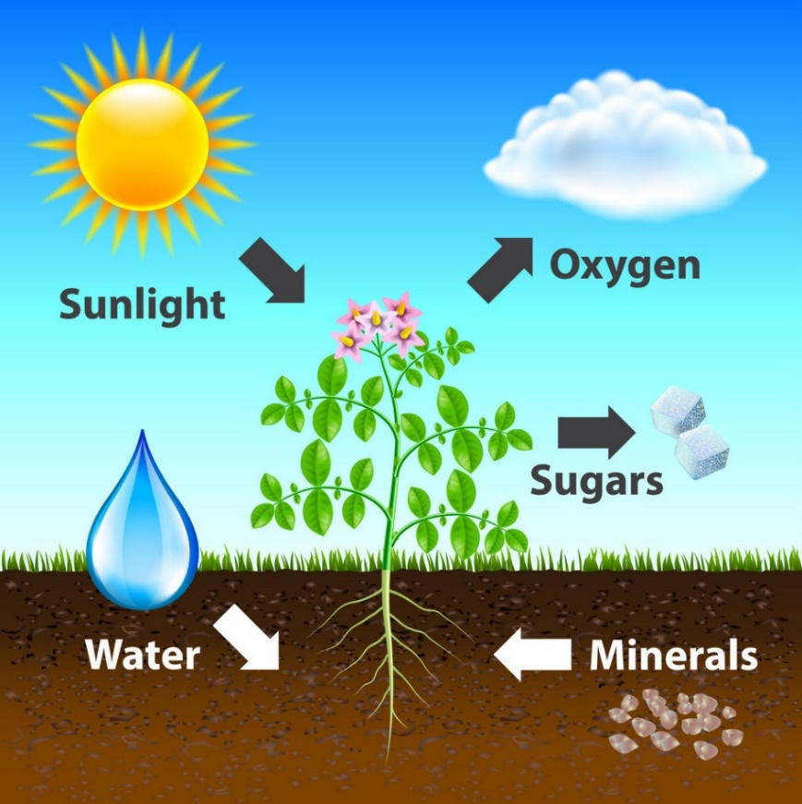
VISUAL DELIVERY
Use figures and images
  e.g. Figure 13 explains photosynthesis
Captions with every image
Main points on slides only
  Elaborate your points verbally
X by X Rule (X = 3, 4, 5, 6, or 7)
  e.g. 5 lines per slide, 5 words per line
Figure 13: Photosynthesis diagram
courtesy of VectorStock
41

Slide 42

PHYSICAL DELIVERY
Speak loudly and slowly
Face the audience
Eye contact with audience
Utilize a laser pointer where appropriate
Mistakes happen!
  Stay calm and keep presenting
Figure 14: Presentation delivery courtesy of NBC
42

Slide 43
CLASSROOM PREPARATION
Preparation:
  Technical difficulties do happen!
  Bring extra copy of presentation on thumbdrive or laptop
  Be prepared to present without slideshow
Etiquette infractions result in loss of points
Classroom etiquette:
  No laptop/cellphone/technology use in class
  Give presenter your full attention
    No rehearsal during class time
43

Slide 44
QUESTIONS?

