Slide 1
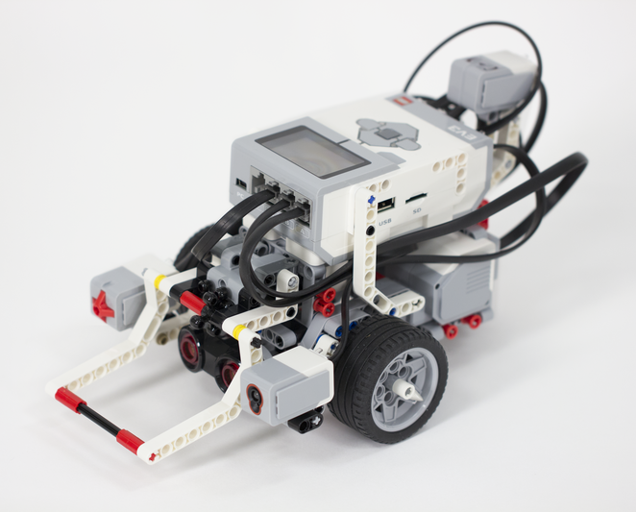
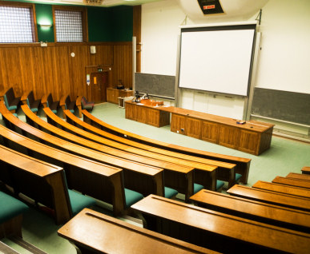
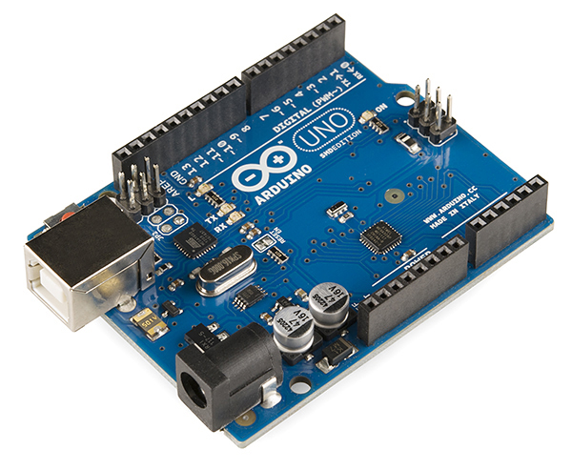
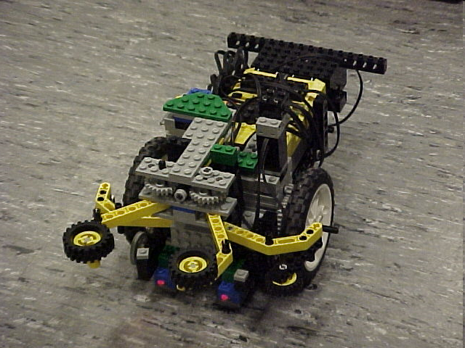
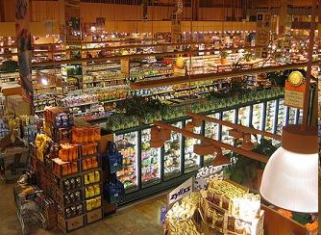
Semester-Long Design Project

Slide 2
Project Introduction
Project duration: 10 weeks
Teams of 2-3 people
Projects to choose from:
  Robot (six types)
  Campus Expansion
  Rapid Assembly and Design

Slide 3
Project Grading
Item | % of Grade
Benchmarks and Commissioning | 50%
Final Presentation | 50%
NOTE: The SLDP counts toward 30% of your course final grade!

Slide 4

Project Grading
Benchmarks:
  Completion of a specified portion of the project
  Two benchmarks throughout semester
  Refer to schedule for due dates
  Penalties for not completing on time
  They are cumulative (Benchmark B includes Benchmark A)

Slide 5
Project Grading
Commissioning:
  Completion of all required tasks
  Last phase of project
  Refer to syllabus for due dates
  Failure to commission will result
  in penalties (partial commissioning)

Slide 6
Project Grading
Partial Commissioning:
  If you have previously reached up to Benchmark A, you’ve earned at least 30% for commissioning
  If you have previously reached up to Benchmark B, you’ve earned at least 70% for commissioning
  Any higher percentage achieved beyond your benchmark is decided by two TAs watching a full run

Slide 7
Project Grading
Project Submission:
  Submit all documents via an online form provided towards the end of the semester
  Form must be received in order to obtain SLDP grade
  Any missing items will result in penalties
  Refer to syllabus for deadline
  Refer to Submission Guidelines

Slide 8
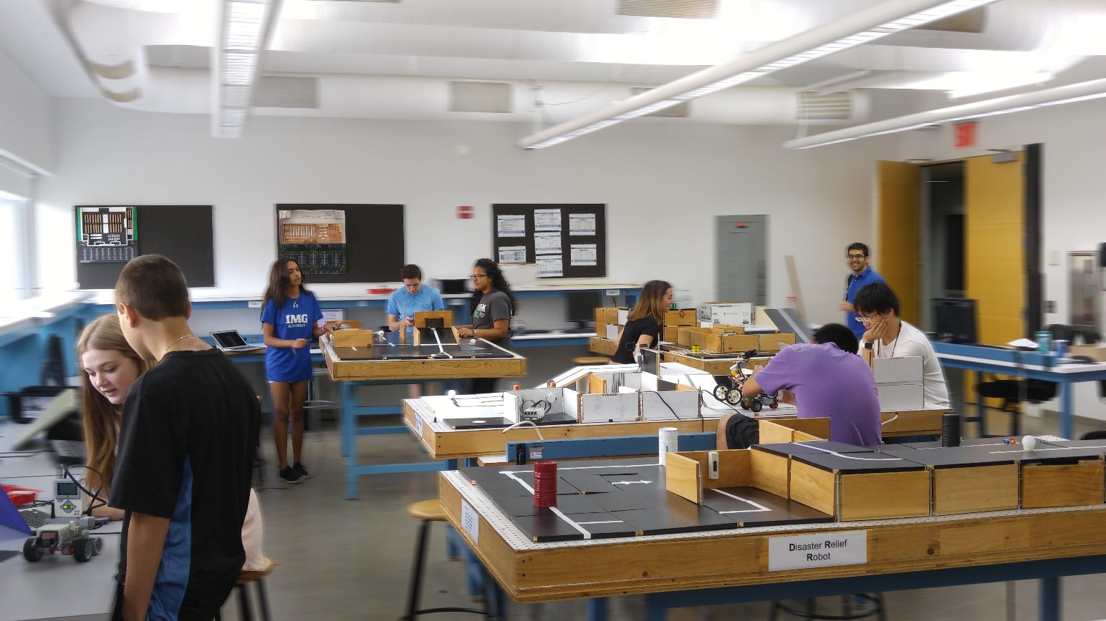
SLDP Options
Six Robot Variants
Housing and Innovation
in Revit
Rapid Assembly and Design

Slide 9
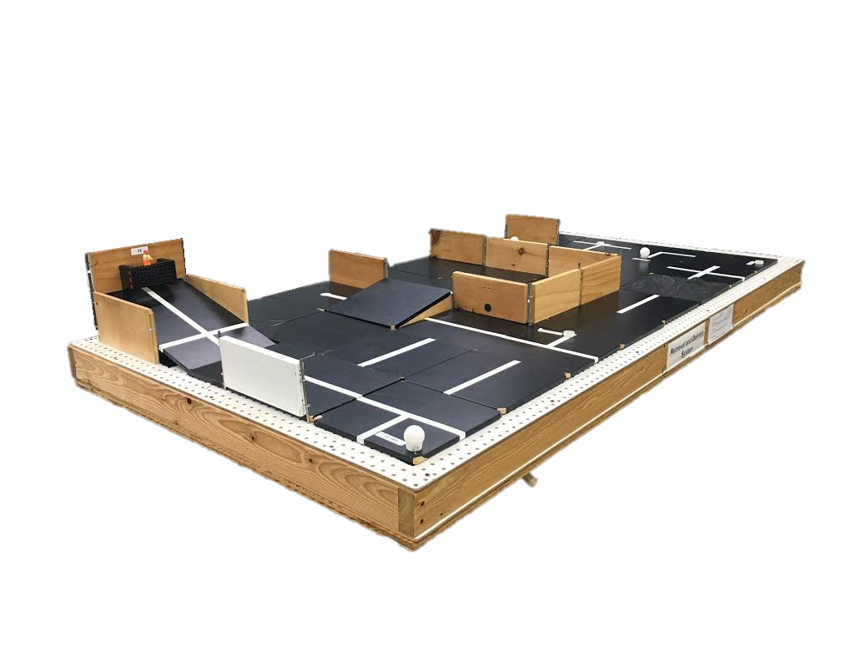
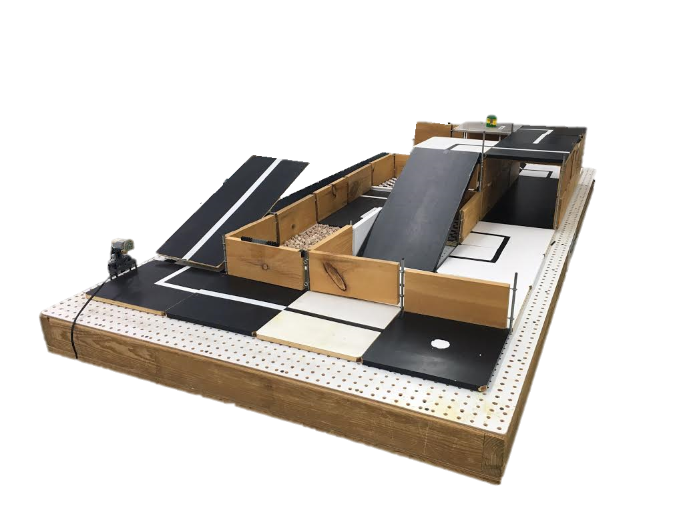
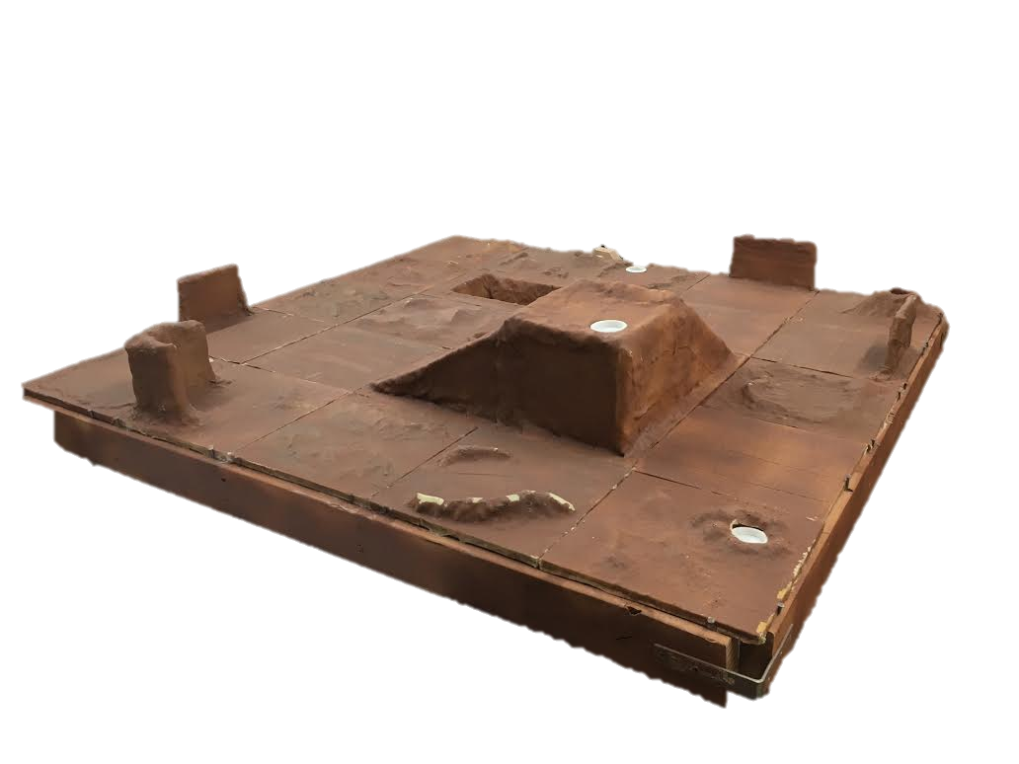
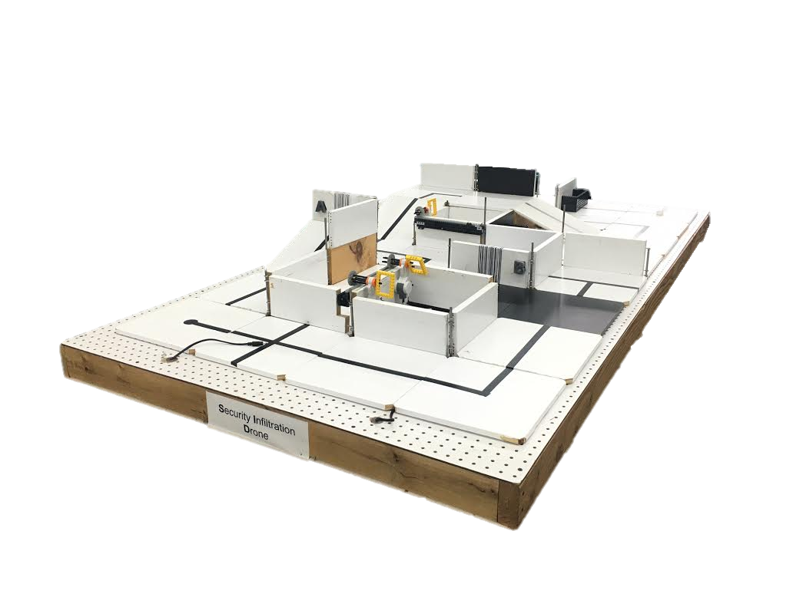
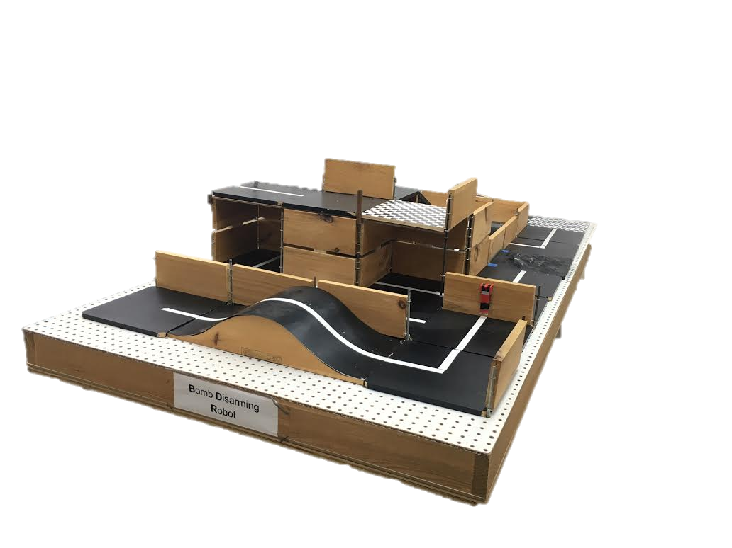
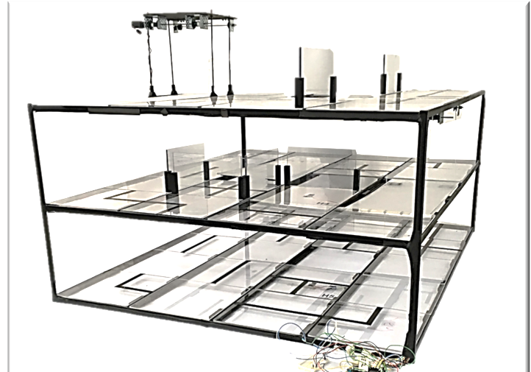
SLDP Options
Robot Variants

Slide 10
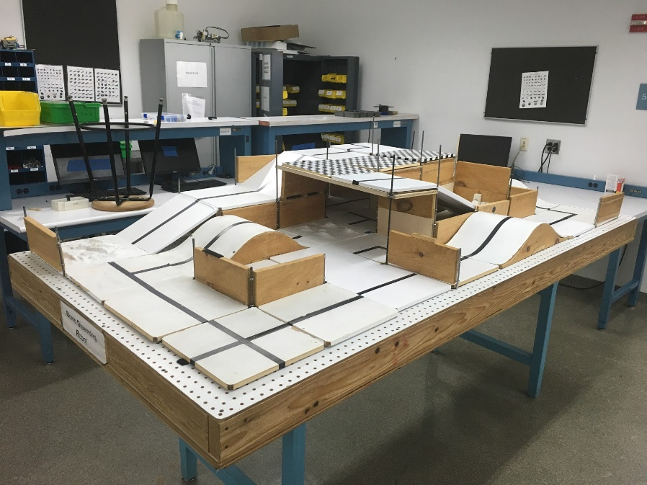
SLDP Options
Bomb Disarming Robot (BDR)
Disarm bomb and return to start
Avoid decoy bombs
Robot must be able to autonomously
navigate the obstacle course provided
Robot must fit in a start area that is 25cm x 25cm
Maximum height is 20cm

Slide 11
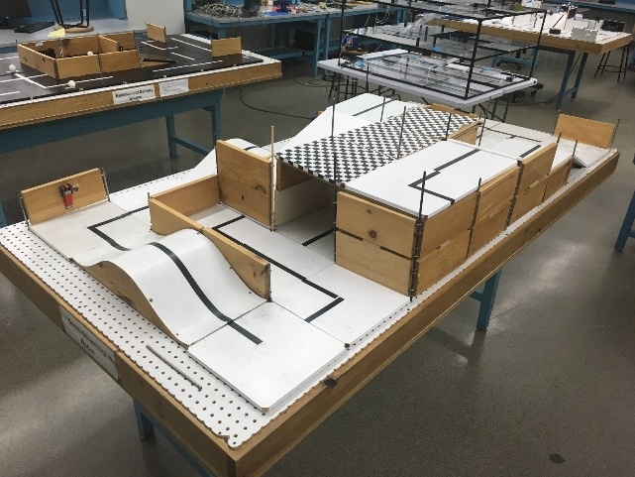
SLDP Options
Bomb Disarming Robot (BDR)
Allowed
Jumping off
upper levels
Climbing walls
Prohibited
Arms
Slingshots
Projectiles

Slide 12

SLDP Options
Bomb Disarming Robot (BDR)
Benchmark A: Pass two hills
Benchmark B: Disarm bomb
Commission: Return to start
Extra Credit: Disable and/or retrieve triangulation device(s)

Slide 13
SLDP Options
Mars Rover Robot (MRR)
Collect one soil and one water reading
Pick up sensor between readings if necessary
Carry module(s) FROM start TO respective tile
Answer Data Specifications questions

Slide 14
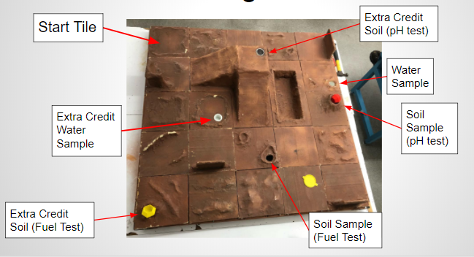
SLDP Options

Slide 15
SLDP Options
Mars Rover Robot (MRR)
Benchmark A:
Obtain one reading
Benchmark B:
Obtain first reading
Return to pick up module if necessary
Obtain second different reading
Commission:
Obtain a water and soil reading
Return to landing site
Conduct all corresponding tests and answer Data Spec questions

Slide 16
SLDP Options
Mars Rover Robot (MRR)
Extra Credit:
Obtain all 3 types of readings
Cross the canyon
Traverse up and down mountain
Collect reading from an EC tile

Slide 17
SLDP Options
Retrieval & Delivery System (RDS)
Retrieve fuel cells
Deliver them to three different hospitals
Hospitals consume power at different
levels of efficiency
Deliver a total of at least 200 hours of battery life
The robot must fit in a start area that is 25cm x 25cm

Slide 18
SLDP Options
Retrieval & Delivery System (RDS)
Fuel Cells
Center of tile = 25 hrs
Edge of tile = 30 hrs
Corner of tile = 35 hrs
Power Supply
Yellow = 1x
Blue = 2x
Red = 3x

Slide 19
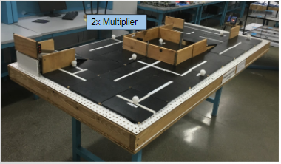
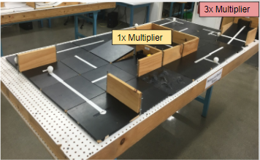
SLDP Options
Retrieval & Delivery System (RDS)

Slide 20
SLDP Options
Retrieval & Delivery System (RDS)
Benchmark A: Deliver 50 hrs
Benchmark B: Deliver 125 hrs total
Commission: Deliver 200 hrs total
Extra Credit: Additional fuel cells
  Depends on extra number of cells, not hours

Slide 21
SLDP Options
Search & Recovery Robot (SRR)
Retrieve lost space module Zarya and return to start
The robot must fit in a start area that is 25cm x 25cm

Slide 22
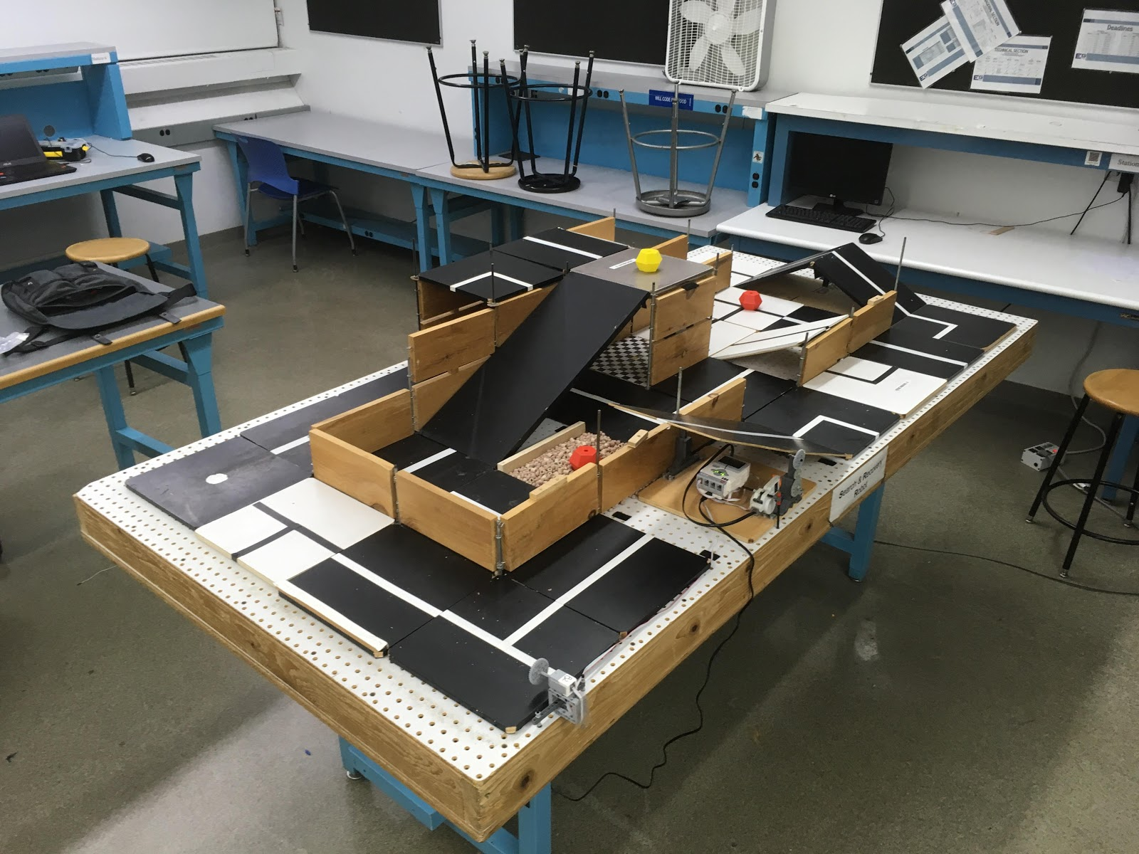
SLDP Options
Search & Recovery Robot (SRR)

Slide 23
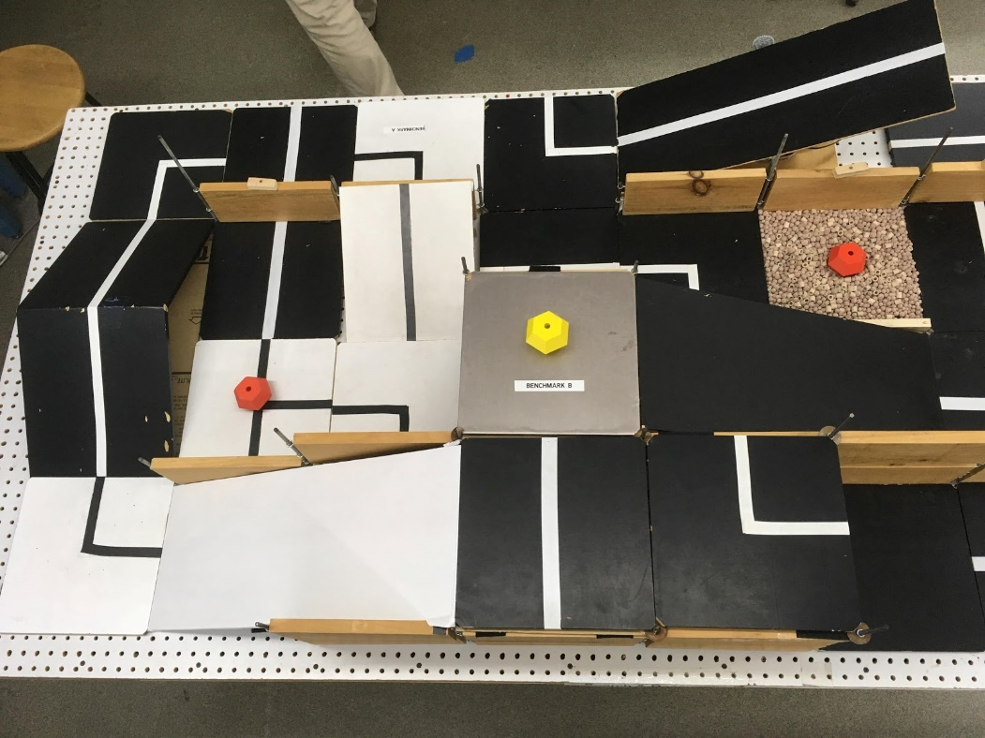
SLDP Options
Search & Recovery Robot (SRR)
Modules
Quest Zarya Unity

Slide 24
SLDP Options
Search & Recovery Robot (SRR)
Benchmark A: Traverse Hill Tile (Path 1) OR Traverse Bridge (Path 2)
Benchmark B: Retrieve Zarya
Commission: Return to start with Zarya
Extra Credit: Retrieve other modules; Traverse moon dust

Slide 25
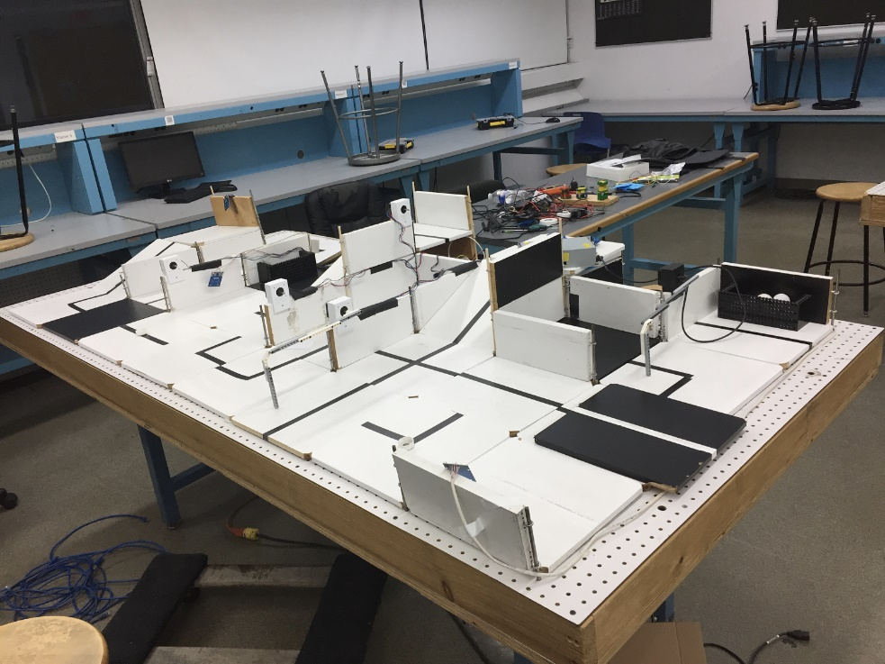
SLDP Options
Security Infiltration Drone (SID)
Solve puzzle to deactivate gates by activating RFID tags
Reach exit point
Robot must fit in a start area that
is 25cm x 25cm

Slide 26
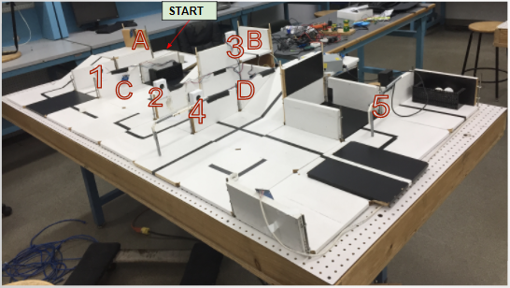
SLDP Options
Security Infiltration Drone (SID)
E
Numbers are gates
Letters are RFIDs

Slide 27

SLDP Options
Security Infiltration Drone (SID)
Benchmark A: Show puzzle solution AND activate first tag in sequence
Benchmark B: Activate first 3 tags in sequence
Commission: Reach exit (behind gate 5)
Extra Credit: Retrieve data canisters

Slide 28
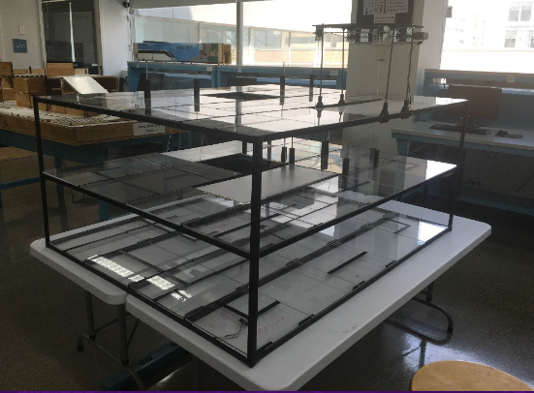
SLDP Options
Subterranean Infiltrator & Fortune Retriever (SIFR)
Solve puzzle
Activate ramps via RFID sensors
Reach the “treasure” at the bottom of the course

Slide 29
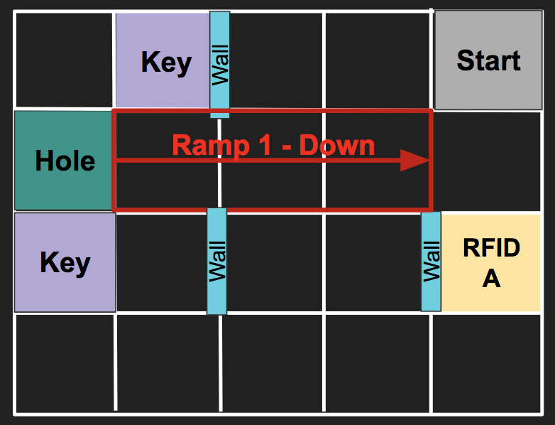
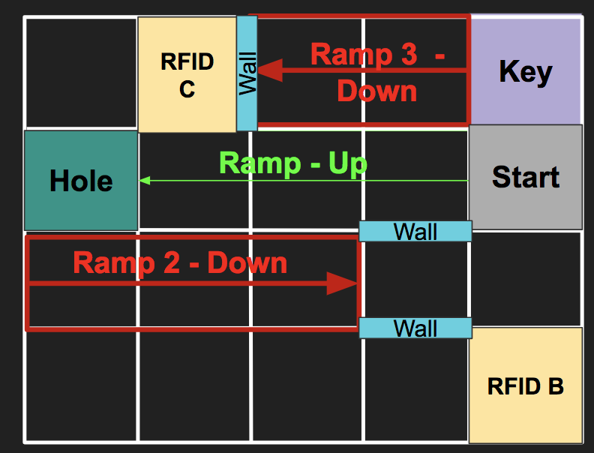
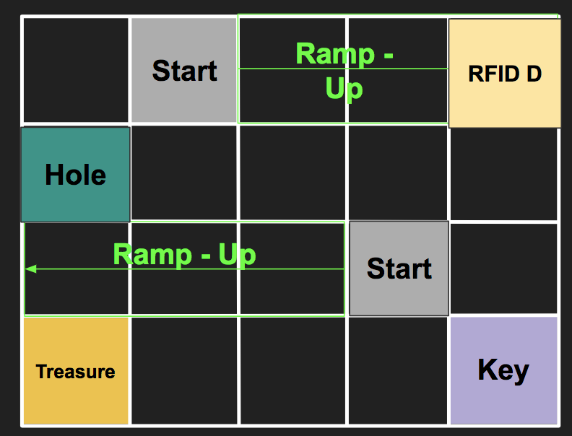
SLDP Options
Subterranean Infiltrator & Fortune Retriever (SIFR)
Top
Middle
Bottom

Slide 30
SLDP Options
Subterranean Infiltrator & Fortune Retriever (SIFR)
Benchmark A: Show TA the puzzle solution AND activate Ramp 1
Benchmark B: Activate Ramp 1 AND Activate Ramp 2 or 3
Commission: Retrieve “Treasure” AND have “escape route” ready
Extra Credit: Use Ramp 3 / Tag 4; Return to Middle Layer; Return to Start

Slide 31
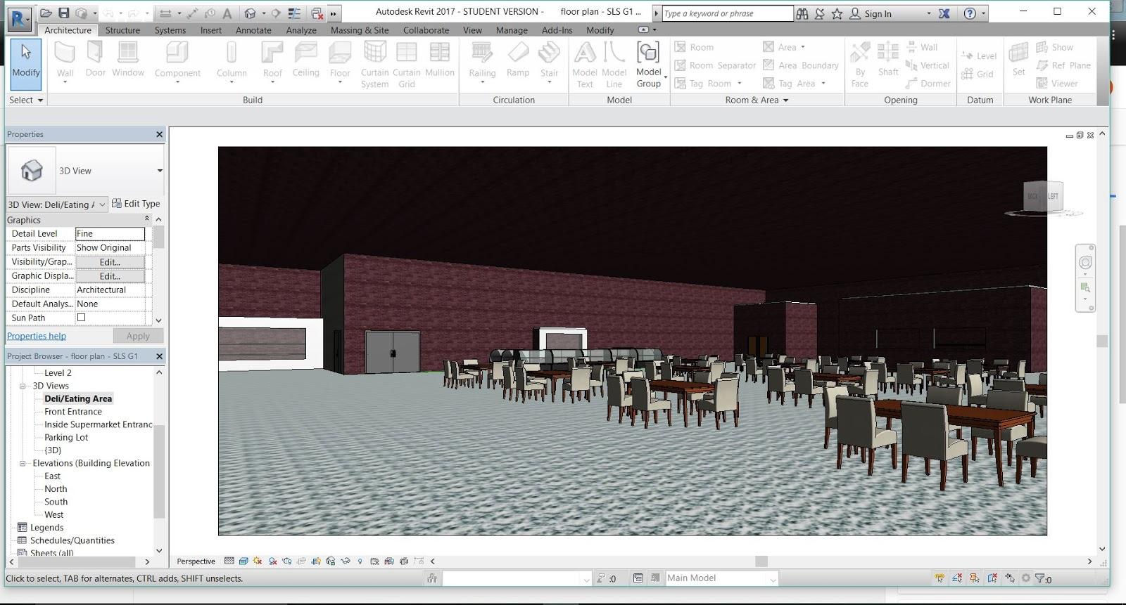
SLDP Options
NYU Housing and Innovation in Revit
Create a 3D Revit Model of a
college campus extension to
NYU Tandon
Plan utilities layout
      Electrical system
      Plumbing system
      HVAC system

Slide 32
SLDP Options
Housing and Innovation in Revit (HIR)
Benchmark A
  One recreational space design
  One 20-student classroom design
  One 40-student classroom design
Benchmark B
  Everything from Benchmark A
  All classroom designs
  Facility of choice
  Electrical, plumbing, and HVAC for one dorm

Slide 33
SLDP Options
Housing and Innovation in Revit (HIR)
Commission:
Revit drawings
  Floor plans for all floors (minimum 6)
  Plumbing system
  Electrical system
  HVAC system
  Front elevation
  Most detailed side
  Gold LEED certification
Model of Building:
  3-D Revit model (in software)
Extra Credit:
  3-D printed exterior of building
  Platinum LEED certification

Slide 34

SLDP Options
Housing and Innovation in Revit (HIR)
LEED Description:
Leadership in Energy & Environmental Design (LEED) is a green building certification program
Different levels of certification
  LEED Silver (2 categories)
  LEED Gold (4 categories) - Mandatory
  LEED Platinum (All 6 categories) – Extra Credit
Teams choose the ones that best fit their design

Slide 35
SLDP Options
Housing and Innovation in Revit (HIR)
LEED Categories:
Location & Transportation
Sustainable Sites
Water Efficiency
Energy & Atmosphere
Indoor Environmental Quality
Innovation

Slide 36
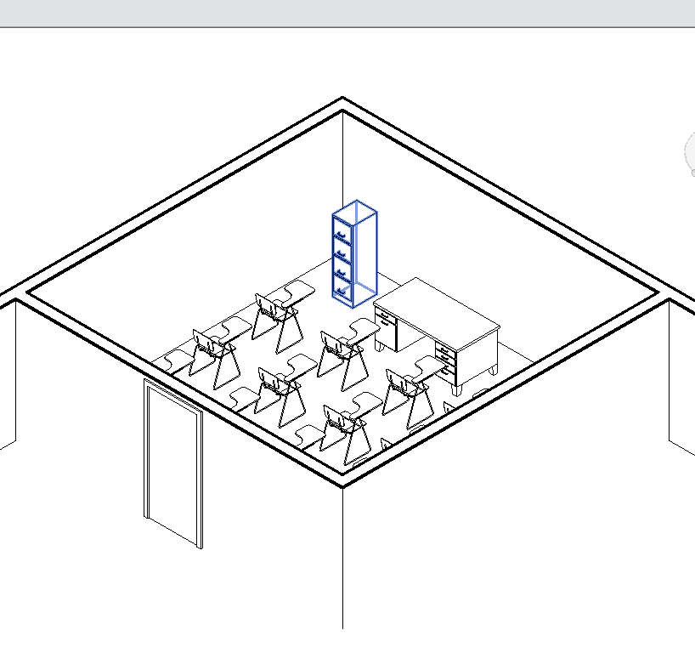
SLDP Options
Housing and Innovation in Revit (HIR)
Examples:

Slide 37
SLDP Options
Rapid Assembly and Design Challenge
Opportunity to create a more challenging semester long design project for those with prior experience in STEM
  More resources provided than for traditional SLDPs
Follows regular benchmark schedule, and includes deadlines for 2 additional reports
Professor approval required
Project varies by section

Slide 38
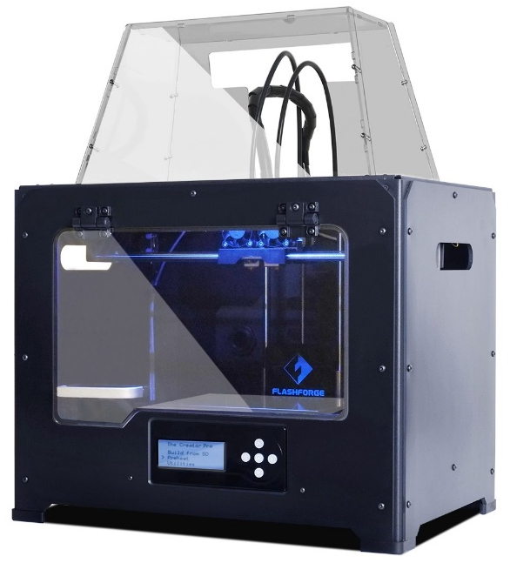
3D Printing Extra Credit
Design your own SLDP team logo
  Due by Milestone 2 Presentations
Be creative with your design
  Design must be approved by a Prototyping Lab TA
  Cannot be text like Lab 1
  Multiple colors are available: purple, black, white,
  yellow, red, green, pink, light blue, blue, clear
  More info on 3D Printing Extra Credit page on lab manual

Slide 39
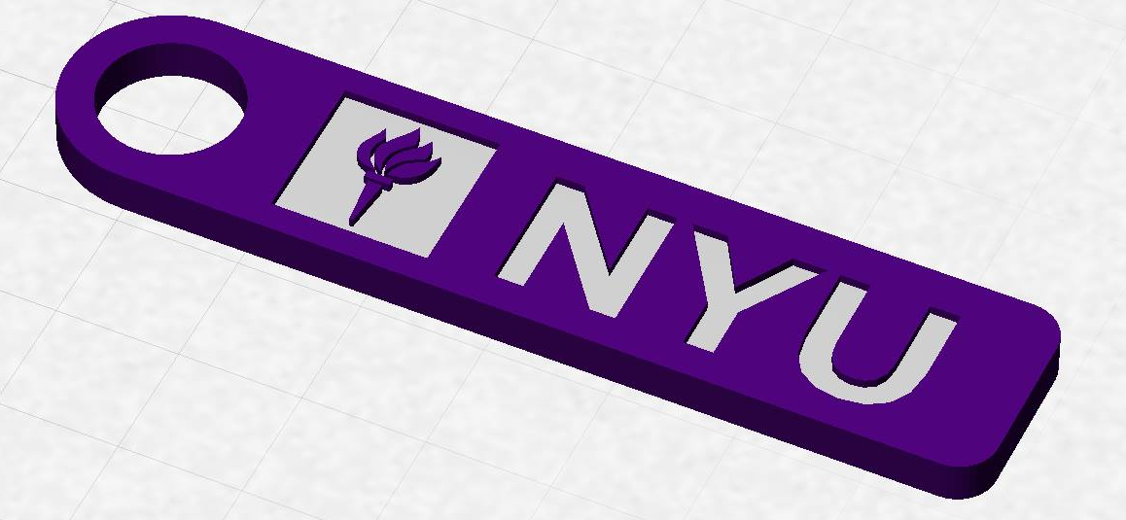
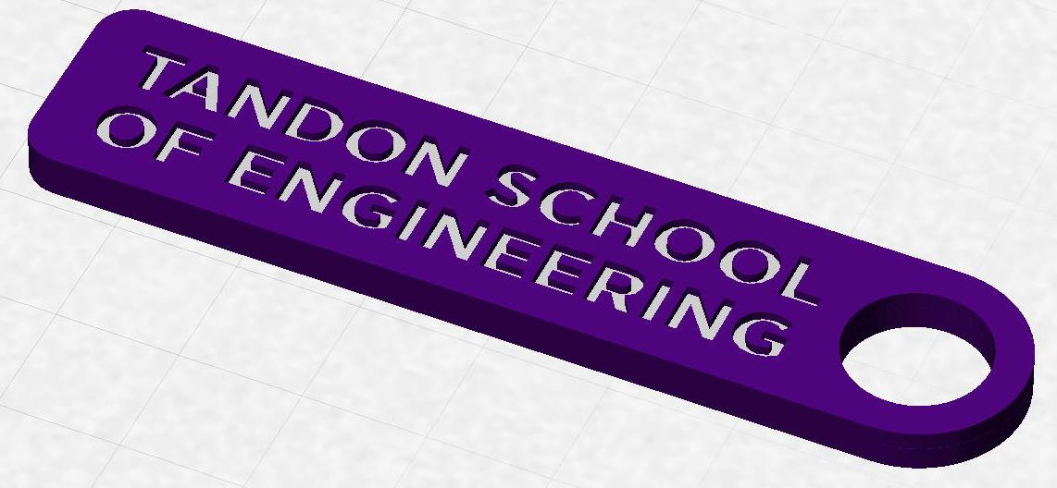
3D Printing Extra Credit
Constraints:
  Maximum weight of 15 grams
  No copyrighted logos
  Must be attached to robot or worn
  as pin during Final Presentation

Slide 40
3D Printing Extra Credit ADVANCED
Create a prototype of a custom, 3D-printed robot part or terrain modification (robots), component for project (RAD), or model of building (HIR)
Constraints:
  Due by Milestone 2 Presentations
  YOU MUST HAVE A CONTINGENCY PLAN if the piece does not
  work or cannot be printed
  For full list of constraints see the 3D Printing Extra Credit page on lab manual
You may print parts at the MakerSpace, or you can receive one-on-one instruction in the EG Prototyping Lab (in the Modelshop)

Slide 41
3D Printing Extra Credit Submission
Submit your design at eg.poly.edu under the
3D Printing Submission tab
  Your first submission is due by Milestone 2
  Your design(s) must be a .stl file
  After your submission has been received you will be contacted by a TA to come start your print

Slide 42
Closing
Refer to manual.eg.poly.edu for details
Think about which project interests you
Brainstorm ideas
Speak with professors and TAs regarding projects

Slide 43

Semester-Long Design Project
QUESTIONS?

