Slide 1

RECITATION 6
EG1004

Slide 2
AGENDA
Ethics & Stakeholder Impact in Engineering
Data is Your Argument
Presentation Activity
Lab 5 Presentations
1

Slide 3
What impacts do engineering decisions have on society?
What ethical & social issues arise from the implementation of different technologies?
DISCUSSION QUESTIONS
2
Notes:
**Give students time to discuss this question in groups and/or have a larger group discussion**

Slide 4
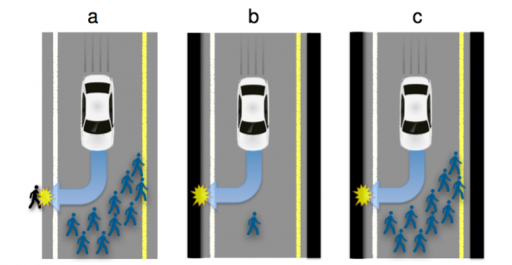
CASE SCENARIO 1: AUTONOMOUS VEHICLES
Who decides the value of human lives?
Figure 1: Traffic situations with inevitable harm (MIT Tech Review)
2
Notes:
**Give students time to discuss this question in groups and/or have a larger group discussion**

Slide 5
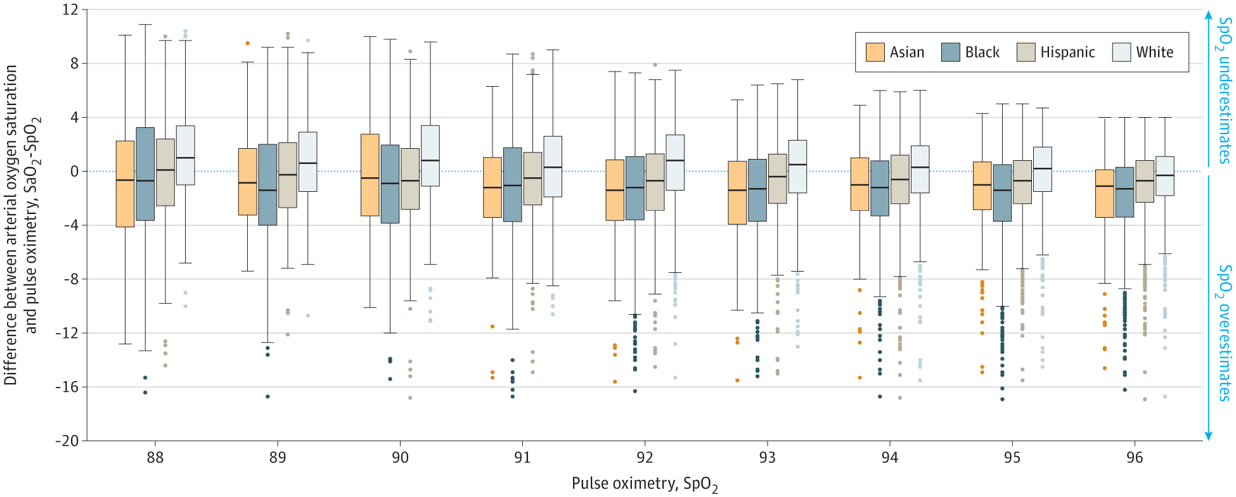
CASE SCENARIO 2: PULSE OXIMETERS
Whose needs are considered when designing technology?
Figure 2: Difference between arterial O₂ staturation and pulse oximetry measurements (JAMA)
3
Notes:
**Give students time to discuss this question in groups and/or have a larger group discussion**

Slide 6
How can we tackle instances of bias to make engineering design more inclusive?
DISCUSSION QUESTION
4
Notes:
**Give students time to discuss this question in groups and/or have a larger group discussion**

Slide 7
INCLUSIVE LANGUAGE
Inclusive language is the daily practice of intentional and unbiased word selection that
  Acknowledges diversity
  Conveys respect to all people
  Promotes equitable opportunities
  Prioritizes people and identity first
See here for the full resource.
5
Notes:
**Give students time to discuss this question in groups and/or have a larger group discussion**

Slide 8
INCLUSIVE LANGUAGE
Do’s
Take time to learn correct pronunciations of names and honor pronouns
Utilize people first language Poor → person from a low-income background Criminal → person convicted of a crime
Be as specific, descriptive, and accurate as possible in what you are describing
Don’ts
Avoid using racial descriptors unless absolutely relevant
Avoid outdated terms Caucasian -> White Oriental -> Asian
Avoid coded or othering language Sketchy, shady, ghetto
See here for the full resource.
5
Notes:
**Give students time to discuss this question in groups and/or have a larger group discussion**

Slide 9
INCLUSIVE LANGUAGE EXAMPLES
Instead of… | Try… | Why?
Visually challenged person Person with blindess | Blind person Person who is blind Visually impaired person Vision-impaired person | Avoid using ‘challenged,’ Use person-first or identity-first language for the community or person being discussed.
Elderly Senior Citizen | Older adults Older people Persons 65 years and older | The term ‘elderly’ is considered offensive because it depicts images of frailty and physical decline.
Special Needs Disabled people | Person with a disability Person who has a disability | Avoid using ‘challenged,’ Use person-first or identity-first language for the community or person being discussed.
See here for the full resource.
6
Notes:
**Give students time to discuss this question in groups and/or have a larger group discussion**

Slide 10
ETHICS SUMMARY
Technology & engineering design raise ethical & social questions
Your technical perspective and voice will be important
You must work with policy-makers, business leaders, and the public
National Society of Professional Engineers Code of Ethics (https://www.nspe.org/resources/ethics/code-ethics)
  Fundamental Canons
  Rules of Practice
  Professional Obligations
7
Notes:
Absences must be excused through the office of student affairs or you will not be able to complete makeup labs, receive a grade for your report or presentations. Communication is key!
Attendance at lecture adds up over time, make it a priority to attend every lecture.
If your lab absence is excused/in the process of being excused, you may request a makeup lab through the EG website.
Plagiarism is not a small slip up. It is a very major offense. Remember that for most courses, including this one, software are used to detect plagiarism.
Stay on top of your deadlines- this is a tough way to loose points since you are doing the work anyway, just do it on time.
Grow from mistakes you’ve made on presentations and lab reports by reviewing feedback from your TAs, Professors and Writing Consultants. As the semester goes on, you will be penalized for repeatedly making the same mistakes

Slide 11
PRESENTATION ACTIVITY
Following each presentation, all teams discuss and share one effective aspect and one improvement for the group that just presented
8

Slide 12
QUESTIONS?

