Slide 1
EG1004 Laboratory 9: Lemon-Powered Car
Notes:
Fall 2006 Pratima G.

Slide 2
Overview
Experimental Objective
Background Information
Materials
Procedure
Report / Presentation
Conclusion

Slide 3
Experimental Objective
Determine potency of reducing agents
Create chemical cells to generate electricity
Use capacitors to store/release energy
Build car powered by chemical reaction

Slide 4
Background Information
Fundamental ideas
Redox (reduction/oxidation) reactions
Batteries
Designing citrus cell batteries
Capacitors

Slide 5
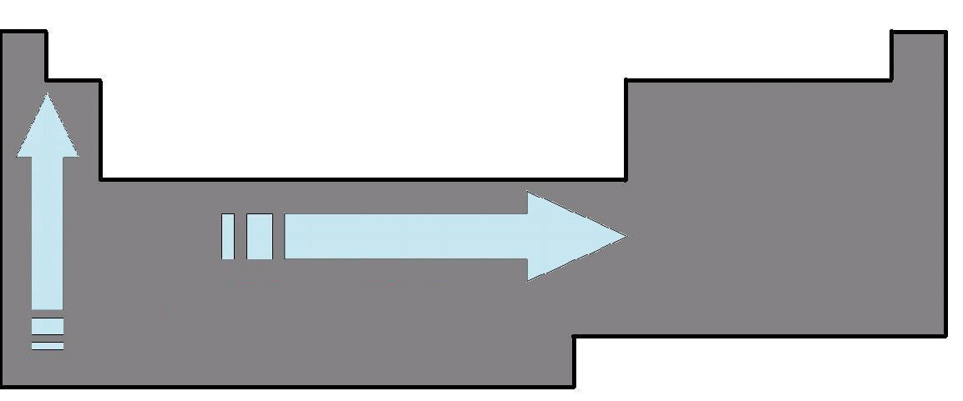
Fundamental Ideas
Electronegativity: measure of element’s attractions of another’s electrons
Ionization energy: energy to remove electron from atom and form a cation
Periodic Table
Both properties
Increase:
left to right
bottom to top

Slide 6
Redox Reactions
When a reaction can be separated into oxidation and reduction
Oxidation: electron loss
ex: Mg → Mg⁺² + 2e⁻
Reduction: electron gain
ex: O₂ + 4e⁻ → 2O⁻²
Notes:
Oil Rig is a analogy for this property (Oxidation Is Loss, Reduction Is Gain)

Slide 7
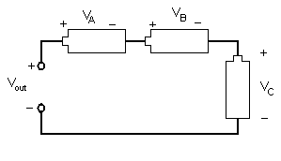
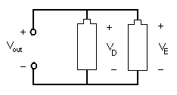
Batteries
Battery arrangement
Series circuit increases voltage
Parallel circuit increases current

Slide 8
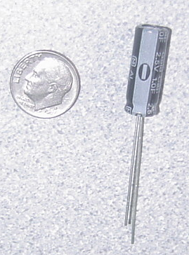
Capacitors
Store electrical energy
1Farad Polarized Capacitor
Positive
Negative

Slide 9
Capacitor Charging
Capacitor charge limit is restricted by charge voltage
Maximizing applied voltage maximizes energy stored
Capacitor is charged in time increments called the time constant (tau):
τ =RC
R=resistance C=capacitance

Slide 10
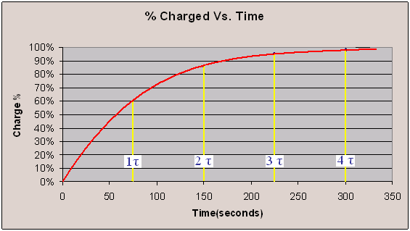
Percentage Charged
Charge is logarithmic
It takes approximately 4τ to charge the capacitor
Ex:

Slide 11
Designing of Citrus Cells
A citrus cell/battery
Uses two different electrodes
Citrus acid used as electrolyte

Slide 12
Electrolytic Solutions
Non-metallic part of circuit
Electrolytes dissociate free ions to create an electrically conductive solution
Lemon Juice used as electrolyte

Slide 13
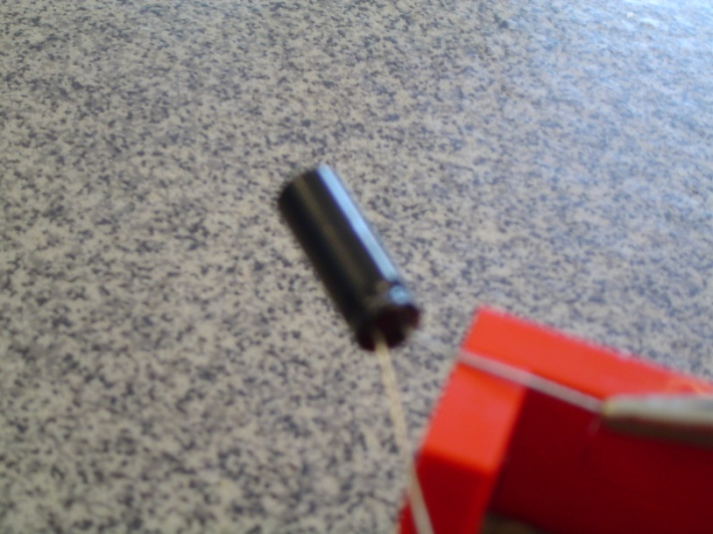
Materials
Lemons
Lemon Juice
Magnesium
Copper
Zinc
Nickel
Aluminum
3 Alligator Cable Sets
1 Farad 2.5v Capacitor
Standard Lego Car Chassis
Lego to Alligator Cable Clip Connector
Light Emitting Diode (LED)
Small Cups
Scissors
Tape
DMM (Digital Multi-meter)
Large Plates

Slide 14
Procedure
Part 1
Determine voltage potential of electrodes
Determine positive and negative poles
Part 2
Light up LED using two lemon cells with most potent electrode pairs
Part 3
Decide on the power source
Chemical cell or capacitor
Design/Build your car to accept power source

Slide 15
Procedure
Part 1
Acquire Materials
Squeeze/roll lemon
Insert electrodes into lemon ½ cm from each other
Connect electrodes to DMM
Record Voltage
Determine polarity of lemon cell

Slide 16
Procedure
Part 2
Create second citrus cell
Connect two citrus cells in series
Attach to LED
Is it lit?

Slide 17
Procedure
Part 3
Choose your electrodes (remember cost)
Design your power source
Chemical or capacitor
Design car for power source
Allow 15 min for capacitor to charge
Create a sketch/pricelist
TA must sign your work
Enter competition
Notes:
N

Slide 18
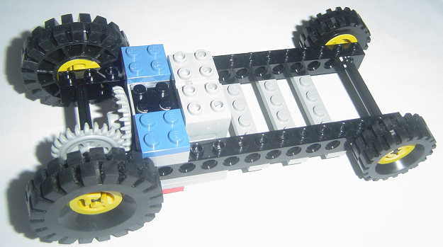
Competition
Factors that will effect the CR (Competition Ratio) are:
Distance traveled in 60 seconds
Cost of components
Cost List
Item | Cost
Capacitor | $1.00
2oz Lemon Juice (with cup) | $0.25
1.5" Mg Strips | $1.00
Cu Strip | $0.25
Zn Strip | $0.50
Al Strip | $0.25
Ni Strip | $0.25
Lemon Car Components | $0.00

Slide 19
Assignment: Report
Team report
Title page
Discussion topics in the manual
Include original data with instructor’s initials
Scan in data and lab notes
(ask TA for assistance)

Slide 20
Assignment: Presentation
Team presentation
Include photos of the lemon car
Explain how the battery works

Slide 21
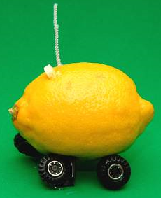
Conclusion
Return all electrodes to TA
Have return signed
Clean up all materials
TAs will tabulate competition results
Extra credit awarded according to manual

