Slide 1
Introduction to LabVIEW
Notes:
D. Castronuova 2009

Slide 2
Overview
Objectives
Background
Materials
Procedure
Report / Presentation
Closing

Slide 3
Objectives
Familiarization with graphical programming
Obtain data from outside the computer using simulated instrumentation
Use this knowledge to create programs in LabVIEW
  Simple calculator
  Heating and cooling system
  Lighting system

Slide 4
What is LabVIEW?
Laboratory Virtual Instrument Engineering Workbench
Graphical programming language
Used for data acquisition, instrument control, and signal processing
Based on G programming language

Slide 5
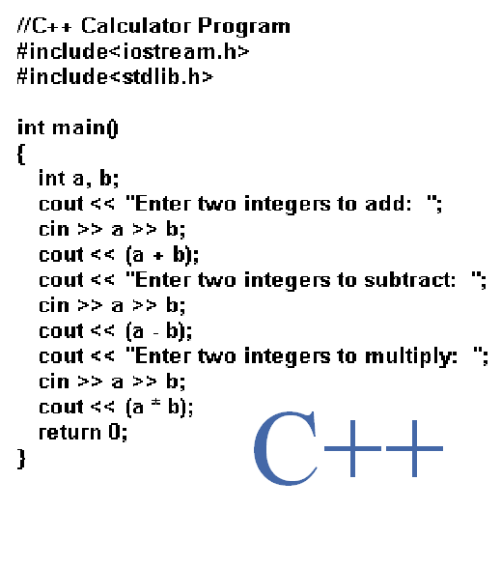
Text-based

Slide 6
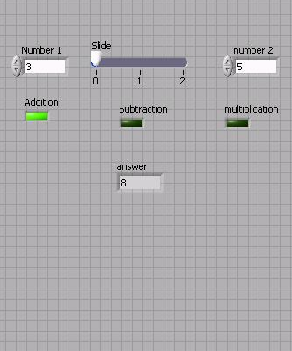
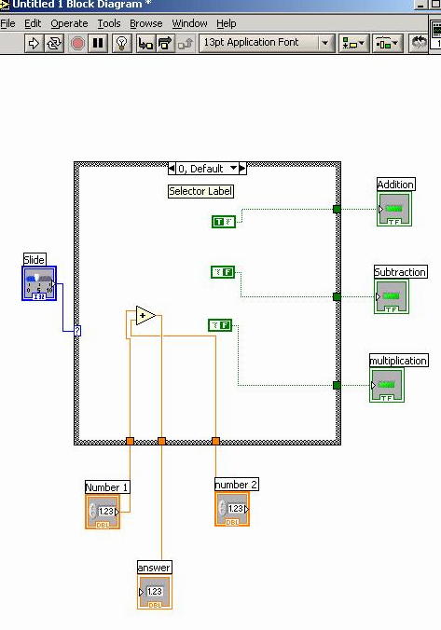
Graphic-based
G

Slide 7
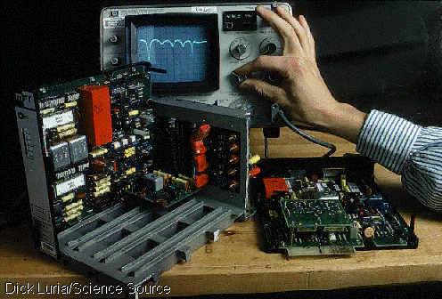
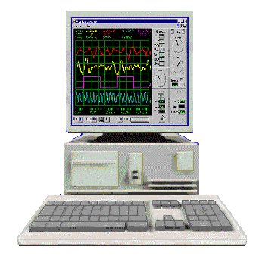
LabVIEW Programs (VIs)
Called “Virtual Instruments” (VIs)
Appearance and operation imitates actual physical instruments
Without
With

Slide 8
Applications in EG 1003
Heat Transfer and Thermal Insulation Lab
  Temperature Recording
Electronic Filters Lab
  Oscilloscope (SignalExpress)
Semester Long Project – Supermarket, Train
  Lighting system and heater/AC
  Security system
  Light sensors
  Switches rail paths

Slide 9
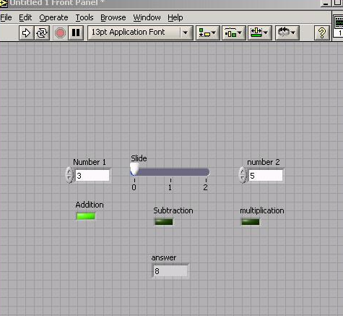
LabVIEW Interface
Front Panel - User Interface (UI), where the program is controlled and executed
Back Panel (Block Diagram) - The internal circuit where the program code is written

Slide 10
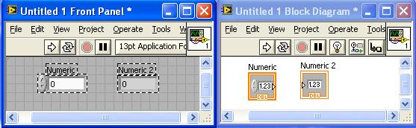
Controls & Indicators
Icon in back panel
represents object in front panel

Slide 11
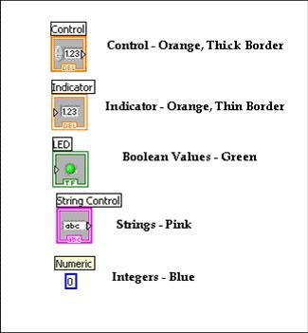
Color Representation

Slide 12
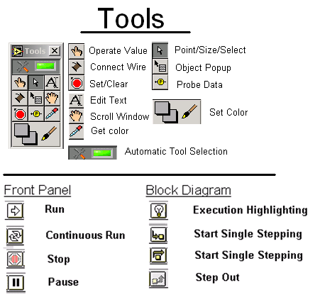

LabVIEW Tools

Slide 13
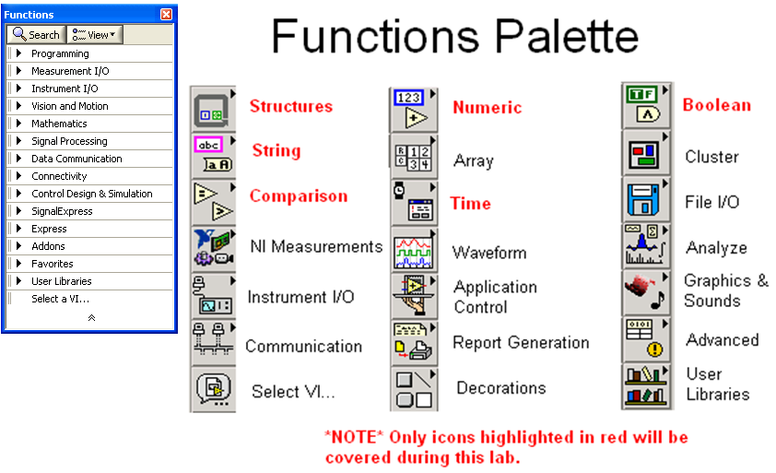
LabVIEW Functions
(View → Functions)

Slide 14
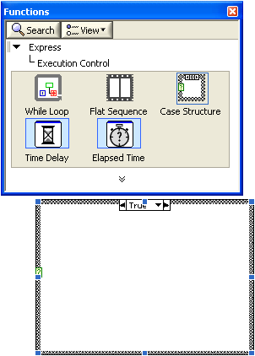
Structures
Allow programmer to produce conditional statements or multiple outputs, based on input
Example
  Case Structure
    Executes code based
    on input value

Slide 15
DAC Board
Data Acquisition & Control Board
  Interface that exchanges data (sends/receives) between the computer and the outside world
  DAC Icons Used:
    DAQ Assist
References: See EG1003 Online Manual, National Instruments documentation, and other LabVIEW oriented websites
(i.e. IIT’s LabVIEW for Dummies©)

Slide 16
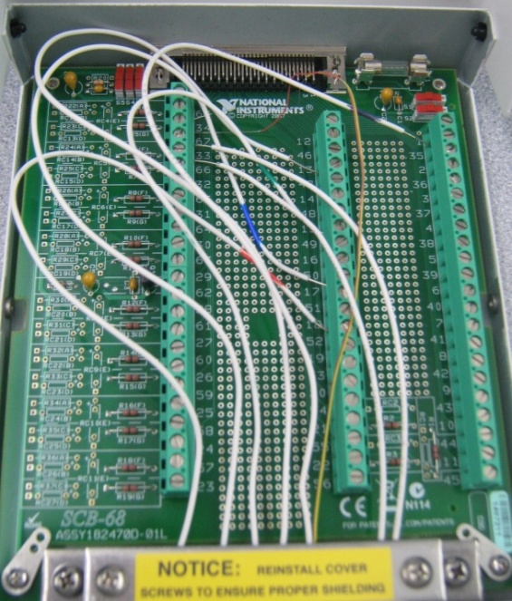
Termination Board:
Pins and Channels
Pin (numbered 1-68)
  Channel termination node
  One pin receives one bit of information
  Bit values and pin states
    “0” or “1” in binary terms
    Bit value of “0” → low voltage ≈ 0 VDC
    Bit value of “1” → high voltage ≈ +5VDC
Channel
  Path for sending information (i.e. cable)
  8-bit Digital IO channel terminating at 8 pins
  Each channel sends a byte following a pattern
Notes:
Paul-Henry Volmar September 2007 : Channel and Termination Nodes

Slide 17
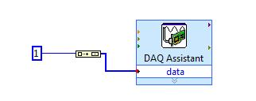
Pattern and Pin activation
  Channel pattern
    8 positions numbered 0 to 7 and right to left
  Each position can have a binary value of “0” or “1”
    Corresponding decimal value @ position = 2^{(position #)}
    To activate a pin:
      Determine decimal value of respective bit position: 2^{(position #)}
      Feed the decimal value into Build Array
      Provide the array output to the data field of DAQ Assistant
Notes:
Pattern and Pin slide: Paul-Henry Volmar September 2007

Slide 18
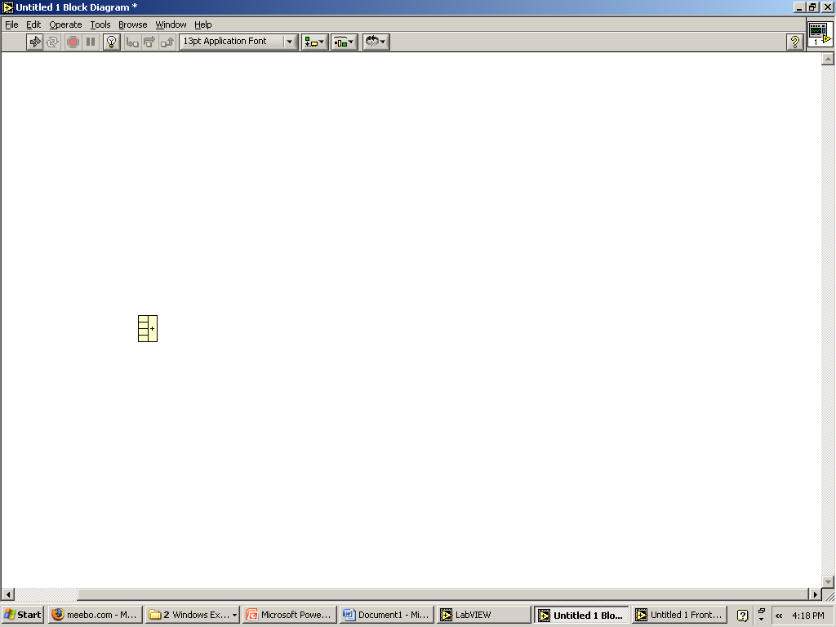
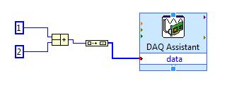
Pattern and Pin activation
      Activate multiple pins
      Use compound arithmetic operator
      Add as many inputs as needed
        Click and drag the bottom to add inputs
      Link sum to Build Array
Notes:
Pattern and Pin slide: Paul-Henry Volmar September 2007

Slide 19
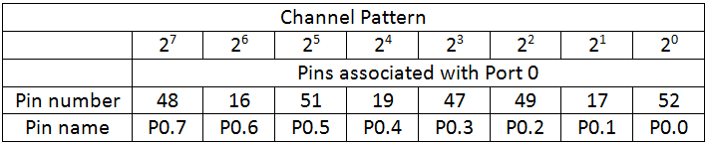
Pattern table
0
0
0
0
1
0
0
1
    If pin 47 and 52 are activated, channel will send:
    “1” at position 0 and at position 3: [0 0 0 0 1 0 0 1] (byte)
    Corresponding Decimal value = 0+0+0+0+2³+0+0+2⁰ = 9

Slide 20

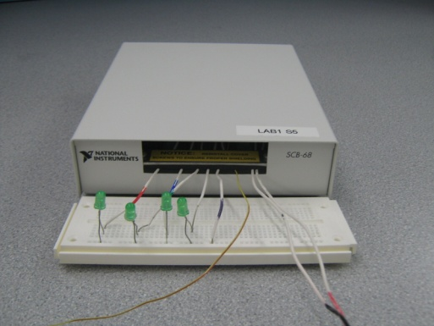
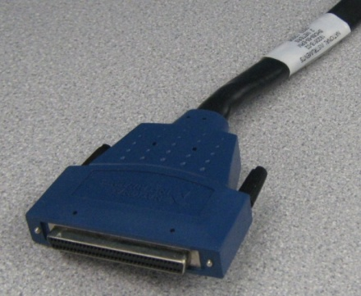
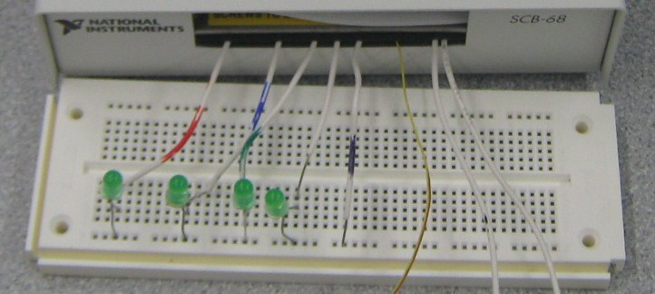
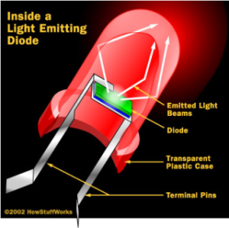
Materials
Computer with:
  Internal DAQ board
Termination board
Cable (Termination-DAC)
LED assembly (breadboard with LEDs)
  Light Emitting Diode (LED)
(termination board)

Slide 21
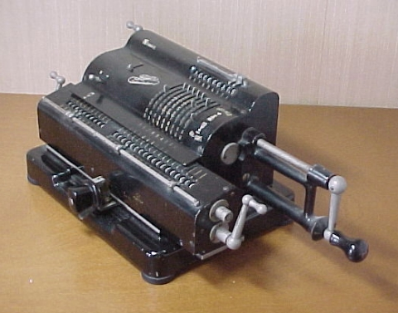
Procedure
Program 1: Simple Calculator
Program 2: Thermal Control
Program 3: Lighting System
Program 1: Simple Calculator VI
  Create program simulating basic calculator
  Able to add, subtract, and multiply

Slide 22
Procedure
Program 1: Simple Calculator VI
  Front panel of program must have:
    1 slide to control 3 different arithmetic operations
    (add +; subtract -; multiply *)
    3 LED (Boolean) indicators to show which arithmetic operation is selected
    Two numeric controls for inputting numbers
    One numeric indicator to display results
  Back panel should have:
    A case statement to control arithmetic operations
Program 1: Simple Calculator
Program 2: Thermal Control
Program 3: Lighting System

Slide 23
Procedure
Program 1: Simple Calculator
Program 2: Thermal Control
Program 3: Lighting System
Program 2: Thermal Control VI
  Home heating/cooling system
  Program requirements- Automatic Mode
    Regulate house air temperature
    AC is ON when temperature is greater than 80ºF
    Heater is ON when the temperature is less than 60ºF
    Heater and AC are OFF when temperature is between 60ºF and 80ºF
  Program requirements- Manual Mode
    Heater and AC power are controlled directly by user
    (overrides automatic mode)

Slide 24
Procedure
Program 1: Simple Calculator
Program 2: Thermal Control
Program 3: Lighting System
Program 2: Thermal Control VI
  Front panel must have:
    3 LEDs
      AC on/off indicator
      Heater on/off indicator
      Manual operation on/off indicator
    3 switches for AC, heater and system operation (automatic/manual)
    A temperature control represented by a thermometer
  Back panel should have:
    A Boolean case statement to control manual and automatic operations

Slide 25

Procedure
Program 1: Simple Calculator
Program 2: Thermal Control
Program 3: Lighting System
Program 3: Lighting System VI
  Simulate typical household lighting system
  Use Boolean indicators in conjunction with real LEDs to illustrate operation

Slide 26
Procedure
Program 1: Simple Calculator
Program 2: Thermal Control
Program 3: Lighting System
Program 3: Lighting System VI
  Front panel must have:
    Main power on/off switch for all lights
    4 lights, each representing a different room
      Each light should have a separate on/off switch
  Back panel should have:
    A “DAQ Assist” setup to control LEDs through DAC board
    A Boolean case for each LED
  Real world
    Functional LED assembly (depict real lights)

Slide 27
Assignment: Report/Presentation
Submit a Zip file with all LabVIEW programs (.vi)
No Presentation for this Lab
Individual report
Title page
Discussion topics in the manual
Include lab notes with TA’s initials
  TA must note that student programs worked
Scan in data and lab notes
(ask TA for assistance)

Slide 28
Closing
Have all lab notes signed by TA
Each team member should have turn using software
Save Heating and Cooling VI – to be used in a future lab session
Submit all work electronically
Return all unused materials to TA

