Slide 1
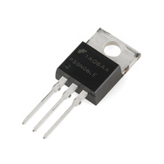
EG1003: Introduction to Engineering and Design
Introduction to LabVIEW

Slide 2
Overview
Objective
Background
Materials
Procedure
Report / Presentation
Closing

Slide 3
Objective
Familiarization with graphical programming
Obtain data from outside the computer using simulated instrumentation
Use this knowledge to create programs in LabVIEW
Simple calculator
Heating and cooling system
Lighting system

Slide 4
What is LabVIEW?
Laboratory Virtual Instrument Engineering Workbench
Graphical programming language
Used for data acquisition, instrument control, and signal processing
Based on G programming language

Slide 5
Text-based

Slide 6
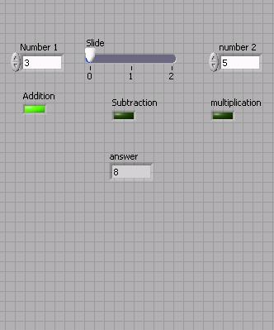
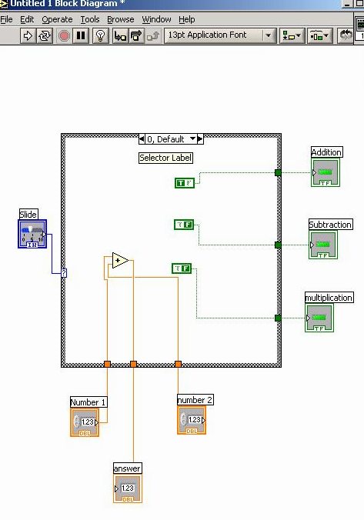
Graphic-based

Slide 7
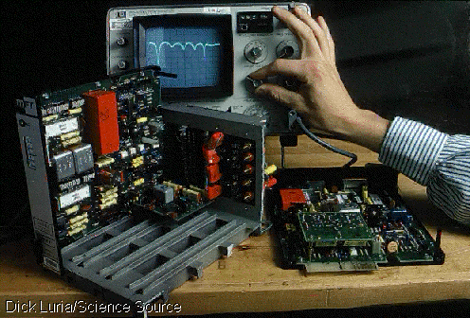
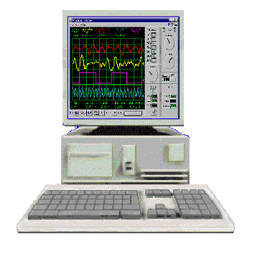
LabVIEW Programs (VIs)
Called “Virtual Instruments” (VIs)
Appearance and operation imitates actual physical instruments
Without
With

Slide 8
Applications in EG1003
Heat Transfer and Thermal Insulation Lab
Temperature Recording
Electronic Filters Lab
Oscilloscope (SignalExpress)
Semester Long Project – Supermarket, Train
Lighting system and heater/AC
Security system
Light sensors
Switches rail paths

Slide 9
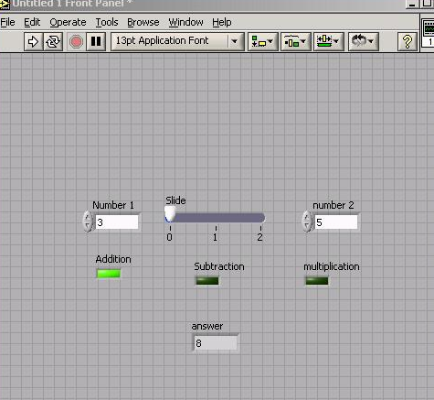
LabVIEW Interface
Front Panel - User Interface (UI), where the program is controlled and executed
Back Panel (Block Diagram) - The internal circuit where the program code is written

Slide 10
Controls and Indicators
Icon in back panel represents object in front panel

Slide 11
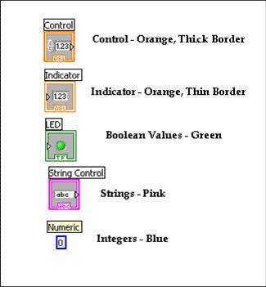
Color Representation

Slide 12
LabVIEW Tools

Slide 13
LabVIEW Functions (View > Functions)

Slide 14
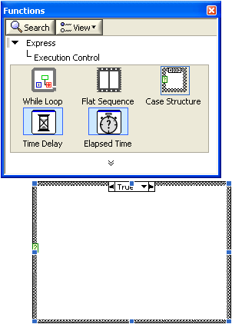
Structures
Allow programmer to produce conditional statements or multiple outputs, based on input
Example
Case Structure
Executes code based
on input value

Slide 15
NI-ELVIS Board
National Instruments’ Educational Laboratory Virtual Instrumentation Suite Board
Interface that exchanges data (sends/receives) between the computer and the outside world
References: See EG1003 Online Manual, National Instruments documentation, and other LabVIEW oriented websites (i.e. IIT’s LabVIEW for Dummies©)

Slide 16
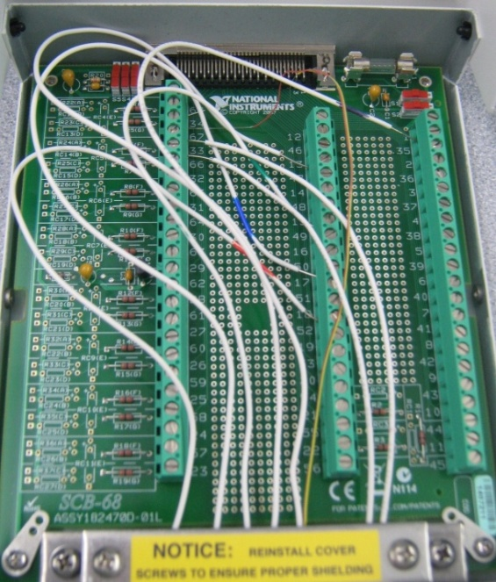
Termination Board: Pins and Channels
Pin (numbered 1-68)
Channel termination node
One pin receives one bit of information
Bit values and pin states
“0” or “1” in binary terms
Bit value of “0” > Low voltage ≈ 0 VDC
Bit value of “1” > High voltage ≈ +5VDC
Channel
Path for sending information (i.e. cable)
8-bit Digital IO channel terminating at 8 pins
Each channel sends a byte following a pattern

Slide 17
Pattern and Pin activation
Channel pattern
8 positions numbered 0 to 7 and right to left
Each position can have a binary value of “0” or “1”
Corresponding decimal value @ position = 2(position #)
To activate a pin:
Determine decimal value of respective bit position: 2(position #)
Feed the decimal value into Build Array

Slide 18
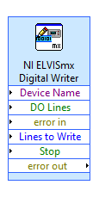
Pattern and Pin activation
Activate multiple pins
Use compound arithmetic operator
Add as many inputs as needed
Click and drag the bottom to add inputs
Link sum to Build Array

Slide 19
Materials
Computer with:
NI-ELVIS Board
Termination board
LED assembly (breadboard with LEDs)
Light Emitting Diode (LED)

Slide 20
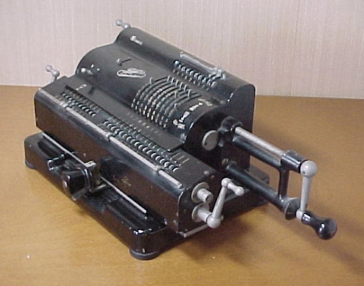
Procedure
Program 1: Simple Calculator
Program 2: Thermal Control
Program 3: Lighting System
Program 1: Simple Calculator VI
Create program simulating basic calculator
Able to add, subtract, and multiply

Slide 21
Procedure
Program 1: Simple Calculator VI
Front panel of program must have:
1 slide to control 3 different arithmetic operations (add +; subtract -; multiply *)
3 LED (Boolean) indicators to show which arithmetic operation is selected
Two numeric controls for inputting numbers
One numeric indicator to display results
Back panel should have:
A case statement to control arithmetic operations
Program 1: Simple Calculator
Program 2: Thermal Control
Program 3: Lighting System

Slide 22
Procedure
Program 2: Thermal Control VI
Home heating/cooling system
Program requirements- Automatic Mode
Regulate house air temperature
AC is ON when temperature is greater than 80ºF
Heater is ON when the temperature is less than 60ºF
Heater and AC are OFF when temperature is between 60ºF and 80ºF
Program requirements- Manual Mode
Heater and AC power are controlled directly by user (overrides automatic mode)
Program 1: Simple Calculator
Program 2: Thermal Control
Program 3: Lighting System

Slide 23
Procedure
Program 2: Thermal Control VI
Front panel must have:
3 LEDs
AC on/off indicator
Heater on/off indicator
Manual operation on/off indicator
3 switches for AC, heater and system operation (automatic/manual)
A temperature control represented by a thermometer
Back panel should have:
A Boolean case statement to control manual and automatic operations
Program 1: Simple Calculator
Program 2: Thermal Control
Program 3: Lighting System

Slide 24
Procedure
Program 3: Lighting System VI
Simulate typical household lighting system
Use Boolean indicators in conjunction with real LEDs to illustrate operation
Program 1: Simple Calculator
Program 2: Thermal Control
Program 3: Lighting System

Slide 25
Procedure
Program 3: Lighting System VI
Front panel must have:
Main power on/off switch for all lights
4 lights, each representing a different room
Each light should have a separate on/off switch
Back panel should have:
A “NI ELVISmx Digital Writer node” setup to control LEDs through board
A Boolean case for each LED
Real world
Functional LED assembly (depict real lights)
Program 1: Simple Calculator
Program 2: Thermal Control
Program 3: Lighting System

Slide 26
Assignment: Report/Presentation
Submit a Zip file with all LabVIEW programs (.vi)
No Presentation for this Lab
Individual report
Title page
Discussion topics in the manual
Scan in data and lab notes (ask TA for assistance)

Slide 27
Closing
Have all lab notes signed by TA
Each team member should have turn using software
Save Heating and Cooling VI – to be used in a future lab session
Submit all work electronically
Return all unused materials to TA

