Slide 1
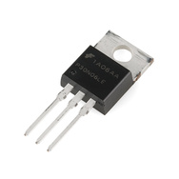
EG1003: Introduction to Engineering and Design
Introduction to LabVIEW

Slide 2
Overview
Objective
Background
Materials
Procedure
Report / Presentation
Closing

Slide 3
Objective
Familiarization with graphical programming
Obtain data from outside the computer using simulated instrumentation
Use this knowledge to create programs in LabVIEW
Simple calculator
Lighting system
Heating and cooling system

Slide 4
What is LabVIEW?
Laboratory Virtual Instrument Engineering Workbench
Graphical programming language
Used for data acquisition, instrument control, and signal processing
Based on G programming language

Slide 5
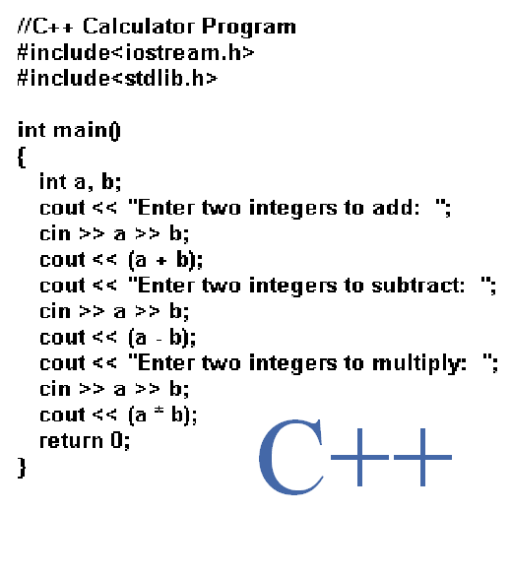
Text-based

Slide 6
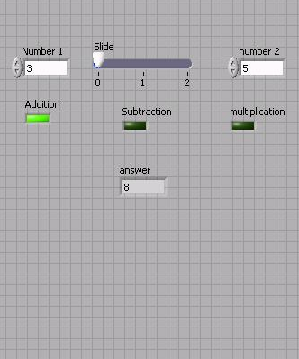
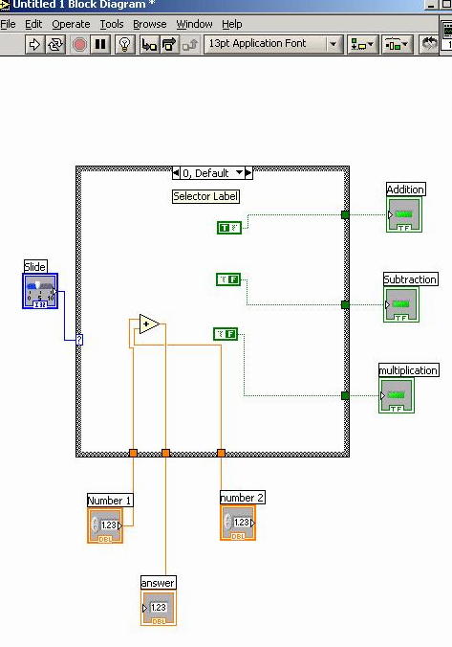
Graphic-based

Slide 7
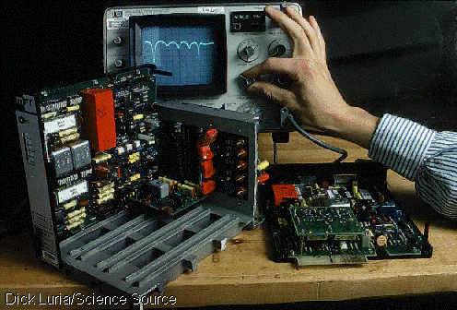
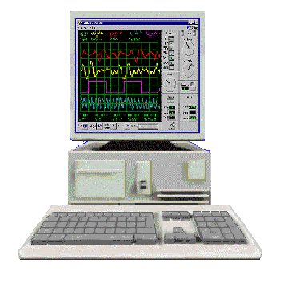
LabVIEW Programs (VIs)
Called “Virtual Instruments” (VIs)
Appearance and operation imitates actual physical instruments
Without
With

Slide 8
Applications in EG1003
Heat Transfer and Thermal Insulation Lab
Temperature Recording
Electronic Filters Lab
Oscilloscope (SignalExpress)
Semester Long Project – Supermarket, Train
Lighting system and heater/AC
Security system
Light sensors
Switches rail paths

Slide 9
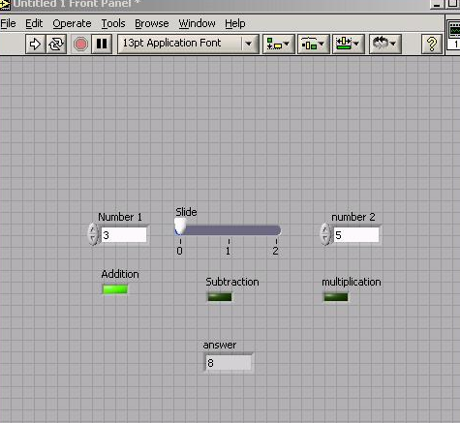
LabVIEW Interface
Front Panel - User Interface (UI), where the program is controlled and executed
Back Panel (Block Diagram) - The internal circuit where the program code is written

Slide 10
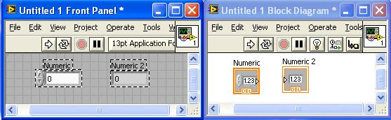
Controls and Indicators
Icon in back panel represents object in front panel

Slide 11
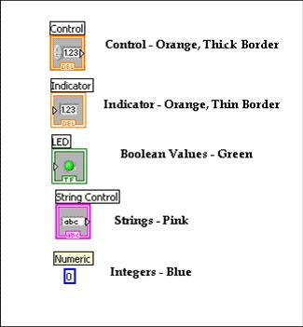
Color Representation

Slide 12
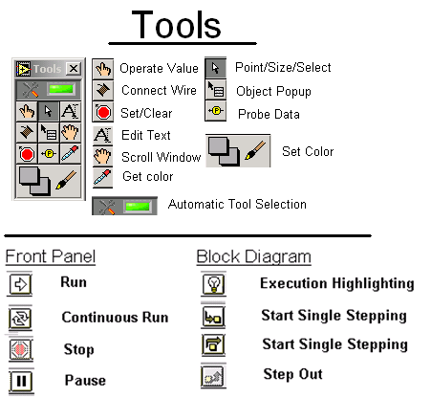
LabVIEW Tools

Slide 13
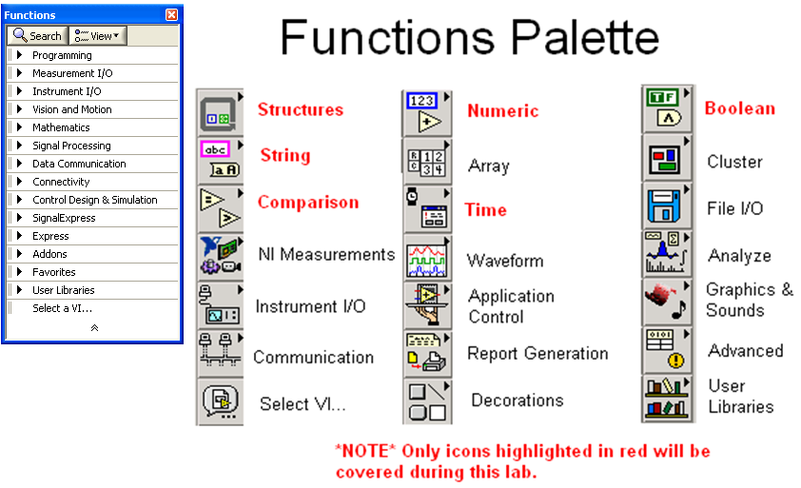
LabVIEW Functions (View > Functions)

Slide 14
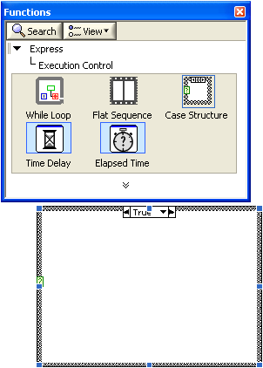
Structures
Allow programmer to produce conditional statements or multiple outputs, based on input
Example
Case Structure
Executes code based
on input value

Slide 15
NI-ELVIS Board
National Instruments’ Educational Laboratory Virtual Instrumentation Suite Board
Interface that exchanges data (sends/receives) between the computer and the outside world
References: See EG1003 Online Manual, National Instruments documentation, and other LabVIEW oriented websites (i.e. IIT’s LabVIEW for Dummies©)

Slide 16
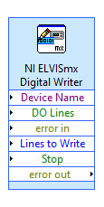
Pattern and Pin activation
Activate multiple pins
Use compound arithmetic operator
Add as many inputs as needed
Click and drag the bottom to add inputs
Link sum to Build Array

Slide 17

Materials
Computer with LabVIEW
NI-ELVIS Board
Wires
3D Printed Heat Cube

Slide 18
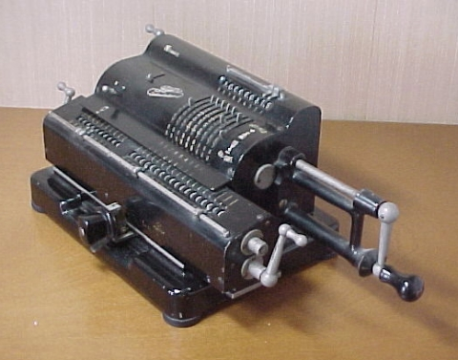
Procedure
Program 1: Simple Calculator
Program 2: Lighting System
Program 3:
Thermal Control
Program 1: Simple Calculator VI
  Create program simulating basic calculator
  Able to add, subtract, and multiply

Slide 19
Procedure
Program 1: Simple Calculator VI
Front panel of program must have:
  1 slide to control 3 different arithmetic operations (add +; subtract -; multiply *)
  3 LED (Boolean) indicators to show which arithmetic operation is selected
  Two numeric controls for inputting numbers
  One numeric indicator to display results
  Back panel should have:
  A case statement to control arithmetic operations
Program 1: Simple Calculator
Program 2: Lighting System
Program 3:
Thermal Control

Slide 20

Procedure
Program 2: Lighting System VI
  Simulate typical household lighting system
  Use Boolean indicators in conjunction with real LEDs to illustrate operation
Program 1: Simple Calculator
Program 2: Lighting System
Program 3:
Thermal Control

Slide 21
Procedure
Program 2: Lighting System VI
Front panel must have:
Main power on/off switch for all lights
4 lights, each representing a different room
Each light should have a separate on/off switch
Back panel should have:
A “NI ELVISmx Digital Writer node” setup to control LEDs through board
A Boolean case for each LED
Real world
Functional LED assembly (depict real lights)
Program 1: Simple Calculator
Program 2: Lighting System
Program 3:
Thermal Control

Slide 22
Procedure
Program 3: Thermal Control VI
  Home heating/cooling system
  Program requirements- Automatic Mode
  Regulate house air temperature
  AC is ON when temperature is greater than 80ºF
  Heater is ON when the temperature is less than 60ºF
  Heater and AC are OFF when temperature is between 60ºF and 80ºF
  Program requirements- Manual Mode
  Heater and AC power are controlled directly by user (overrides automatic mode)
Program 1: Simple Calculator
Program 2: Lighting System
Program 3:
Thermal Control

Slide 23
Procedure
Program 3: Thermal Control VI
  Front panel must have:
  3 LEDs
  AC on/off indicator
  Heater on/off indicator
  Manual operation on/off indicator
  3 switches for AC, heater and system operation (automatic/manual)
  A temperature control represented by a thermometer
  Back panel should have:
  A Boolean case statement to control manual and automatic operations
Program 1: Simple Calculator
Program 2: Lighting System
Program 3:
Thermal Control

Slide 24
Procedure
Program 3: Thermal Control VI
  Real World
  Functional heating/cooling system “Heat Cube”
  Import premade VI’s to control fans, heaters and thermometers using your logic program
    Temperature Reading VI
      Receive real time data
    Heat control VI
      Power heating element
    Cooling Control VI
      Power fan/Cooling unit
Program 1: Simple Calculator
Program 2: Lighting System
Program 3:
Thermal Control

Slide 25
Assignment: Report/Presentation
Submit a Zip file with all LabVIEW programs (.vi)
No Presentation for this Lab
Individual report
Title page
Discussion topics in the manual
Scan in data and lab notes (ask TA for assistance)

Slide 26
Closing
Have all lab notes signed by TA
Each team member should have turn using software
Save Heating and Cooling VI – to be used in a future lab session
Submit all work electronically
Return all unused materials to TA

