Slide 1



Introduction to LabVIEW

Slide 2
Overview
Objectives
Background
Materials
Procedure
Report/Presentation
Closing

Slide 3
Objective
Familiarization with graphical programming
Obtain data from outside the computer using simulated instrumentation
Use this knowledge to create programs in LabVIEW
  Simple calculator
  Lighting system
  Heating and cooling system

Slide 4
What is LabVIEW?
Laboratory Virtual Instrument Engineering Workbench
Graphical programming language
Used for data acquisition, instrument control, and signal processing
Based on G programming language

Slide 5
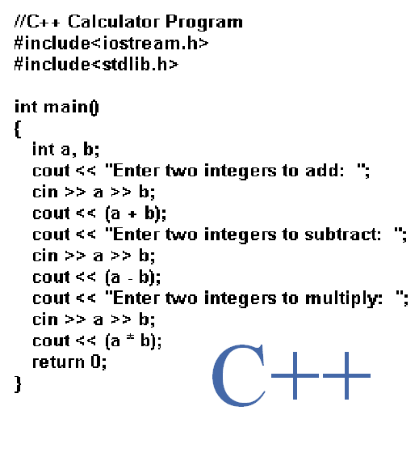
Text-based
Text-based code for a simple calculator

Slide 6
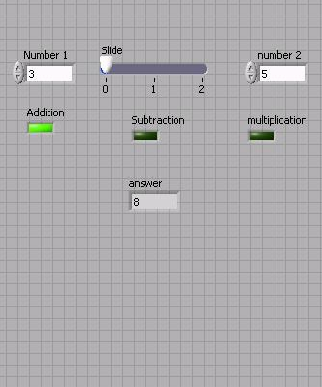
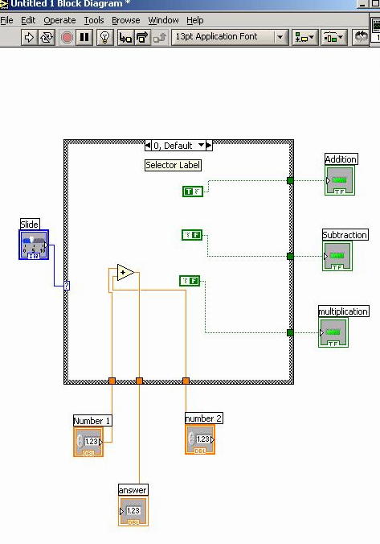
Graphic-based
Graphic-based code for a simple calculator

Slide 7
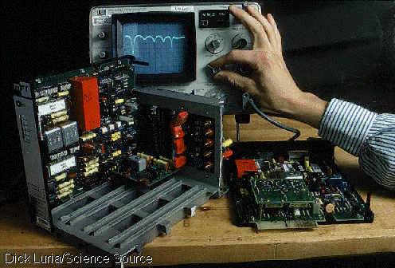
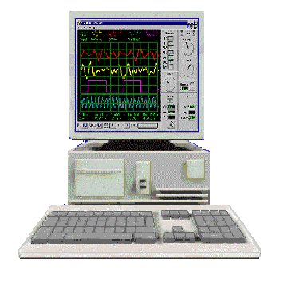
LabVIEW Programs (VIs)
Called “Virtual Instruments” (VIs)
Appearance and operation imitates actual physical instruments
Without
With

Slide 8
Applications in EG1003
Heat Transfer and Thermal Insulation Lab
  Temperature Recording
Electronic Filters Lab
  Oscilloscope (SignalExpress)
Semester Long Project – Supermarket, Train
  Lighting system and heater/AC
  Security system
  Light sensors
  Switches rail paths

Slide 9
Graphic-based
Back Panel (Block Diagram): The internal circuit where the program code is written
Front Panel - User Interface (UI), where the program is controlled and executed

Slide 10
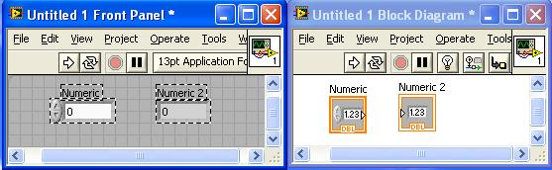
Controls and Indicators
Icons in back panel represent objects in front panel
Controls can be identified by a triangle on the right of the block shown on the back panel

Slide 11


Toolbar &Tools Panel
Run once
Run Continuously
Stop
Pause
Highlight Execution
Automatic Tool Selector
Operating Tool
Positioning Tool
Labeling Tool
Wiring Tool
Scrolling Tool
Probe Tool
Coloring Tool
Get Color

Slide 12
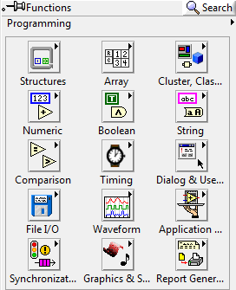
LabVIEW Functions (View > Functions)
The Functions palette contains the VIs, functions and constants you use to create the block diagram.
Only items highlighted in red will be covered in this course

Slide 13
NI-ELVIS Board
National Instruments’ Educational Laboratory Virtual Instrumentation Suite Board
Interface that exchanges data (sends/receives) between the computer and the outside world
  References: See EG1003 Online Manual, National Instruments documentation, and other LabVIEW oriented websites (i.e. IIT’s LabVIEW for Dummies©)

Slide 14
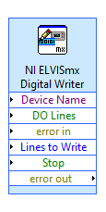
Pattern and Pin activation
Activate multiple pins
Use compound arithmetic operator
Add as many inputs as needed
Click and drag the bottom to add inputs
Link sum to Build Array

Slide 15
Materials
Computer with LabVIEW
NI-ELVIS Board
Wires
3D Printed Heat Cube

Slide 16
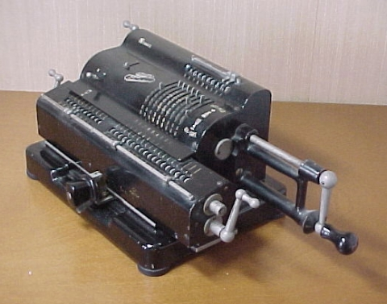
Procedure
Program 1 (Simple Calculator VI):
Create program simulating basic calculator
Able to add, subtract, and multiply

Slide 17
Procedure
Front panel of program must have:
  1 slide to control 3 different arithmetic operations
  (add +; subtract -; multiply *)
  3 LED (Boolean) indicators to show which arithmetic operation is selected
  Two numeric controls for inputting numbers
  One numeric indicator to display results
  Back panel should have:
  A case statement to control arithmetic operations

Slide 18

Procedure
Program 2 (Lighting System VI):
Simulate typical household lighting system
Use Boolean indicators in conjunction with real LEDs to illustrate operation

Slide 19
Procedure
Front panel must have:
  Main power on/off switch for all lights
  4 lights, each representing a different room
  Each light should have a separate on/off switch
Back panel should have:
  A “NI ELVISmx Digital Writer node” setup to control LEDs through board
  A Boolean case for each LED
  Real world: Functional LED assembly depict real lights

Slide 20
Procedure
Program 3 (Thermal Control VI):
Program requirements- Automatic Mode
  Regulate house air temperature
  AC is ON when temperature is greater than 80ºF
  Heater is ON when the temperature is less than 60ºF
  Heater and AC are OFF when temperature is between 60ºF and 80ºF
Program requirements- Manual Mode
  Heater and AC power are controlled directly by user (overrides automatic mode)

Slide 21
Procedure
Front panel must have:
  3 LEDs: AC, Heater, and Manual operation
  3 switches for AC, heater and system operation (automatic/manual)
  A temperature control represented by a thermometer
Back panel should have:
  A Boolean case statement to control manual and automatic operations

Slide 22
Procedure
Real World
Functional heating/cooling system “Heat Cube”
Import premade VI’s to control fans, heaters and thermometers using your logic program
  Temperature Reading VI: Receive real time data
  Heat control VI: Power heating element
  Cooling Control VI: Power fan/Cooling unit

Slide 23
Report/Presentation
Submit a Zip file with all LabVIEW programs (.vi)
No Presentation for this Lab
Individual report
Title page
Discussion topics in the manual
Scan in data and lab notes

Slide 24
Closing
Have all lab notes signed by TA
Each team member should have turn using software
Save Heating and Cooling VI
Submit all work electronically
Return all unused materials to TA

