Slide 1
Introduction to LabVIEW

Slide 2
Overview
Objectives
Background
Materials
Procedure
Report/Presentation
Closing

Slide 3
Objective
Familiarization with graphical programming
Obtain data from outside the computer using simulated instrumentation
Use this knowledge to create programs in LabVIEW
Heating and cooling system
Lighting system

Slide 4
What is LabVIEW?
Laboratory Virtual Instrument Engineering Workbench
Graphical programming language
Used for data acquisition, instrument control, and signal processing
Based on G programming language

Slide 5
Text-Based
Text-based code for a simple calculator

Slide 6
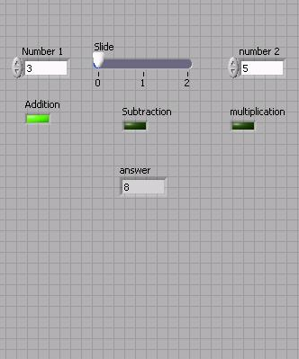
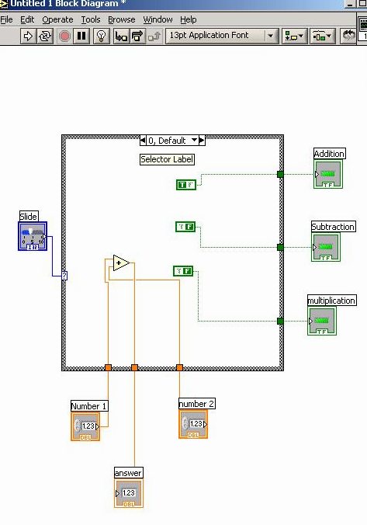
Graphic-Based
Graphic-based code for a simple calculator

Slide 7
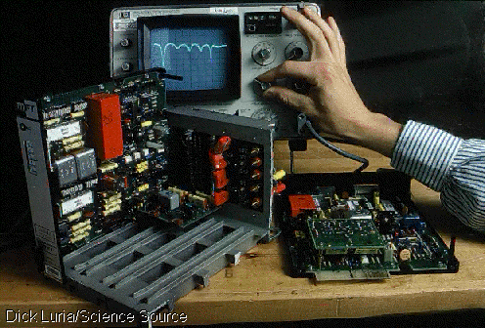
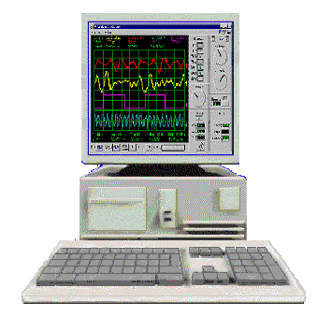
LabVIEW Programs (VIs)
Called “Virtual Instruments” (VIs)
Appearance and operation imitates actual physical instruments
Without
With

Slide 8
Graphic-Based
Back Panel (Block Diagram): The internal circuit where the program code is written
Front Panel - User Interface (UI), where the program is controlled and executed

Slide 9
Controls and Indicators
Icons in back panel represent objects in front panel
Controls can be identified by a triangle on the right of the block shown on the back panel

Slide 10
Toolbar & Tools Panel
Run once
Run Continuously
Stop
Pause
Highlight Execution
Automatic Tool Selector
Operating Tool
Positioning Tool
Labeling Tool
Wiring Tool
Scrolling Tool
Probe Tool
Coloring Tool
Get Color

Slide 11
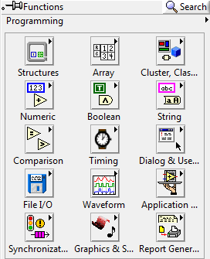
LabVIEW Functions (View > Functions)
The Functions palette contains the VIs, functions and constants you use to create the block diagram
Only items highlighted in red will be covered in this course

Slide 12
NI-ELVIS Board
National Instruments’ Educational Laboratory Virtual Instrumentation Suite Board
Interface that exchanges data (sends/receives) between the computer and the outside world
References: See EG1003 Online Manual, National Instruments documentation, and other LabVIEW oriented websites (i.e. IIT’s LabVIEW for Dummies©)

Slide 13
Materials
Computer with LabVIEW
NI-ELVIS board
Wires
3D-Printed Heat Cube

Slide 14
Procedure
Program 1 (Thermal Control VI)
Program requirements – Automatic Mode
Regulate house air temperature
AC is ON when temperature is greater than 80ºF
Heater is ON when temperature is less than 60ºF
Both OFF when the temperature is between 60ºF & 80ºF
Program requirements – Manual Mode
Heater and AC power are controlled directly by user (overrides automatic mode)

Slide 15
Procedure
Front panel must have:
3 LEDs: AC, Heater, and Manual operation
3 switches for AC, heater, and system operation (automatic/manual)
A temperature control represented by a thermometer
Back panel should have:
A Boolean case statement to control manual and automatic operations

Slide 16
Procedure
Real World Application
Functional heating/cooling system “Heat Cube”
Import premade VIs to control fans, heaters, and thermometers using your logic program
Temperature Reading VI: receive real time data
Heat Control VI: power heating element
Cooling Control VI: power fan/cooling unit

Slide 17
Procedure
Program 2 (Lighting System VI)
Program Requirements
Control the lights in four rooms
Turn off all lights with a master switch
Front Panel
Four LEDs
Five Switches
Back Panel
Case Structure
NI ELVISmx Digital Writer

Slide 18
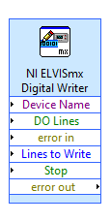
Procedure
Real World Application
Functional lighting system via LED’s on the NI-ELVIS board
Control lights on board using front panel on computer

Slide 19
Report/Presentation
Submit a Zip file with all LabVIEW programs (.vi)
Submit BEFORE end of lab
No presentation for this lab
Individual report
Discussion topics in the manual
Scan in data and lab notes

Slide 20
Closing
Have all lab notes signed by TA
Each team member should have turn using software
Save all VIs
Submit all work electronically
Return all unused materials to TA

Slide 21
Introduction to LabVIEW
QUESTIONS?

