Slide 1
RECITATION 1
EG1004

Slide 2
AGENDA
Recitation Presentation Overview
Engineering Curriculum
Course Overview
Academic Honesty & Plagiarism
How to Write a Lab Report
How to Give a Recitation Presentation
2

Slide 3
EG 1004 RECITATION INTRO PRESENTATIONS OVERVIEW

Slide 4
SKILLS FOR EG 1004
Technical Reports
Professional Presentations
Engineering Design Process
LEARNING ENGINEERING
Metacognition
Ethics and Stakeholder Impact
Reflection
4
Notes:
Many engineering schools across the world use this framework to provide engineering students with the skills and knowledge they’ll need post-university

Slide 5
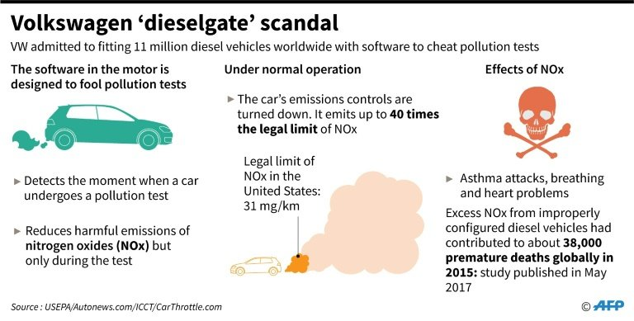
ACADEMIC & PROFESSIONAL GROWTH
Undergraduate Resources
Graduate School
Career Development
THE FUTURE OF ENGINEERING
Engineering & Social Justice
Emerging Global Topics
Entrepreneurial Mindset
Engineering and Social Justice
5
Notes:
Many engineering schools across the world use this framework to provide engineering students with the skills and knowledge they’ll need post-university

Slide 6
ENGINEERING CURRICULUM

Slide 7
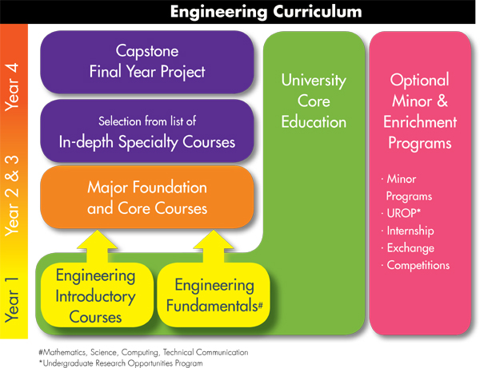
ENGINEERING CURRICULUM
7
Notes:
Many engineering schools across the world use this framework to provide engineering students with the skills and knowledge they’ll need post-university

Slide 8
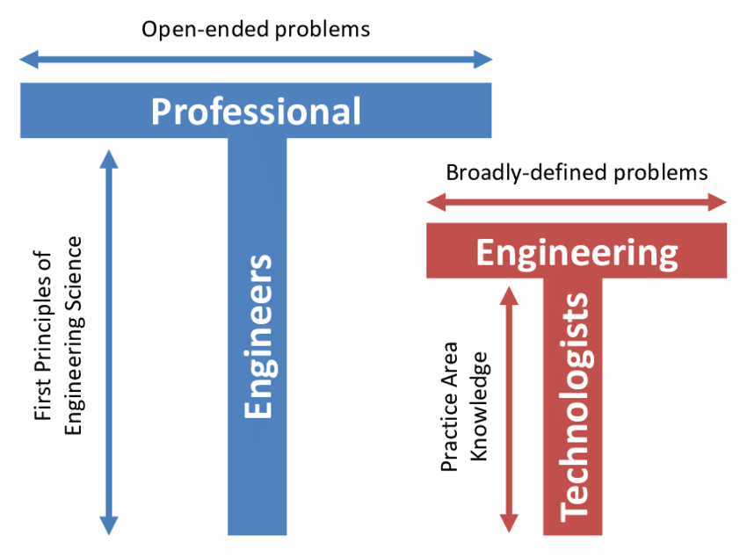
PROFESSIONAL READINESS
The ‘T’ Shaped Engineer:
Height represents expertise
Width represents breadth of general knowledge
‘T’ shape enables engineers to solve a wide range of problems
8
Notes:
The engineering curriculum chart on the previous slide helps to create ’T’ shaped professional engineers. A professional engineer is someone who has a strong foundational science and mathematics background which greatly increases the scope of projects one can work on. An Engineering Technologist is someone who does not have a strong foundation in sciences and math (may not have a college degree) and focus instead on implementation and technical skills.

Slide 9
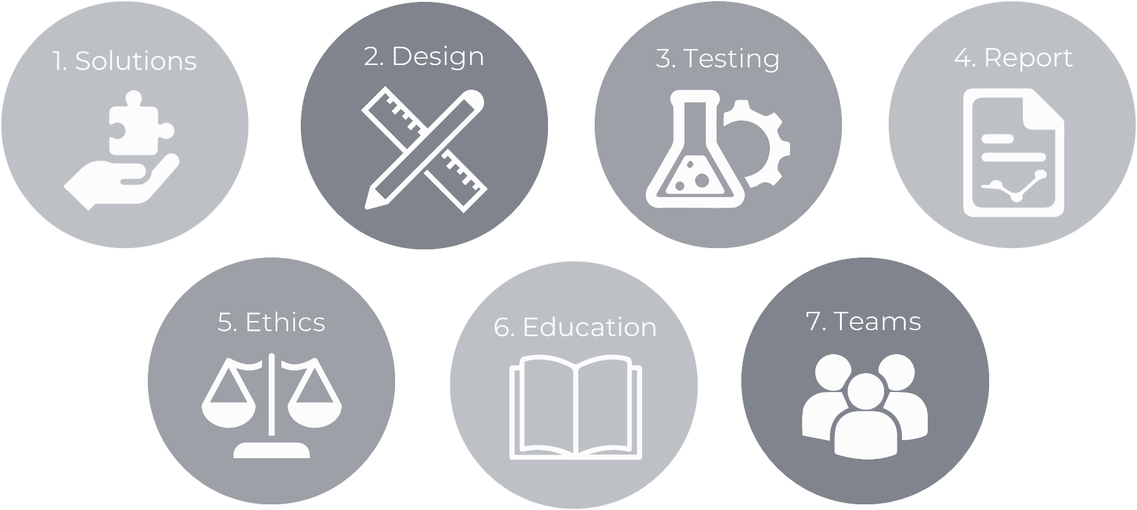
ABET OUTCOMES
9
Notes:
Professional Engineers are those who come out of an ABET accredited engineering program. The ABET accreditation of each major in an engineering school helps provide engineers with the best education by implementing high programmatic standards created by the ABET board. Major programs are reassessed and audited often to ensure that the program adequately prepares engineers for the workforce. The outcomes above highlight some of the ABET accreditations and goals for engineers to develop through their studies. These outcomes are largely used to create curriculum, including in EG 1003.

Slide 10
COURSE OVERVIEW

Slide 11
COURSE OBJECTIVES
Explore concentrations of engineering
Develop professional skills
Teamwork
Oral communication
Written communication
Explore technical tools & skills
Utilize the engineering design process
11

Slide 12
COURSE FORMAT
Lecture
1 hr. / week
Lab
3 hr. / week
Recitation
1.5 hr. / week
Semester-Long Design Project
12

Slide 13
ATTENDANCE POLICIES
Lecture
ID SWIPE
Lab
ID SWIPE
Recitation
PRESENTATION
Semester-Long Design Project
OWN TIME
13

Slide 14
ATTENDANCE POLICIES
Full absence & tardy policies on the EG1004 Manual
Lecture
NO MAKE UP E-mail Recitation Professor
Lab
Makeup by Request
Visit Website
Recitation
E-mail Recitation Professor
Semester-Long Design Project
OWN TIME
14

Slide 15
LECTURE
Professors and industry experts lecture on engineering disciplines
Mandatory attendance
Taken during first five minutes
Don’t be late!
15

Slide 16
LABORATORY
Lab groups of 2-3 students
Weekly lab report due at 11:59 pm on night before the next lab
Weekly quiz
Lab material
Lecture material
Makeup labs requested on EG website
16

Slide 17
RECITATION
Student presentations on labs & projects
Due at 11:59 pm the night before recitation
Professor and TA material on becoming a well-rounded engineer:
Engineering career pathways
Professional skills
Engineering mindset
Technical writing
17

Slide 18
SEMESTER-LONG DESIGN PROJECT (SLDP)
12-week project
Teams of 2-3 students
More info to come
Figure 1: Sample SLDP RAD project courtesy of EG1003
18

Slide 19
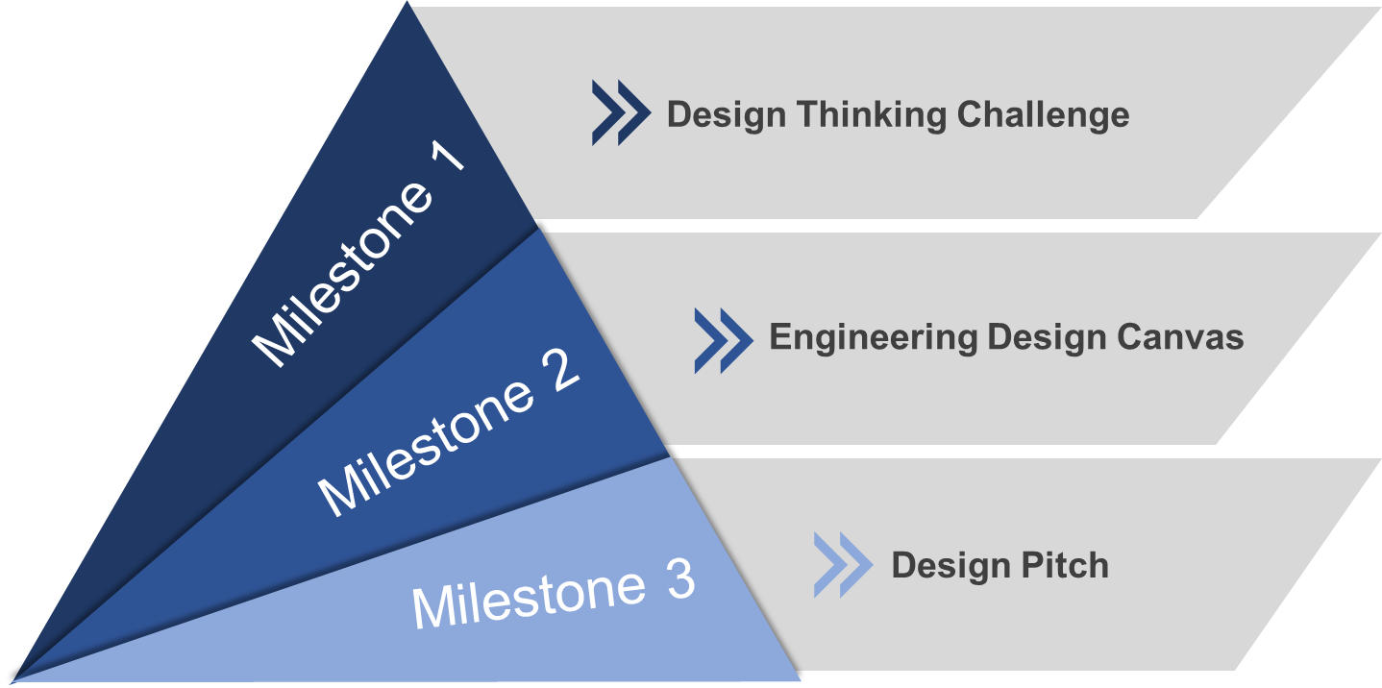
PROFESSIONAL SKILLS
Contributing to the Team’s Work
Interacting with Teammates
Having Relevant KSAs
Keeping the Team on Track
Expecting Quality
19

Slide 20
JOB APPLICATION PRACTICE
Tandon Career Services Lecture
Writing Consultant Presentations
Compile a Mock Job Application
Resume
Cover Letter
LinkedIn Profile
ePortfolio
20

Slide 21
GRADING BREAKDOWN
Item | Percentage of Grade
TA Lab Reports | 15%
WC Lab Reports | 15%
Lab Quizzes | 5%
Recitation Presentations | 15%
Semester-Long Design Project | 30%
Professional Development | 10%
Lecture Attendance | 10%
21

Slide 22
COURSE RESOURCES
EG1004 Website eg.poly.edu
Assignment submission
Course announcements
Syllabus & schedule
Grades
EG1004 Lab Manual manual.eg.poly.edu
Lab & project information
Course material & presentations
Course policies
Help and how-tos
22

Slide 23
QUESTIONS?

