Slide 1


RECITATION 1
EG1004

Slide 2
AGENDA
Recitation Presentation Overview
Engineering Curriculum
Course Overview
Academic Honesty & Plagiarism
How to Write a Lab Report
How to Give a Recitation Presentation
2

Slide 3
EG 1004 RECITATION
INTRO PRESENTATIONS
OVERVIEW

Slide 4
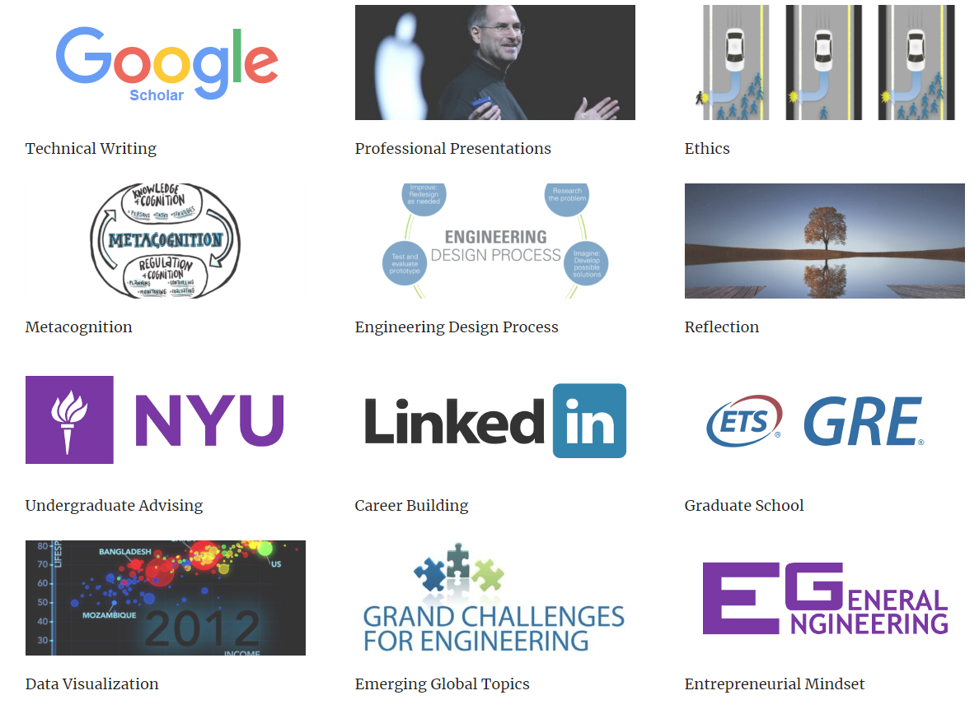

SKILLS FOR EG 1004
Technical Reports
Professional Presentations
Engineering Design Process
LEARNING ENGINEERING
Metacognition
Ethics and Stakeholder Impact
Reflection
4
Notes:
Many engineering schools across the world use this framework to provide engineering students with the skills and knowledge they’ll need post-university

Slide 5
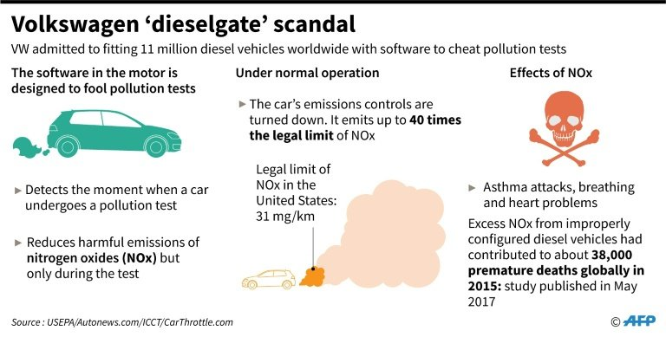

ACADEMIC & PROFESSIONAL GROWTH
Undergraduate Resources
Graduate School
Career Development
THE FUTURE OF ENGINEERING
Engineering & Social Justice
Emerging Global Topics
Entrepreneurial Mindset
Engineering and Social Justice
5
Notes:
Many engineering schools across the world use this framework to provide engineering students with the skills and knowledge they’ll need post-university

Slide 6
ENGINEERING CURRICULUM

Slide 7
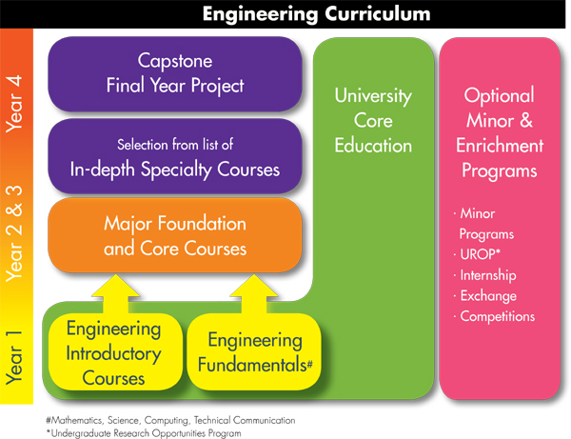
ENGINEERING CURRICULUM
7
Notes:
Many engineering schools across the world use this framework to provide engineering students with the skills and knowledge they’ll need post-university

Slide 8
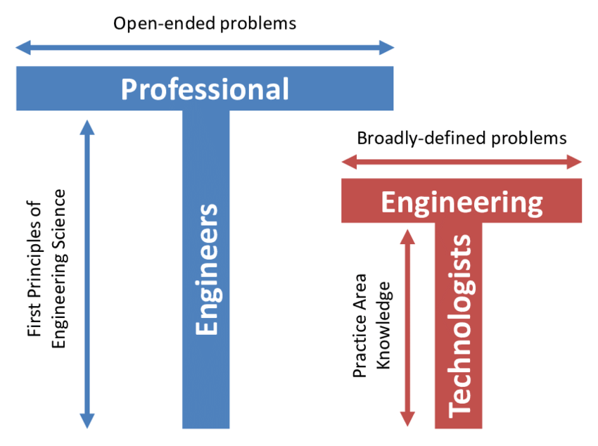
PROFESSIONAL READINESS
The ‘T’ Shaped Engineer:
Height represents expertise
Width represents breadth of general knowledge
‘T’ shape enables engineers to solve a wide range of problems
8
Notes:
The engineering curriculum chart on the previous slide helps to create ’T’ shaped professional engineers. A professional engineer is someone who has a strong foundational science and mathematics background which greatly increases the scope of projects one can work on. An Engineering Technologist is someone who does not have a strong foundation in sciences and math (may not have a college degree) and focus instead on implementation and technical skills.

Slide 9
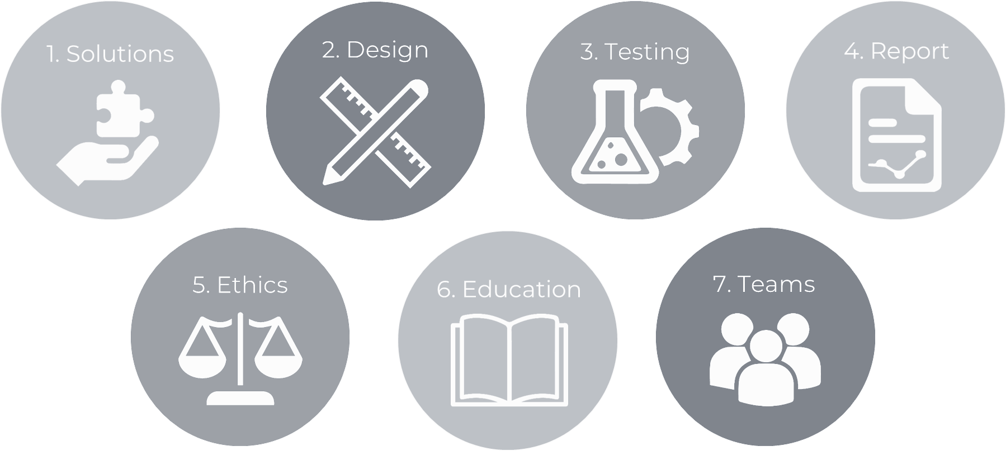
ABET OUTCOMES
9
Notes:
Professional Engineers are those who come out of an ABET accredited engineering program. The ABET accreditation of each major in an engineering school helps provide engineers with the best education by implementing high programmatic standards created by the ABET board. Major programs are reassessed and audited often to ensure that the program adequately prepares engineers for the workforce. The outcomes above highlight some of the ABET accreditations and goals for engineers to develop through their studies. These outcomes are largely used to create curriculum, including in EG 1003.

Slide 10
QUESTIONS?

