Slide 1

TECHNICAL WRITING STANDARDS
EG1003 | RECITATION 4

Slide 2

EQUATIONS
On a separate line, not in text
Centered
Number usually on right
${(x+a) }^{n} =\sum_{R−0}^{n}{k=\left({n \atop k}\right)x^{k}a^{n−k}}$ (1)
$a^{2}+b^{2}=c^{2}$ (2)
6

Slide 3
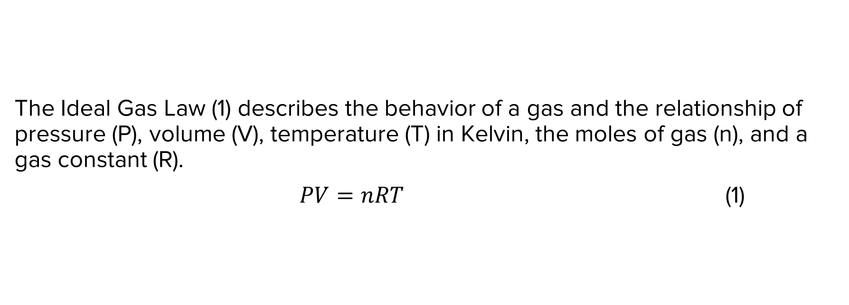
EQUATIONS
The Ideal Gas Law (1) describes the behavior of a gas and the relationship of pressure (P), volume (V), temperature (T) in Kelvin, the moles of gas (n), and a gas constant (R).
$PV=nRT$ (1)
7

Slide 4
EQUATIONS
Go to
“Insert” tab
Click on
“Equation”
Type your equation
Place # after the equation
Enter parentheses and number
Press enter
Correct font and type at “Home” tab
8

Slide 5
TABLES
Copy/paste tables from Excel using “Keep Source Formatting”
Labels must go above tables, aligned left and captioned
Number all tables consecutively, separate from figures
9

Slide 6
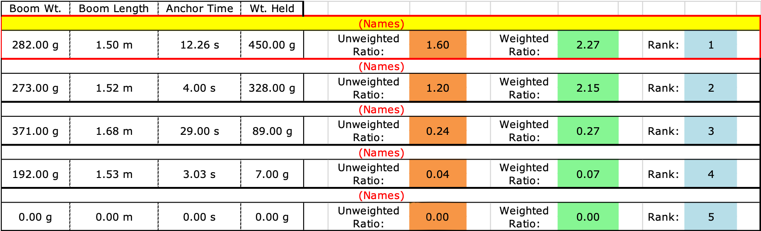
TABLES
Table 1: Boom Construction Competition Ranking
10

Slide 7
NUMBERING FIGURES
VS. TABLES
FIGURES
Graphs, charts, diagrams, infographics and images are all figures and numbered together
TABLES
Tables are their own type of item and are not numbered with figures
Labels must go over tables, aligned left and numbered consecutively
Labels must go under graphs and figures, aligned left and numbered consecutively
11

Slide 8

FIGURES
Figure 1: Anchor Time & Rank in Competition
Figure 2: Cantilever Bridge
12

Slide 9
ACRONYMS
No acronyms in the Abstract
Spell out words on first reference & introduce the acronym in parentheses
  e.g. Virtual Instrument (VI)
Once an acronym is introduced, do not spell it out again
There are cases where you do not need to spell out the acronym
  e.g. LED, radar, sonar, scuba
4

Slide 10
CAPITALS
Proper nouns (e.g. names, places, organizations)
First word of a sentence or first word on a line in a slide
Acronyms or trademarks (e.g. SolidWorks, MATLAB) AND, OR, NOT
Boolean operators (e.g. AND, OR, NOT)
“Important words” of a title (convert to title case in Microsoft Word & PPT)
Do not capitalize “a, and, the, or” unless they are the first word of the title
5

Slide 11
NUMBERS
Spell out any numbers below 10, including rank (e.g. first, second, third)
Use digits If the number is 10 or above
Exceptions
  Titles: Lab 1, Figure 1, Table 1
  Measurements: 0.05, 1.5
  Ratios: 1:2, 2:1, 1:2:2:1
In EG, round to two decimal places (you’ll learn significant digits in physics)
6

Slide 12
RESOURCES
EG1004 Student Manual:
  Writing Consultants will meet with you 1:1 during recitation to answer questions
  EG1004 Writing Style Guide
  Sample Lab Report
  Writing Consultant Lab Report Rubric
Writing Center:
  Schedule an appointment: nyupoly.mywconline.com
  Location: 2 MTC, 9th Floor
  NYU Writing Center Website & Peer Tutor Program
6

Slide 13
QUESTIONS?

