Slide 1
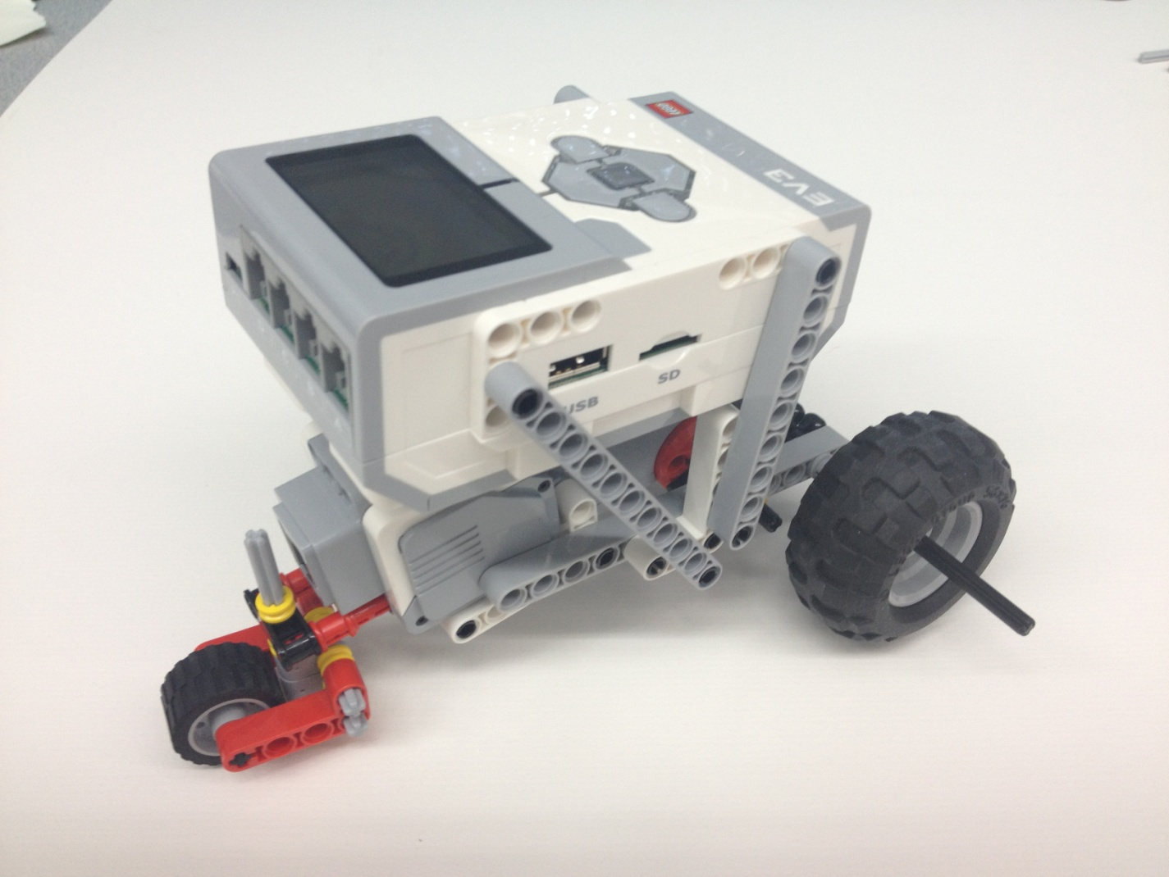
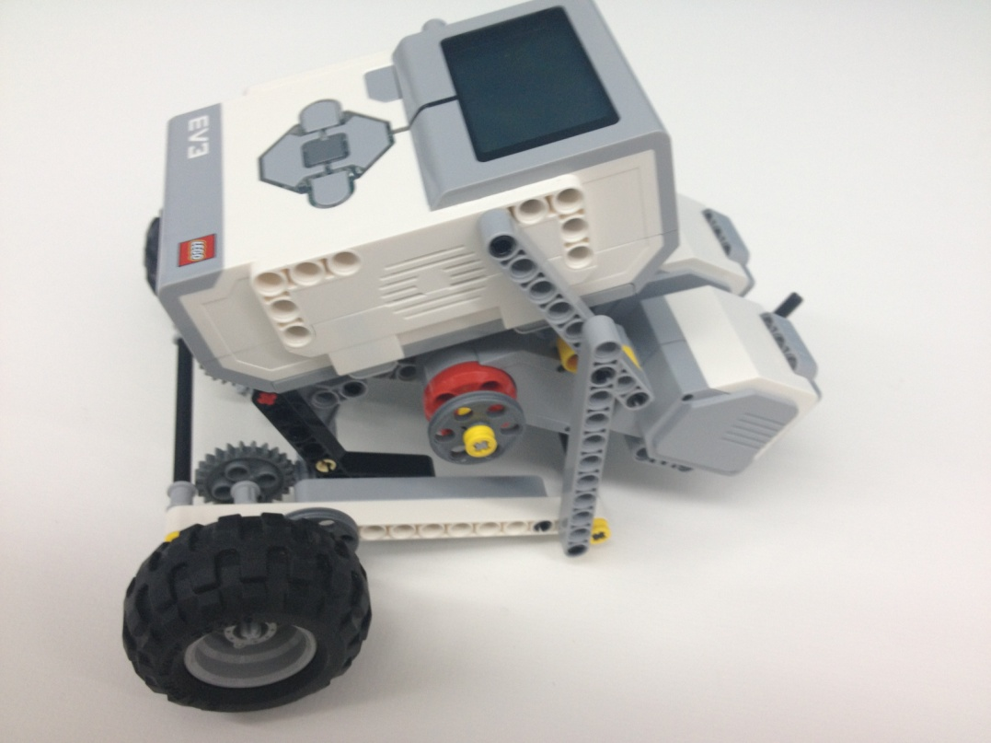
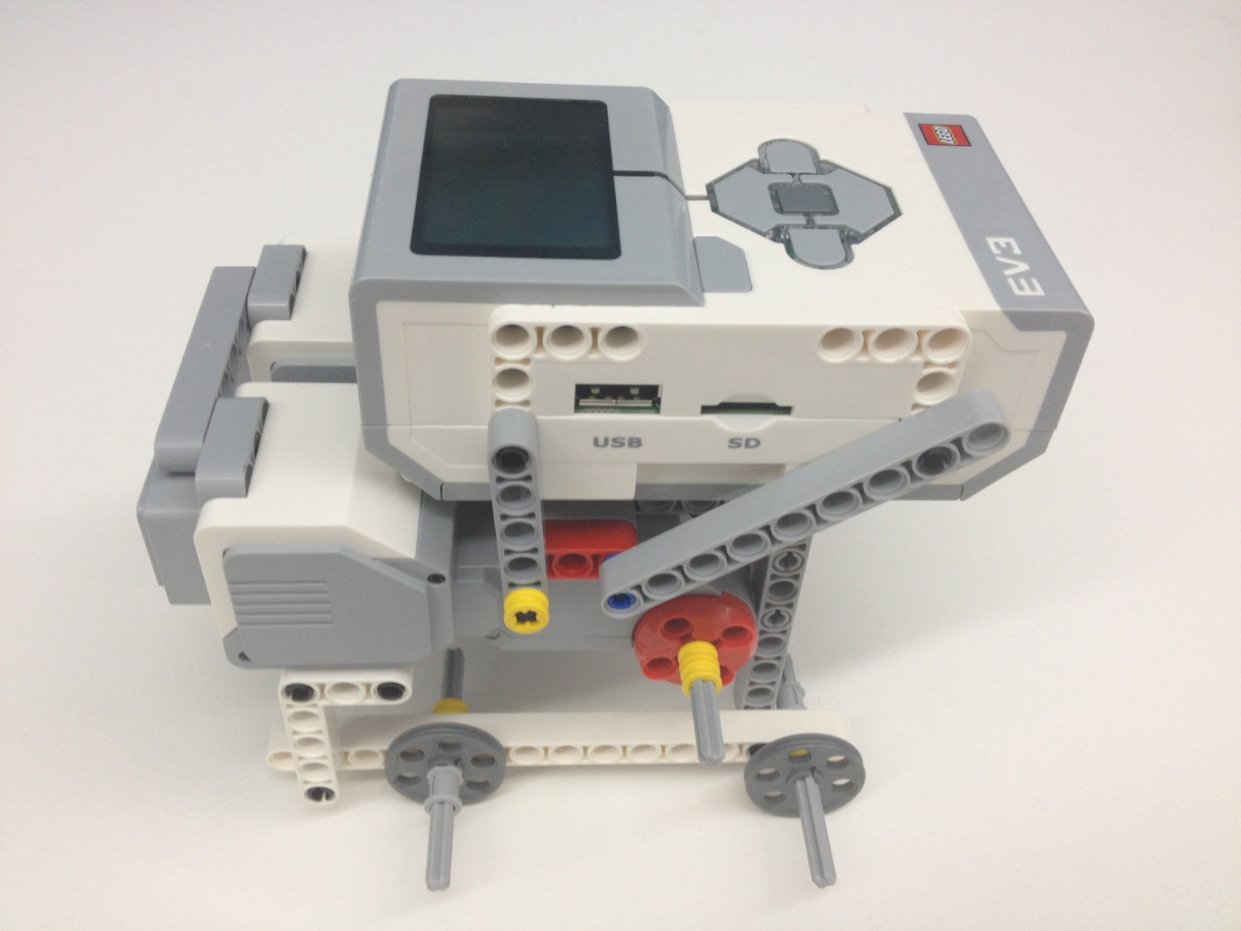
EG1003: Introduction to Engineering and Design
Product Evaluation &
Quality Improvement

Slide 2
Overview
Objectives
Background
Materials
Procedure
Report
Closing

Slide 3
Objectives
Build a robot and test it against the EG standards for accuracy and precision
Demonstrate the importance of product evaluation
Disassemble the robot and make quality improvements to the design

Slide 4
Design Analysis
Engineers perform prototype testing
Look for improvement suggestions
Continuously improves product quality
Tests are performed to a company standard
If the standard is met, the product is acceptable
If standard not met, product may be redesigned or withdrawn

Slide 5
Accuracy & Precision
      Accuracy:
Comparison of the average of the results to the standard
      Precision:
Repeatability of the results
How close are the results to each other?

Slide 6




Accuracy & Precision
Accurate
Precise
Accurate
Imprecise
Inaccurate
Precise
Inaccurate
Imprecise

Slide 7
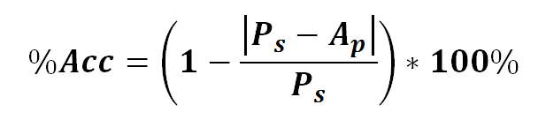

Accuracy & Precision
%Acc = Percent Accuracy
P_{s} = Standard Value
A_{p} = Value Measured
%Prec = Percent Precision
B = Exponential Decay Factor
P = Actual Precision
Distance test B=0.0972
Angle of Deviation test B=0.0323

Slide 8
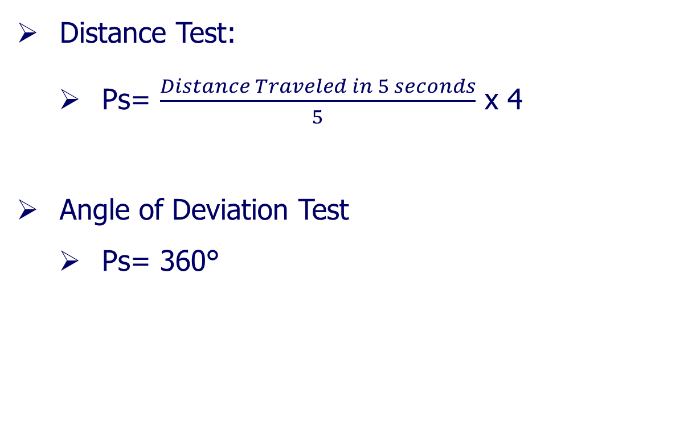
Accuracy & Precision

Slide 9
Quality Improvement
Analyzing the design
Testing the design
Through physical or mathematical modeling or computer modeling
Does the robot perform to standard?
If no, what can be done to improve its functionality?
If yes, what can be done to improve its performance beyond the standard??

Slide 10
Reverse Engineering
Understanding how a product functions
Disassembly of said product
Noting the key components
Reverse Engineering is carried out in both software and hardware fields

Slide 11


Gears
Used to manipulate torque and speed
Torque & speed are inversely proportional
Velocity ratio equals inverse of gear ratio
Values for Output and Input are the diameters (or the number of teeth) of the respective gears

Slide 12
Gears
There are many different types of gears
Crown, worm, spur, rack, idler gears
Full description of each type of gear can be found on EG Manual
Please take note of gear and velocity ratios since they are extremely useful with SLDP robots

Slide 13
Materials
Mindstorms Kit
Computer with Mindstorms Software
Protractor and Ruler
Graph Paper
Procedure

Slide 14
Procedure
Build a robot according to the robot provided by your TA
Program robot to perform two tests
Distance
Angle of Deviation
Determine whether or not robot meets the 80% EG Standard
Reverse engineer the robot and make quality improvements to the design

Slide 15
Procedure – Distance/Angle Test
Distance & Angle tests are performed at the same time
Create distance/angle test program.
Download distance program to NXT/EV3
Run program for 5 seconds on testing paper to determine testing standard
Change program to run for 4 seconds
Record five trials

Slide 16
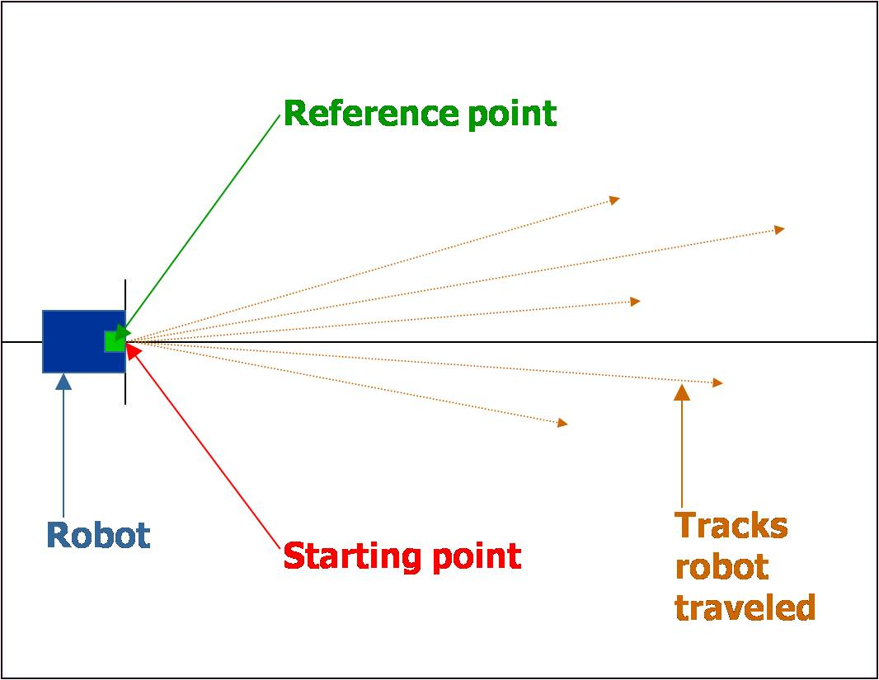
Procedure – Distance/Angle Test

Slide 17
Procedure – Distance/Angle Test
Assess Robot design from data collected and from observations
Make necessary adjustments
Retest robot and collect data
Take pictures of both original design and finalized design

Slide 18
Procedure – Reverse Engineering
Visually assess the robot's design. Consider how it works
Sketch the front, top, and most detailed side of the robot. Be sure to include dimensions in your sketch. Also sketch the most detailed view of the gear train
Before disassembling the robot, remember to take a picture of it

Slide 19
Procedure – Reverse Engineering
Disassemble the robot. Analyze its inner workings and sketch the gear train(s)
All sketches in EG1003 must be done in pencil
Have all sketches and original data signed by your TA

Slide 20
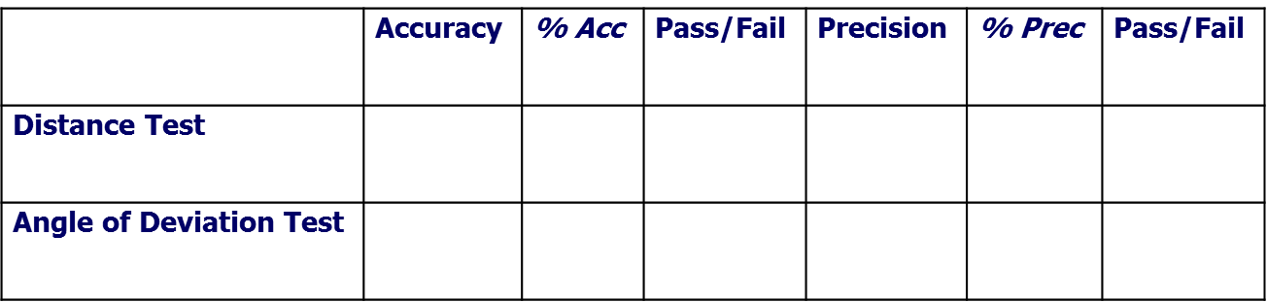
Tabulation of Results
Tabulate Results in a chart:
It must pass all the tests at a rate of at least 80%

Slide 21
Report
Individual Lab Report
Title page
Discussion topics in the manual
MUST include spreadsheet with test results, standard, average, accuracy, and precision of each test

Slide 22
Presentation
Team presentation
Follow “Your Assignment” guidelines on EG Manual
Include photos of robot
TA will assist with digital camera if needed

Slide 23
Closing
Share tasks – one team member to program; another to build
Have all original data signed by TA
Remember to submit all work electronically
Submit testing paper to TA at beginning of next lab
Disassemble robot and sort parts into the kits
Return all unused materials to TAs

