Slide 1
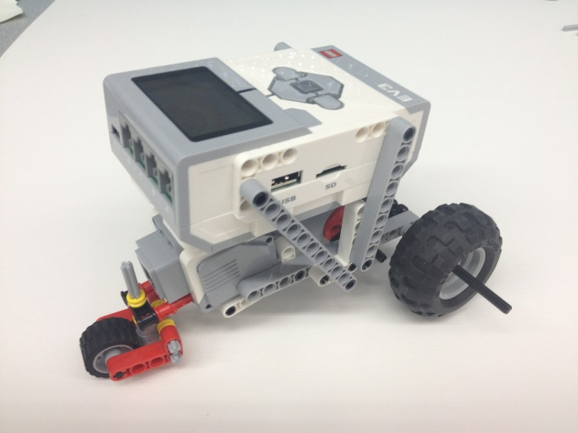
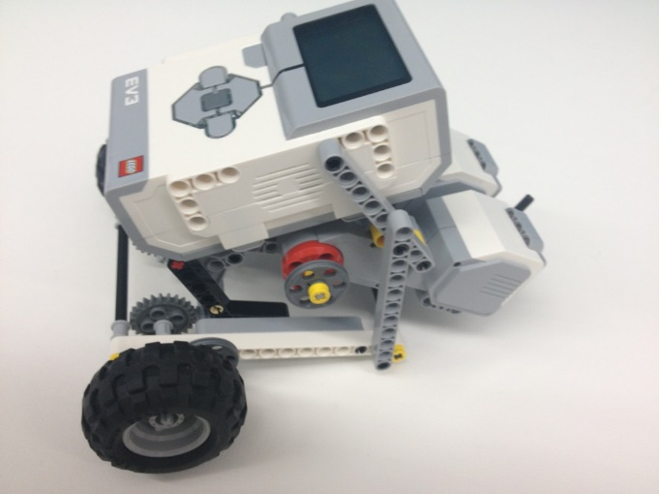
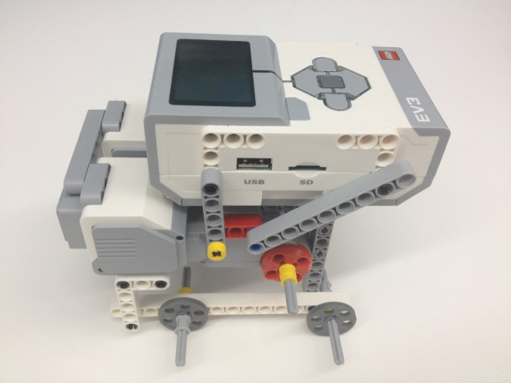
Product Evaluation & Quality Improvement

Slide 2
Overview
Objectives
Background
Materials
Procedure
Report
Closing

Slide 3
Objective
Build a robot and test it against the EG standards for accuracy and precision
Demonstrate the importance of product evaluation
Disassemble the robot and make quality improvements to the design

Slide 4
Design Analysis
Engineers perform prototype testing
Look for improvement suggestions
Continuously improves product quality
Tests are performed to a company standard
If the standard is met, the product is acceptable
If standard not met, product may be redesigned or withdrawn

Slide 5
Accuracy & Precision
Accuracy:
Comparison of the average of the results to the standard
Precision:
Repeatability of the results
How close are the results to each other?

Slide 6
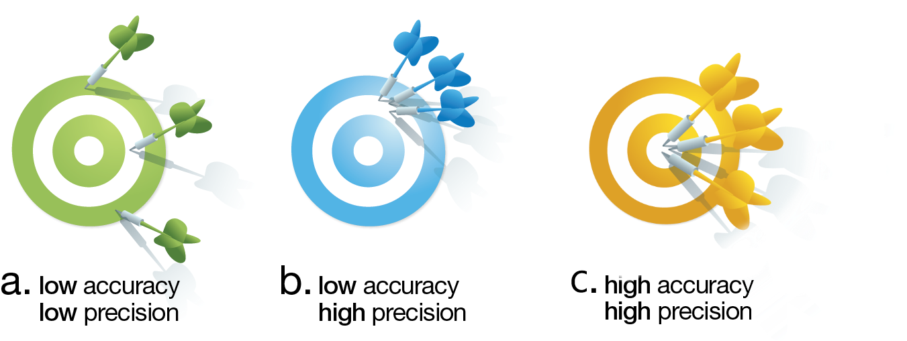
Accuracy & Precision

Slide 7

Accuracy & Precision
$\% Acc=\left(1−\frac{\left|P_{s}−A_{p}\right|}{P_{s}}\right)×100$
Where | $$\% Acc$$ | = Percent Accuracy
 | $$P_{s}$$ | = Standard Value
 | $$A_{p}$$ | = Value Measured

Slide 8

Accuracy & Precision
$\% Prec=100×e^{−BP}$
For Distance and Angle deviation test B = 0.0972 and 0.0323 respectively
Where | $$\% Prec$$ | = Percent Precision
 | $$B$$ | = Exponential Decay Factor
 | $$P$$ | = Actual Precision

Slide 9

Accuracy & Precision
Distance Test:
$P_{s}=\frac{Distance traveled in 5 seconds}{5}× 4$
Angle Deviation Test
$P_{s}=360⁰$
Reference Point
360º + $θ$
Path traveled
$$θ$$
360º
Starting Point
360º - $θ$

Slide 10
Quality Improvement
Analyzing the design
Testing the design
Through physical or mathematical modeling or computer modeling
Does the robot perform to standard?
If no, what can be done to improve its functionality?
If yes, what can be done to improve its performance beyond the standard??

Slide 11
Reverse Engineering
Understanding how a product functions
Disassembly of said product
Noting the key components
Reverse Engineering is carried out in both software and hardware fields

Slide 12
Gears
Used to manipulate torque and speed
Torque & speed are inversely proportional
Velocity ratio equals inverse of gear ratio
Values for Output and Input are the diameters (or the number of teeth) of the respective gears
$$Velocity Ratio=\frac{Input}{Output}$$ | $$Gear Ratio=\frac{Output}{intput}$$

Slide 13
Gears
There are many different types of gears
Crown, worm, spur, rack, idler gears
Full description of each type of gear can be found on EG Manual
Please take note of gear and velocity ratios since they are extremely useful with SLDP robots

Slide 14
Materials
Mindstorms Kit
Computer with Mindstorms Software
Protractor and Ruler
Graph Paper

Slide 15
Procedure
Build a robot according to the robot provided by your TA
Program robot to perform two tests
Distance
Angle of Deviation
Determine if robot meets the 80% EG Standard
Reverse engineer the robot and make quality improvements to the design

Slide 16
Procedure - Testing
Distance & Angle tests are performed simultaneously
Create distance/angle test program.
Download distance program to NXT/EV3
Run program for 5 seconds on testing paper to determine testing standard
Change program to run for 4 seconds
Record five trials and average these values

Slide 17
Procedure - Reverse Engineering
Assess data collected and any observations
Visually assess the robot's design
Consider how it works
Sketch the front, top, and most detailed side of the robot (include dimensions)
Sketch the gear train and calculate velocity and gear ratios (if applicable)

Slide 18
Procedure - Reverse Engineering
Before making changes to the original robot, remember to take a picture of it
Make necessary adjustments
Retest and collect data using modified robot
Take a picture of final design
Like before Sketch the front, top, and most detailed side of the robot (include dimensions)
Sketch the gear train and calculate velocity and gear ratios (if applicable)

Slide 19
Procedure
Tabulate Results in a chart:
It must pass all the tests at a percentage of at least 80%
 | Accuracy | % Acc | Pass/Fail | Precision | % Prec | Pass/Fail
Distance Test
Angle of Deviation Test

Slide 20
Report
Individual Lab Report
Title page
Discussion topics in the manual
MUST include spreadsheet with test results, standard, average, accuracy, precision, gear ratios, and velocity ratios

Slide 21
Presentation
Team presentation
Follow “Your Assignment” guidelines on EG Manual
Include photos of robot

Slide 22
Closing
Share tasks – one team member to program; another to build
Have all original data signed by TA
Remember to submit all work electronically
Submit testing paper to TA at beginning of next lab
Disassemble robot and sort parts into the kits
Return all unused materials to TAs

