Slide 1

RECITATION 5
EG1003

Slide 2
AGENDA
Software Engineering
Prototyping Resources
Metacognition
1

Slide 3
SOFTWARE ENGINEERING

Slide 4
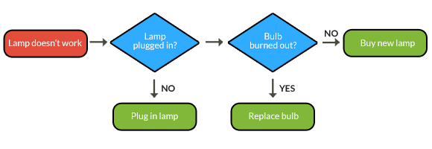
ALGORITHMS & FLOW CHARTS
3
Notes:
The very basic foundation of software engineering utilizes logical algorithms which can be easy modeled using a flow chart -- like this one. It shows the logical process of repairing a broken lamp. A series of questions is shown in sequence whose answers determine an outcome or lead to another question.

Slide 5



PROGRAMMING LANGUAGES
Visual Languages:
LabVIEW/Lego Mindstorms
Google Blockly/MIT Scratch
ModelBuilder in ArcGIS
Object Oriented Languages:
C
Java
Python
4
Notes:
Visual programming languages are often used for educational purposes to allow a wider range of audiences to program using images and symbols on a dashboard. Visual programming is also known as a “block-based” programming language. Object oriented languages have a more specialized vernacular and allow virtually endless programming possibilities.

Slide 6
PROGRAMMING RESOURCES
NYU Lynda
Codeacademy
w3schools (web design)
Online open courses
  Coursera
  MIT OpenCourseWare
Google & Stack Overflow
5
Notes:
Want to learn programming or brush up on your skills outside of your coursework? Use these online resources which all have free components.

Slide 7
ENGINEERING SOFTWARE
Math:
MATLAB, Mathematica
CAD:
Autodesk, SOLIDWORKS, SketchUp
Databases:
SQL, Oracle, GIS
Statistics:
R, SPSS, SAS
Web design:
Wordpress, HTML, Javascript, CSS, PHP
IDEs:
Visual Studio, Eclipse, Xcode
Source code text editors:
Notepad++, VIM, Emacs
Version control:
Dropbox, Google Drive
6
Notes:
Software is a powerful tool that has widened the possibilities and scope of engineering projects. Here are some important tool areas and common softwares used.

Slide 8
PROTOTYPING RESOURCES

Slide 9
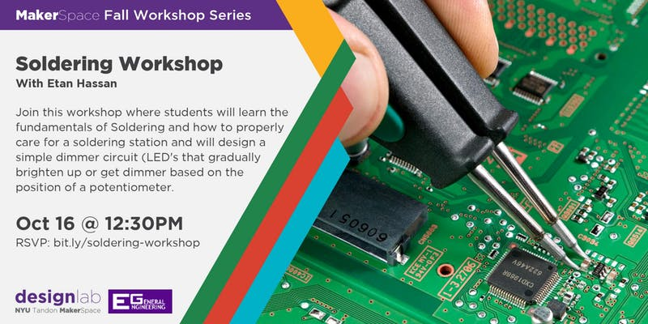
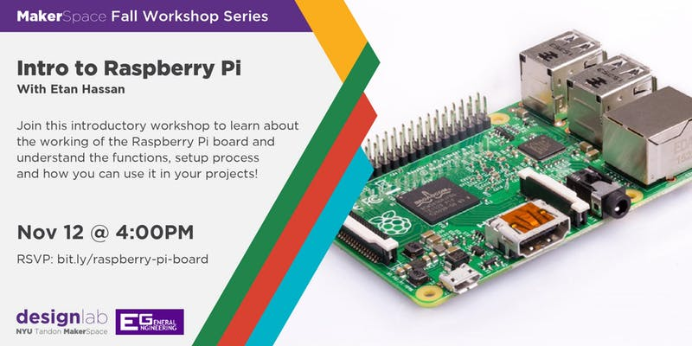
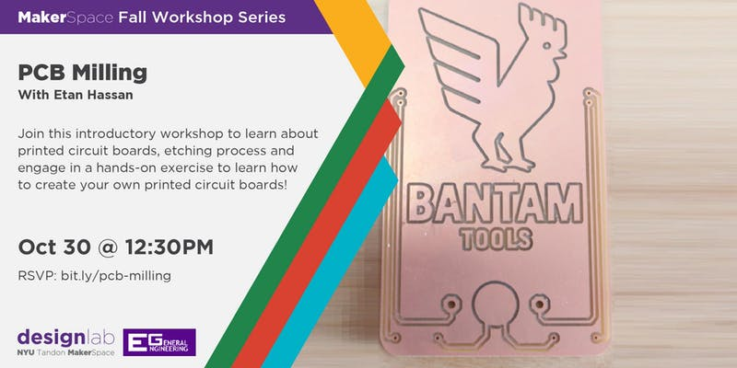
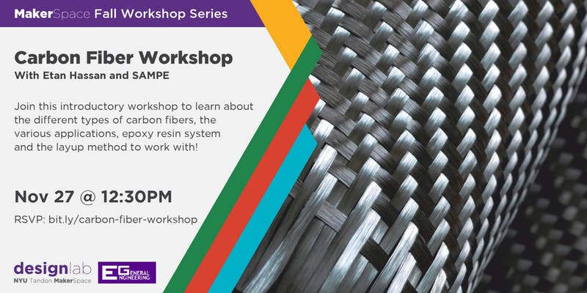
PROTOTYPING TRAINING
http://bit.ly/nyu-design-lab
8
Notes:
The MakerSpace has a series of prototyping training providing an introduction to various prototyping methods. Training dates and sign ups for workshops are available on the MakerSpace website.

Slide 10
PROTOTYPING SOFTWARE
Computer-aided design (CAD): SolidWorks
  Circuit CAD: Fritzing
  Vector graphics editor: Adobe Illustrator
Computer-aided manufacturing (CAM): Fusion 360
Computer-aided engineering (CAE): ANSYS
  Finite element analysis (FEA)
  Multibody dynamics (MBD)
  Computational fluid dynamics (CFD)
9
Notes:
In addition to physically prototyping, there are a large variety of software programs available to aid in prototyping.

Slide 11
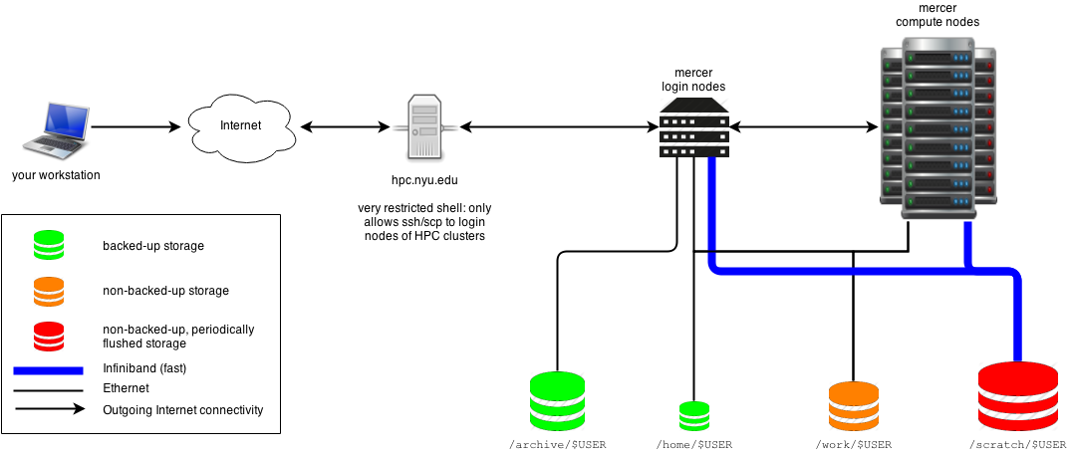
COMPUTING OPTIONS
Microcontrollers (Arduino)
Single board computer (Raspberry Pi 3)
NYU Virtual Computer Lab
High Performance Computing at NYU
10
Notes:
When creating electronic protypes it is important to consider the computing power and the needed functionality the prototype. The NYU Virtual computer lab is an easy way for all NYU students to gain access to NYU’s software licenses without installing an application. High performance computing at NYU is used by faculty members to aid in research and class instruction.

Slide 12
METACOGNITION

Slide 13

Notes:
Please play video. You must enable content when opening the presentation in order for the video to work.

Slide 14
QUESTIONS?

