Slide 1
SOFTWARE FOR ENGINEERS
EG1003 | LAB 1A & 1B

Slide 2
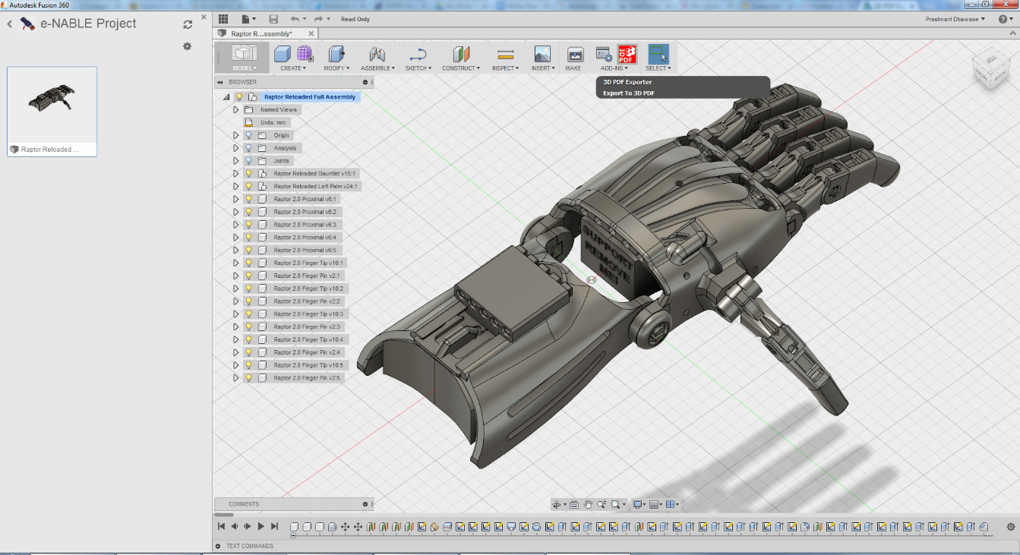
OVERVIEW
Objective
Background
Procedure
Assignment
Closing
Figure 1: Fusion 360 Courtesy of Autodesk
1

Slide 3
OBJECTIVE
Familiarization with software relevant to this course
Explore software tools
Word
PowerPoint
Excel
Fusion 360
Figure 2: Software Icons Courtesy of AppRecs
2

Slide 4
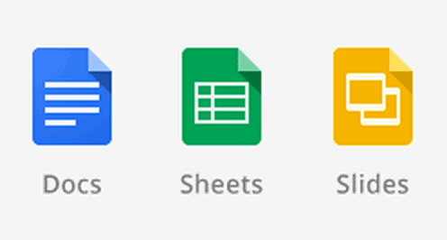
BACKGROUND
Microsoft Excel or Google Sheets
Spreadsheet program
Create tables, charts, graphs, data analysis
Microsoft Word or Google Documents
Word processing program
Create lab reports, proposals, documents
Microsoft PowerPoint or Google Slides
Professional presentation program
Figure 3: G Suite (Top) and Microsoft Office (Bottom) Courtesy of UNC Charlotte and Softpedia
3

Slide 5
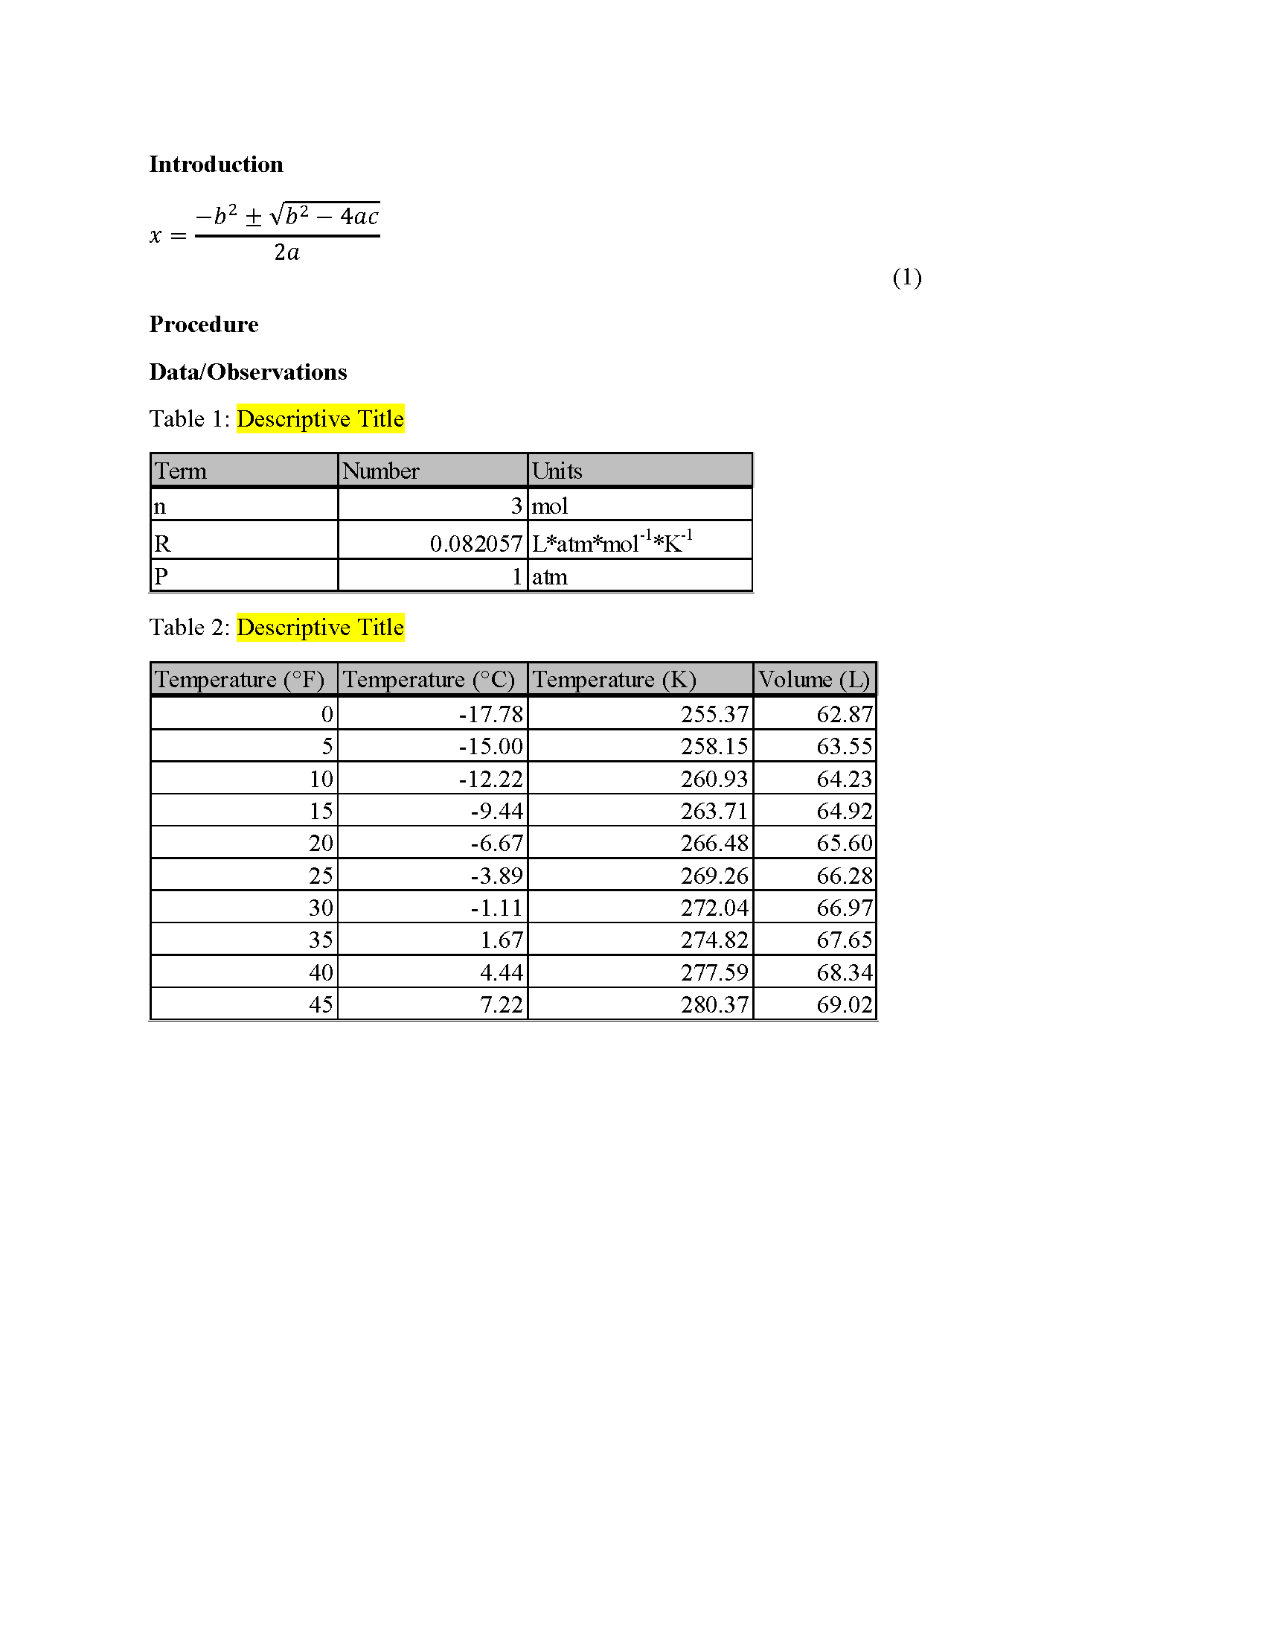
WORD AND POWERPOINT
Figure 4: Examples of Word (Left) and PowerPoint (Right)
4

Slide 6
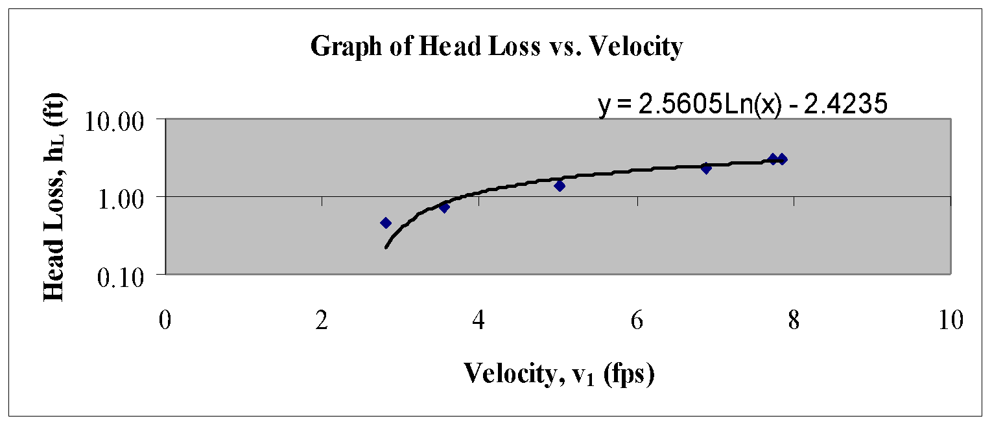
EXCEL
Figure 5: Example of Excel
5

Slide 7
BACKGROUND
Fusion 360
Computer-aided design (CAD) program
Creates 3D drawings of engineering designs
Also used for CAM, rendering, simulation, etc.
3D printing – allows for rapid prototyping and onsite manufacturing
Cura
3D printing preparation application
Figure 6: Fusion 360 (Left) and Cura (Right) Courtesy of AppRecs and Wikipedia
6

Slide 8
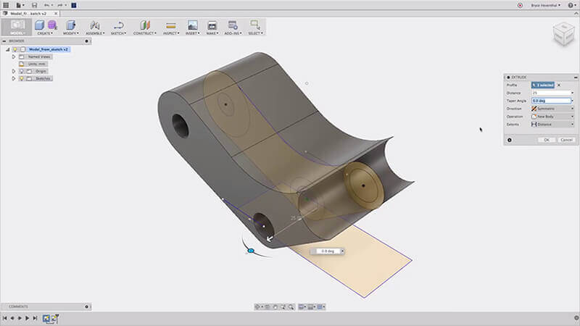
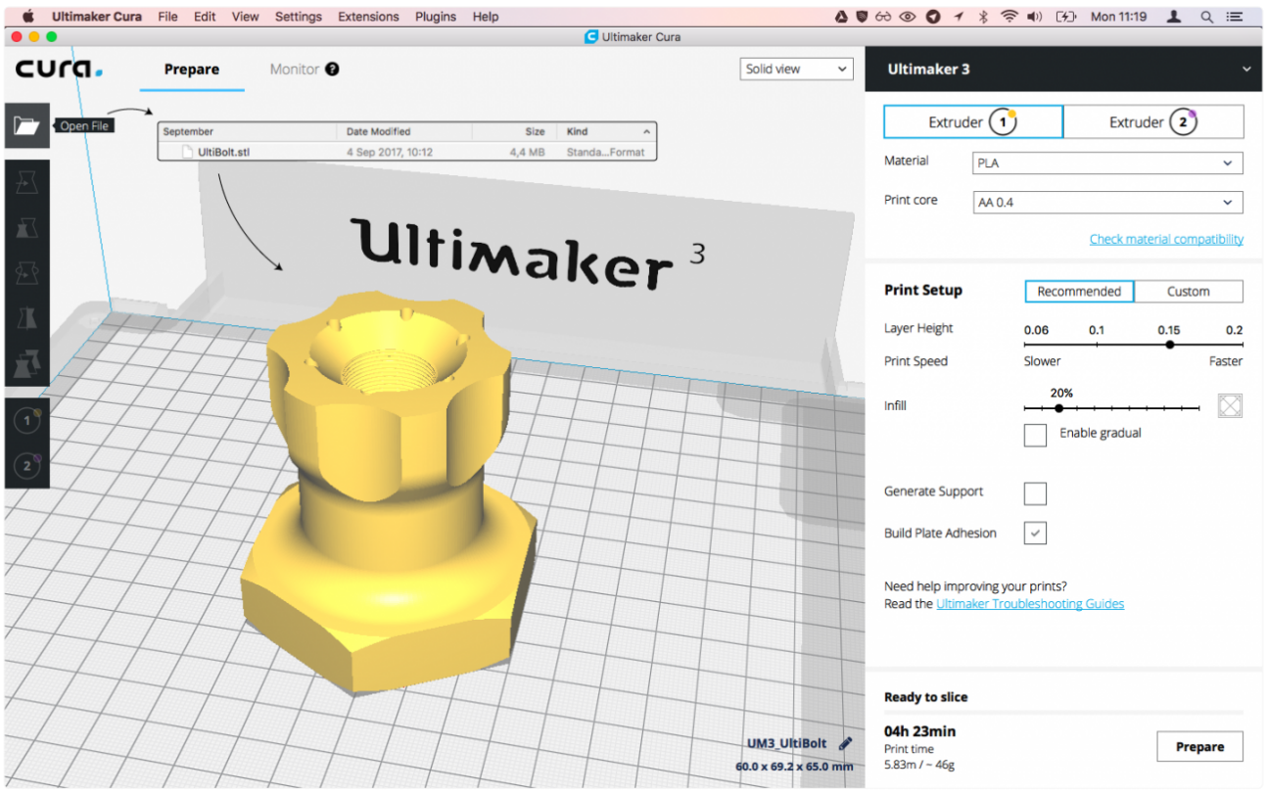
FUSION 360 AND CURA
Figure 7: Examples of Fusion 360 (Left) and Cura (Right) Courtesy of FabCafe and Ultimaker
7

Slide 9
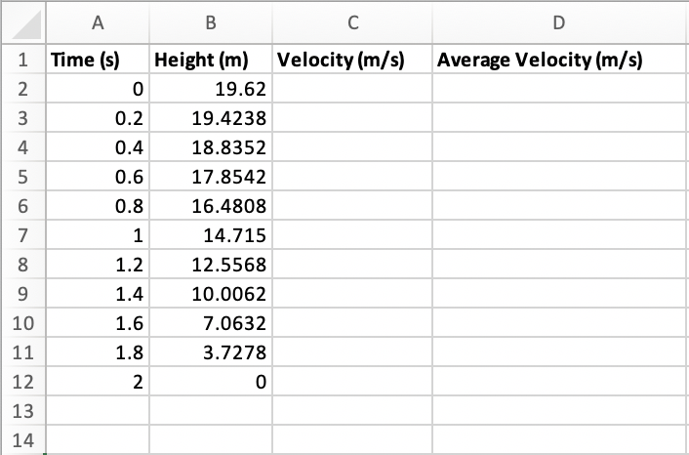
PROCEDURE
Go to Lab 1A – Introduction to Microsoft Office
Excel
Open premade Microsoft Excel Template
Fill in blank cells with correct values using the given equations
Plot Velocity vs. Time
Figure 8: Microsoft Excel Template to Fill
8

Slide 10
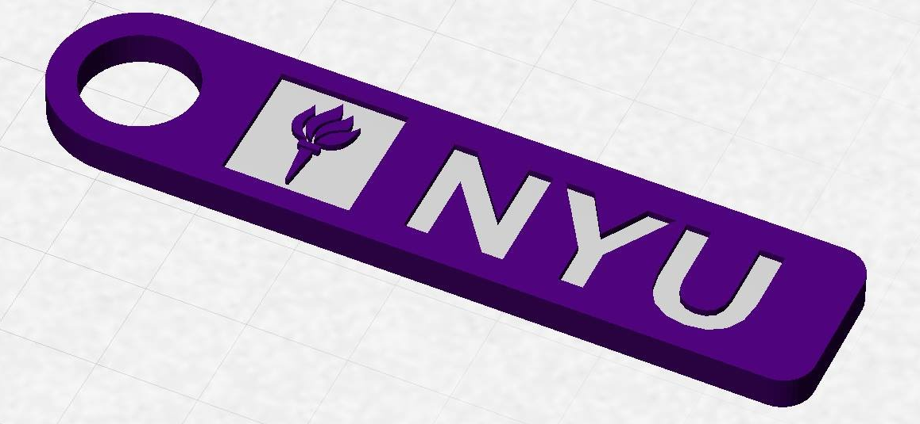
PROCEDURE
Go to Lab 1B – Introduction to 3D Printing
Fusion 360
Use the manual tutorial to create an NYU keychain
Save as STL file
Cura
Setup the keychain model to be 3D printed
Save as GCODE file
Figure 10: NYU Keychain to Design
10

Slide 11
ASSIGNMENT
No lab report for Lab 1A or Lab 1B
No presentation for Lab 1A or Lab 1B
Submit Excel & GCODE files to the EG1003 website (eg.poly.edu)
Due at 11:59 PM the night before Lab 2
11

Slide 12
CLOSING
All students must attempt to use the software
TAs are always available for assistance
Must submit Excel & GCODE files to the EG1003 website before next lab
Go to the EG1003 student manual (manual.eg.poly.edu) for lab instructions
12

Slide 13
CLOSING
In preparation for the next virtual lab, download these software ahead of time:
Autodesk Fusion 360
Autodesk Revit
13

Slide 14
QUESTIONS?

