Slide 1

TEAM WRITING
EG1004 | RECITATION 3

Slide 2
WHAT DO THE BEST TEAMS DO?
Designate a report director who
  Sets the schedule
  Assigns responsibility
  Acts as the editor (although everyone edits)
Communicate in-person, over email, on the Word Document (track changes)
Accept constructive criticism & offer respectful suggestions
2

Slide 3
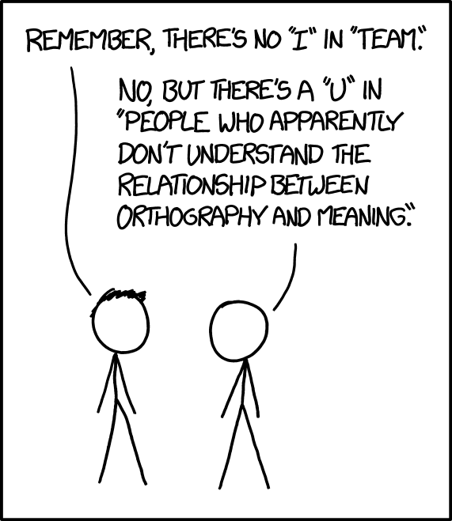
WHY DO YOU WRITE IN TEAMS?
Requirement for future engineering courses
Standard professional practice for engineers
Divide and conquer!
Emphasizes more perspectives and skillsets
  Everyone is held accountable
Avoid penalties for the sum of all member’s errors
3

Slide 4
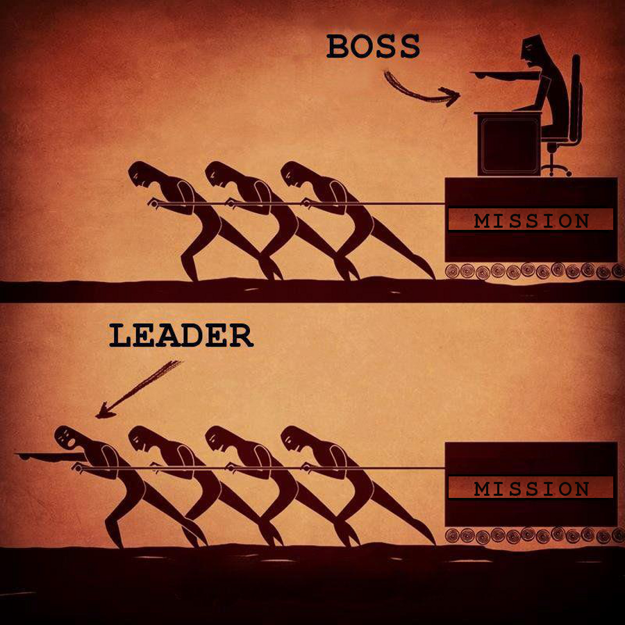
HOW DO WE WRITE IN TEAMS?
Each team member writes one or two section(s)
Divide work evenly!
Create a schedule and keep it (Google Calendar)
Revise iteratively, coordinate who is responsible for next edit
One team member finalizes the report to ensure a cohesive voice
4

Slide 5
RESOURCES
EG1004 Student Manual:
  Writing Consultants will meet with you 1:1 during recitation to answer questions
  EG1004 Writing Style Guide
  Sample Lab Report
  Writing Consultant Lab Report Rubric
Writing Center:
  Schedule an appointment: nyupoly.mywconline.com
  Location: 2 MTC, 9th Floor
  NYU Writing Center Website & Peer Tutor Program
5

Slide 6
QUESTIONS?

