Slide 1
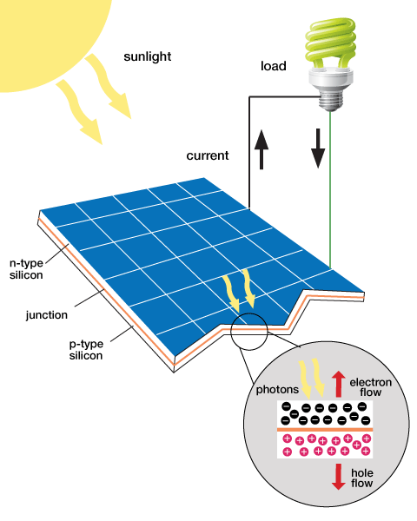
Renewable Energy Lab

Slide 2
Overview
Experimental Objective
Background Information
Materials
Procedure
Assignment
Closing

Slide 3
Experimental Objective
Test the capabilities of solar panels and wind turbines
Test the capabilities of the hydrogen fuel cells and capacitors
Design a renewable energy car to compete against the other groups

Slide 4
Background Information
Renewable Energy
Solar panels
Wind-turbine technology
Hydrogen fuel cells
Electronic Components

Slide 5
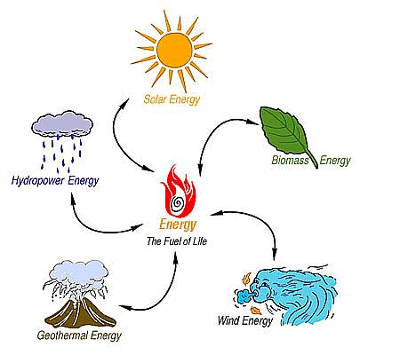
Renewable Energy
Harnessed from natural resources
Clean energy sources
Sources for energy are abundant
in supply^{[1]}

Slide 6
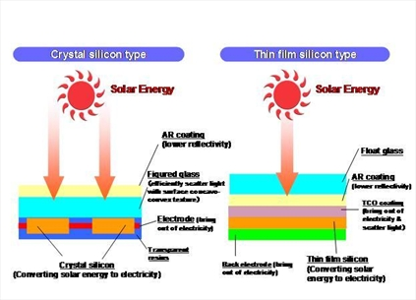
Solar Panels
Made from silicon or copper indium gallium (di)selenide (CIGS)
Converts Sunlight to electrical current
Absorbed sunlight excites electrons to allow freedom of motion (generates an electric current)^{[2]}

Slide 7
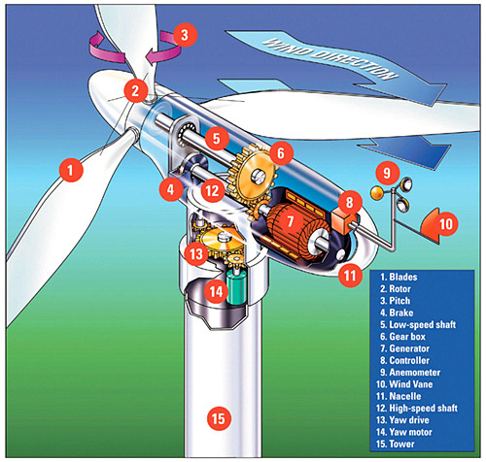
Wind-Turbine Technology
Use pressure difference generated by the wind to spin the turbine blades
Converts mechanical energy into electrical energy
The wind vane (10) is use to determine the direction the wind-turbine will face^{[3]}

Slide 8
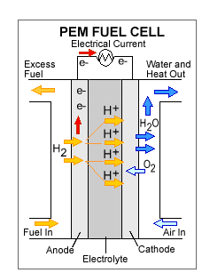
Hydrogen Fuel
Stores chemical energy and converts it into electrical energy
Types of fuels used includes (but not limited to) hydrogen, methane, and gasoline
Reversible fuel cells can separate water into hydrogen and oxygen, then use it to generate electrical energy ^{[4]}

Slide 9
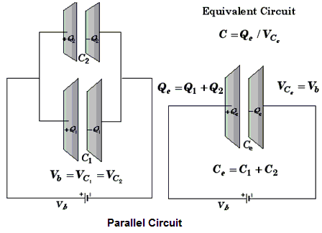
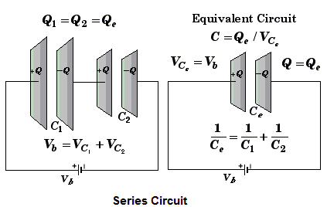
Electronic Components
A capacitor is an electrical device used to store charge
Capacitors can be connected in parallel (increases charge stored) and in series (increases voltage stored)^{[5]}

Slide 10
Competition Rules
Power storage devices must be contained in the car
The only power sources allowed are the wind-turbine and solar panel
The renewable energy car may not be pushed or launched
The renewable energy car should not be touched after it has started to move
The car will run for up to five minutes or until the car comes to a stop

Slide 11
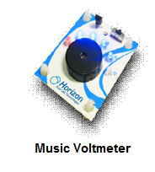
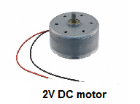
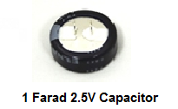
Materials
Horizon Wind-Turbine
Solar Battery Panels
Adjustable Table fan
Heat Lamp
DMM (Digital Multi-meter)
Music Voltmeter
3V DC Motor
Horizon Hydrogen Fuel cell
1 Farad 2.5V Capacitor
Alligator cable sets
Standard Lego Car Chassis plus Lego parts kit
Mini Electric propeller
LED (Light Emitting Diode)
Lego to Alligator Cable Clip Connector
Scissors
Tape

Slide 12
Materials Price List
Horizon Wind-Turbine ($5.00/each)
Solar Battery Panels ($10.00/each)
Horizon Hydrogen Fuel cell ($12.00/each)
1 Farad 5.5V Capacitor ($3.00/each)
Alligator cable sets ($0.50/each pair)
Standard Lego Car Chassis plus Lego parts kit (only one kit)
Lego to Alligator Cable Clip Connector ($0.10/each)
Tape ($0.10/feet)

Slide 13
Procedure
Part 1:Test the Power sources using music voltmeter
Solar panel
Wind-turbine
Part 2: Test the power storage devices
Hydrogen fuel cell
Capacitor
Part 3: Design a renewable energy car using the power sources and power storage devices of your choice

Slide 14
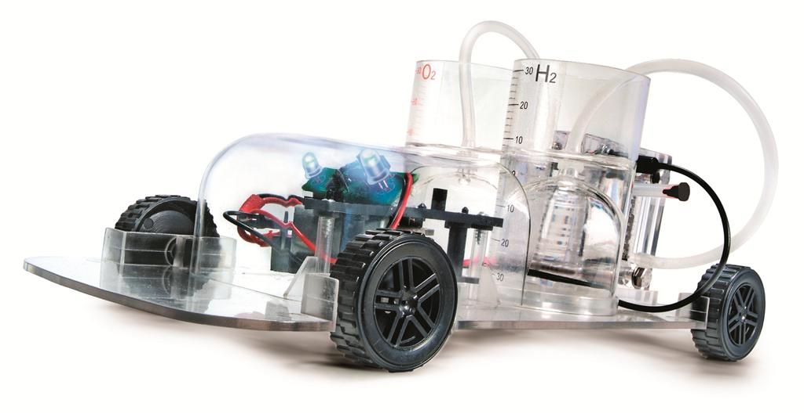

Procedure
Here is an inspiration for your design!

Slide 15
Assignment: Report
Individual lab reports
Title page
Discussion of topics in the manual
Include a picture of your vehicle
Scan in lab notes (ask TA for assistance)
TA must initial that table and graph were completed

Slide 16
Assignment: Presentation
Team presentation
State rules of competition
Describe your design and its concepts
Include table of class results, cost and photo/video of design
How could your current design be improved?
Refer to “Creating PowerPoint Presentations” found on
EG website

Slide 17
Closing
Have all original data signed by TA
Submit all work electronically
Clean up workstations
Return all materials to TA

Slide 18
Works Cited
Eriksson, J.. "Renewable energy vs. fossil fuel." Renewable power news. N.p., 2010. Web. 26 Jul 2012. <http://www.renewablepowernews.com/archives/1413>.
http://www.agc-flatglass.com/AGC-Flat-Glass/English/Other/News-Overview/News-Detail/page.aspx/1014?newsitem=1273.
. The structure of a modern wind turbine – an overview. N.p., n.d. Web. 26 Jul 2012. <http://www.wwindea.org/technology/ch01/en/1_2.html>.
Reg Tyler, . "Types of Fuel Cells." Energy efficeny and renewable energy. U.S. Department of Energy, 2011. Web. 24 Jul 2012. <http://www1.eere.energy.gov/hydrogenandfuelcells/fuelcells/fc_types.html>.
. Rotational Equilibrium. WWU, n.d. Web. 26 Jul 2012. <http://faculty.wwu.edu/vawter/PhysicsNet/Topics/TopicsMainTemplate.html>.
http://www.horizonfuelcell.com/files/Education_Series_PDF.pdf

