Slide 1
Digital Logic Circuits
Notes:
L.Mexhitaj 2009

Slide 2
Overview
Objectives
Background
Materials
Procedure
Report / Presentation
Closing

Slide 3
Objectives
Understand logic gates and digital logic circuits
Design combinational logic circuit
  Activate under specific conditions
  Test with LabVIEW
  Test using digital trainer

Slide 4
Logic Functions
AND - “All or nothing operator”
  Output high (1) only when ALL inputs are high (1)
OR gate - “Any or all operator”
  Output high (1) when at least ONE input is high (1)
NOT operator – “Inverter”
  Output always opposite of input
  Only one input and one output

Slide 5
Logic Functions
Logic Function | Logic Symbol | Boolean Expression | Truth Table
 |  |  | Inputs |  | Output
 |  |  | A | B | Y
AND |  | A • B = Y | 0 | 0 | 0
 |  |  | 0 | 1 | 0
 |  |  | 1 | 0 | 0
 |  |  | 1 | 1 | 1
OR |  | A + B = Y | 0 | 0 | 0
 |  |  | 0 | 1 | 1
 |  |  | 1 | 0 | 1
 |  |  | 1 | 1 | 1
NOT |  | A = Ā | 0 | - | 1
 |  |  | 1 | - | 0

Slide 6
Sample Problem
ATM machine has three options:
  Print statement
  Withdraw money
  Deposit money
ATM machine will charge $1.00 to:
  Withdraw
  Print out statement with no transactions
No charge for:
  Deposits without withdrawal

Slide 7
Truth Table
A truth table displays all possible input / output combinations.
INPUT OUTPUT
P = Print C = Charge
W = Withdraw
D = Deposit
0 = “do not” 0 = $0.00
1 = “do” 1 = $1.00
INPUTS
OUTPUT
P
W
D
C
0
0
0
0
0
0
1
0
0
1
0
1
0
1
1
1
1
0
0
1
1
0
1
0
1
1
0
1
1
1
1
1

Slide 8
Boolean Equation
Outputs with a value of “ONE” are kept
INPUTS
OUTPUT
P
W
D
C
C =
0
0
0
0
PWD
0
0
1
0
0
1
0
1
+ PWD
0
1
1
1
+ PWD
1
0
0
1
1
0
1
0
+ PWD
1
1
0
1
1
1
1
1
+ PWD

Slide 9
Karnaugh Maps (K-maps)
C = PWD+ PWD+ PWD + PWD + PWD
PWD
PWD
PWD
0
0
0
1
1
1
1
0
P
W
P
W
P
W
P
W
0
D
0
1
1
1
1
D
0
1
1
0
_
Why can’t you switch PW and PW?
Why can’t you loop the three
adjacent 1s in the top row together?

Slide 10
Karnaugh Maps (K-maps)
C = PWD+ PWD+ PWD + PWD + PWD
0
0
0
1
1
1
1
0
P
W
P
W
P
W
P
W
0
D
0
1
1
1
1
D
0
1
1
0
NOTE:Circle neighboring ONES in powers of 2. Try to find the greatest amount of “neighbors.” Only overlap circles as a last resort!

Slide 11
Simplified Boolean Equation
_ _
PWD
_
PWD
D
D
Opposite values cancel out
P
W
0
0
1
1
1
1
_
PWD
W
P
W
1
C =
P
W
1
1
1
1
_
+ PD
_ _
PWD
_
PWD
P
W
1
0
1
PWD

Slide 12
Simplified Boolean Equation
D
D
Opposite values in circles cancel out
_ _
PWD
3
_
PWD
P
W
0
0
_
PWD
= W
Step 1
2
PWD
P
W
1
1
4
_
PWD
_
= PD
P
W
1
1
Step 1
_ _
PWD
P
W
1
0
C = W + PD

Slide 13
Combinational Logic Circuit
W
C =
W
W
W
W
P
_
PD
P
D
+
+
+
P
P
P
D
D
+
D
P
D
D
_
D

Slide 14
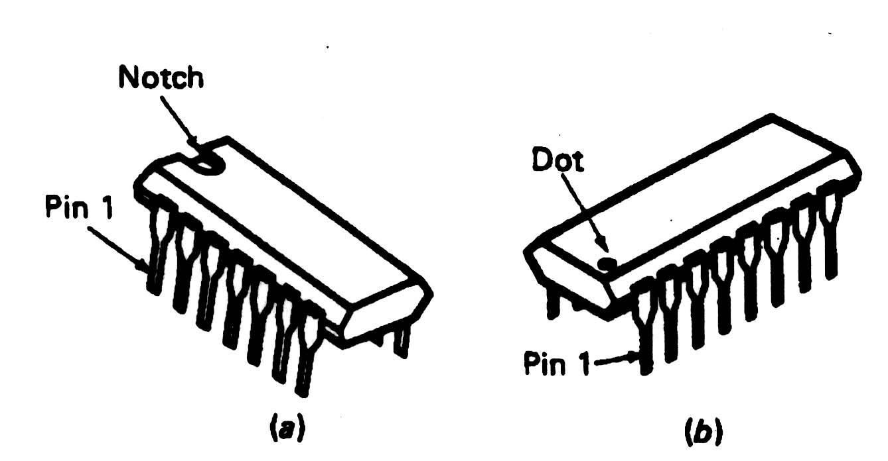
Integrated Circuits (ICs)
Used for implementation of combinational logic circuits
  Use TTL family (transistor transistor logic)

Slide 15
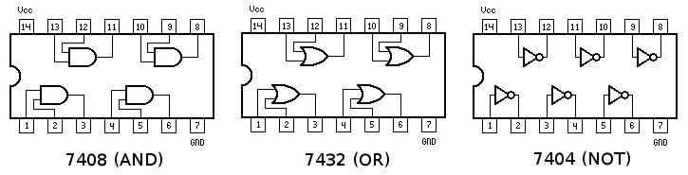
IC Identification

Slide 16
Materials for Lab
Computer equipped with LabVIEW
Digital/Analog Trainer
  7432 2-Input OR gate IC
  7408 2-Input AND gate IC
  7404 Hex Inverter (NOT gate) IC
Hook-up Wire

Slide 17
Problem Statement
A farmer has 2 barns
  3 items: fox, hen, corn
    Items can be in any barn, in any combination
  Concerns:
    Protect hen from fox
    Protect corn from hen
Design alarm system using digital electronics. Alarm sounds when:
  Fox and hen are in same barn
  Hen and corn are in same barn

Slide 18
Problem Statement
Design combination logic circuit for alarm system:
  Use least amount of gates and input variables (cost effectiveness)
Logical circuit output connected to LED
  LED “on” indicates alarm activation
  LED “off” indicates no problem (alarm off)
Fox, hen and corn must be in barn 1 or barn 2
  Presence in barn 1 = 1
  Presence in barn 2 = 0

Slide 19
Procedure
Truth Table
Boolean Expression
K-Map
Simplified Boolean Expression
Logic Circuit
LabVIEW Simulation
Digital Trainer
Truth Table
  Determine input and output variable (s)
  How many combinations are there?
  Complete truth table on a sheet of paper

Slide 20

Procedure
Boolean Expression
  Gather all combinations that produce a 1 for output
  Create a Boolean expression from these smaller expressions (independent conditions)
Truth Table
Boolean Expression
K-Map
Simplified Boolean Expression
Logic Circuit
LabVIEW Simulation
Digital Trainer

Slide 21
Procedure
Truth Table
Boolean Expression
K-Map
Simplified Boolean Expression
Logic Circuit
LabVIEW Simulation
Digital Trainer
K-Map
  Create a K-Map table
  Only have one variable change state at a time between adjacent boxes
  Use the Boolean expression to fill in the 1’s

Slide 22
Procedure
Truth Table
Boolean Expression
K-Map
Simplified Boolean Expression
Logic Circuit
LabVIEW Simulation
Digital Trainer
Simplified Boolean Expression
  Use K-Map to circle groups of 1’s
  1’s may only be circled in powers of 2, starting from largest possible combination and working downward
  Write new simplified expression

Slide 23
Procedure
Truth Table
Boolean Expression
K-Map
Simplified Boolean Expression
Logic Circuit
LabVIEW Simulation
Digital Trainer
Logic Circuit Diagram
  Use new simplified Boolean expression to design a logic circuit
  Have TA check/initial work

Slide 24
Procedure
LabVIEW Simulation
  Create logic circuit in LabVIEW based on theoretical work
  Front panel
    3 control switches represent input variables
    1 Boolean indicator shows output
  HINT: some LabVIEW comparison functions are:
Truth Table
Boolean Expression
K-Map
Simplified Boolean Expression
Logic Circuit
LabVIEW Simulation
Digital Trainer
NOT
AND
OR

Slide 25
Procedure
Digital Trainer
  Do NOT electrically connect anything until TA has reviewed your work
  Use created logic circuit and IC chip diagram to wire actual circuit on digital trainer breadboard
  Be sure to connect each of the ICs to “Ground” and “VCC-5V” (circuit power)
  V_{CC} is an acronym:
  Voltage at the Common Collector
  (positive [+] electrical connection)
Truth Table
Boolean Expression
K-Map
Simplified Boolean Expression
Logic Circuit
LabVIEW Simulation
Digital Trainer

Slide 26
Assignment: Report
Individual Report
Title page
Discussion topics in the manual
Include original data with instructor’s initials
Scan in data and lab notes
(ask TA for assistance)
  Original tables and work should be legible
Include screenshots of LabVIEW front and back panels

Slide 27
Assignment: Presentation
Team presentation
Professional-looking tables
Include screen shots of your programs
  Photo of functioning LED assembly
Explain steps taken to complete lab
  Be prepared to provide walk-through
Include lab data
Refer to “Creating PowerPoint Presentations” found in Online Manual

Slide 28
Closing
Have all original data signed by TA
Each team member should have turn using software
Perform prelab exercise for Sensors Lab
Submit all work electronically
Return all unused materials to TA

