Slide 1



Digital Logic Circuits

Slide 2
Overview
Objectives
Logic Functions
Sample Problem
Background Information
Materials
Problem Statement
Procedure
Assignment: Report/Presentation
Closing

Slide 3
Objective
Understand logic gates and digital logic circuits
Design combinational logic circuit
  Activate under specific conditions
  Test with LabVIEW
  Test using NI-ELVIS prototyping board

Slide 4
Logic Functions
AND – “all or nothing operator”
  Output high (1) only when ALL inputs are high (1)
OR – “any or all operator”
  Output high (1) when at least ONE input is high (1)
NOT – “inverter”
  Output always opposite of input
  Only uses one input and one output

Slide 5


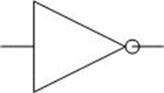
Logic Functions
Logic Function | Logic Symbol | Boolean Expression | Truth Table
 |  |  | Inputs |  | Output
 |  |  | A | B | Y
AND |  | A • B = Y | 0 | 0 | 0
 |  |  | 0 | 1 | 0
 |  |  | 1 | 0 | 0
 |  |  | 1 | 1 | 1
OR |  | A + B = Y | 0 | 0 | 0
 |  |  | 0 | 1 | 1
 |  |  | 1 | 0 | 1
 |  |  | 1 | 1 | 1
NOT |  | A = Ā | 0 | - | 1
 |  |  | 1 | - | 0

Slide 6
Sample Problem
ATM has three options:
  Print statement
  Withdraw money
  Deposit money
ATM will charge $1.00 to:
  Withdraw money
  Print out statement without depositing money
No charge for:
  Depositing money without withdrawing money

Slide 7
Sample Problem
A truth table displays all possible input / output combinations
INPUTS | OUTPUT
P = Print W= Withdraw D = Deposit | C = Charge
0 = “do not” 1 = “do” | 0 = $0.00 1 = $1.00

Slide 8
Sample Problem
Outputs with a value of “ONE” are kept
C = PWD
+ PWD
+ PWD
+ PWD
+ PWD
The resulting equation is known as the un-simplified Boolean equation

Slide 9
Sample Problem
Karnaugh Maps (K-Maps)
  Help simplify Boolean equations
C =PWD + PWD + PWD + PWD + PWD
 | PW | PW | PW | PW
D | 0 | 1 | 1 | 1
D | 0 | 1 | 1 | 0
Circle neighboring ONES in the highest powers of 2 (i.e. 2, 4, 8, etc.) possible
Try to find the greatest amount of “neighbors”
Only overlap circles as a last resort!

Slide 10
Sample Problem
C =PWD + PWD + PWD + PWD + PWD
Grouped terms share variables in common
  (Ex: W is common in the bigger group)
The uncommon terms in a group can be eliminated to simplify the previous equation into a simplified Boolean equation
C = W + PD
 | PW | PW | PW | PW
D | 0 | 1 | 1 | 1
D | 0 | 1 | 1 | 0

Slide 11
Sample Problem
Graphical implementation of Boolean logic
W
or
C = W + PD
P
and
D
not
PD
D

Slide 12
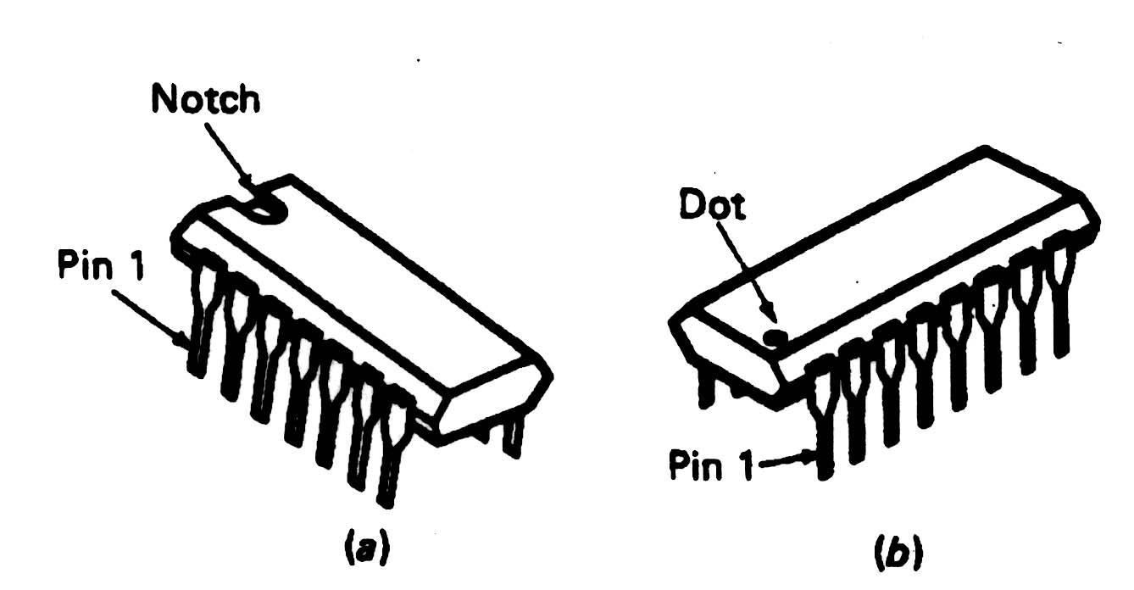
Background Information
Integrated Circuits (ICs)
Used for implementation of combinational logic circuits
  Use TTL family (transistor transistor logic)

Slide 13
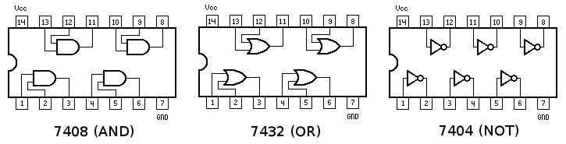
Background Information
Integrated Circuits (ICs)
IC identification

Slide 14
Materials
Computer equipped with LabVIEW
NI-ELVIS II+ Prototyping Board
Prototyping wire and IC chips

Slide 15
Problem Statement
A farmer has 2 barns
3 items: fox, hen, corn
  Items can be in any barn, in any combination
Concerns:
  Protect hen from fox
  Protect corn from hen
Design alarm system using digital electronics that sounds when:
Fox and hen are in the same barn
Hen and corn are in the same barn

Slide 16
Problem Statement
Design combination logic circuit for alarm system
  Use least amount of gates and input variables
  (cost effectiveness)
Logical circuit output connected to LED
  LED “on” indicates alarm activation
  LED “off” indicates no problem (alarm off)
Fox, hen, and corn must be either in barn 1 or barn 2
  Presence in barn 1 = 1
  Presence in barn 2 = 0

Slide 17
Procedure
Truth Table
Determine input and output variable(s)
How many combinations are there
Complete truth table on lab note paper

Slide 18
Procedure
Boolean Equation
Gather all combination that produce a 1 for output
Create a Boolean equation from these smaller equations (independent conditions)

Slide 19
Procedure
K-Map
Create a K-Map table
Only have one variable change state at a time between adjacent boxes
Use the Boolean equation to fill in the 1s and 0s

Slide 20
Procedure
Simplified Boolean Equation
Use K-Map to circle groups of 1s
1s may only be circled in powers of 2
  Starting from the largest possible combination and
  working downward
Write new simplified equation

Slide 21



Procedure
Logic Circuit Diagram & LabVIEW Simulation
Use new simplified Boolean equation to design a logic circuit (have TA check/initial work)
Implement circuit using 3 control switches representing input variables and 1 Boolean indicator showing output
Hint:
NOT
AND
OR

Slide 22
Procedure
NI-ELVIS Prototyping Board
Do NOT electronically connect anything until TA has reviewed your work
Use created logic circuit and IC chip diagram to wire actual circuit on the prototyping board
Be sure to connect each of the correct end of each IC
to “Ground” and “+5V” (circuit power)
Connect final output to an LED
**VCC (Voltage at the Common Collector)

Slide 23
Assignment: Report
Individual Report
Title page
Discussion topics in the manual
Scan in data and lab notes
Original tables and work should be legible
Include screenshots of LabVIEW front and back panels

Slide 24
Assignment: Presentation
Team presentation
Professional-looking tables
Include screenshots of your programs
Include photo of functioning LED assembly
Explain steps taken to compete lab
  Be prepared to provide walk-through
Include lab data

Slide 25
Closing
Have all original data signed by TA
Each team member should have a turn using software
Submit all work electronically
Return all unused materials to TAs
Refer to presentation & lab report guidelines on manual

Slide 26

Digital Logic Circuits
QUESTIONS?

