Slide 1
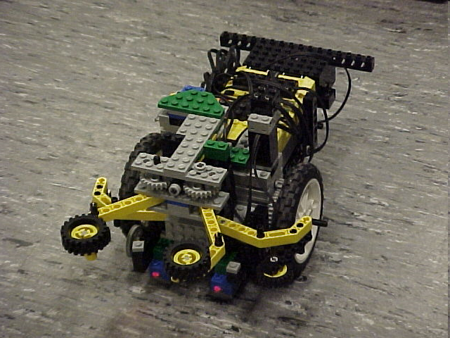
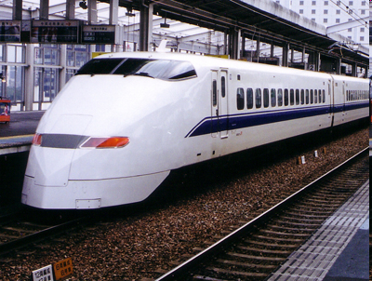
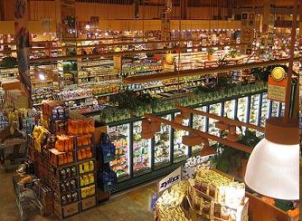

EG1003: Introduction to Engineering and Design
Semester-Long Design Project

Slide 2
Project Introduction
Project duration: 10 weeks
Teams of 2-3 people
Projects to choose from:
  Supermarket
  Train Guidance System
  Robot (Five types)

Slide 3
Project Grading
Item | % of Grade
Benchmarks and Commissioning | 50%
Final Presentation | 50%
NOTE: The SLDP counts toward 30% of your
course final grade!

Slide 4
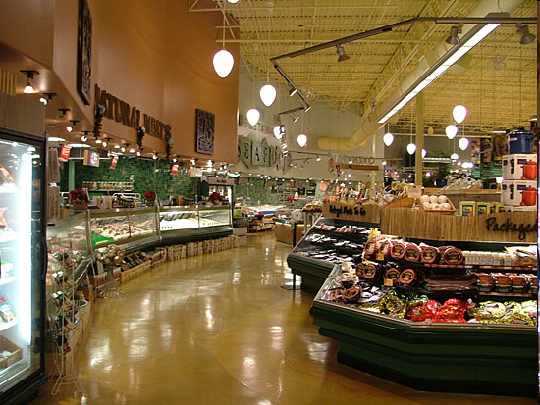
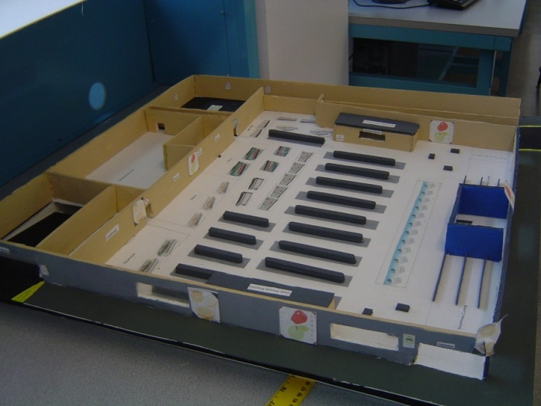
Supermarket Logistics System (SLS)

Slide 5
Objectives
Design supermarket for a 400’ x 400’ lot
Create scaled 3-D model (actual or CAD)
Create security, lighting, and temperature systems for store using LabVIEW
Calculate building and maintenance costs

Slide 6
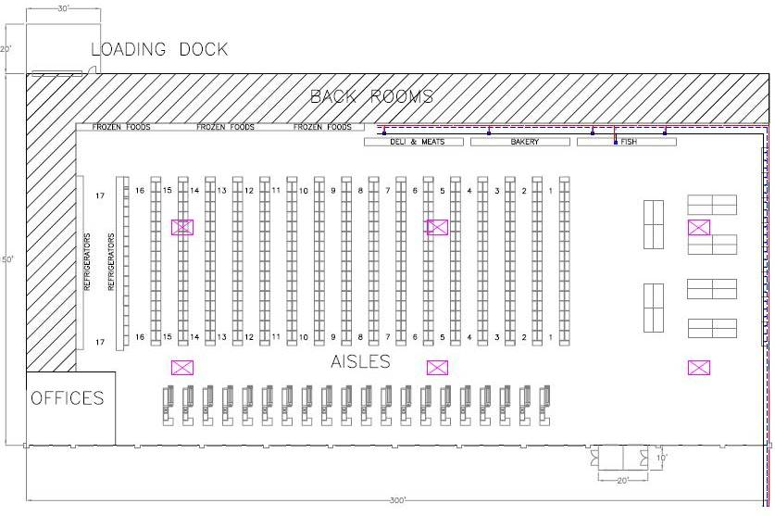
Final Product

Slide 7
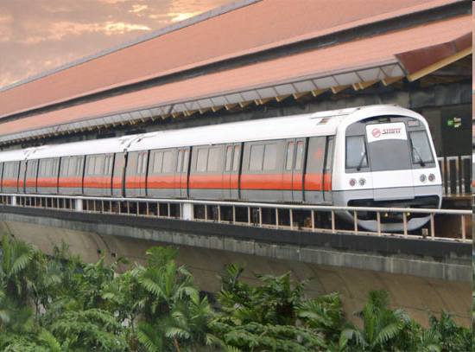
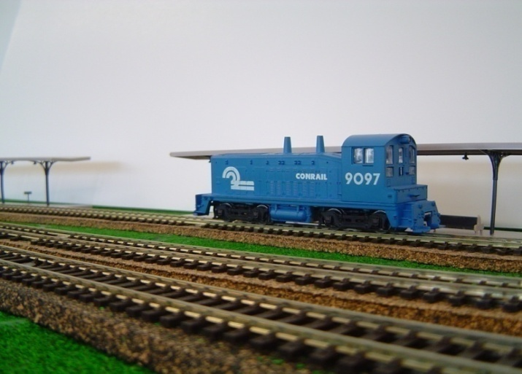
Railroad Train Guidance System
(RTGS)

Slide 8
Objectives
Guide train from one end of the track to the other
Avoid collisions with other trains and obstructions
Implement digital logic program using LabVIEW to control the train track

Slide 9
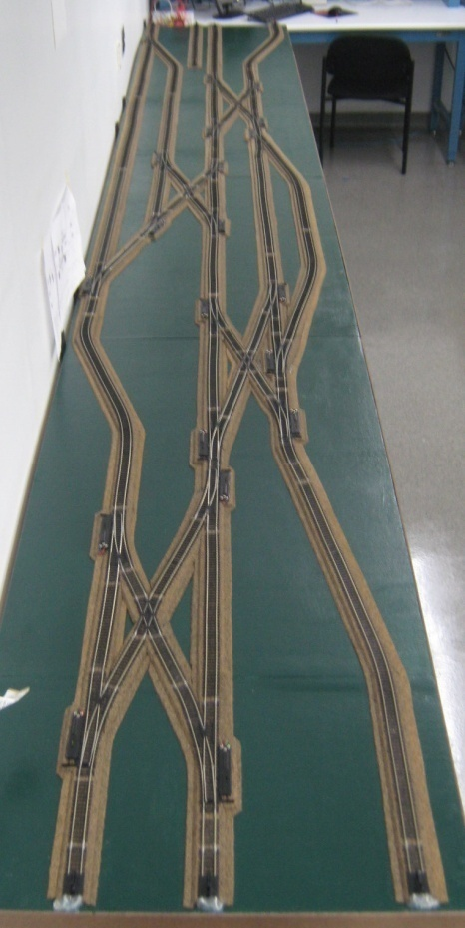
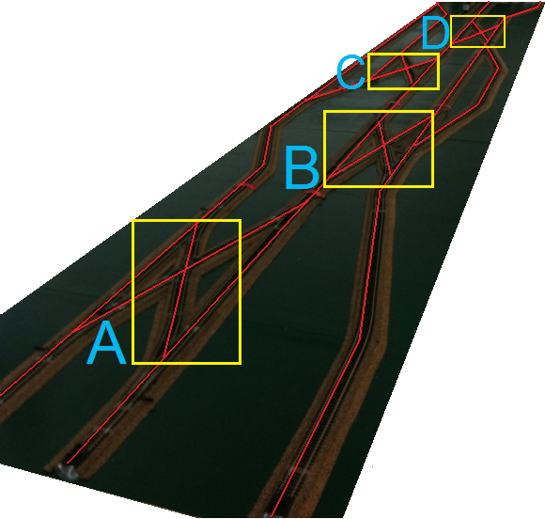
Course Layout

Slide 10
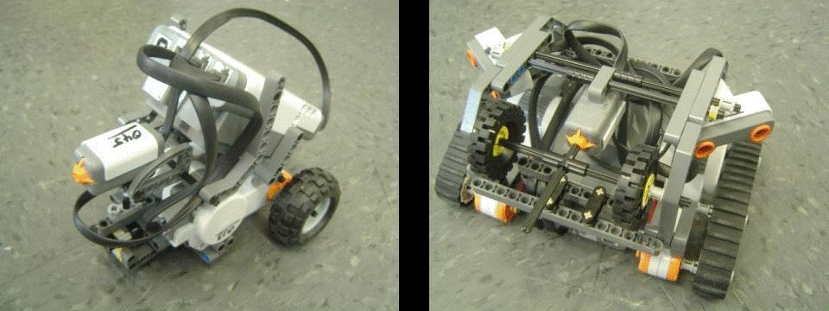
Bomb Disarming Robot
(BDR)

Slide 11
Objectives
Robot must be able to autonomously navigate the obstacle course provided
Disarm the bomb avoiding any decoy bombs
Robot must fit in a start area that is 25cm x 25cm x 20cm
Extra Credit: Disable and retrieve triangulation device(s)

Slide 12
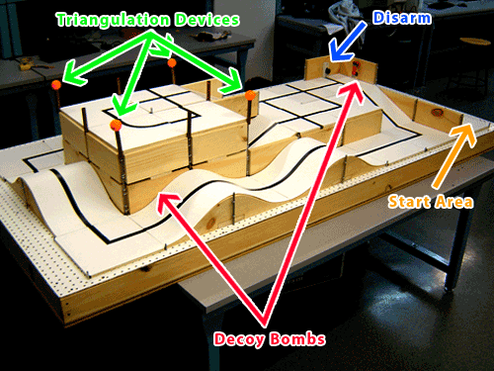
Course Layout

Slide 13
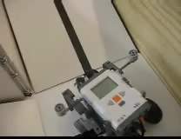
Final Product

Slide 14
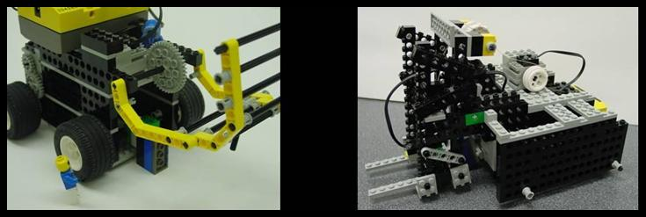
Retrieval & Delivery System (RDS)

Slide 15
Objectives
Robot must be able to:
  Retrieve fuel cells
  Deliver them to a hospital
    Hospitals consumes power at different levels of efficiency
Deliver a total of at least 175 hours of battery life

Slide 16
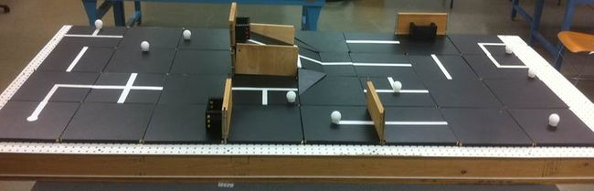
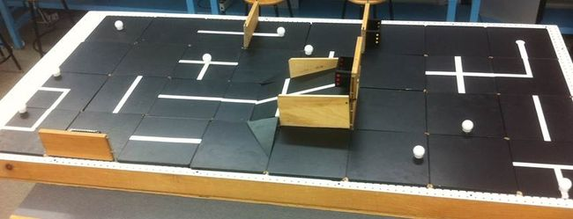
Course Layout

Slide 17
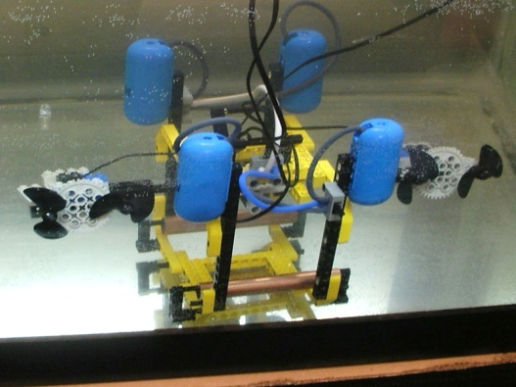
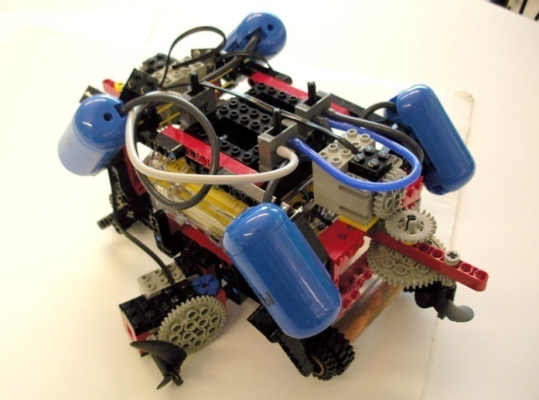
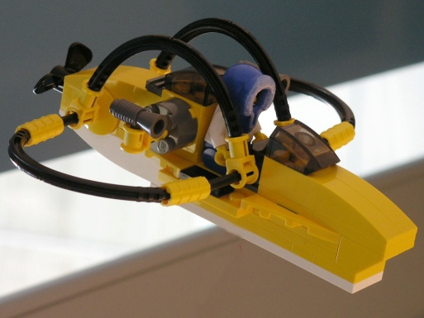
Autonomous Underwater Vehicle (AUV)

Slide 18
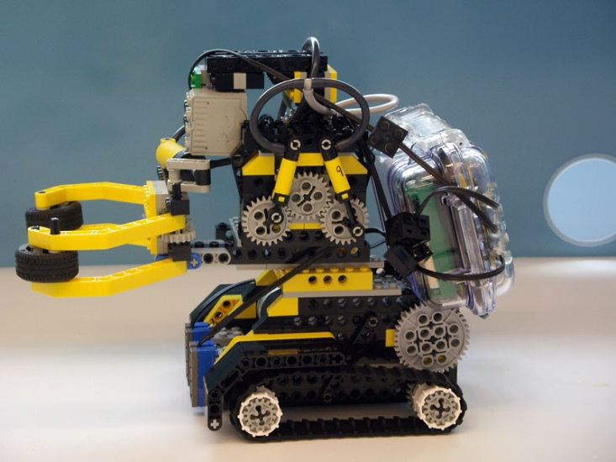
Objectives
Oil Spill Task
Perform tasks for a total of 100 points
AUV must fit into a 1’ x 1’ x 1’ box
Must use waterproofed sensors and NXT case

Slide 19
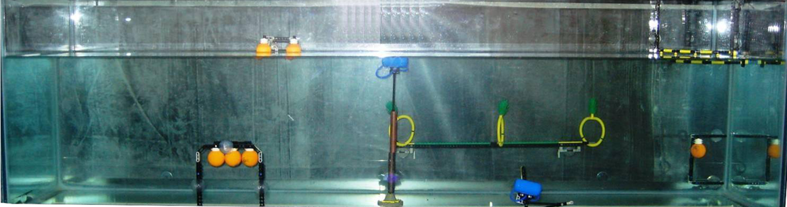
Course Layout & Tasks
Marine Plant Samples
  5 points per plant released
  10 points per plant recovered
2. Data Canisters – 10 points each
3. Oceanographic Sensor – 20 points
Seismic Reading – 10 points
Oil spill task – 40 points

Slide 20
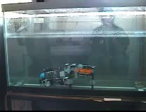
Final Product

Slide 21
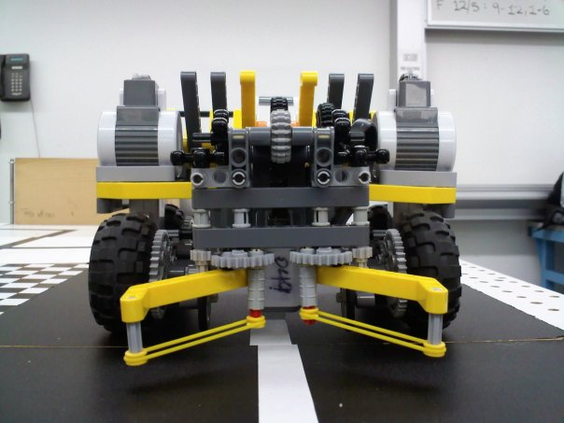
Search & Recovery Robot
(SRR)

Slide 22
Objectives
Robot must move autonomously over a pre-selected route
Retrieve power supply module and return to space shuttle
The robot must fit in a start area that is 25cm x 25cm
Extra Credit: Retrieve specific modules that have fallen off the ISS

Slide 23
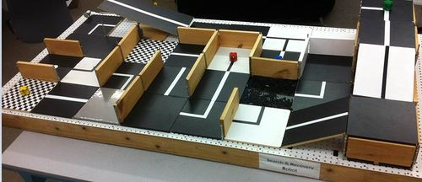
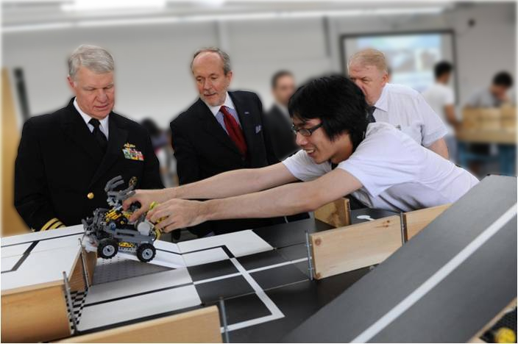
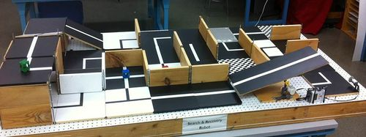
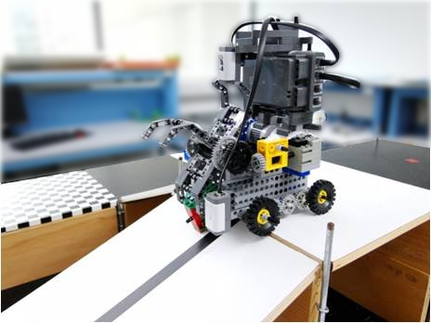
Course Layout

Slide 24
Disaster Relief Robot
(DRR)

Slide 25
Objectives
Robot must perform at least five of the six tasks
Must return back to base in 5 minutes or less
The robot must fit in a start area that is 25cm x 25cm

Slide 26
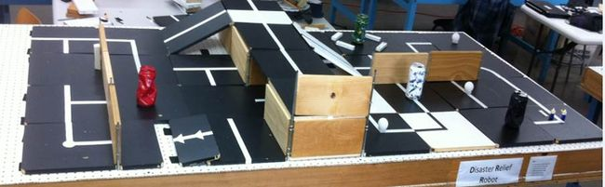
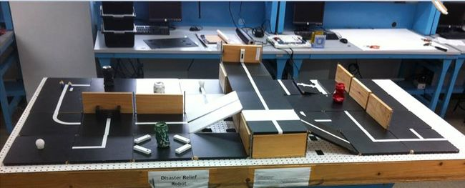
Course Layout

Slide 27
Security Infiltration Drone
(SID)

Slide 28
Objectives
Robot must scan barcodes to open the gates, retrieve the data canister, deliver the data canister to the extraction point, and proceed to the exit.
The robot must fit in a start area that is 25cm x 25cm

Slide 29
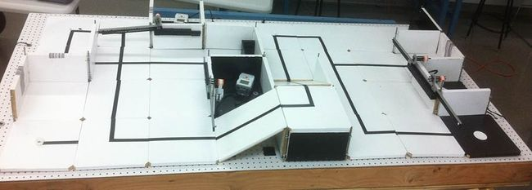
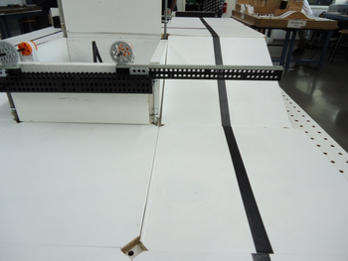
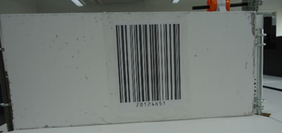
Course Layout

Slide 30
Closing
Refer to manual.eg.poly.edu for details
Think about which project interests you
Brainstorm ideas
Speak with professors and TAs regarding projects

