Slide 1
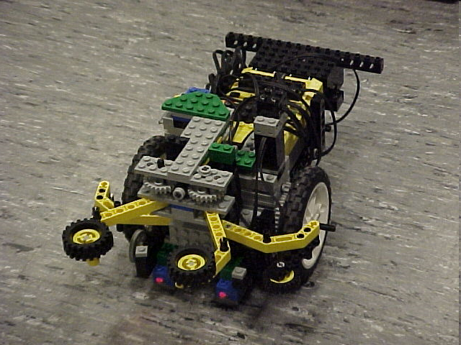
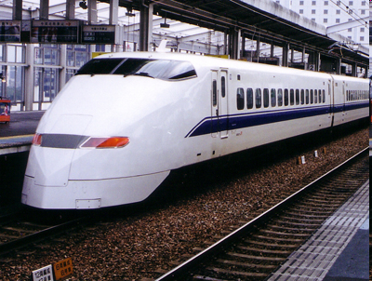
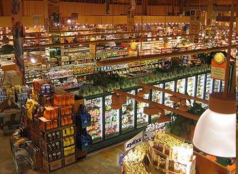
EG1003: Introduction to Engineering and Design
Semester-Long Design Project

Slide 2
Project Introduction
Project duration: 10 weeks
Teams of 2-3 people
Projects to choose from:
Supermarket
Train Guidance System
Robot (Seven types)

Slide 3
Project Grading
Item | % of Grade
Benchmarks and Commissioning | 50%
Final Presentation | 50%
NOTE: The SLDP counts toward 30% of your course final grade!

Slide 4

Project Grading
BENCHMARKS & COMMISSIONING
Benchmarks:
  2 Benchmarks throughout semester
  Refer to syllabus for due dates
  Penalties for not completing on time
Commissioning:
  Completion of all required tasks
  Last phase of project
  Refer to syllabus for due dates
  Failure to commission will result in penalties (Partial Commissioning)

Slide 5

Project Grading
Project Submission:
  Hand in Technical and Managerial related documents
  Must be received in order to obtain SLDP Grade (30%)
  Any missing items will result in penalties
  Refer to syllabus for deadline
  Refer to Submission Guidelines

Slide 6
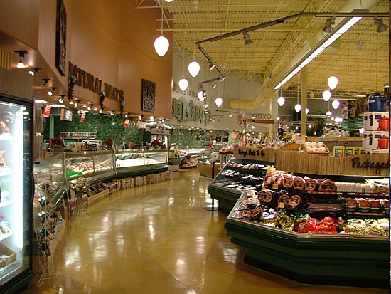
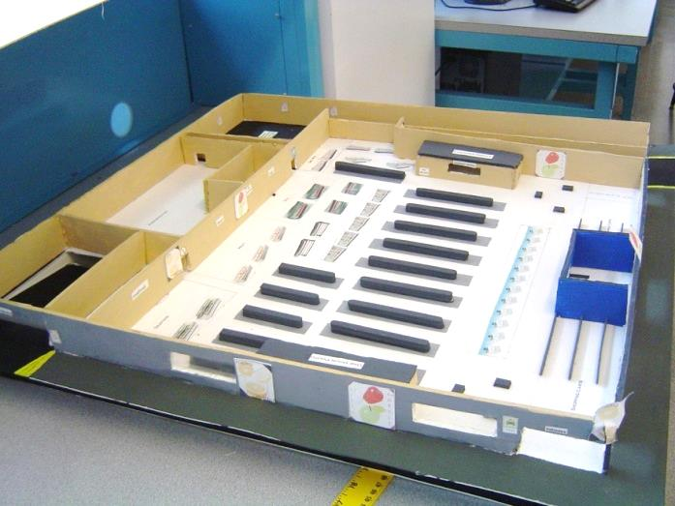
Supermarket Logistics System (SLS)

Slide 7
Objectives
Design supermarket for a 400’ x 400’ lot
Create scaled 3-D model (actual or CAD)
Create security, lighting, and temperature systems for store using LabVIEW
Calculate building and maintenance costs

Slide 8
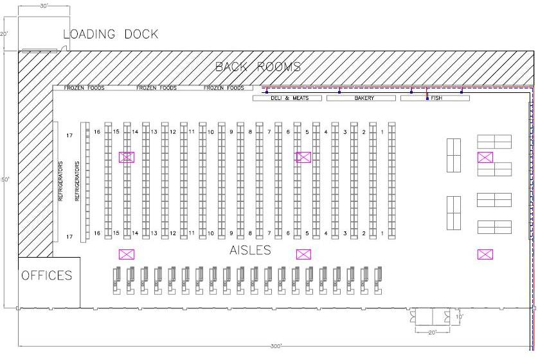
Final Product

Slide 9
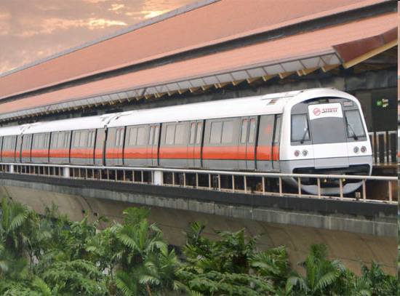
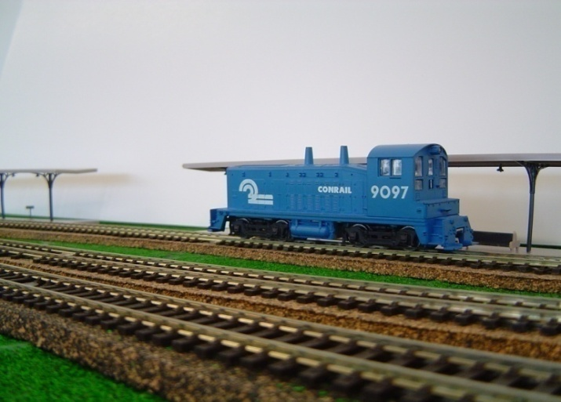
Railroad Train Guidance System
(RTGS)

Slide 10
Objectives
Guide train from one end of the track to the other
Avoid collisions with other trains and obstructions
Implement digital logic program using LabVIEW to control the train track

Slide 11
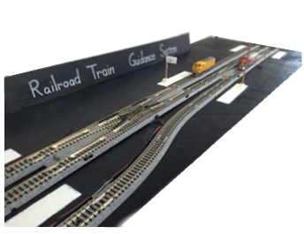
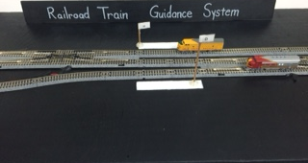
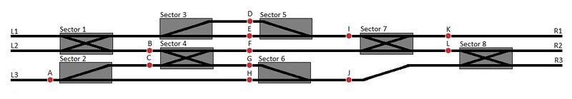
Course Layout

Slide 12
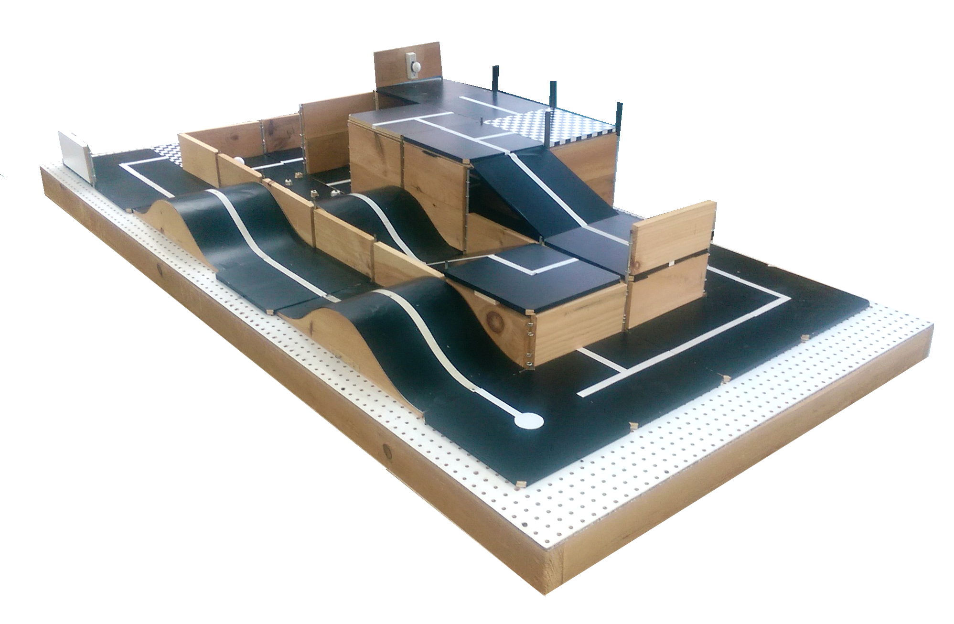
Bomb Disarming Robot
(BDR)

Slide 13
Objectives
Robot must be able to autonomously navigate the obstacle course provided
Disarm the bomb avoiding any decoy bombs
Robot must fit in a start area that is 25cm x 25cm x 20cm
Extra Credit: Disable and retrieve triangulation device(s)

Slide 14
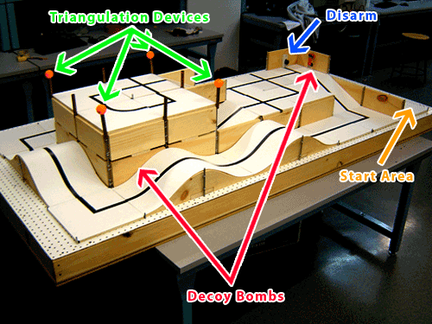
Course Layout

Slide 15
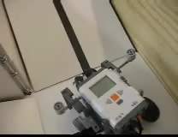
Final Product

Slide 16
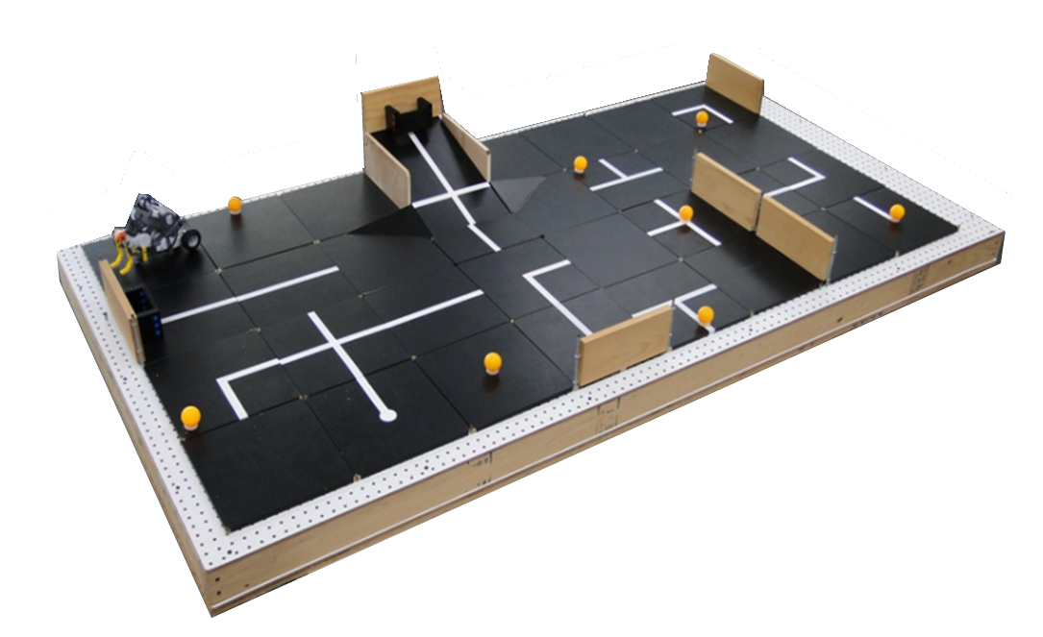
Retrieval & Delivery System (RDS)

Slide 17
Objectives
Robot must be able to:
Retrieve fuel cells
Deliver them to a hospital
Hospitals consumes power at different levels of efficiency
Deliver a total of at least 200 hours of battery life
Extra Credit: Additional points rewarded for hour accumulated past 200

Slide 18
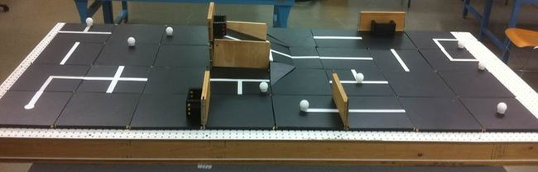
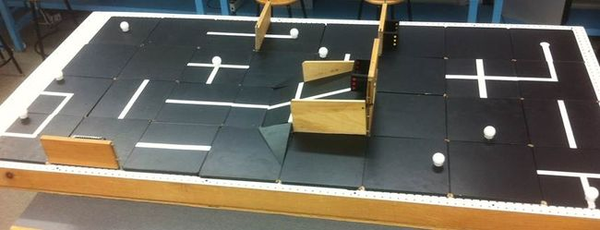
Course Layout

Slide 19
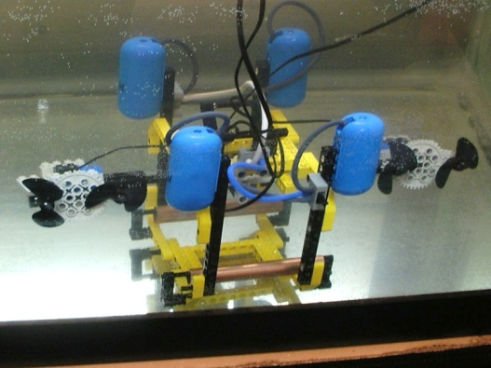
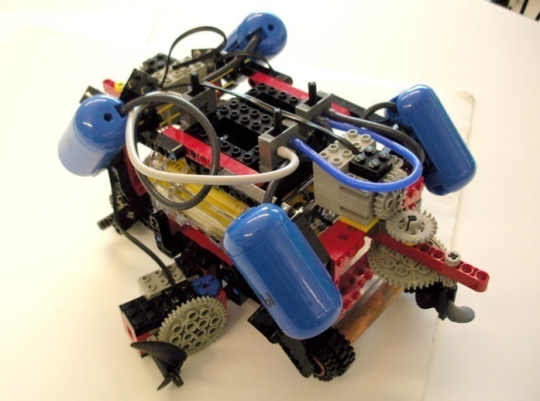
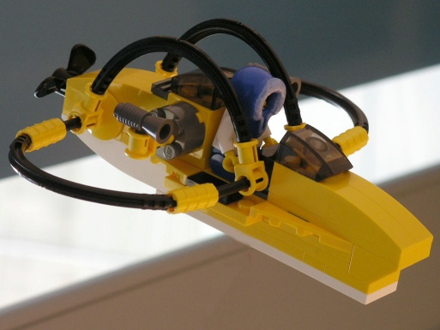
Autonomous Underwater Vehicle (AUV)

Slide 20
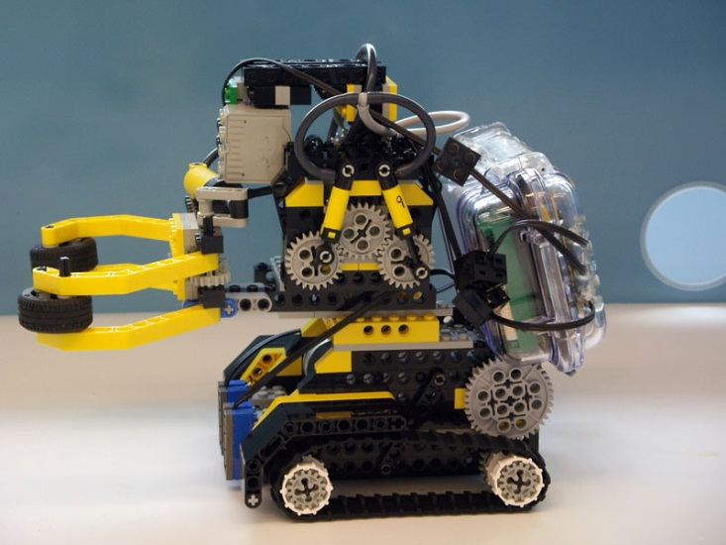
Objectives
Oil Spill Task
Perform tasks for a total of 100 points
AUV must fit into a 1’ x 1’ x 1’ box
Must use waterproofed sensors and NXT case

Slide 21
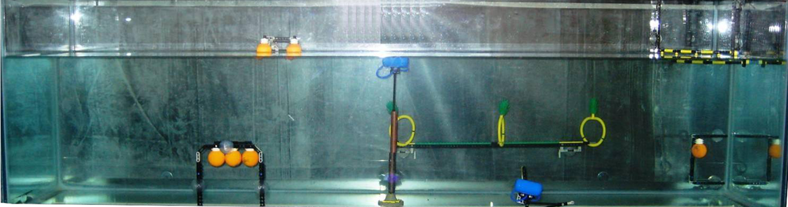
Course Layout & Tasks
Oceanographic Sensor – 20 points
Seismic Reading – 10 points
Oil spill task – 40 points
Marine Plant Samples
5 points per plant released
10 points per plant recovered
Data Canisters – 10 points each

Slide 22
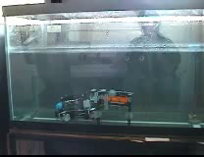
Final Prodct

Slide 23
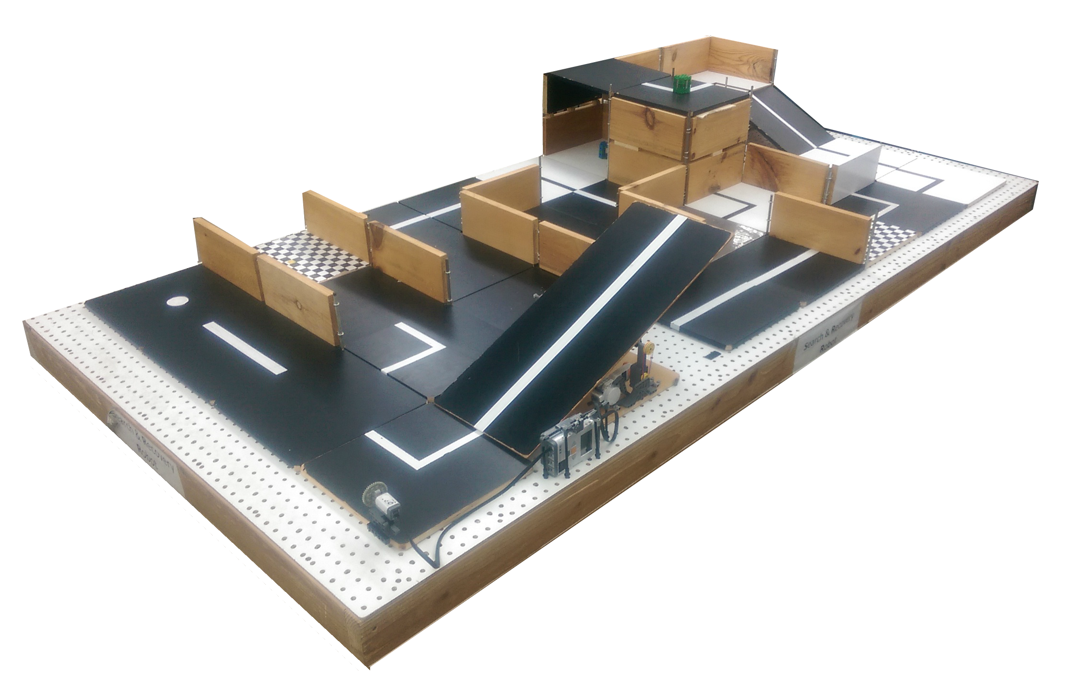
Search & Recovery Robot
(SRR)

Slide 24
Objectives
Robot must move autonomously over a pre-selected route
Retrieve power supply module and return to space shuttle
The robot must fit in a start area that is 25cm x 25cm
Extra Credit: Retrieves modules and returns them to the space shuttle

Slide 25
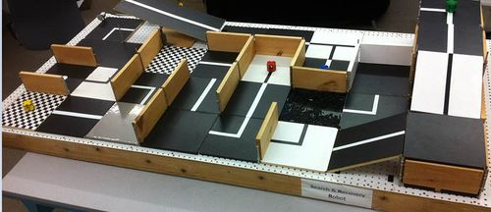
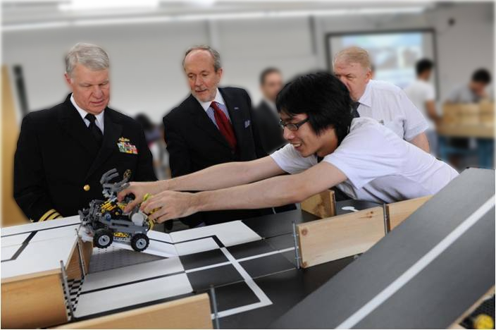
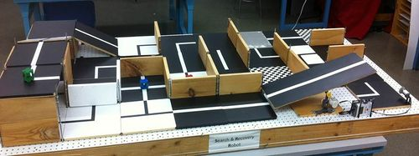
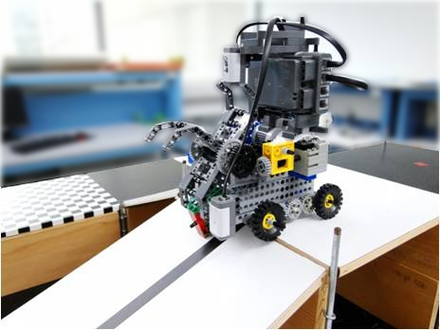
Course Layout
Course Layout

Slide 26
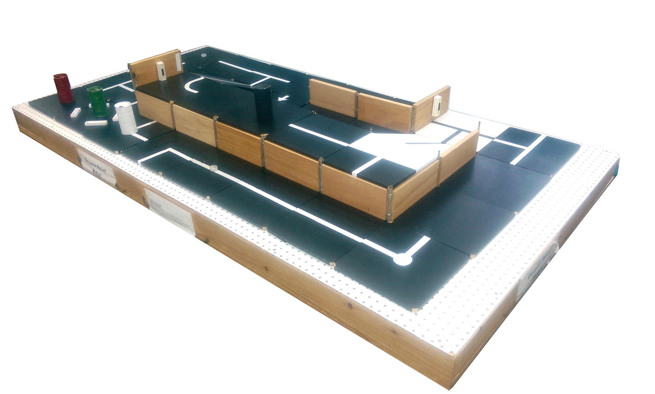
Disaster Relief Robot
(DRR)

Slide 27
Objectives
Robot must perform at least five of the six tasks
Must return back to base in 5 minutes or less
The robot must fit in a start area that is 25cm x 25cm
Extra Credit: Complete all six tasks, retrieve extra fuel cells, and activate a second power cutoff station

Slide 28
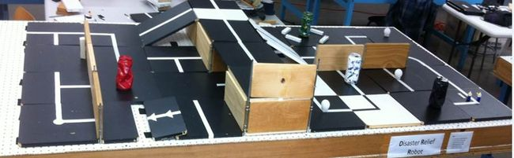
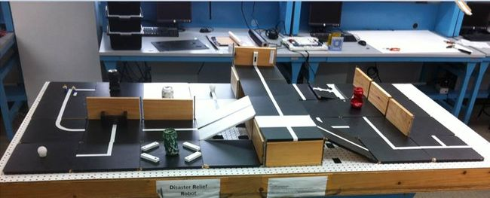
Course Layout

Slide 29
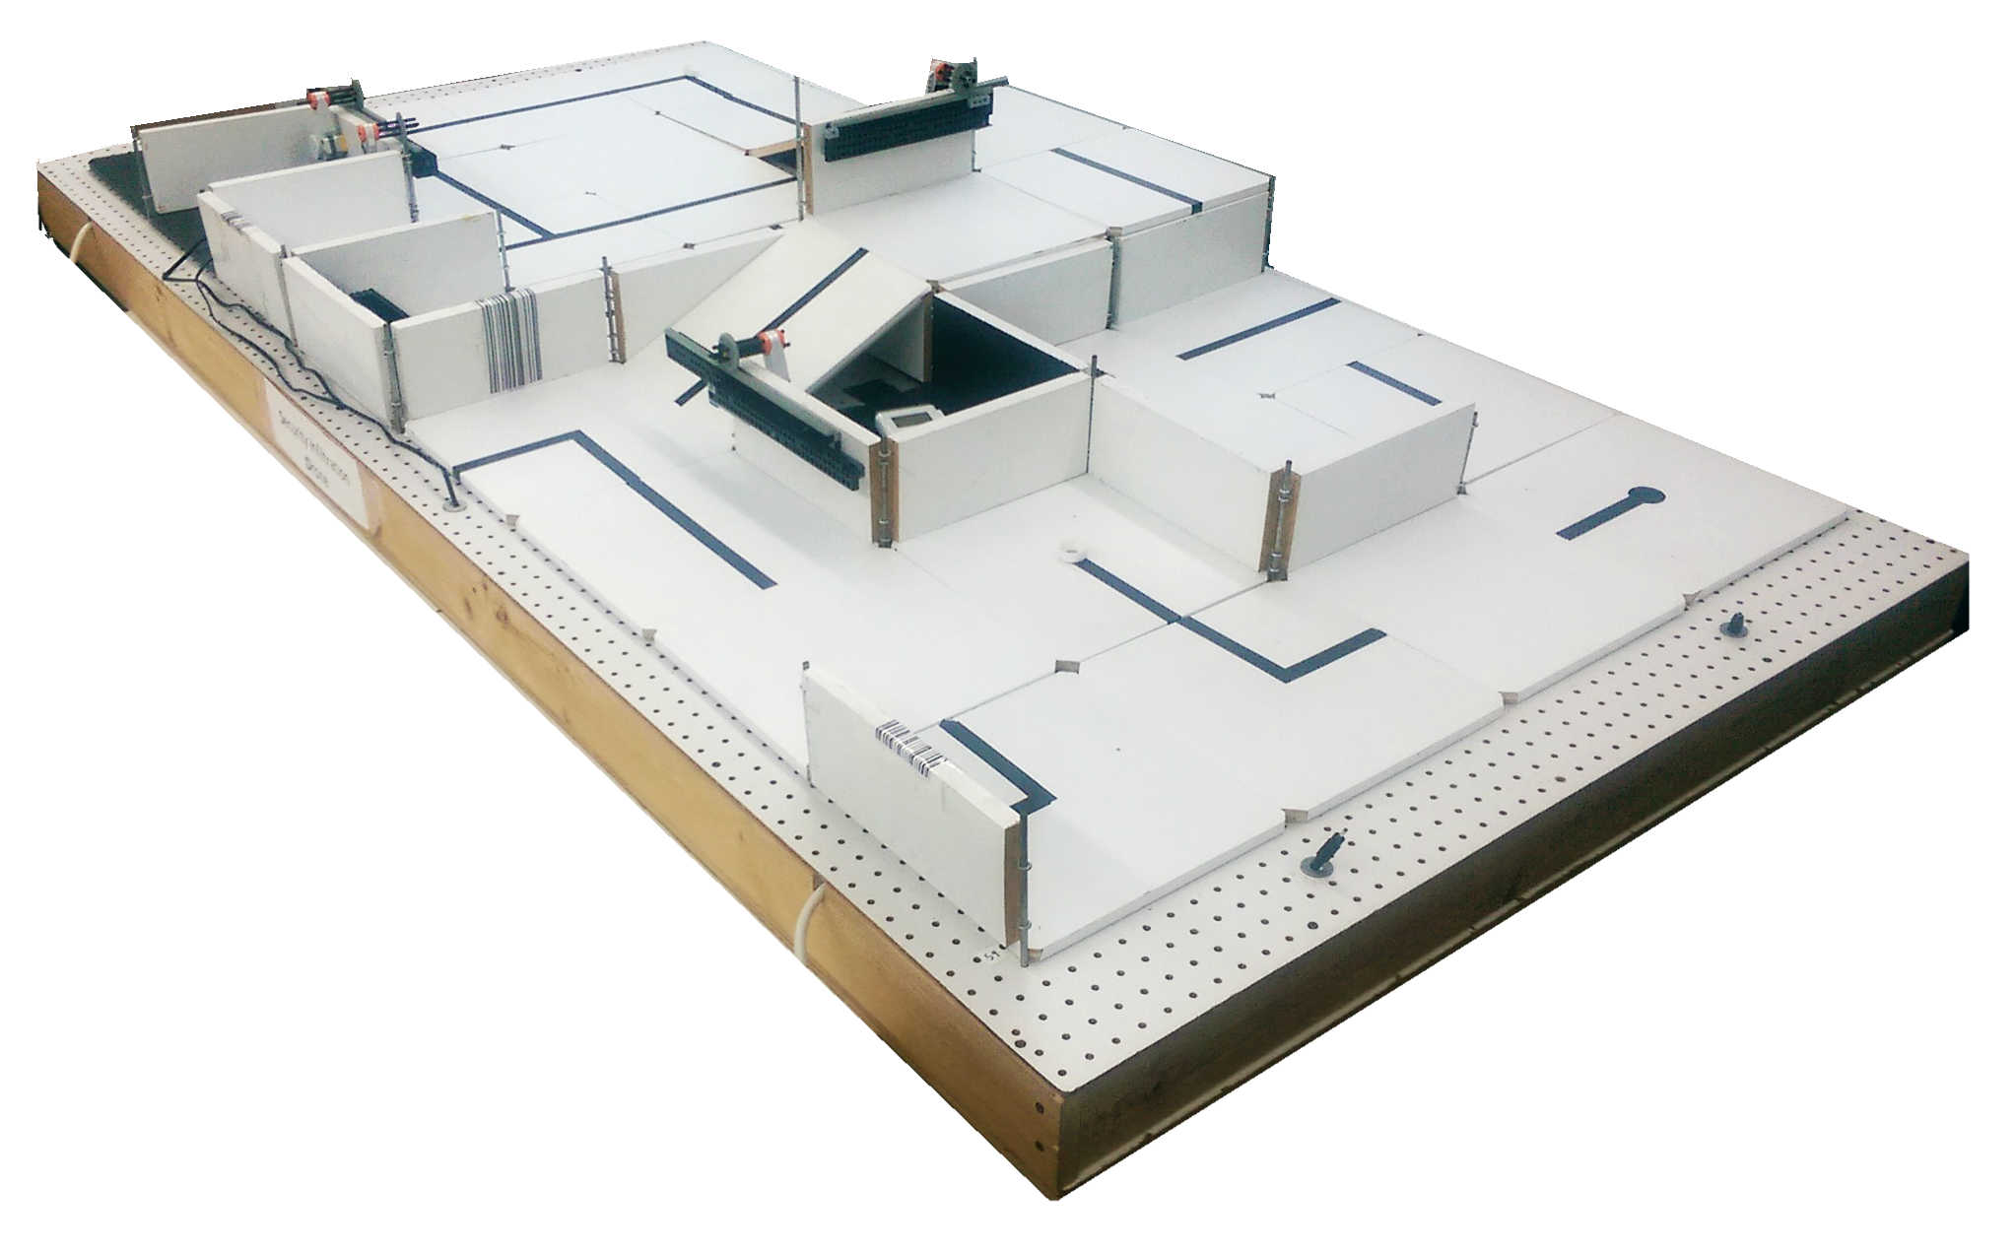
Security Infiltration Drone
(SID)

Slide 30
Objectives
Robot must scan barcodes to open the gates, retrieve the data canister, deliver the data canister to the extraction point, and proceed to the exit.
The robot must fit in a start area that is 25cm x 25cm
Extra Credit: Retrieve data canisters (with a robotic arm) and bring them to extraction point

Slide 31
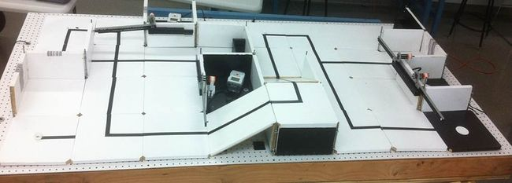
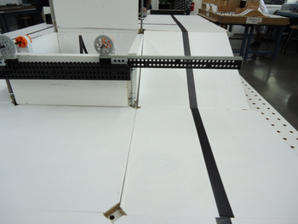
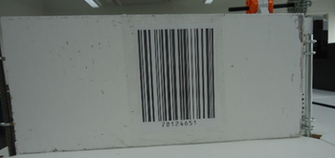
Course Layout

Slide 32
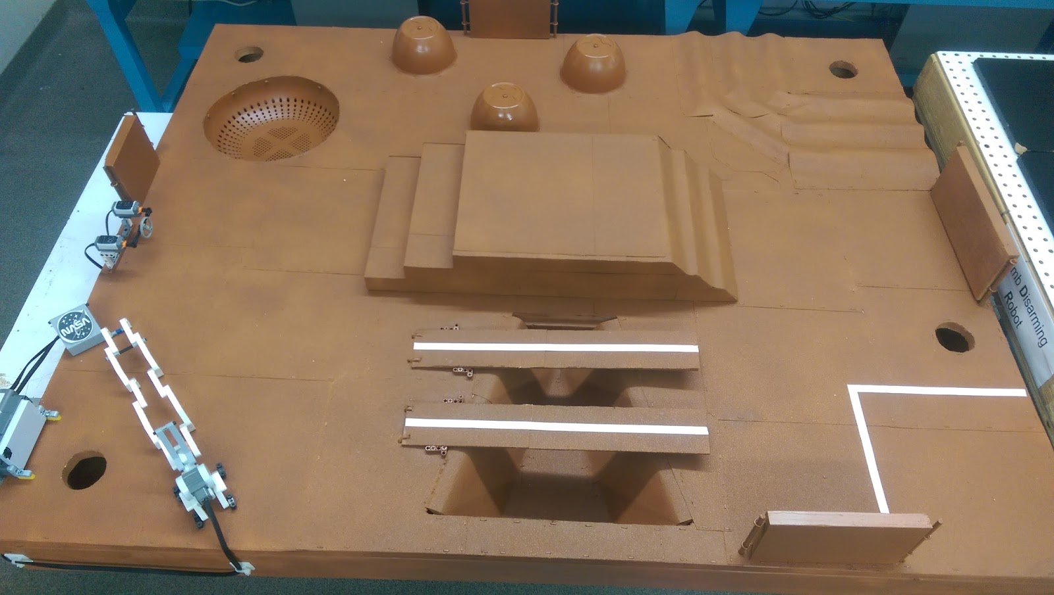
Mars Rover Robot
(MRR)

Slide 33
Objectives
Robot must collect two different readings of water sources with the Vernier salinity sensor
Return to the space shuttle at the landing site once both readings are taken
Extra Credit:
Obtain a third water source reading and return it to the space shuttle
Robot travels down into and over the crater
Robot travels up the step side of the hill

Slide 34
Closing
Refer to manual.eg.poly.edu for details
Think about which project interests you
Brainstorm ideas
Speak with professors and TAs regarding projects

