Slide 1
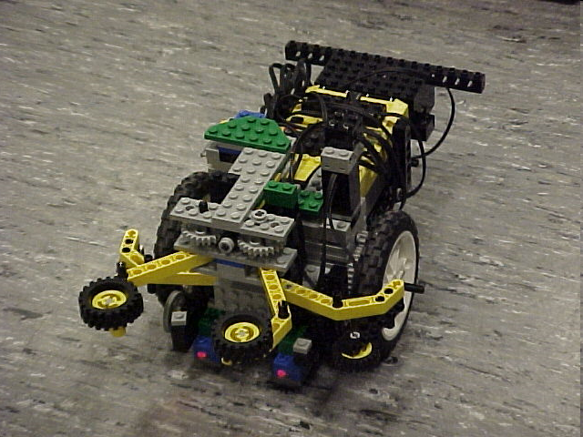
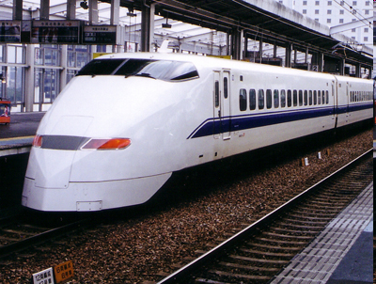
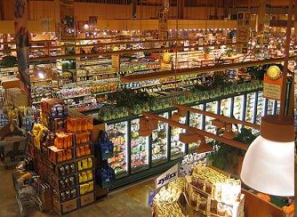
EG1003: Introduction to Engineering and Design
Semester-Long Design Project

Slide 2
Project Introduction
Project duration: 10 weeks
Teams of 2-3 people
Projects to choose from:
Supermarket
Train Guidance System
Robot (Seven types)

Slide 3
Project Grading
Item | % of Grade
Benchmarks and Commissioning | 50%
Final Presentation | 50%
NOTE: The SLDP counts toward 30% of your course final grade!

Slide 4

Project Grading
Benchmarks:
  Completion of a specified portion of the project
  2 Benchmarks throughout semester
  Refer to syllabus for due dates
  Penalties for not completing on time
Commissioning:
  Completion of all required tasks
  Last phase of project
  Refer to syllabus for due dates
  Failure to commission will result in penalties
  (Partial Commissioning)

Slide 5

Project Grading
Project Submission:
  Hand in Technical and Managerial related documents
  Must be received in order to obtain SLDP Grade (30%)
  Any missing items will result in penalties
  Refer to syllabus for deadline
  Refer to Submission Guidelines

Slide 6
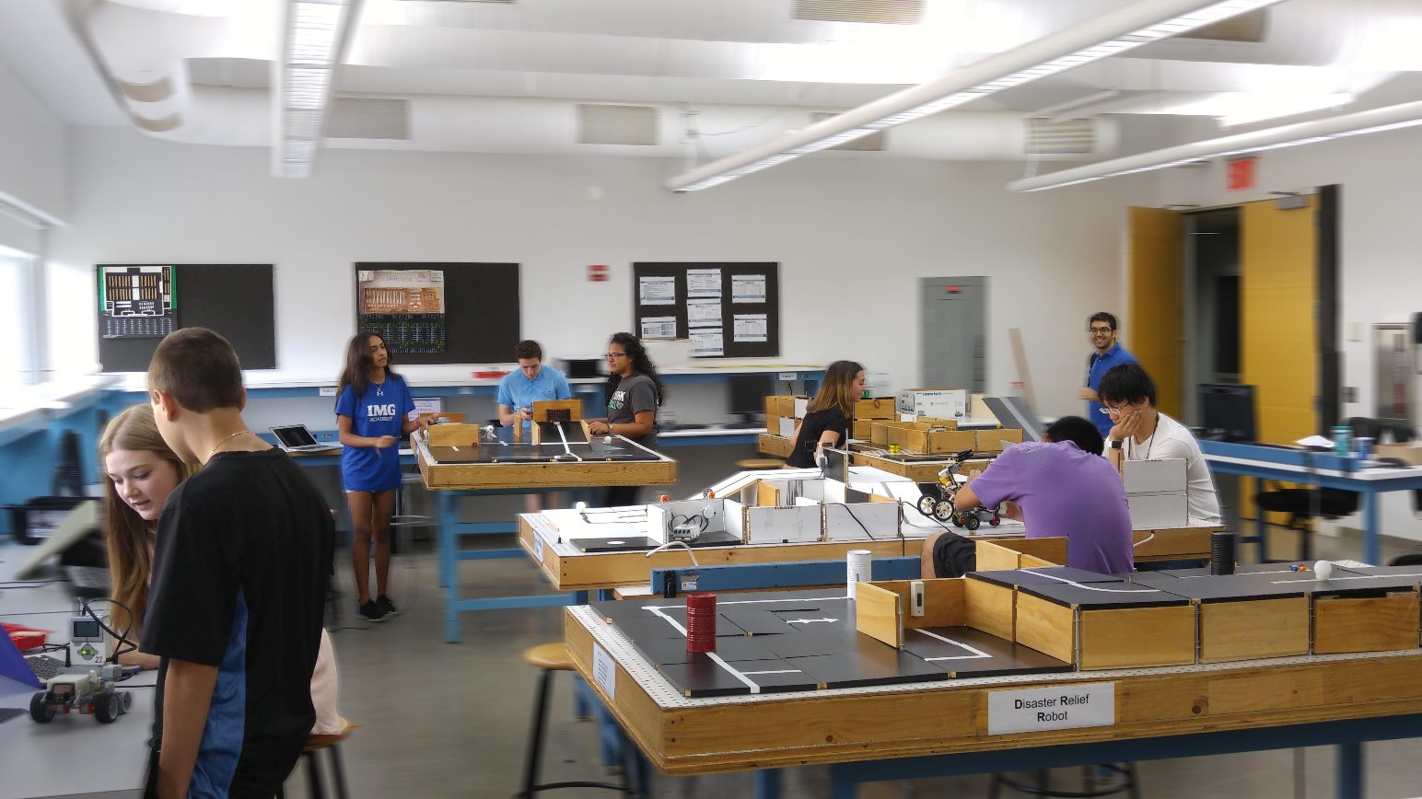
SLDP Options
Seven Robot Variants
Supermarket Logistics System
Digital Logic Train Guidance System

Slide 7
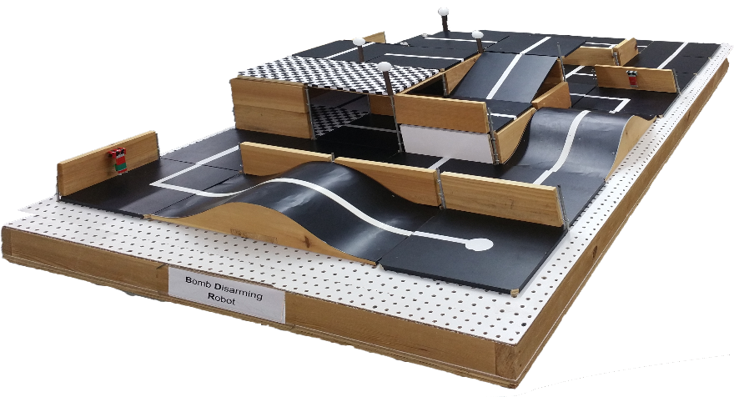
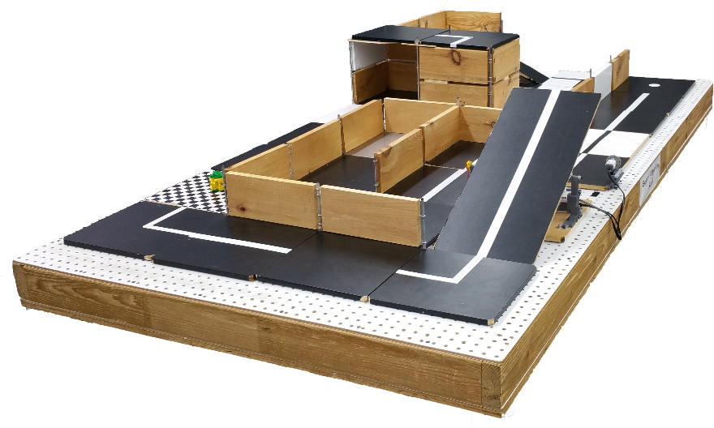
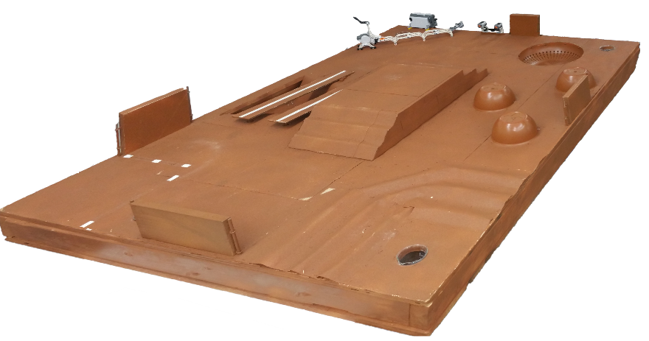
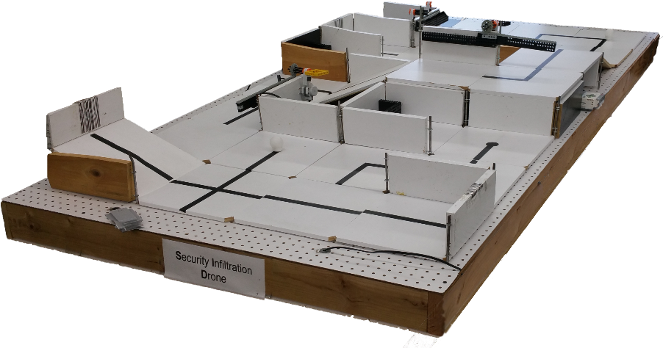
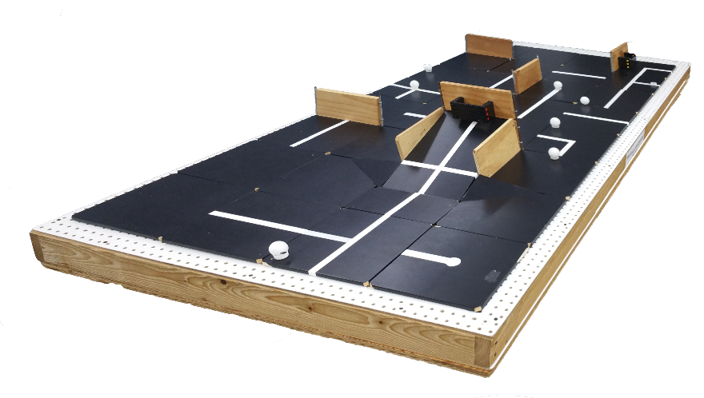
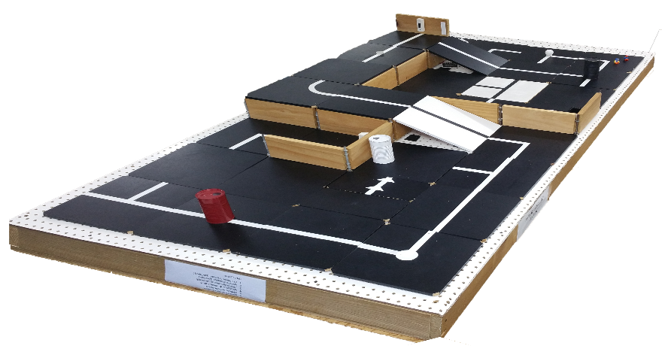
SLDP Options
Robot Variants

Slide 8
SLDP Options
Mars Rover Robot (MRR)
Retrieve and analyze water salinity readings to determine if life can exist on Mars
Collect two different readings of water sources with the Vernier salinity sensor
Return to the space shuttle at the landing site once both readings are taken

Slide 9
SLDP Options
Mars Rover Robot (MRR)
Extra Credit:
Obtain a third water source reading and return it to the space shuttle
Robot travels down into and over the crater
Robot travels up the step side of the hill

Slide 10
SLDP Options
Search & Recovery Robot (SRR)
Retrieve lost space module from moon
and return safely
Robot must move autonomously over
a pre-selected route
Retrieve power supply module and return to space shuttle
The robot must fit in a start area that is 25cm x 25cm

Slide 11
SLDP Options
Search & Recovery Robot (SRR)
Extra Credit:
Retrieves modules and returns them to the space shuttle

Slide 12
SLDP Options
Bomb Disarming Robot (BDR)
Day and night courses
Robot must be able to autonomously navigate the obstacle course provided
Disarm the bomb while avoiding any decoy bombs
Robot must fit in a start area that is 25cm x 25cm x 20cm

Slide 13
SLDP Options
Bomb Disarming Robot (BDR)
Extra Credit:
Disable and retrieve triangulation device(s)

Slide 14
SLDP Options
Security Infiltration Drone (SID)
Open gates using barcode scanners
to infiltrate enemy headquarters
Retrieve data canister and deliver it
to extraction point
The robot must fit in a start area that is 25cm x 25cm

Slide 15
SLDP Options
Security Infiltration Drone (SID)
Extra Credit:
Retrieve data canisters (with a robotic arm) and bring them to extraction point

Slide 16
SLDP Options
Retrieval & Delivery System (RDS)
Retrieve fuel cells
Deliver them to three different hospitals
Hospitals consumes power at different levels of efficiency
Deliver a total of at least 200 hours of battery life

Slide 17
SLDP Options
Retrieval & Delivery System (RDS)
Extra Credit:
Additional points rewarded for additional fuel cells accumulated past the 200-hour requirement

Slide 18
SLDP Options
Disaster Relief Robot (DRR)
After tragedy strikes, clean the affected
area, rescue workers, and remove
hazardous waste
Robot must perform at least five of the six tasks
Must return back to base in 5 minutes or less
The robot must fit in a start area that is 25cm x 25cm

Slide 19
SLDP Options
Disaster Relief Robot (DRR)
Extra Credit:
Complete all six tasks, retrieve extra fuel cells, and activate a second power cutoff station

Slide 20
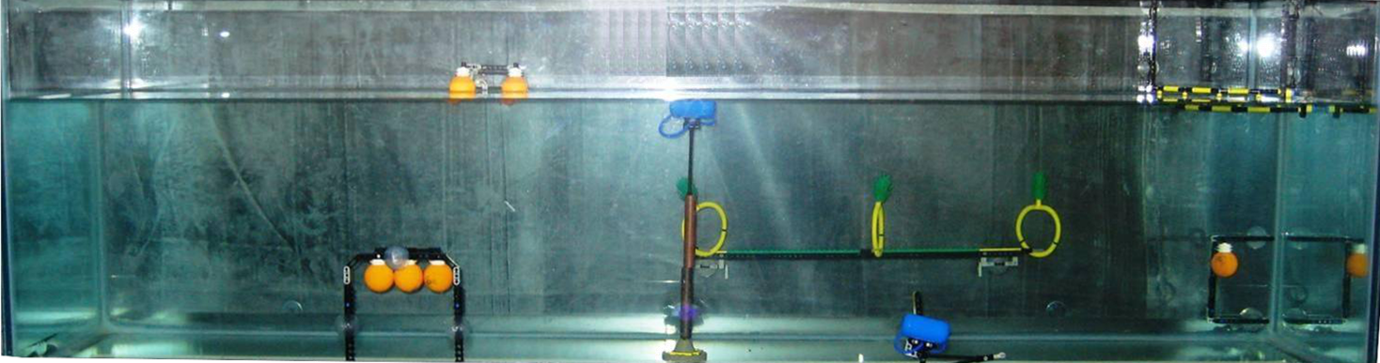
SLDP Options
Autonomous Underwater Vehicle (AUV)
Construct a robot that functions underwater
Oil spill task
Perform tasks for a total of 100 points
AUV must fit into a 1’ x 1’ x 1’ box
Must use waterproofed sensors and NXT case

Slide 21
SLDP Options
Autonomous Underwater Vehicle (AUV)
Marine Plant Samples
5 points per plant released
10 points per plant recovered
Data Canisters – 10 points each
Oceanographic Sensor – 20 points
Seismic Reading – 10 points
Oil spill task – 40 points

Slide 22
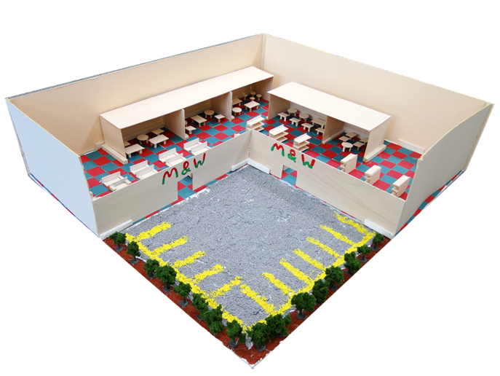
SLDP Options
Supermarket Logistics System (SLS)
Design a customer-friendly supermarket
with AutoCAD
Design for a 400’ x 400’ lot
Create scaled 3-D model (actual or CAD)
Create security, lighting, and temperature
systems for store using LabVIEW
Calculate building and maintenance costs

Slide 23
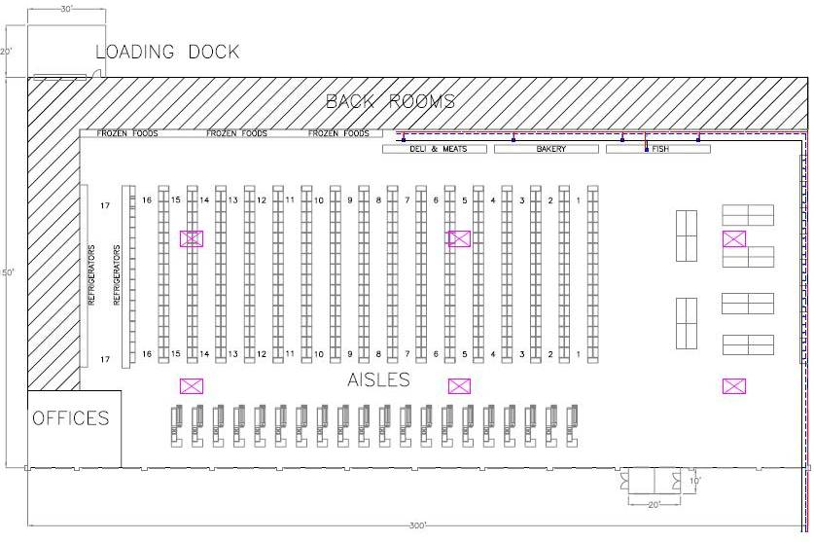

SLDP Options
Supermarket Logistics System (SLS)
Extra Credit:
Incorporate LEED certification
into the design of supermarket

Slide 24
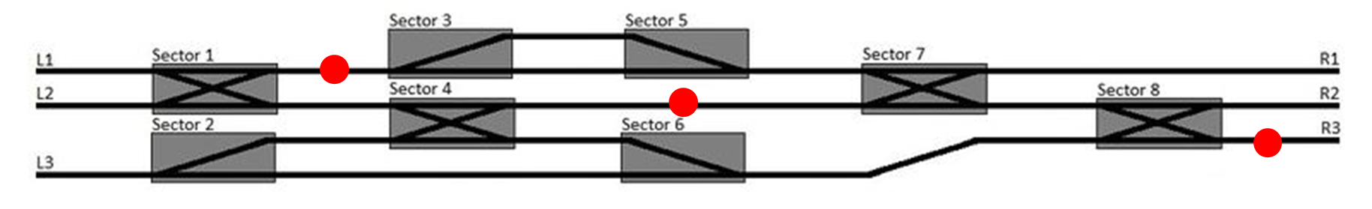
SLDP Options
Railroad Train Guidance System (RTGS)
Design a logic system to avoid obstacles by selecting an optimal path
Guide train from one end of the track to the other
Avoid collisions with other trains and obstructions

Slide 25
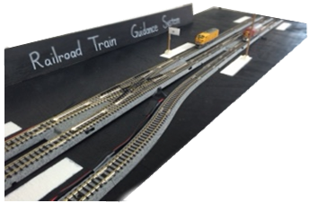
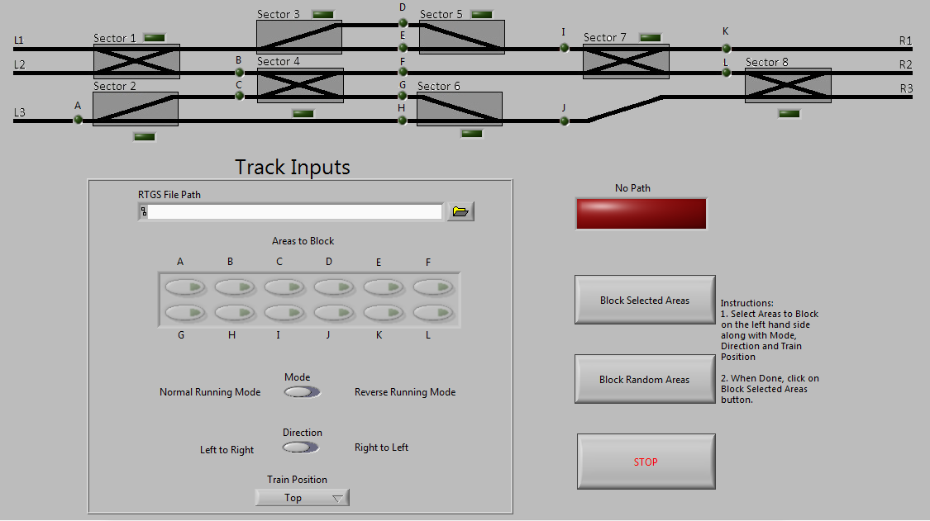
SLDP Options
Railroad Train Guidance System (RTGS)
Implement digital logic program using LabVIEW to control the train track

Slide 26
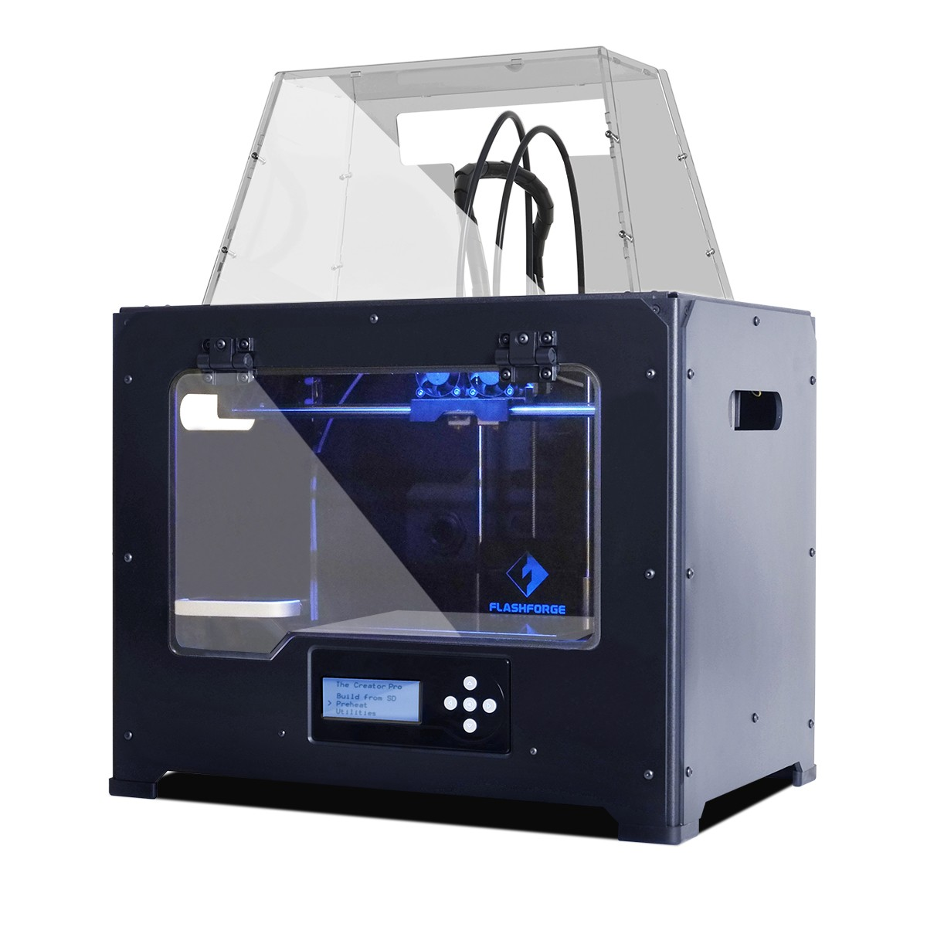
3D Printing Extra Credit
Design your own SLDP team logo using
the techniques practiced in Lab 1B
Be creative with your design (2 pts EC)
  Your design will need approval by the
  3D printer TAs who will print it for you
  Multiple colors are available: purple, black, white, yellow, red, green, pink, light blue,
  blue, clear

Slide 27

3D Printing Extra Credit
Constraints:
  Dimensions
      1”×3”×½”
  2 colors max
  No copyrighted logos
  Must be attached to robot or worn as pin during final presentation
  Must be done before any advanced printing

Slide 28
3D Printing Extra Credit ADVANCED
An experimental opportunity to create a prototype of a custom, 3D-printed robot part (4 pts EC)
Constraints: (Rules subject to change, no guarantee)
  Must be approved by 3D printer TA
  Maximum 2-hour print time and 3 attempts
  YOU MUST HAVE A CONTINGENCY PLAN if the piece does not work or cannot be printed
You may also use print parts at NYU School of Engineering temporary makerspace (opens October 1st, Rogers Hall 2nd floor) after TA approval

Slide 29
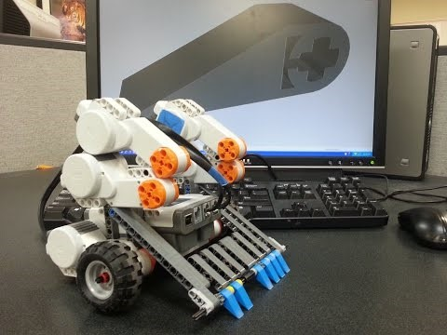
3D Printing Extra Credit ADVANCED

Slide 30
Closing
Refer to manual.eg.poly.edu for details
Think about which project interests you
Brainstorm ideas
Speak with professors and TAs regarding projects

