Slide 1
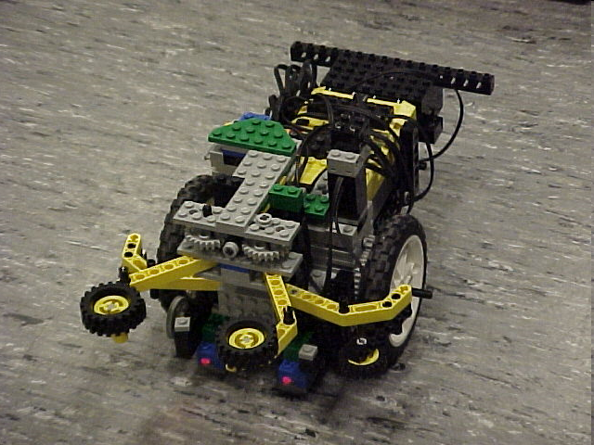
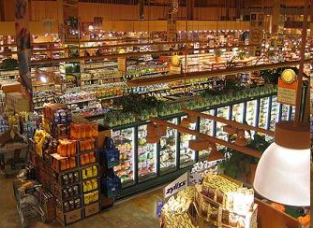
Semester-Long Design Project

Slide 2
Project Introduction
Project duration: 10 weeks
Teams of 2-3 people
Projects to choose from:
  Supermarket
  Robot (seven types)

Slide 3
Project Grading
Item | % of Grade
Benchmarks and Commissioning | 50%
Final Presentation | 50%
NOTE: The SLDP counts toward 30% of your course final grade!

Slide 4

Project Grading
Benchmarks:
  Completion of a specified portion of the project
  2 Benchmarks throughout semester
  Refer to schedule for due dates
  Penalties for not completing on time
  They are cumulative, i.e. Benchmark B includes Benchmark A

Slide 5
Project Grading
Commissioning:
  Completion of all required tasks
  Last phase of project
  Refer to syllabus for due dates
  Failure to commission will result
  in penalties (partial commissioning)

Slide 6
Project Grading
Partial Commissioning:
  If you have reached up at least to Benchmark A, you’ve earned at least 30% for commissioning
  If you have reached up at least to Benchmark B, you’ve earned at least 70% for commissioning
  Any value higher than their benchmarks is decided by two TAs watching a full run

Slide 7

Project Grading
Project Submission:
  Hand in Technical and Managerial related documents
  Must be received in order to obtain SLDP grade (30%)
  Any missing items will result in penalties
  Refer to syllabus for deadline
  Refer to Submission Guidelines
  Must hand in folder before due date for credit!

Slide 8
Project Grading
Project Submission:
  Refer to Submission Guidelines
  Submit through an online form accessible by
  an email that will be provided to each group
  Must be received in order to obtain SLDP grade (30%)
  Any missing items will result in penalties
  Refer to syllabus for deadline

Slide 9
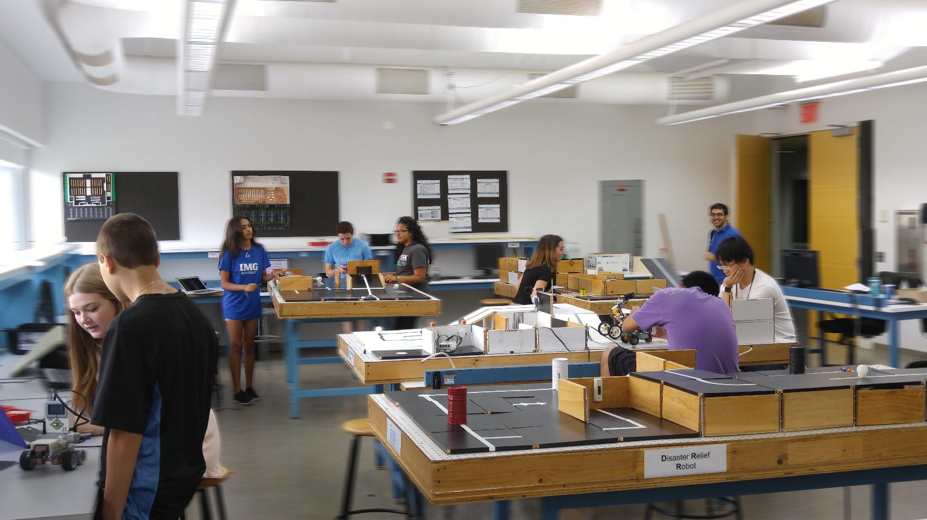
SLDP Options
Seven Robot Variants
Supermarket Logistics System

Slide 10
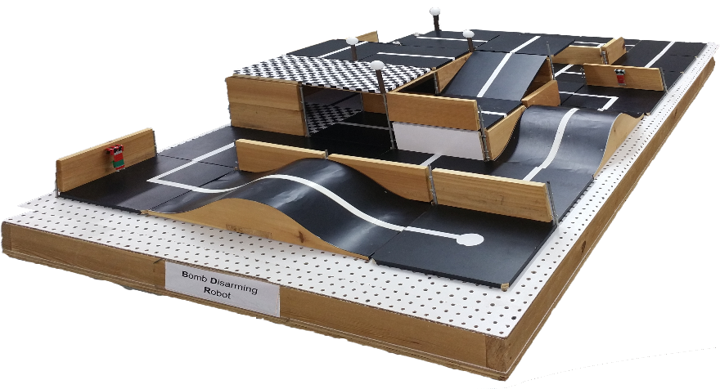
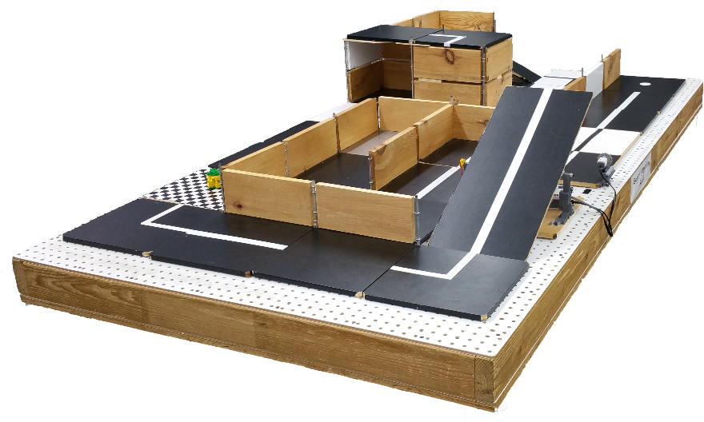
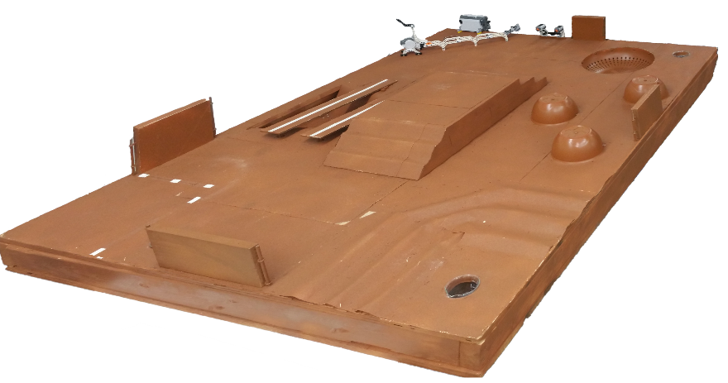
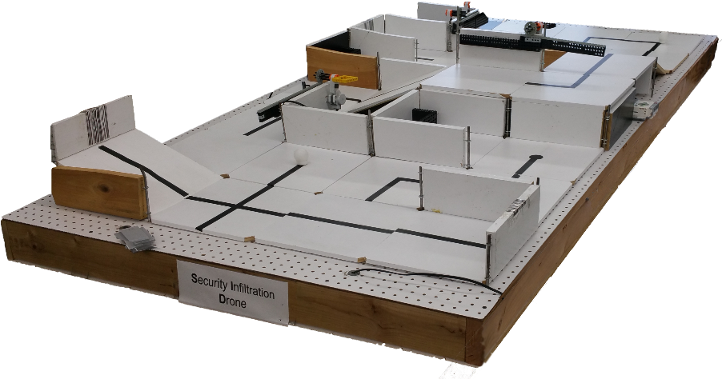
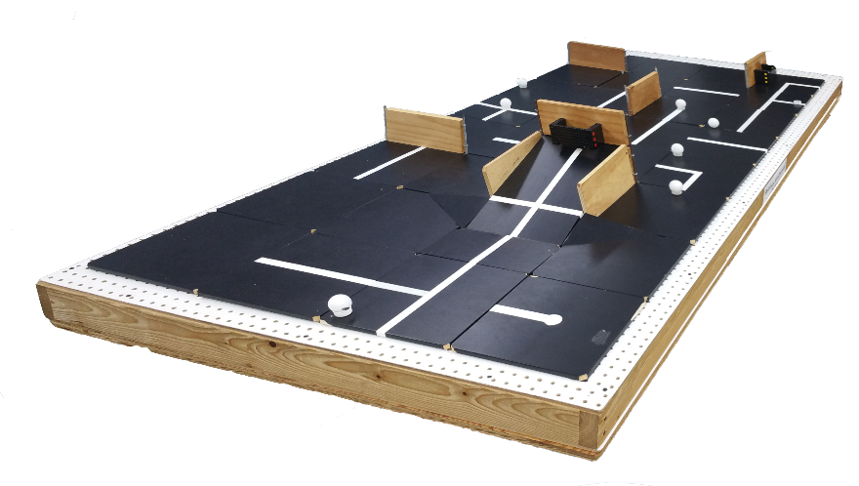
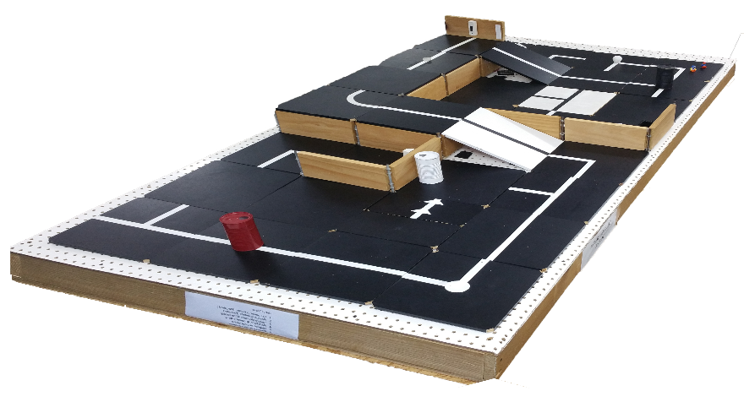
SLDP Options
Robot Variants

Slide 11
SLDP Options
Mars Rover Robot (MRR)
Collect one soil and one water reading
Pick up sensor between readings if necessary
Answer Data Specifications questions

Slide 12
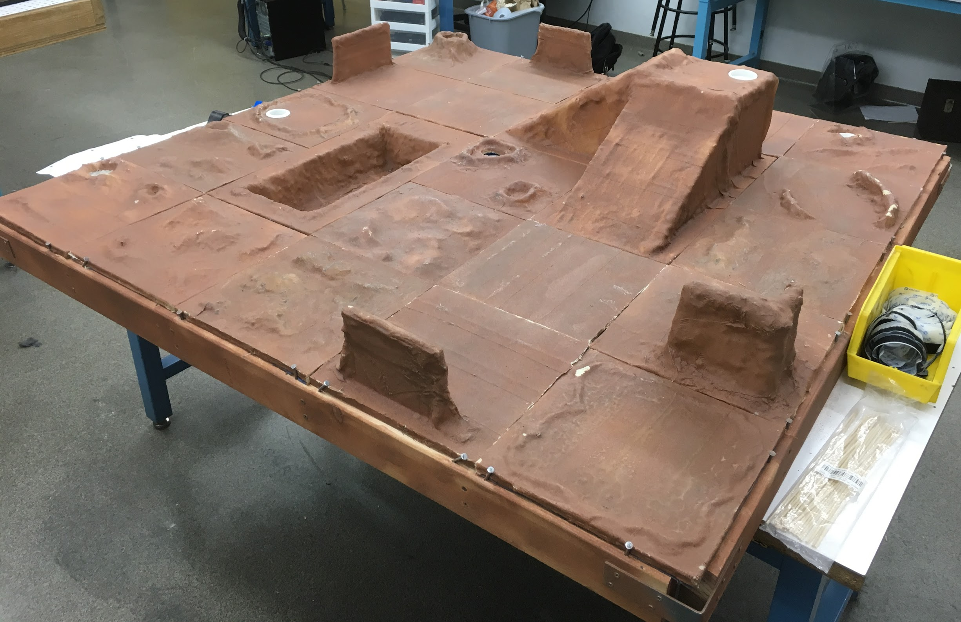
SLDP Options
Mars Rover Robot (MRR)
EC Soil 2
EC Soil 1
Reg Soil 2
EC Water
Reg Water
Reg Soil 1
Start

Slide 13
SLDP Options
Mars Rover Robot (MRR)
Benchmark A:
Obtain one soil reading
Benchmark B:
Return to site if salinity sensor needs to be added
Obtain water reading
Commission:
Return to site
Answer Data Specification questions

Slide 14
SLDP Options
Mars Rover Robot (MRR)
Extra Credit:
EC tiles
Travel up mountain
Travel across canyon
Obtain two soil readings and one water reading

Slide 15
SLDP Options
Search & Recovery Robot (SRR)
Retrieve lost space module Zarya from moon and return to start
The robot must fit in a start area that is 25cm x 25cm

Slide 16
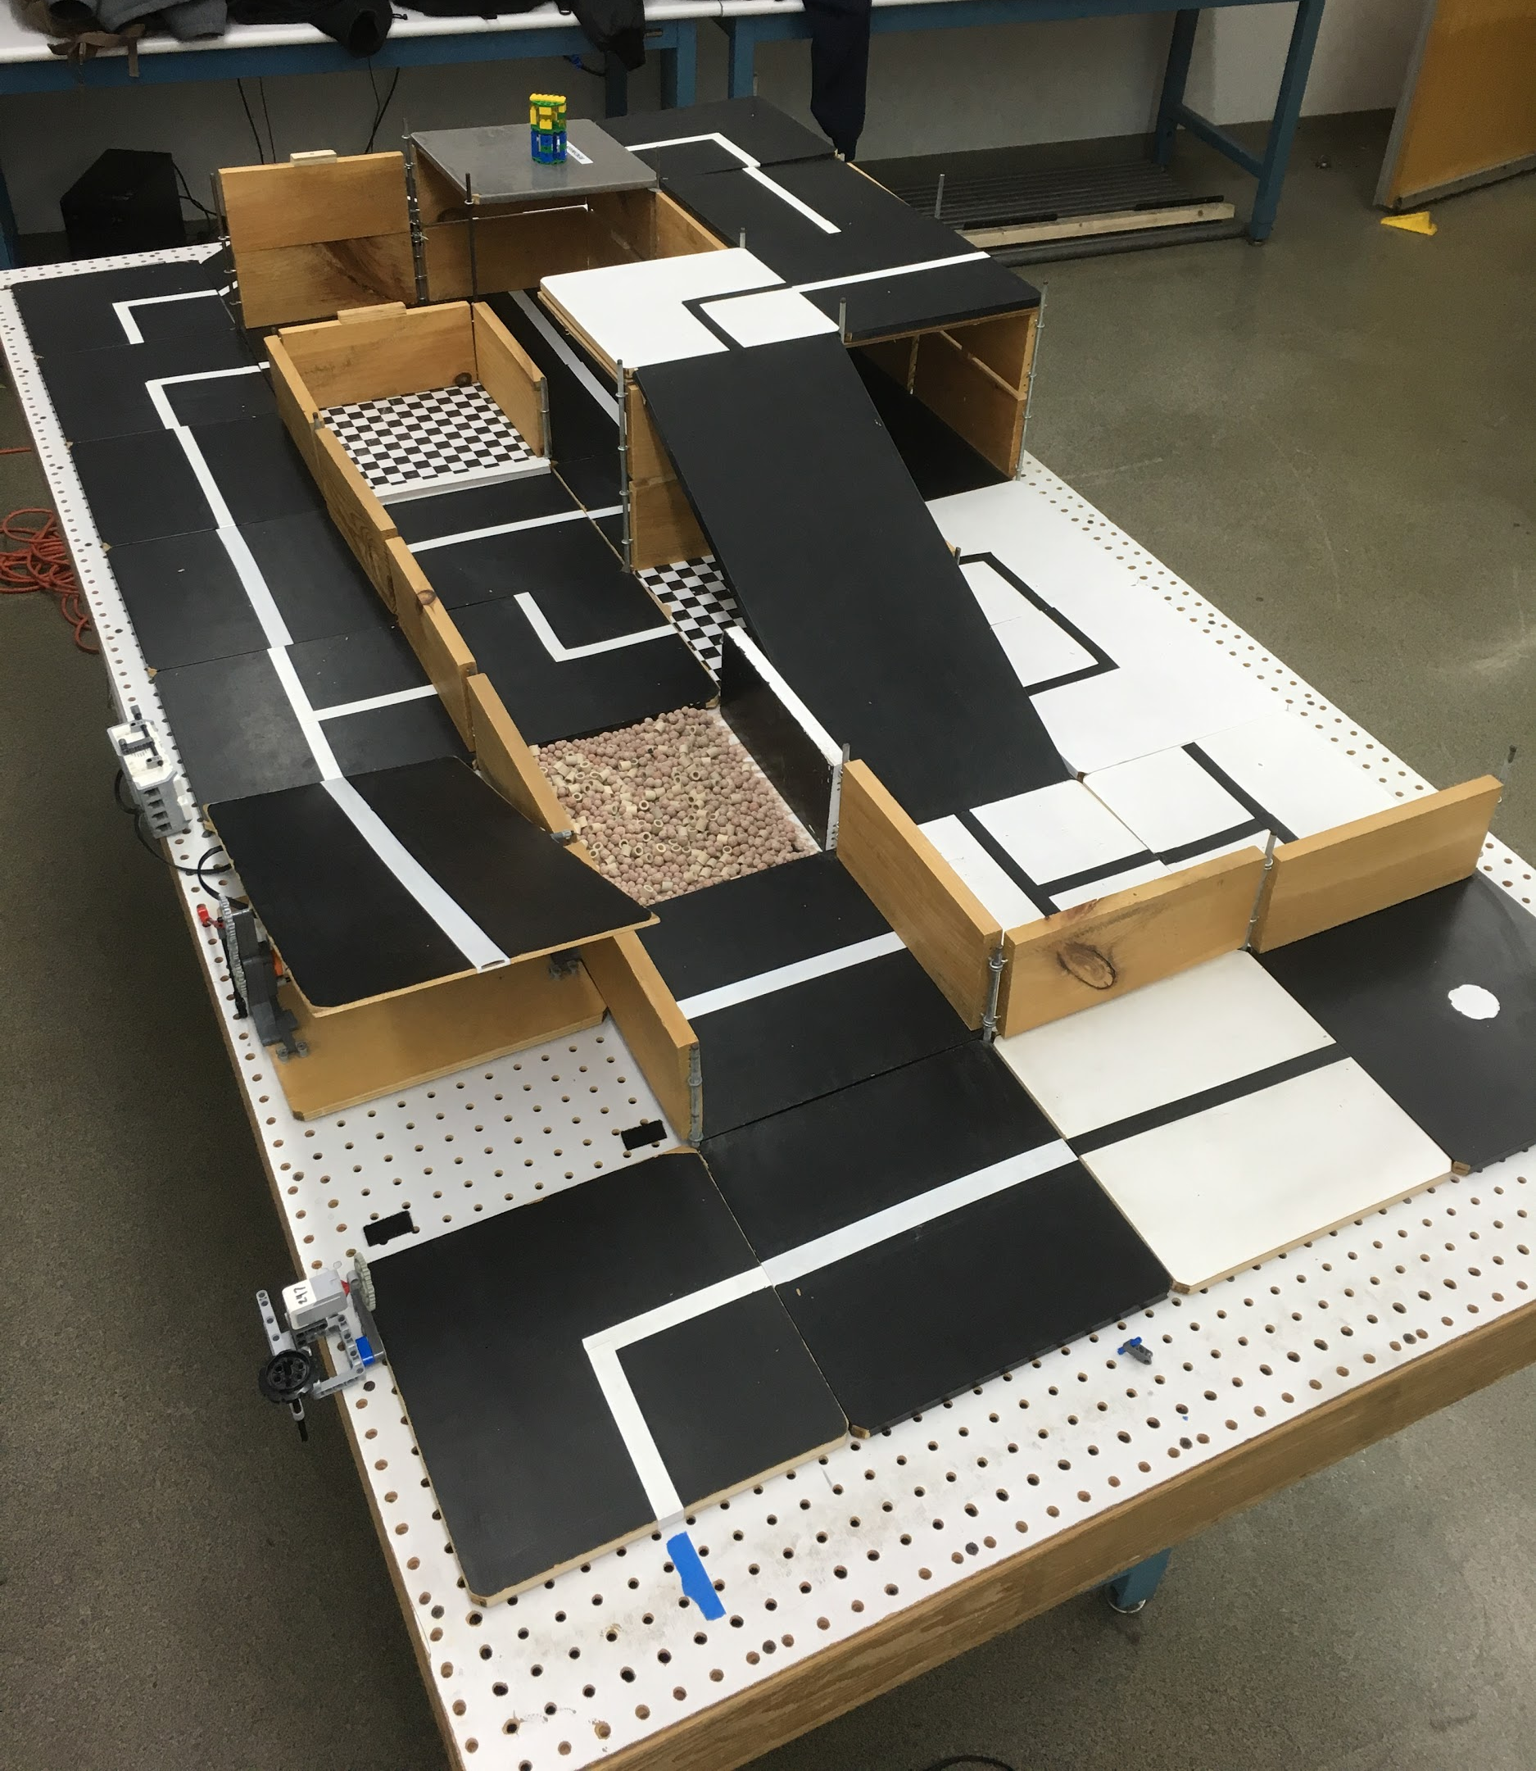
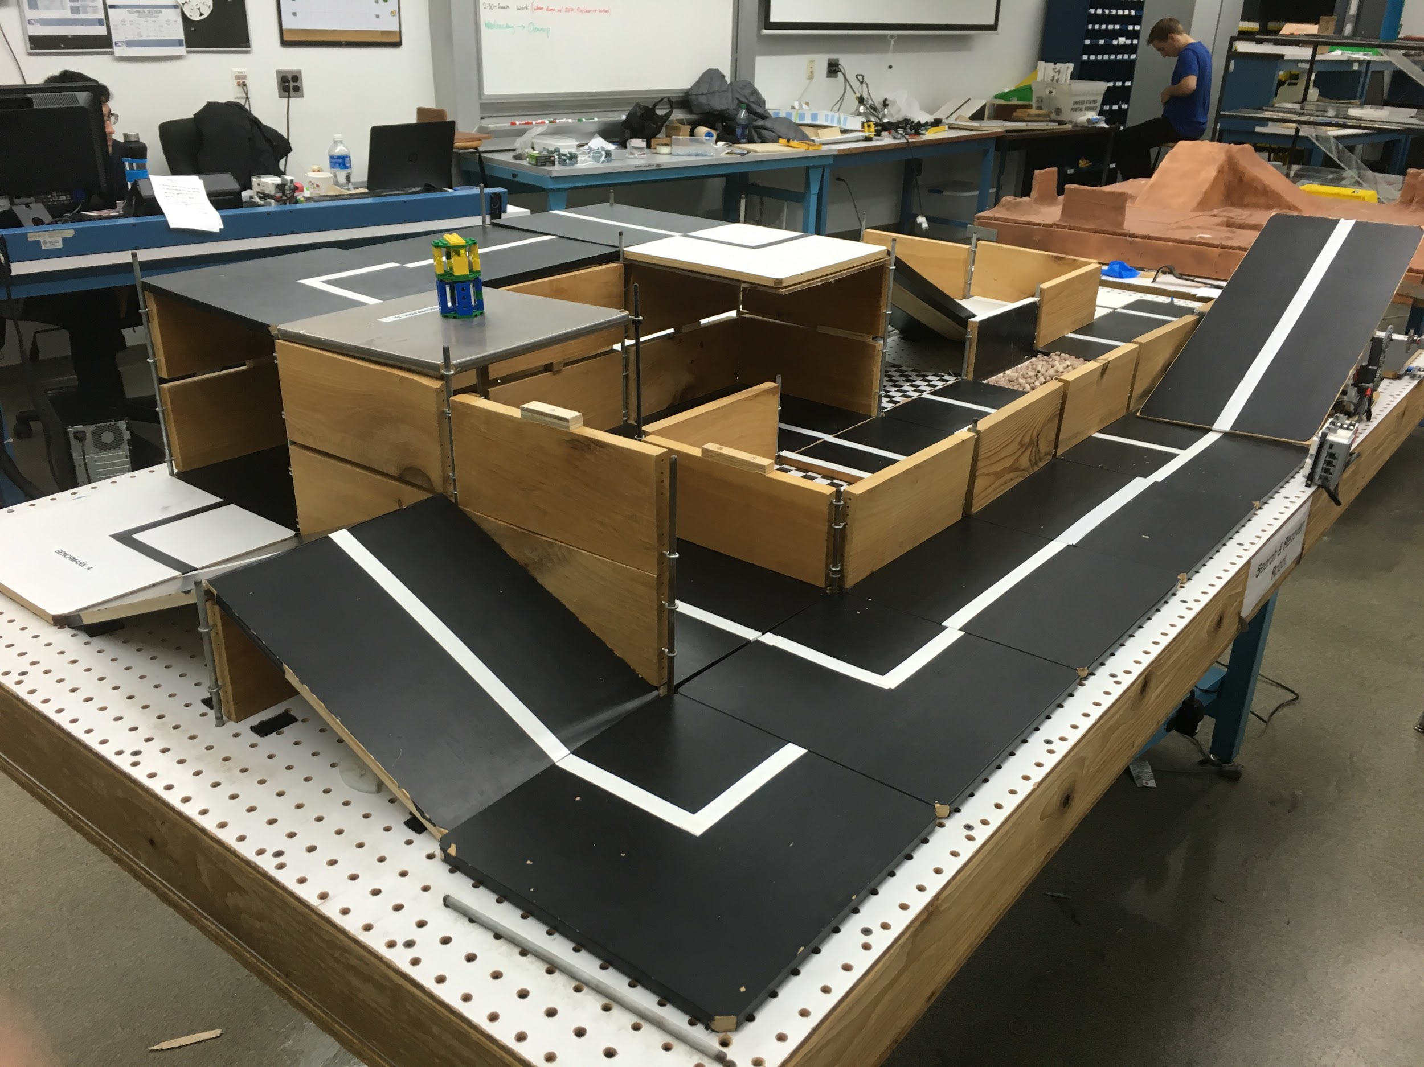
SLDP Options
Search & Recovery Robot (SRR)

Slide 17
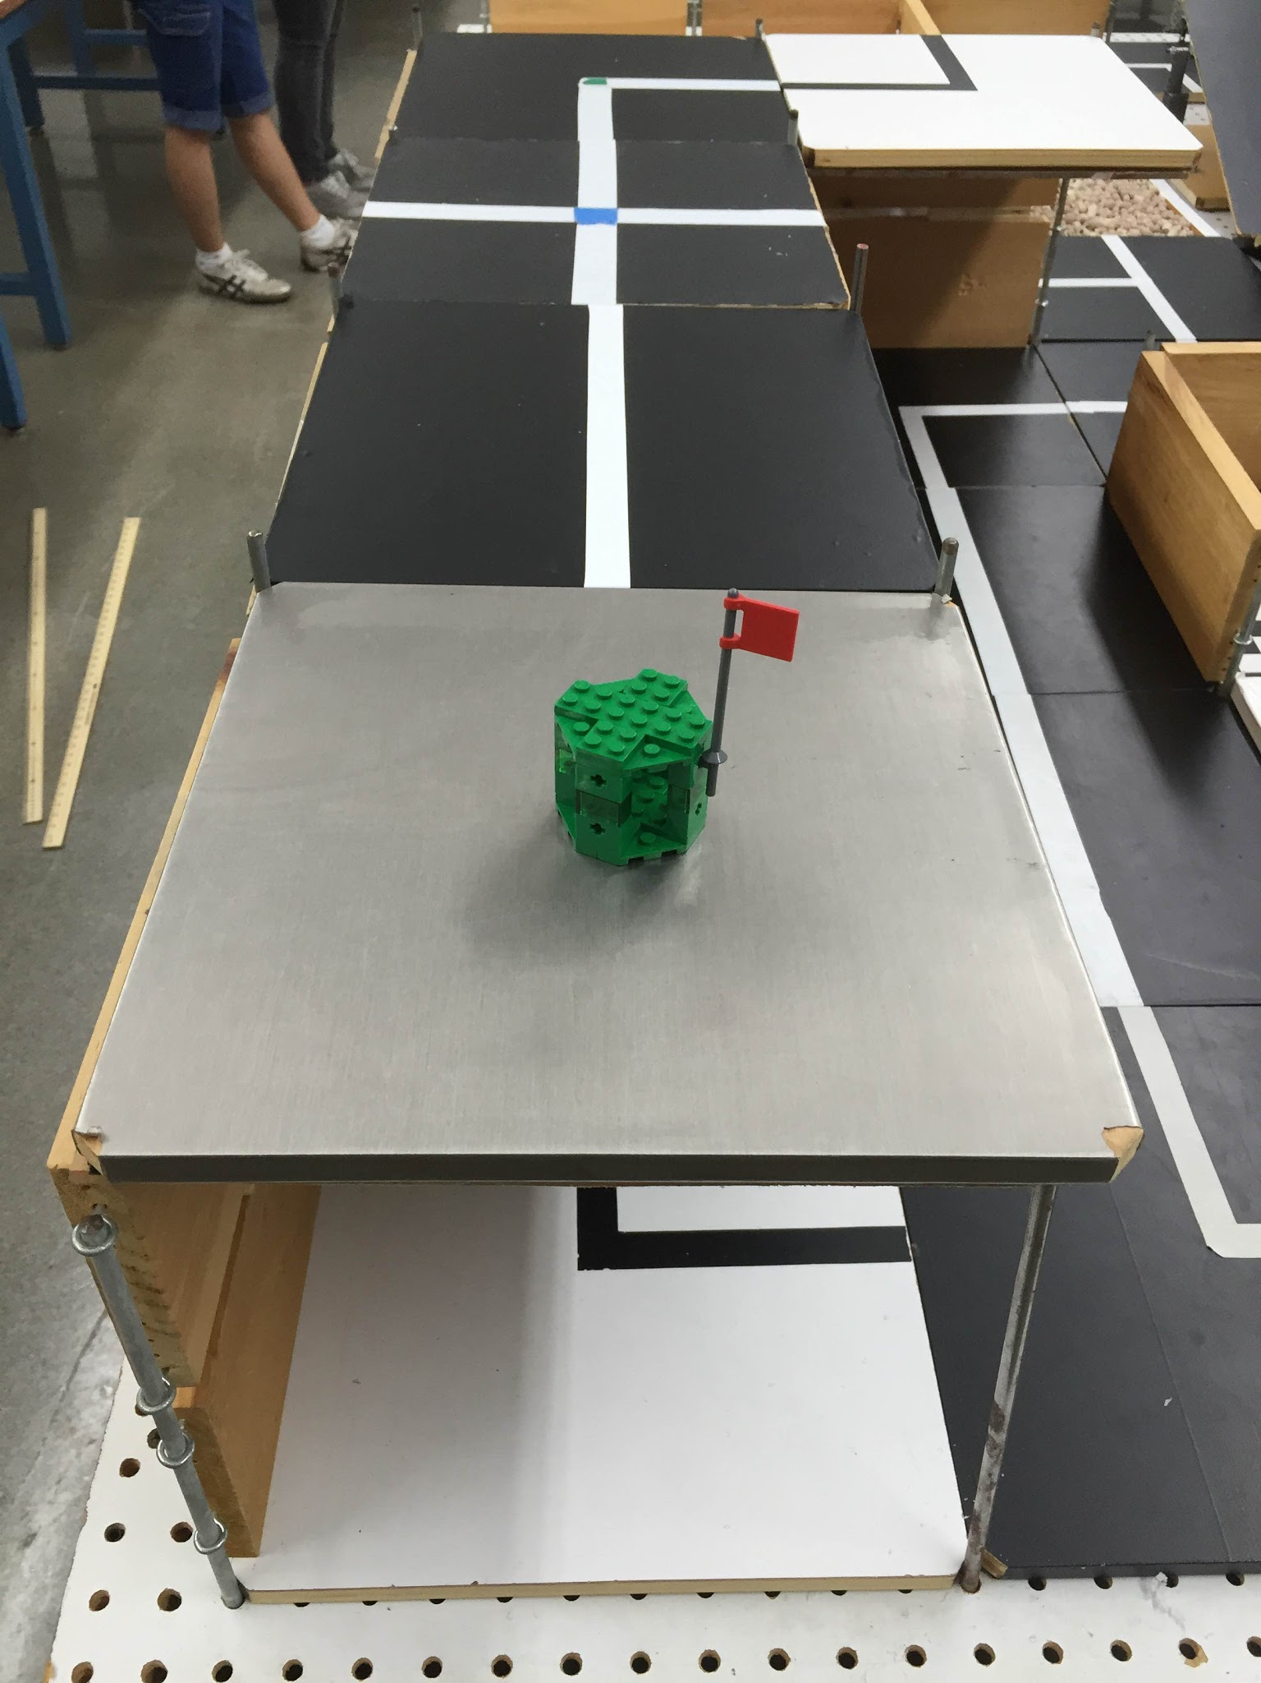
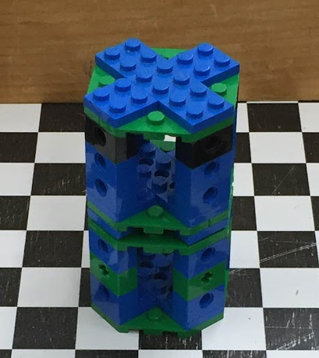
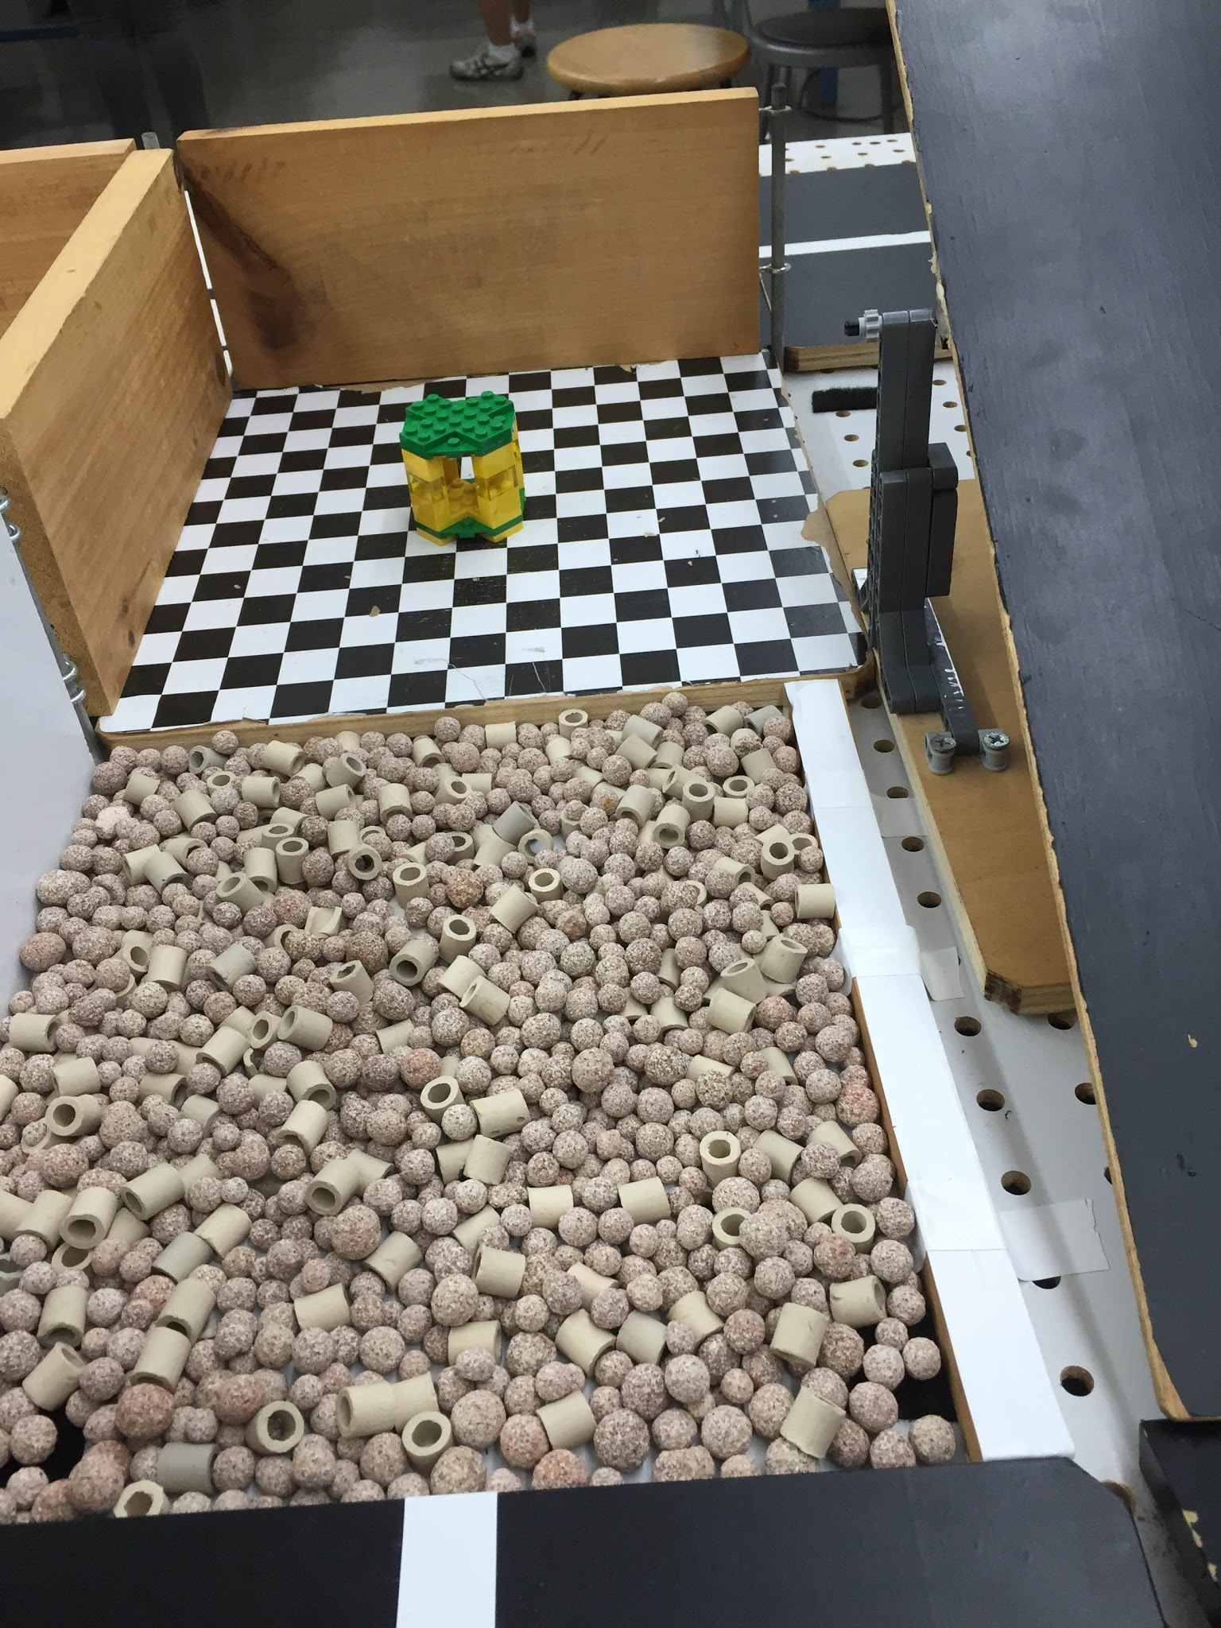
SLDP Options
Search & Recovery Robot (SRR)
Modules
Zarya
(Mandatory)
Unity
(Optional)
Quest
(Optional)

Slide 18
SLDP Options
Search & Recovery Robot (SRR)
Benchmark A:
Pass the hill
Benchmark B:
Retrieve Zarya
Commission:
Return to start with Zarya

Slide 19
SLDP Options
Search and Recovery Robot (SRR)
Extra Credit:
Retrieve other modules and return them
to the space shuttle
Traverse moon dust

Slide 20
SLDP Options
Bomb Disarming Robot (BDR)
Disarm bomb and return to start
Avoid decoy bombs
Robot must be able to autonomously
navigate the obstacle course provided
Robot must fit in a start area that is 25cm x 25cm
Maximum height is 20cm

Slide 21
SLDP Options
Bomb Disarming Robot (BDR)
Allowed
Jumping off
upper levels
Climbing walls
Prohibited
Arms
Slingshots
Projectiles

Slide 22
SLDP Options
Bomb Disarming Robot (BDR)
Benchmark A:
Pass two hills
Benchmark B:
Disarm bomb
Commission:
Return to start

Slide 23
SLDP Options
Bomb Disarming Robot (BDR)
Extra Credit:
Disable and retrieve triangulation device(s)

Slide 24
SLDP Options
Security Infiltration Drone (SID)
Solve puzzle to deactivate gates by scanning barcodes
Reach exit point
Robot must fit in a start area that
is 25cm x 25cm

Slide 25
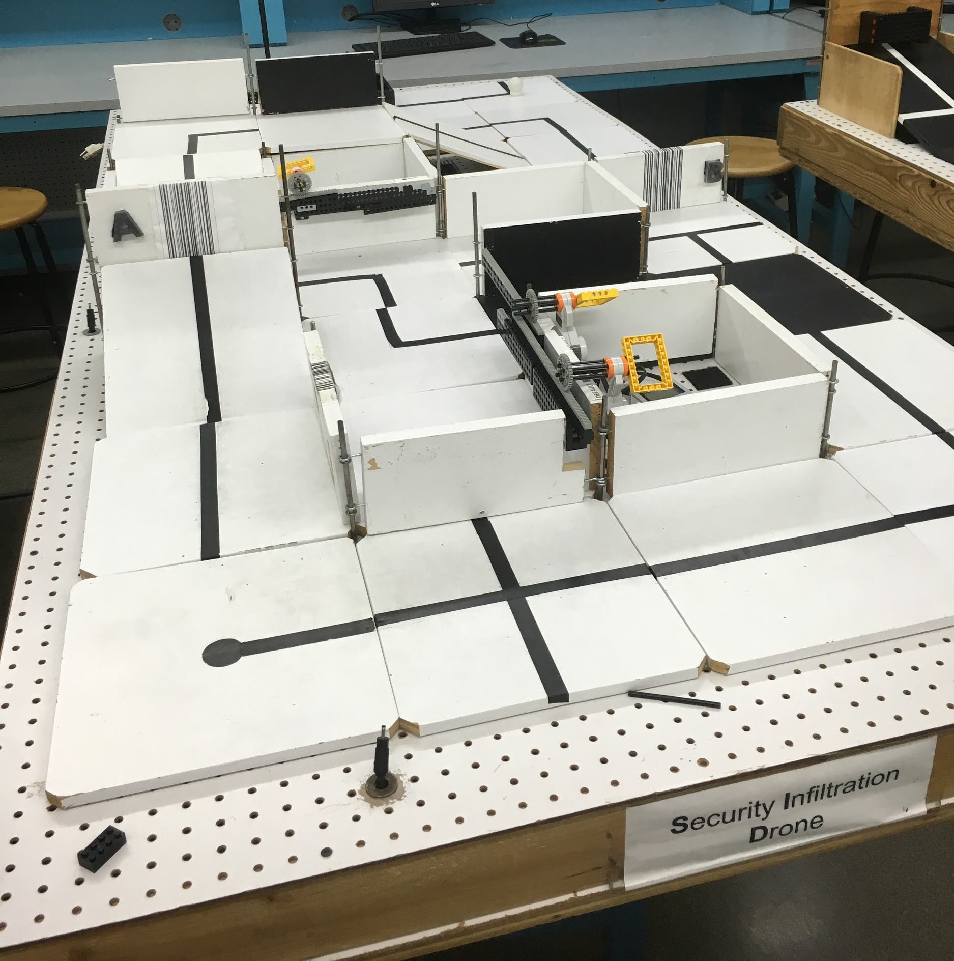
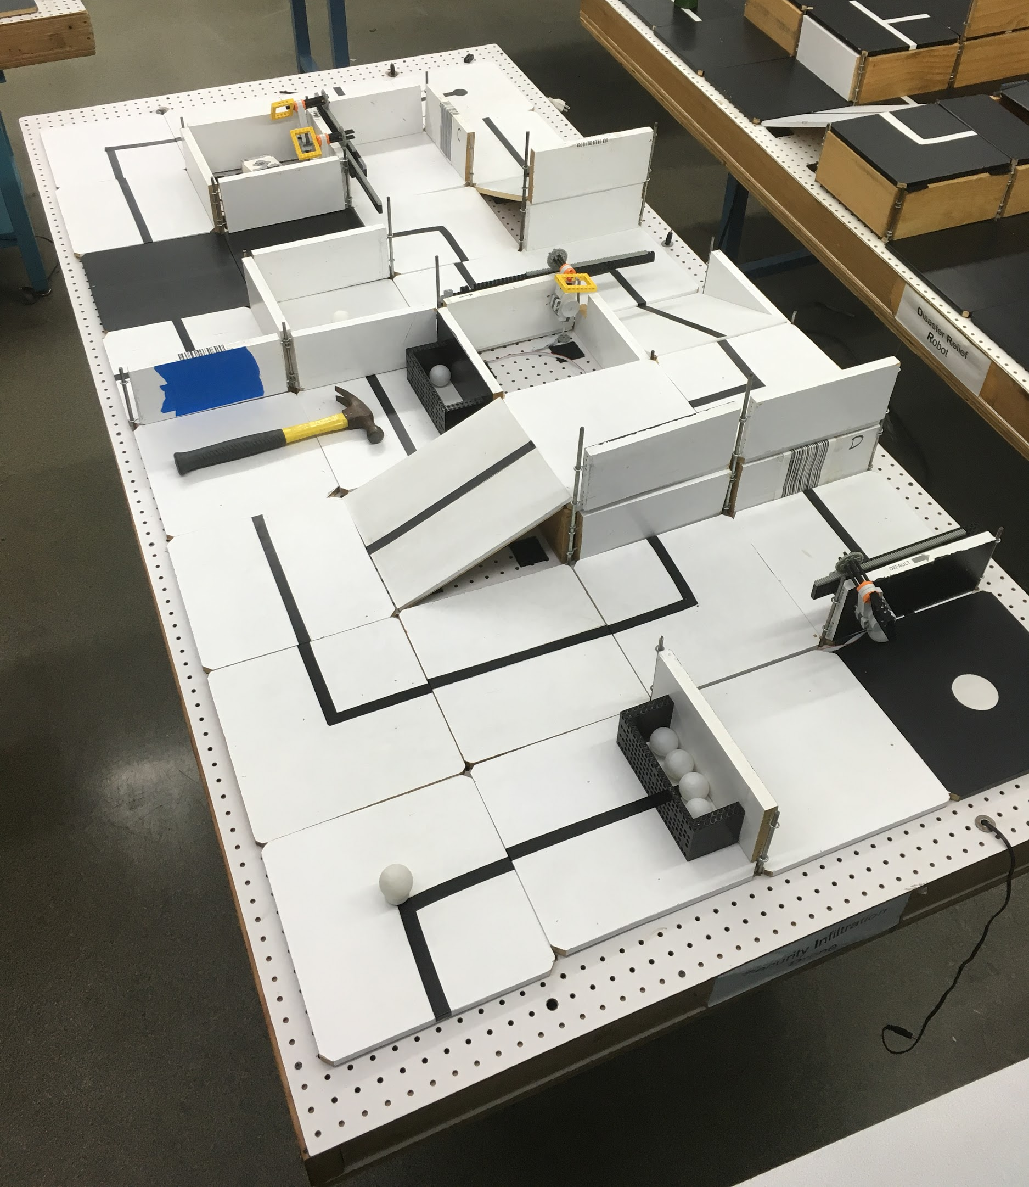
SLDP Options
Security Infiltration Drone (SID)
C
B
A
3
2
D
1
4
Numbers are gates
Letters are barcodes

Slide 26
SLDP Options
Security Infiltration Drone (SID)
Benchmark A:
Show puzzle solution
Scan first barcode in sequence
Benchmark B:
Scan 3 barcodes
Commission:
Reach exit (black tile)

Slide 27
SLDP Options
Security Infiltration Drone (SID)
Extra Credit:
Retrieve data canisters
(with robotic arm)

Slide 28
SLDP Options
Retrieval & Delivery System (RDS)
Retrieve fuel cells
Deliver them to three different hospitals
Hospitals consume power at different
levels of efficiency
Deliver a total of at least 200 hours of battery life
The robot must fit in a start area that is 25cm x 25cm

Slide 29
SLDP Options
Retrieval & Delivery System (RDS)
Fuel Cells
Center of tile = 25 hrs
Edge of tile = 30 hrs
Corner of tile = 35 hrs
Power Supply
Yellow = 1x
Blue = 2x
Red = 3x

Slide 30
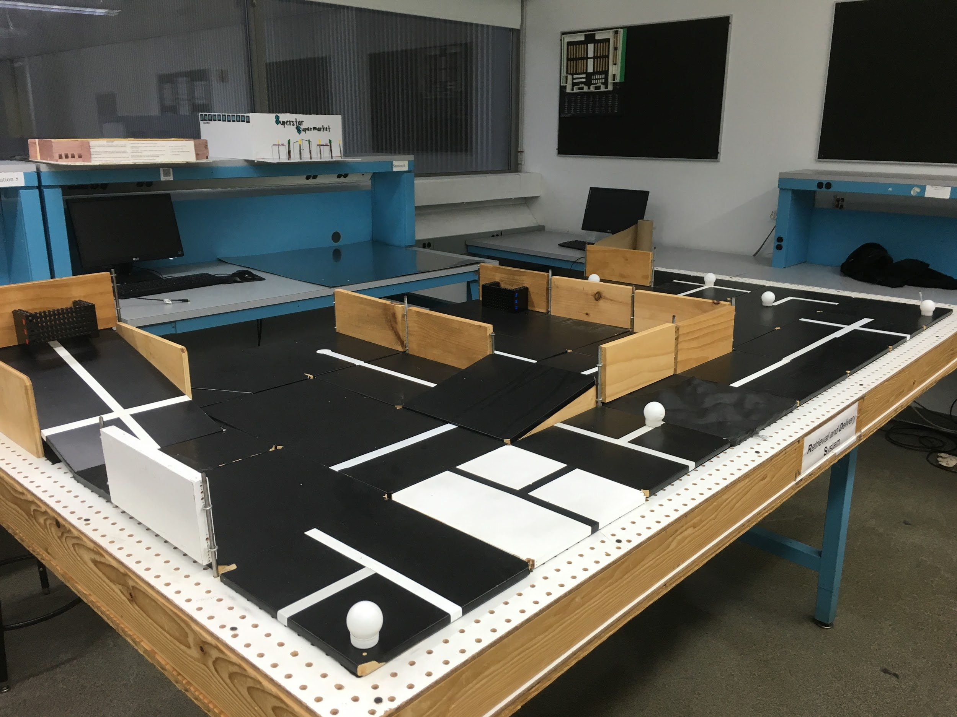
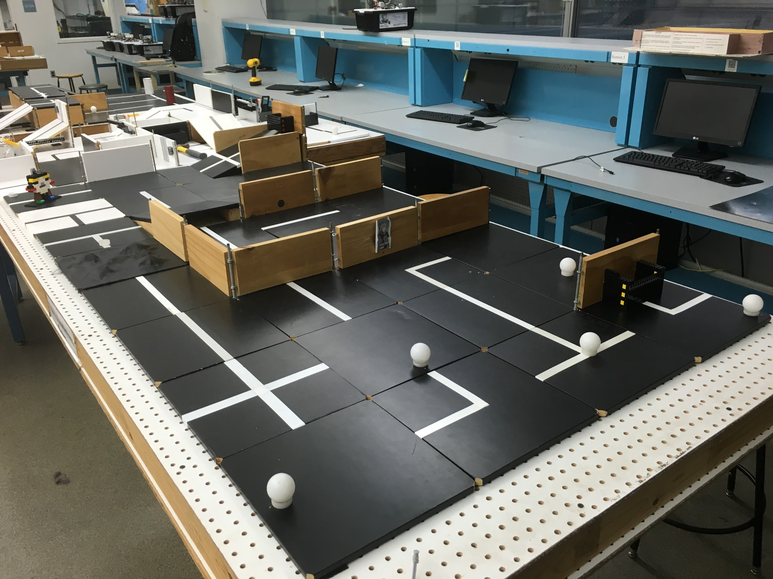
SLDP Options
Retrieval & Delivery System (RDS)
3x Multiplier
2x Multiplier
1x Multiplier

Slide 31
SLDP Options
Retrieval & Delivery System (RDS)
Benchmark A:
Deliver 50 hrs
Benchmark B:
Deliver 125 hrs total
Commission:
Deliver 200 hrs total

Slide 32
SLDP Options
Retrieval & Delivery System (RDS)
Extra Credit:
Additional points rewarded for
additional fuel cells accumulated
past the 200-hour requirement

Slide 33
SLDP Options
Disaster Relief Robot (DRR)
Robot must perform at least five of the six tasks
Must return back to base in 5 minutes or less
The robot must fit in a start area that is 25cm x 25cm

Slide 34
SLDP Options
Disaster Relief Robot (DRR)
Tasks:
5. Dispose nuclear waste
  Green Can
6. Dispose empty container
  Black Can
Note:
Red can may not be touched
White can may be touched
Cut power to facility (required)
Rescue scientists (required)
Secure structure of the facility
  Tile
Refill backup power supply
  Ping-pong balls

Slide 35
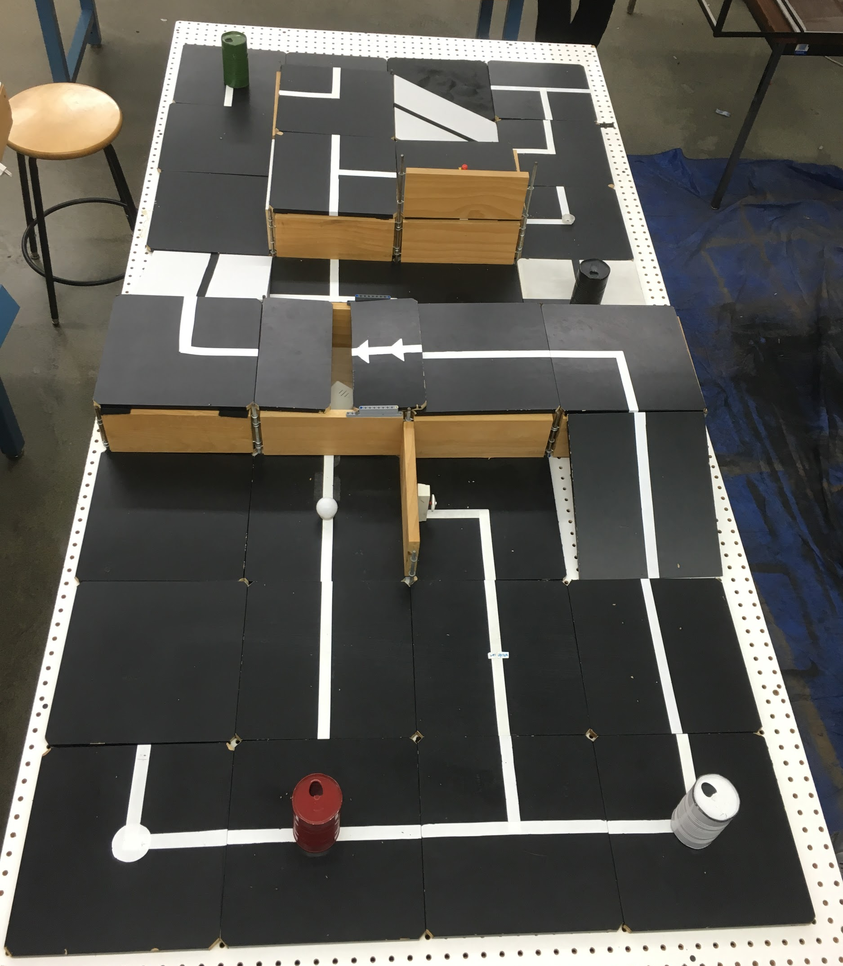
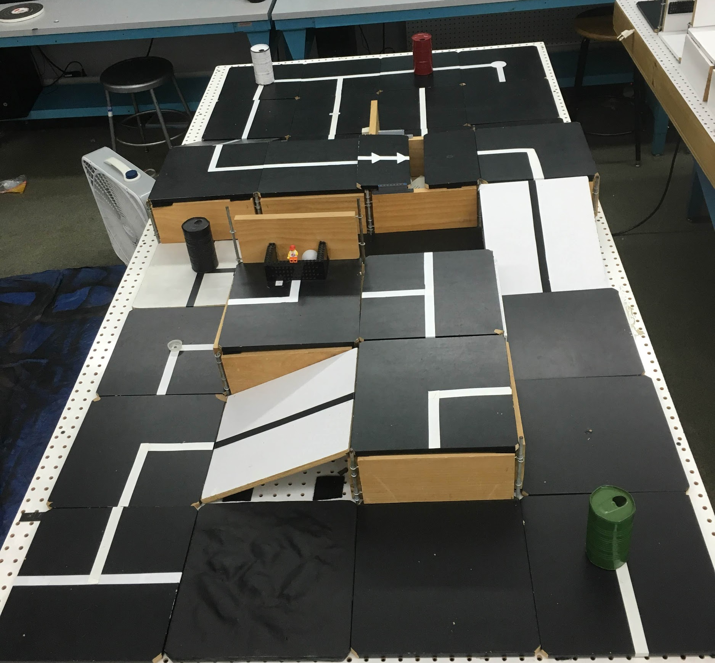
SLDP Options
Disaster Relief Robot (DRR)
Nuclear Waste
Empty Container
Secure Structure
Rescue Scientists
Refill Backup Power
Start
Cut Power

Slide 36
SLDP Options
Disaster Relief Robot (DRR)
Benchmark A:
Cut power to facility
Two optional tasks
Benchmark B:
Both required tasks
Three optional tasks
Commission:
Both required tasks
Three optional tasks
Return to start

Slide 37
SLDP Options
Disaster Relief Robot (DRR)
Extra Credit:
Complete all six tasks
Retrieve extra fuel cells

Slide 38
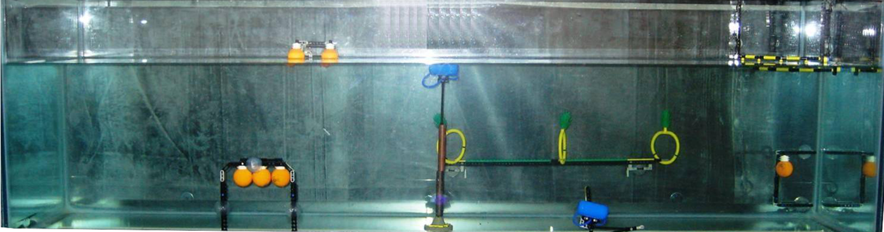
SLDP Options
Autonomous Underwater Vehicle (AUV)
Construct a robot that functions underwater
Perform tasks for a total
of 100 points
AUV must fit into a
1’ x 1’ x 1’ box
Must use waterproofed sensors and case
Oil spill task

Slide 39
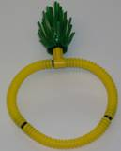
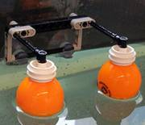
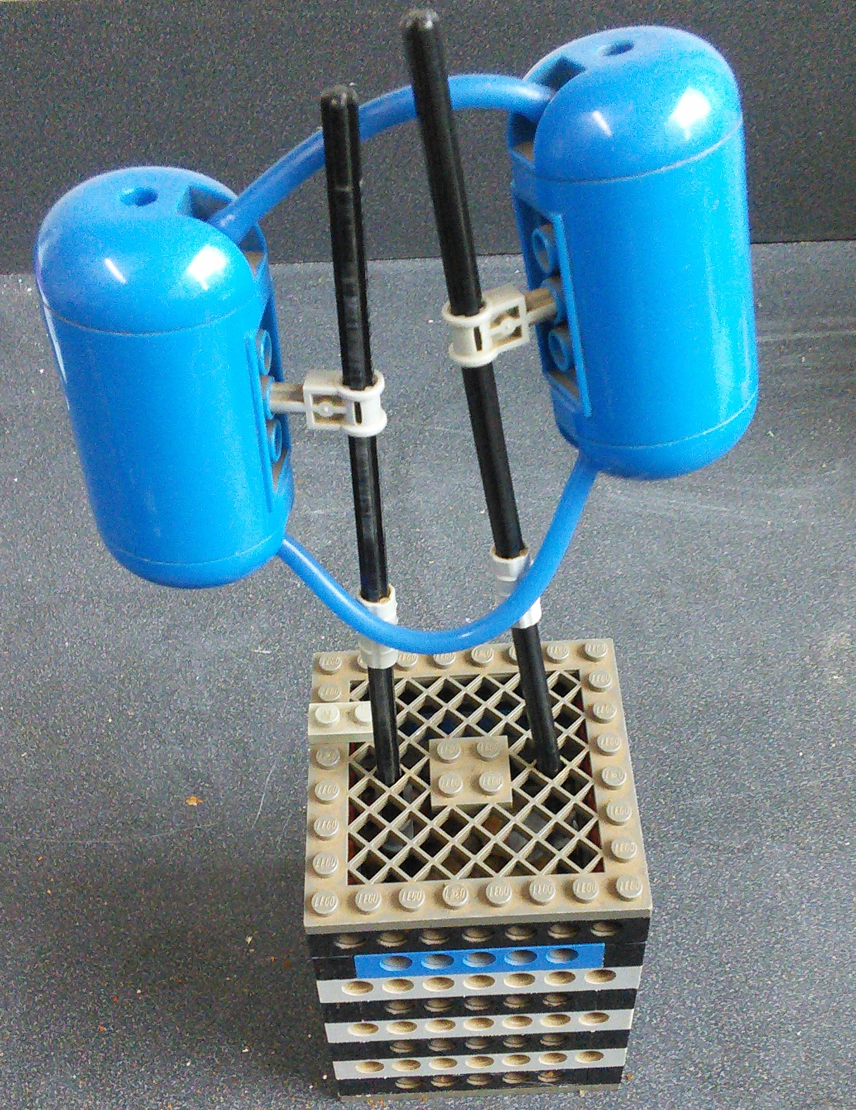
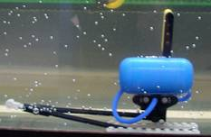
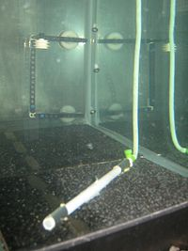
SLDP Options
Autonomous Underwater Vehicle (AUV)
1
2
3
4
5
1. Marine Plant Samples
5 points
15 points if brought back to start
2. Data Canisters
10 points
3. Oceanographic Sensor
20 points
4. Seismic Reader
10 points
5. Oil Spill
40 points

Slide 40
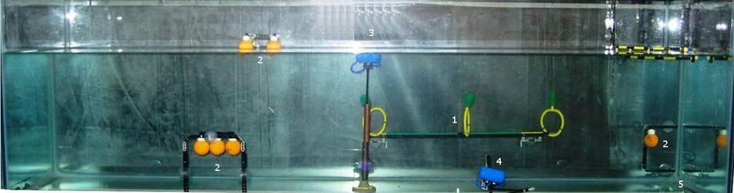
SLDP Options
Autonomous Underwater Vehicle (AUV)
20 points
5 or 15 points
10 points
40 points
10 points

Slide 41
SLDP Options
Autonomous Underwater Vehicle (AUV)
Benchmark A:
Earn 25 points
Benchmark B:
Earn 60 points
Commission:
Earn 100 points

Slide 42
SLDP Options
Autonomous Underwater Vehicle (AUV)
Extra Credit:
Rover design (stays underwater): 5 pts
Skimmer design (skims water surface): 10 pts
Hybrid design (floats underwater, changes elevation): 15 pts

Slide 43
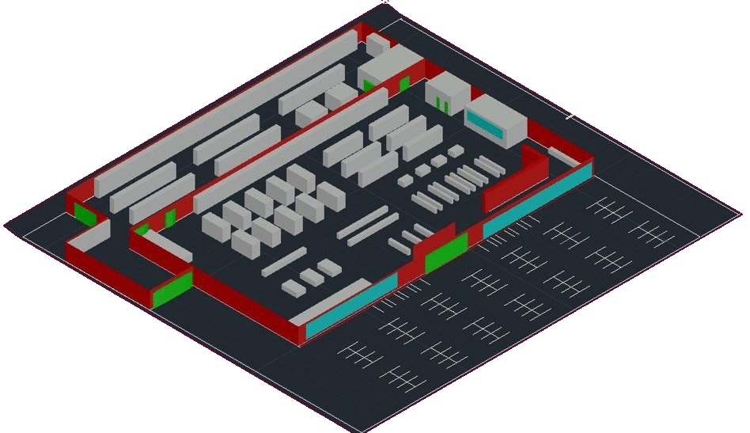
SLDP Options
Supermarket Logistics System (SLS)
  Create 3D AutoCAD or
  Revit model of supermarket
  Plan utilities layout
      Electrical system
      Plumbing system
Create LabVIEW VI’s
    Lighting System
    Heating/ Cooling system
    Security System

Slide 44
SLDP Options
Supermarket Logistics System (SLS)
Benchmark A:
  Floor plan
  Front elevation
  Most detailed side
  Lighting system VI
    8 lights w breaker switch
Benchmark B:
  Plumbing layer
  Electrical layer
  Most detailed side
  Heating & cooling VI

Slide 45
SLDP Options
Supermarket Logistics System (SLS)
Commission:
LabVIEW VI’s
  Lighting system
  Heating & cooling system
  Alarm system
Model of building & parking lot
  3D AutoCAD or Revit
  No physical models
AutoCAD drawings
  Floor plan
  Plumbing system
  Electrical system
  Front elevation
  Most detailed side

Slide 46

SLDP Options
Supermarket Logistics System (SLS)
Extra Credit:
Incorporate LEED certification
into the design of supermarket

Slide 47
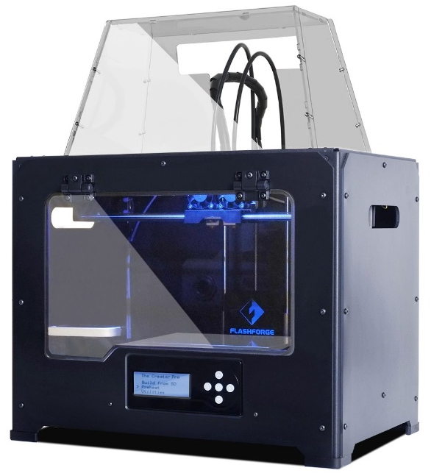
3D Printing Extra Credit
Design your own SLDP team logo
  Due by Milestone 2 Presentations
Be creative with your design (2 pts EC)
  Your design will need approval by a 3D printing TA
  Can’t be text like Lab 1
  Multiple colors are available: purple, black, white,
  yellow, red, green, pink, light blue, blue, clear
  More info on 3D Printing Extra Credit page on lab manual

Slide 48
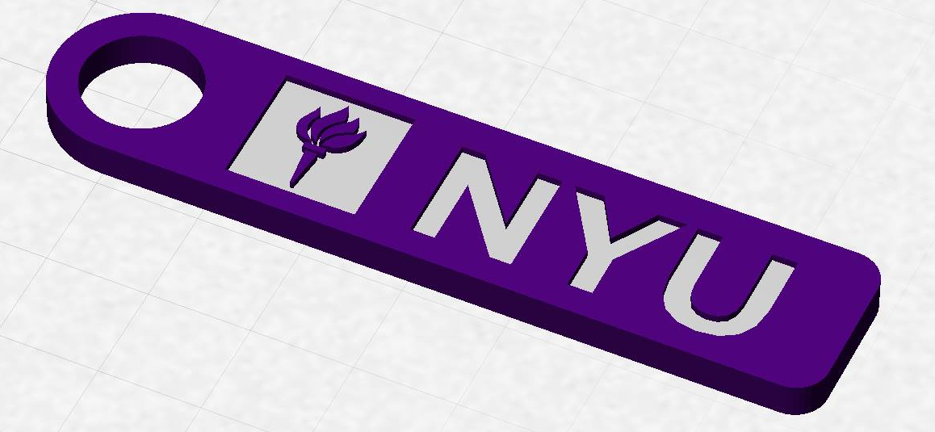
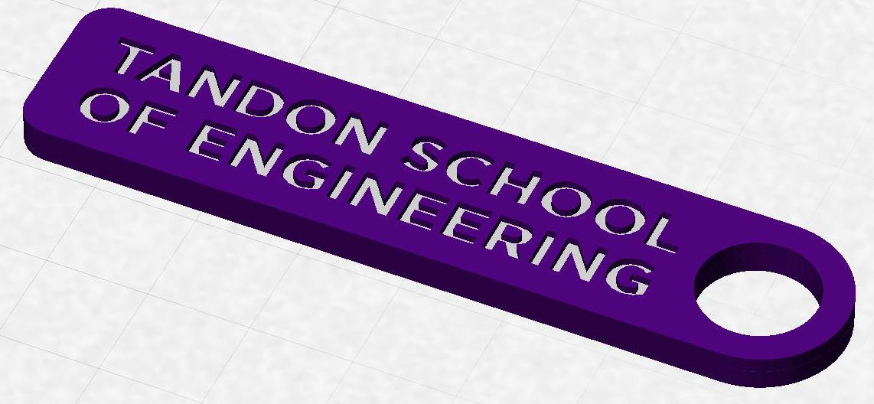
3D Printing Extra Credit
Constraints:
  Maximum weight of 15 grams
  No copyrighted logos
  Must be attached to robot or worn
  as pin during Final Presentation

Slide 49
3D Printing Extra Credit ADVANCED
An experimental opportunity to create a prototype of a custom,
3D-printed robot part or terrain modification (4 pts EC)
Constraints:
  Due by Milestone 2 Presentations
  YOU MUST HAVE A CONTINGENCY PLAN if the piece does not
  work or cannot be printed
  For full list of constraints see the 3D Printing Extra Credit page on lab manual
You may also print parts at the MakerSpace, or you can receive one-on-one instruction in the EG Prototyping Lab (Rogers Hall 223)

Slide 50
3D Printing Extra Credit Submission
Submit your design at eg.poly.edu under the
3D Printing Submission tab
  Your first submission is due by Milestone 2
  Your design must be a .stl file
  After your submission has been received you will be contacted by a TA to come start your print

Slide 51
Closing
Refer to manual.eg.poly.edu for details
Think about which project interests you
Brainstorm ideas
Speak with professors and TAs regarding projects

Slide 52

Semester-Long Design Project
QUESTIONS?

